Slide 1
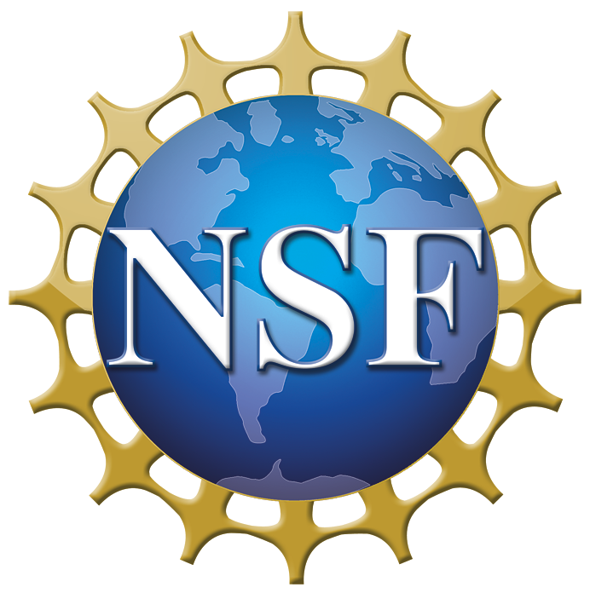

IRG: Manipulating Light with Materials
A cross-disciplinary effort involving the Departments of
Physics: Li, Pesin, Raikh, Vardeny
Mathematics: Golden, Guevara-Vasquez, Milton
Electrical and Computer Engineering: Menon
Mechanical Engineering: Park

Slide 2
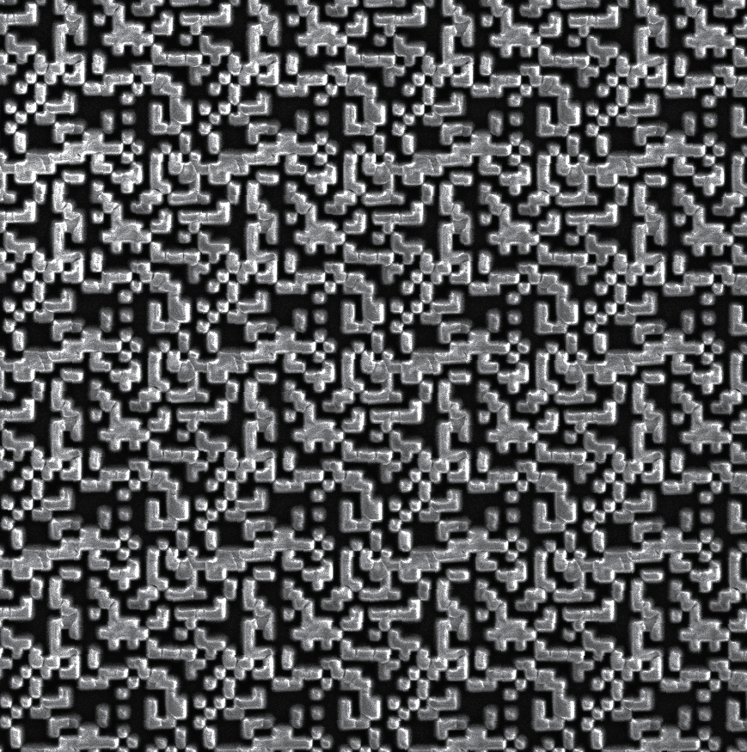
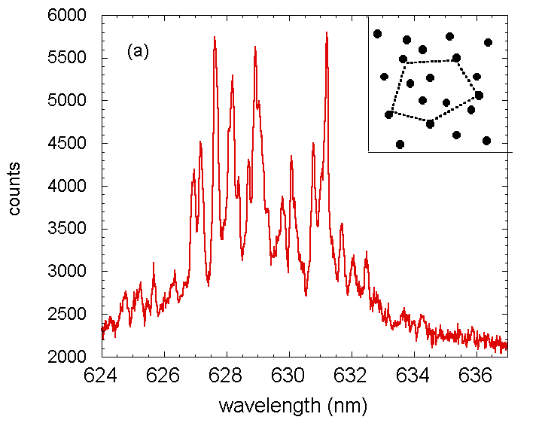
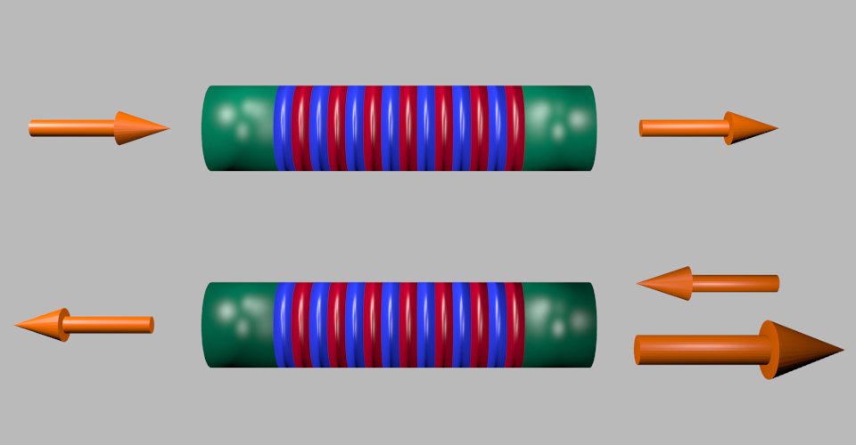
Theory, computation, design and fabrication of novel materials
and devices to manipulate light for exciting applications.
Digital MetaMaterials (DMMs)
enhancing photonic integration
Random Lasers (RLs)
imaging cancer
Parity-Time Symmetry (PTS)
unidirectional optics
Cutting edge mathematics on the interactions of electromagnetic waves with materials provides the foundation.

Slide 3
IRG Director: Ken Golden
FRG1: Digital Metamaterials Group Leader: Rajesh Menon
Graeme Milton, Fernando Guevara-Vasquez, Kay Park, Ken Golden
FRG2: Random Lasers Group Leader: Misha Raikh
Valy Vardeny, Dima Pesin, Sarah Li, F. Guevara-Vasquez, Ken Golden
FRG3: P-T Symmetry Group Leader: Valy Vardeny
Misha Raikh, Sarah Li, Dima Pesin (and external participants)

Slide 4
Why fund this IRG?
Integrated photonics can leapfrog power density and bandwidth limitations of nanoelectronics -- major risks to a trillion-dollar semiconductor industry.
Fundamental breakthroughs in integration density to enable integrated metamaterial-based photonics.
Rigorous techniques to tailor a material to optimize laser performance.
Strategy and realization of imaging cancerous tumors with random lasers.
Create novel optical devices exploiting the balance of gain and loss in PT symmetric structures.
Explore and implement PT symmetry for spin waves (magnonics).
Advance the mathematics of designing materials to control wave behavior, exploiting the interplay between theorists and experimentalists in the group.

Slide 5
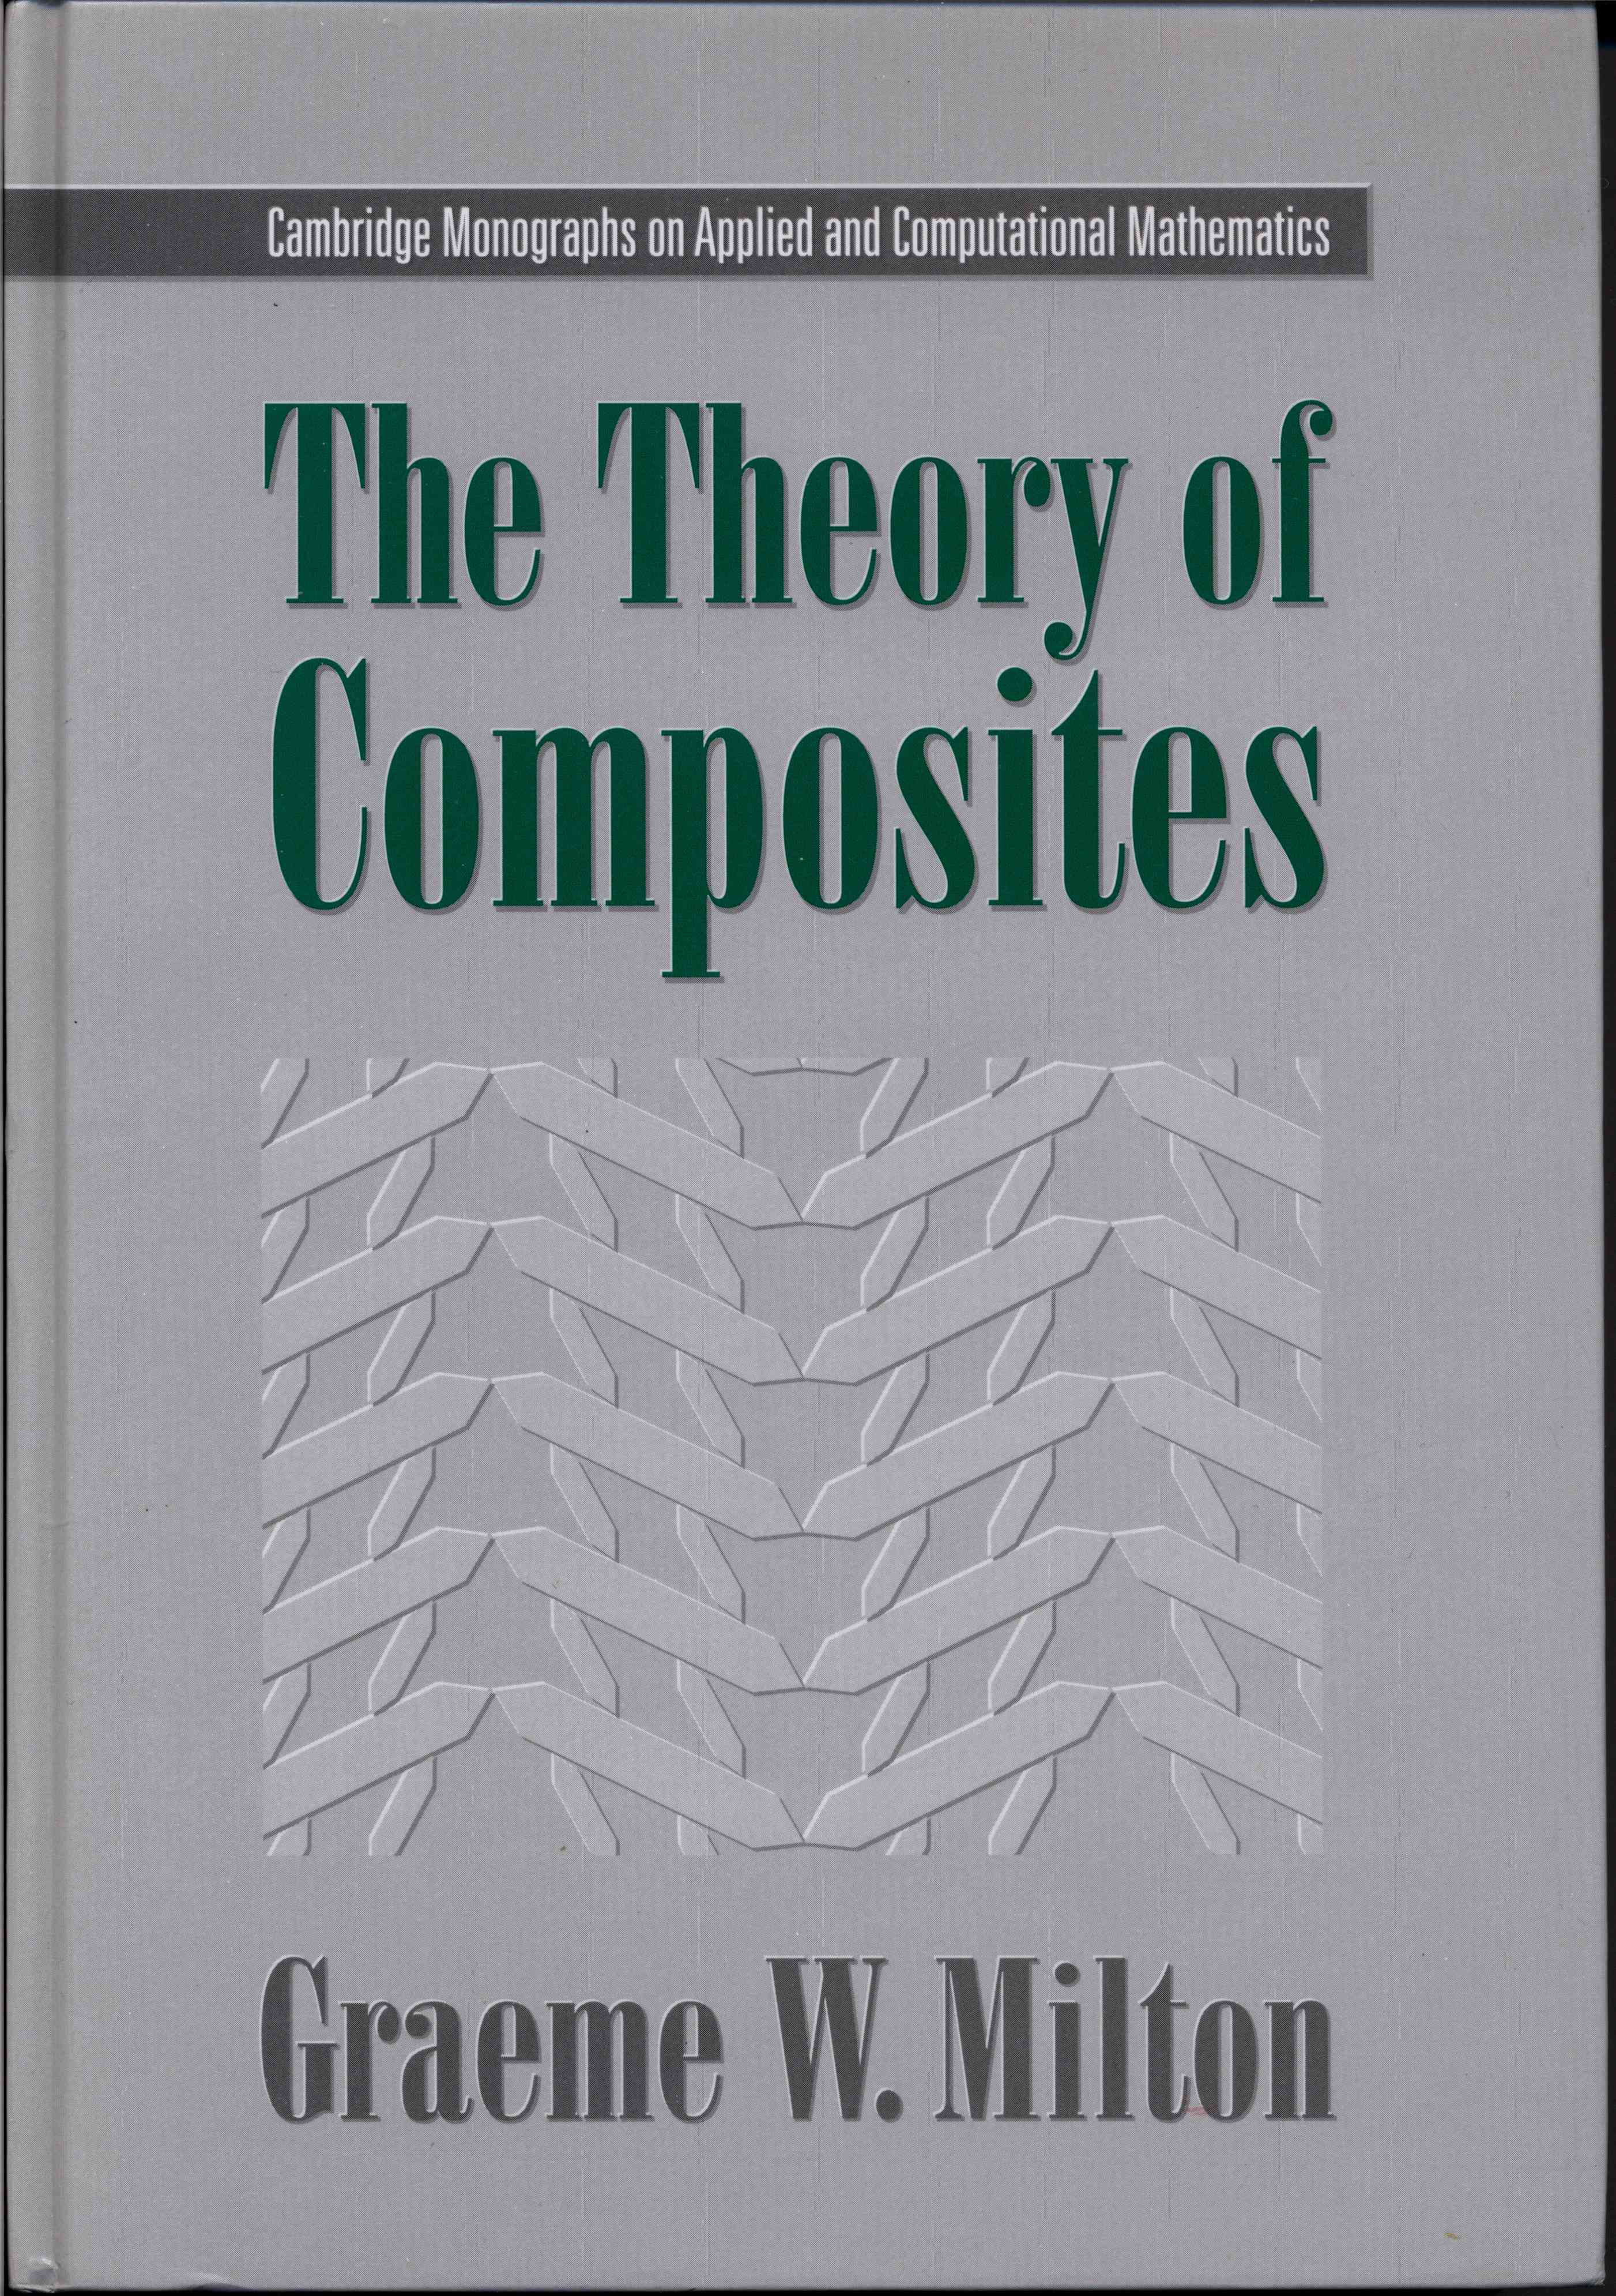
What makes this IRG unique?
The infusion of rigorous mathematics of composite and structured materials as the platform upon which we will design and optimize complex media and devices to control optical behavior.
The definitive text in the field.

Slide 6
IRG Research and Engineering Objectives
Create fundamental theory, explore the potential, and elucidate the limitations of digital metamaterials.
Design and fabricate DMMs; realize DMM-based nanophotonic devices with enhanced integration density; explore use of chiral materials.
Develop theory of spatially separated gain and loss in random lasers; design microstructures to achieve optimal performance.
Explore optical gain and laser action of media with chiral chromophores or mirror-like scatterers.
Develop a strategy for RL imaging of cancerous tissue.
Design optimal materials to balance optical gain and loss in PTS devices.
Fabricate and study tri-layer ferromagnetic structures to realize PT symmetry in spin waves; cross-pollinate from optics to magnonics.

Slide 7

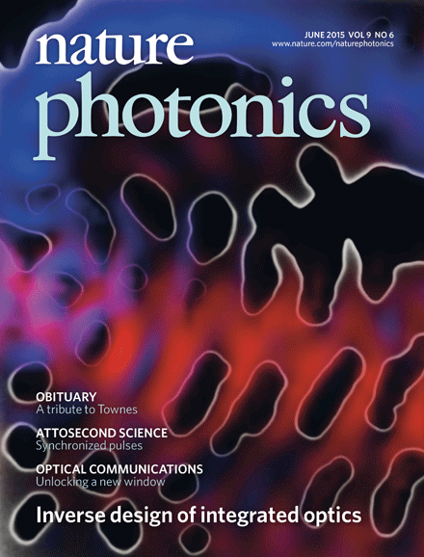
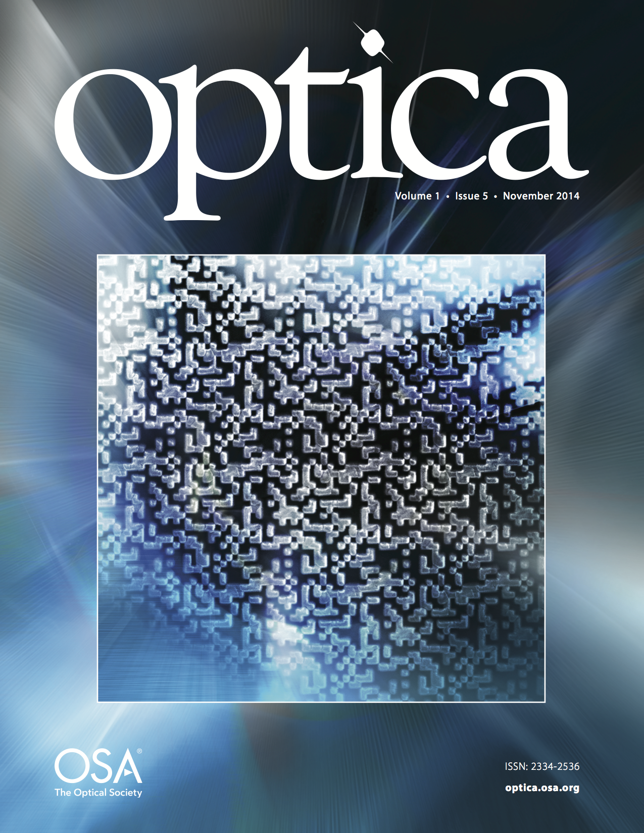
High impact publications and research results
Book
  The Theory of Composites (GM): cited more than 1800 times
Journal Publications
  Founding paper on cloaking (GM): founding paper on random lasers (VV, MR)
  Most downloaded paper in OSA journals in 2007 (GM): >13,000 times
  Published in Nature Photonics, PRL (2), Science, and Optica - pioneering DMM works (RM)
  Published in PRL and APL (3) on cloaking and ultrasound control of particles (FG-V)
  Published in Nano Letters and 10 other journals for tip-based nano-manufacturing (KP)
  Published in Nature Physics, PRL (2), PRB (5) on random lasers (VV, MR)
  Published in Nature, Science, Nature Physics (2), PRL (4), Optics Letters (3) on photo-excitations and laser action in organic and hybrid organic-inorganic perovskites (VV)
  Published in Nature, Science, Nature Materials (2), PRL (2), Nature Comm. on spintronics (VV)
  Published in Science, PRL (3), PRSA (2), Geophys. Res. Lett., Nature Geophys. on composites (KG)
Patents / Commercialization
  15 patents and 3 spin-off companies in photonics (RM)

Slide 8
Core Capabilities of the IRG Group
Theoretical and Computational
Numerical tools using the Amazon cloud for large scale design of nanophotonic devices.
Novel integral representations and variational principles for the response of devices; theoretical and numerical expertise in cloaking.
Numerical methods for the optimal design of device components.
Extensive mathematical and numerical expertise in modeling the effective properties of multiscale composite materials.
Extensive theoretical expertise in lasers and condensed matter.

Slide 9
Core Capabilities
Experimental and Fabricational
Nanofabrication facility, including focused-ion-beam lithography, scanning-electron-beam lithography (MRSEC, USTAR), and tip-based nanolithography.
Custom experimental systems to characterize integrated DMM devices.
Random laser action: fs pump/probe; high power ps and ns pulses.
Materials: π-conjugated polymers, hybrid organic-inorganic perovskites, III-V and II-VI quantum dots.
MRSEC (USTAR) device fabrication facility: two glove-boxes, high vacuum evaporators, spin-cast, etc.
Magnetic PL research instrumentation: 7 Tesla cryostat capable of 2K.
Dedicated chemist synthesizing organic and hybrid organic-inorganic materials.
Magnetic research instrumentation: tunable FMR, inverse spin Hall effect, optically-detected magnetic resonance, Brillouin light scattering spectrometer.
Magneto-optic spectroscopy: Sagnac interferometer, 20 nano-rad angular resolution.

Slide 10
FRG1: Digital Metamaterials (DMMs) for enhancing photonic integration
Participants: Menon, FRG Leader; Milton, Guevara-Vasquez, Golden, Park. 1 postdoc, 2 grad students.
200nm
Example of a DMM polarizer.
Shen, et al, Optica 1(5), 356 (2014)

Slide 11
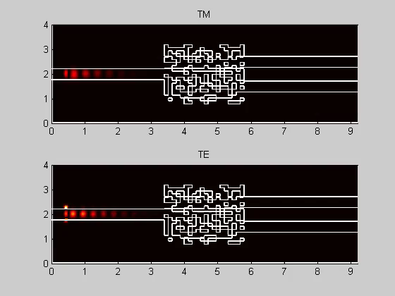
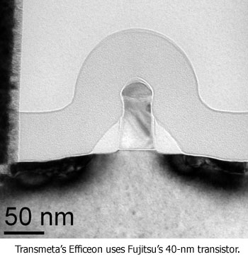
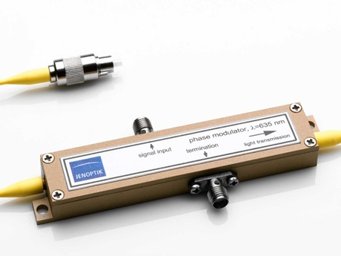
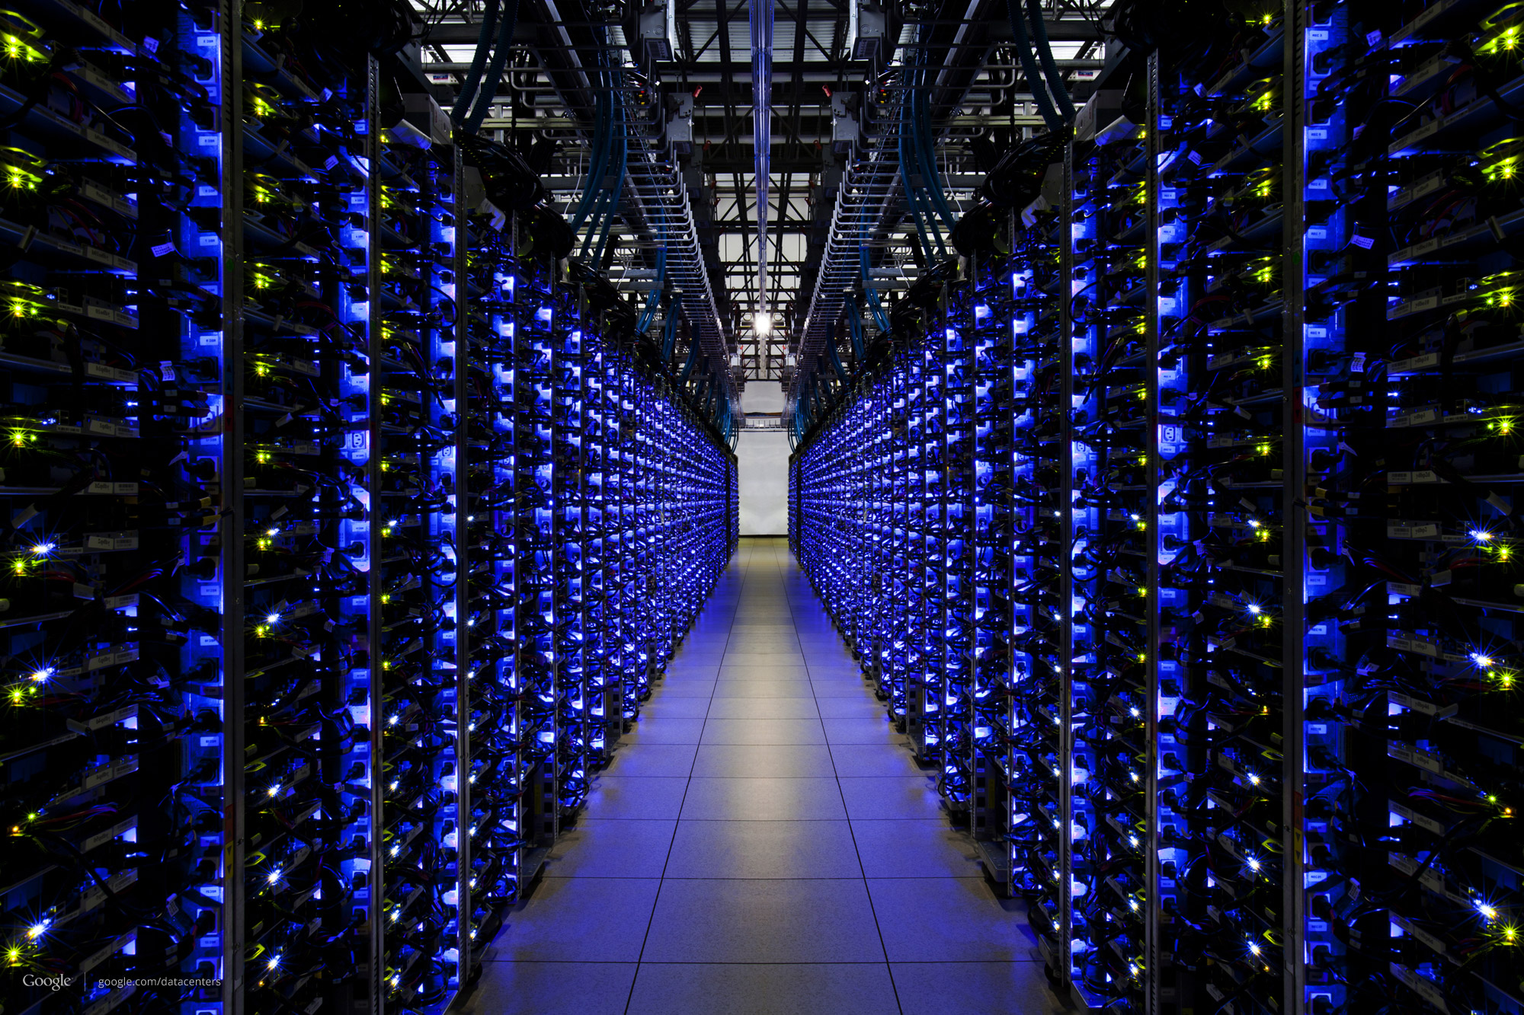
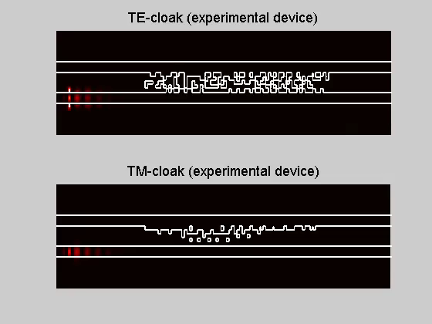
Why DMMs?
Leapfrog power & bandwidth limitations of nanoelectronics
Create fundamental breakthroughs in chiral & non-chiral DMMs
Transistor (electronic
switch)
Modulator (photonic
switch)
Fundamental problem:
World’s smallest polarization beamsplitter
De broglie wavelength of electron is >100X smaller than that of an IR photon!
nanoscale
macroscale
vs
if addressed, will enable
Cloaking to increase integration density
Data centers consume 2% of US electricity
Ultra-high integration of photonics with digital
metamaterials
solved by
Shen and et al., Nature Photonics 9, 378 (2015).

Slide 12
Research Objectives
By combining theory, numerical optimization, fabrication & experiments, we will pioneer chiral and non-chiral DMMs to drastically enhance the integration density of photonics.
Create the fundamental theory of digital metamaterials.
Elucidate the limits of integration density
Design, fabricate, and characterize digital metamaterials
Realize nanophotonic devices with enhanced integration density
Explore whether periodic arrays of these devices can produce metasurfaces with novel properties

Slide 13
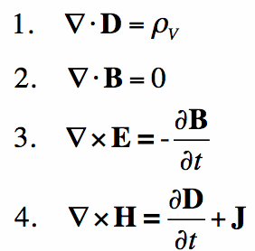
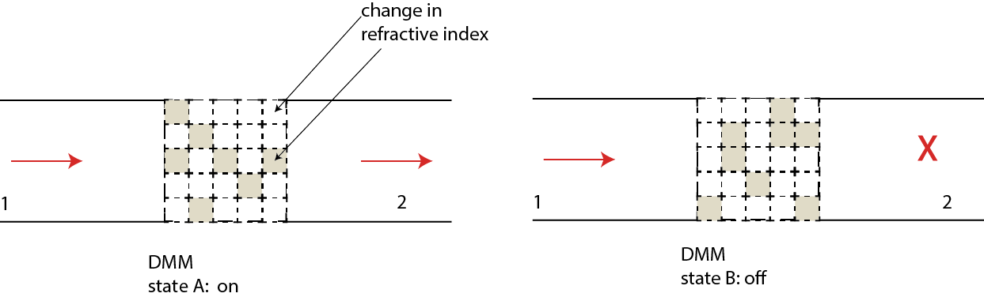
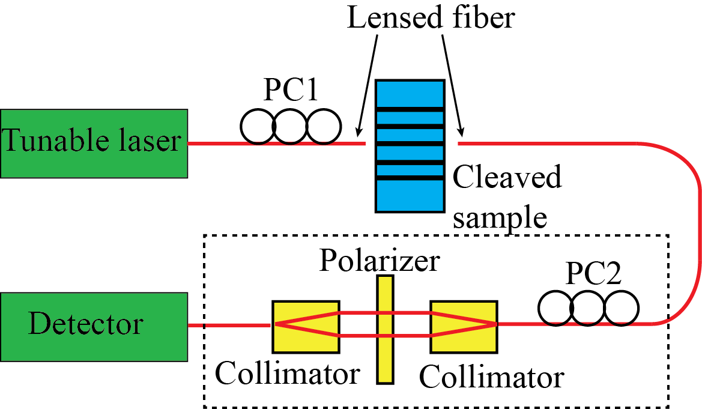
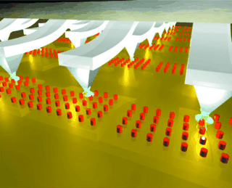
Research Plan Overview
Milton, Guevara-Vasquez (GV), Golden (Math), Menon (ECE), Park (ME)
Theory (Milton, GV, Golden)
Fundamental limits
Transient behavior
Design (GV, Menon)
Numerical techniques
Cloud computing
Fabrication (Menon, Park)
2D, 3D, scalable, cost-effective
Experiments (Menon)
Transient, Quantum

Slide 14
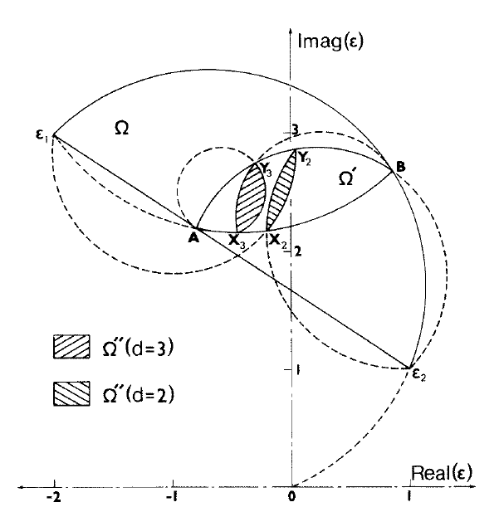
FRG1 Research Plan: Theory
Fundamental questions:
How do DMMs work?
Is interference from waves going through different channels responsible?
What are the fundamental limitations of DMMs?
Mathematical approaches for finding limitations:
For composites the Bergman-Milton bounds limit the possible complex dielectric constant.
Derived via integral representations or via minimization variational principles [Bergman, Milton, Golden and Papanicolaou, Cherkaev and Gibiansky].
Similar tools are available for bounding the dynamic electromagnetic response function of bodies [Milton and collaborators].

Slide 15
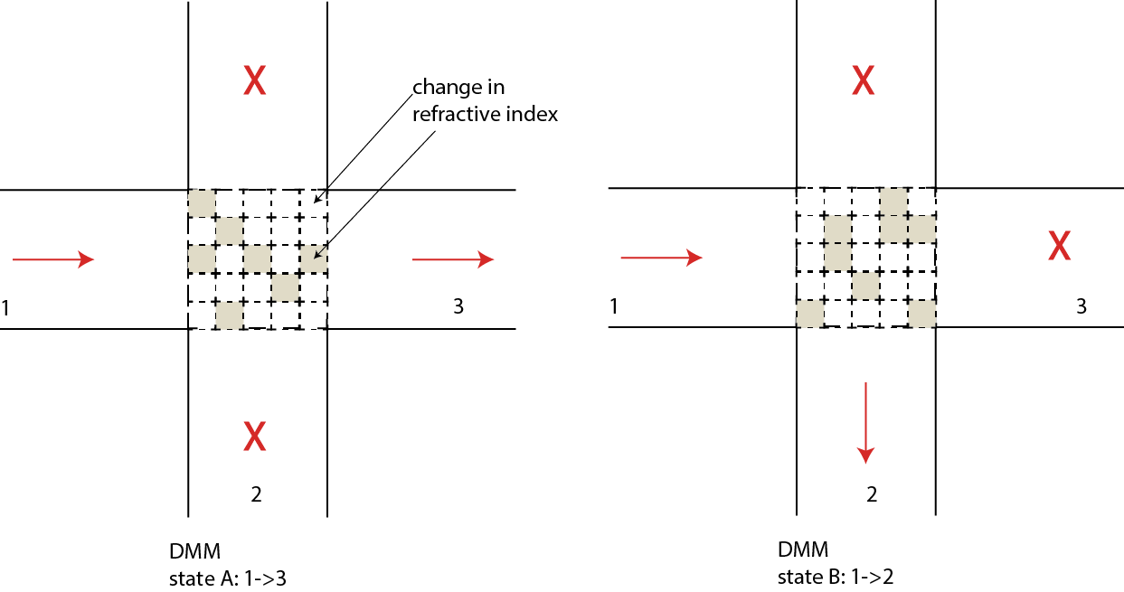
FRG1 Research Plan: Design
Active DMMs: photonic multi-state machines
can be modulated by carrier injection (electronics)
Alternative modulation with light
DMMs designed via optimization to perform
specific tasks within fabrication constraints.
Applications in isolators, modulators, switches, etc.
Tsai et al. Science 324, 917 (2009)

Slide 16
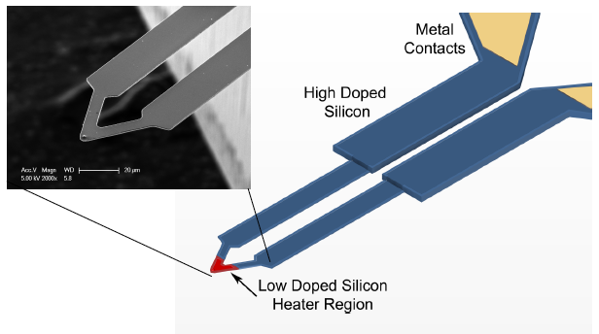
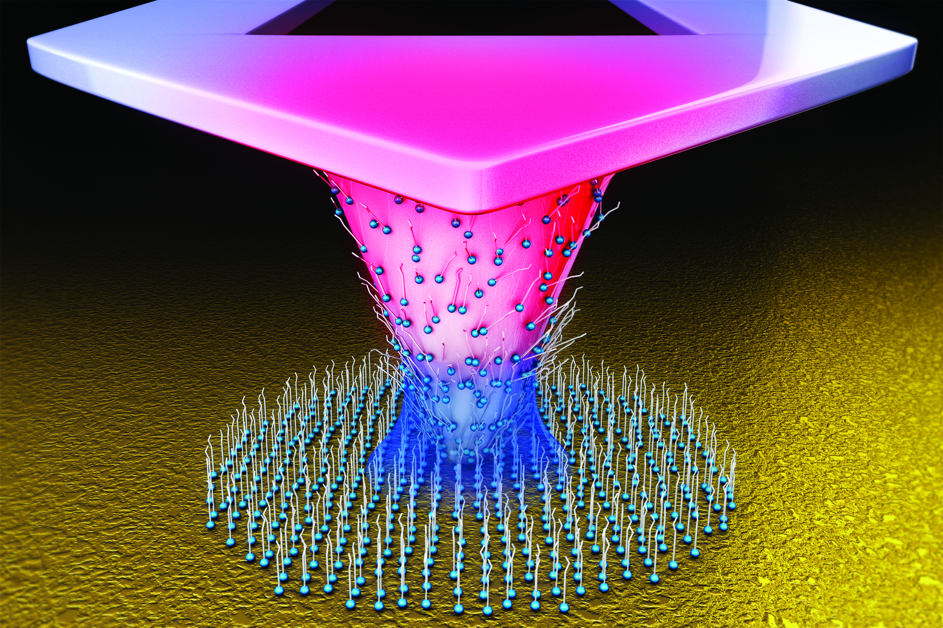
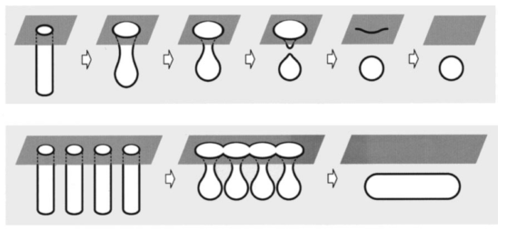
FRG1 Research Plans: Fabrication and Experiment
Fabrication
Experiments
Tip-Based Nanolithography
  Pattern 10-nm-order pixels with scanning probe microscopy to fabricate DMMs in the visible range
Silicon-on-Nothing Manufacturing
  Utilize self-migration of Si atoms at high temperature to fabricate 3D DMMs
Custom probe station for integrated photonics
polarization-sensitive measurements
transient behavior
quantum measurements
chirality-sensitive measurements

Slide 17
Impact of FRG1
Discover the underlying mechanisms of digital metamaterial (DMM) devices.
Significantly reduce the energy requirements of data centers through DMM-based optical inter-connects.
Discover chiral DMM for potential order of magnitude increases in bandwidth.

Slide 18
FRG2: Wave propagation in complex materials with gain; near-threshold random lasing
Participants: Raikh, FRG Leader; Vardeny, Golden, Pesin, Li. 1 postdoc, 1 grad student; Collaborator: Randy Polson, Nanofab.

Slide 19
1. Studies of Random Lasing in Organics
Random lasing in a DOO-PPV film at high excitation intensity;
the narrow lines (<1nm) are coherent radiation due to random resonators

Slide 20
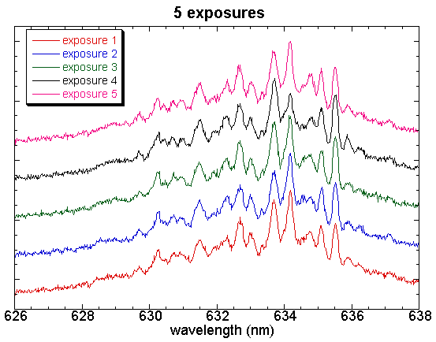
1. Random lasing reproducibility
The sharp peaks are completely reproduced

Slide 21
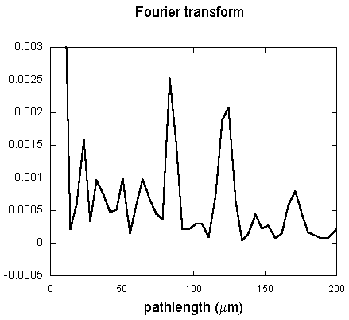
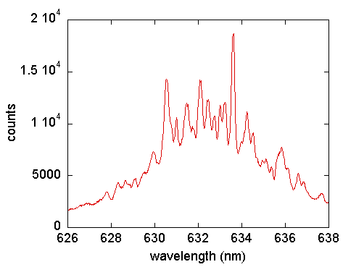
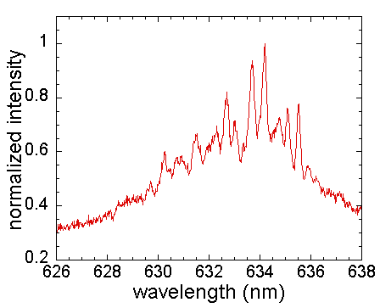
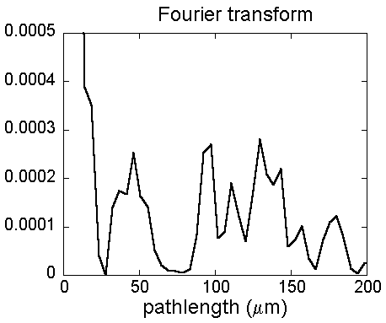
Random Laser; FT spectrum

Slide 22
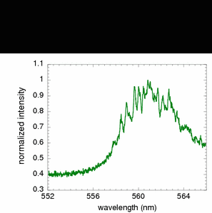
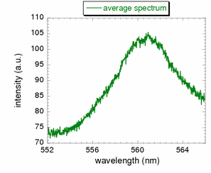
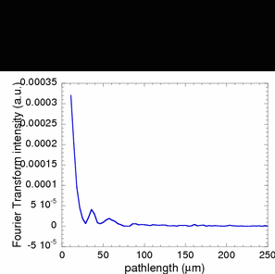
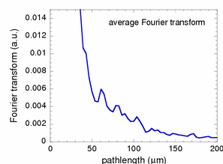
Average Spectrum, Fourier transform

Slide 23
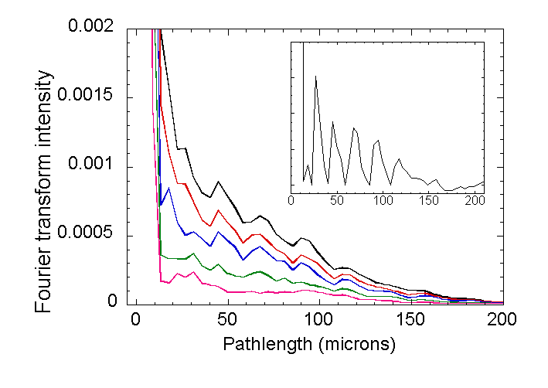
1. Random Lasers; average power Fourier transform build-up
Average Fourier transform of random laser emission spectra revealing the dominant random cavity in the gain medium material

Slide 24
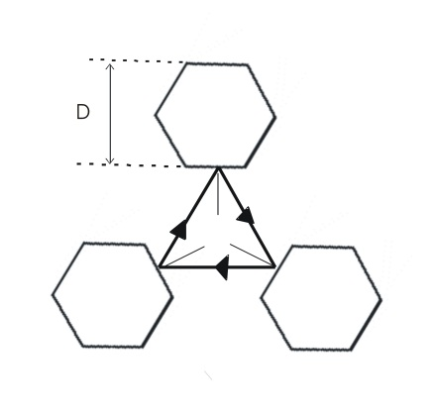
2. Research & Engineering Challenges
Study Random Lasing where the optical gain and loss are spatially separated and balanced.
Explore Random Lasing in materials with chiral optical gain and loss.
Investigate Random Lasing in materials with optical gain impregnated with ‘mirror-like’ scatterers.
Seek RL applications in the Health Sciences.

Slide 25
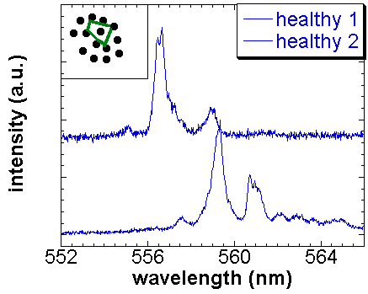
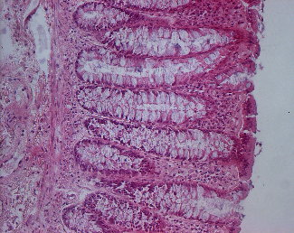
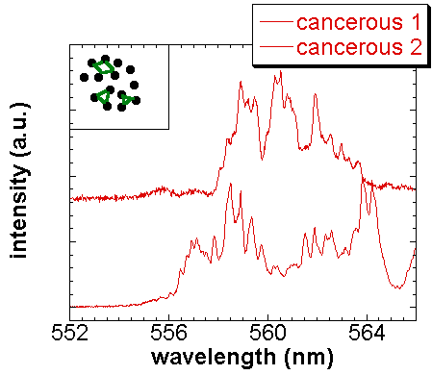
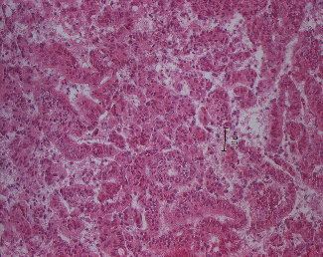
Applications of random lasing in tumors
Laser emission spectra
Stock images (colon)
Healthy tissue
Polson and Vardeny, Appl. Phys. Lett.
cancerous
Malignant tumors show many more sharp peaks

Slide 26
3. Research Plan
Fabricate novel optical materials with spatially separated gain and loss; demonstrate RL threshold and its dependences on avg gain and sample size.
Fabricate novel chiral materials having optical gain; chiral molecules or hybrid perovskites at high magnetic field.
Study RL in chiral materials.
Fabricate ‘mirror-like’ scatterers in the visible spectral range, study RL thresholds, spectra and emissions.
Explore RL in cancer tissues, and design ‘RL tomography’ of cancer; commercialization.

Slide 27
Impact of FRG2
Control Random Lasing using artificial scatterers
Design Random Laser devices based on chiral chromophores
Find commercial applications for ‘RL imaging’ in the Health Sciences and Biomedical Engineering

Slide 28
FRG3
Parity-Time Symmetry; Materials and Devices
Participants: Valy Vardeny, FRG Leader; Sara Li, Dima Pesin, Misha Raikh. External: T. Kottos (Wesleyan), B. Shapiro (Technion), V.V. Tsukruk (GaTech). 1 postdoc, 2 grad students

Slide 29
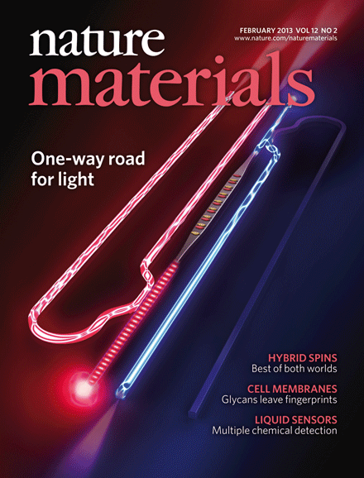
PT-symmetric in optical structures: unidirectional invisibility
Optical Isolator
PT grating
Red=gain; blue=loss
Nature Materials, February 2013
Light entering the structure from the left does not experience reflection.
In contrast, light incident from the right experiences high reflectivity.

Slide 30
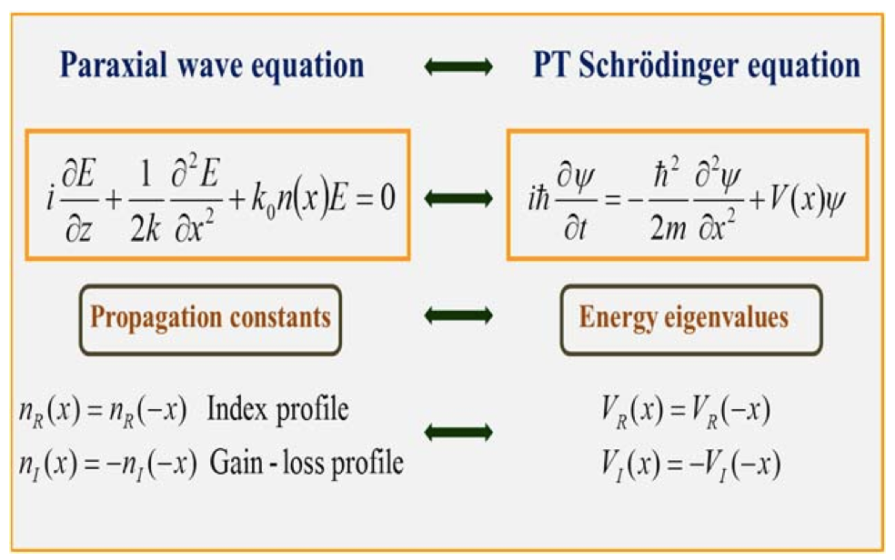

PT Symmetry in Optics; interplay between gain and loss
Complex refractive index:
PT symmetry requires that n(x)=n*(-x); i.e. loss=gain

Slide 31
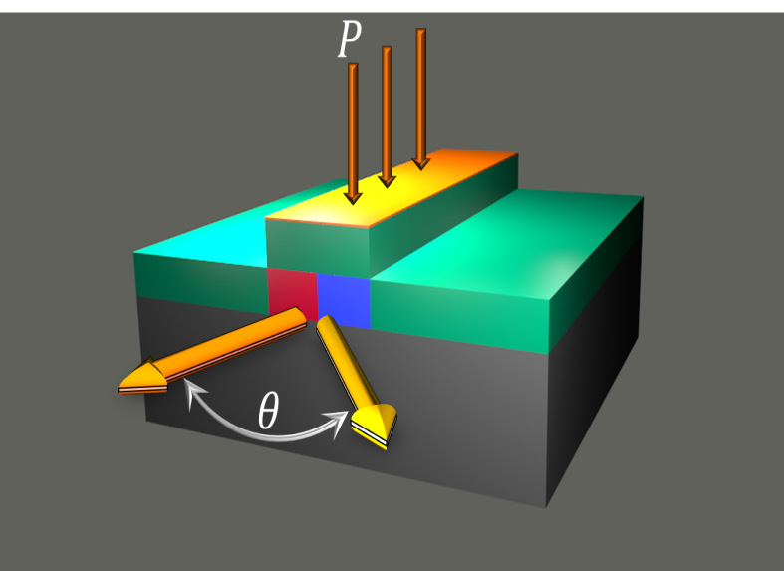
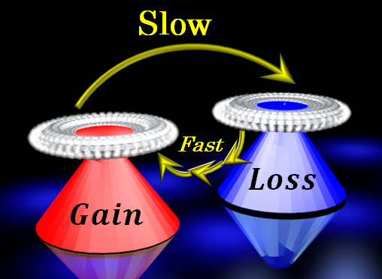
Examples of planned PT symmetry optical devices
PT-deflector
Asymmetric energy exchange
Deflection depends on the
contrast between gain and loss
Energy transfer rate depends on the contrast between gain and loss

Slide 32

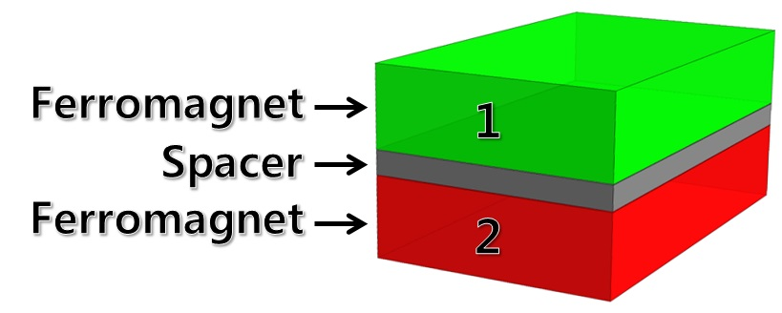








Properties of the S-matrix
PT-symmetry in Magnetics; two coupled FM layers
T. Kottos and B. Shapiro; 2015
LLG equation
P
1 → 2
2→ 1
T
t → -t
A → -A

Slide 33
Questions and Challenges for FRG3
Find the best material for optical gain and optical loss interplay
What is the role of chirality in PT symmetry?
Prove experimentally the existence of PT in Magnetism, and investigate what is meant by gain and loss
Research & Engineering Objectives
Fabricate novel optical devices based on PT symmetry
Study magnetic trilayers of FM1/NM/FM2
Fabricate novel devices based on magnetic PT symmetry

Slide 34
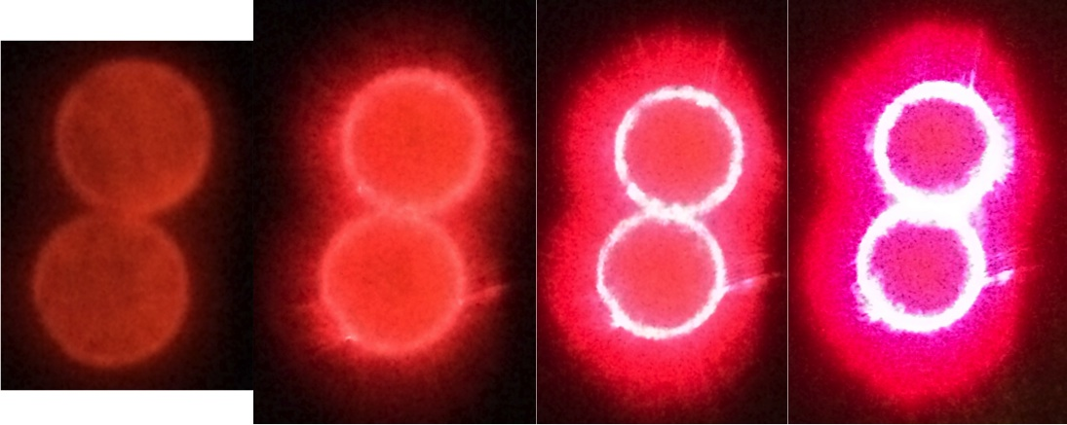
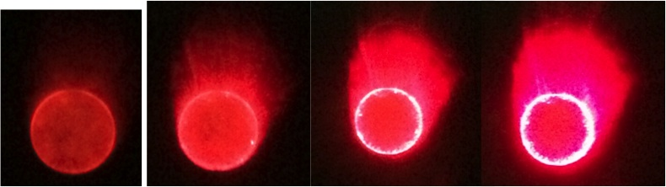
Pumping microdisk pair; optical PT symmetry
‘Mode-splitting’
Pumping one disk while the other is ‘dark’ leading to PT symmetry

Slide 35
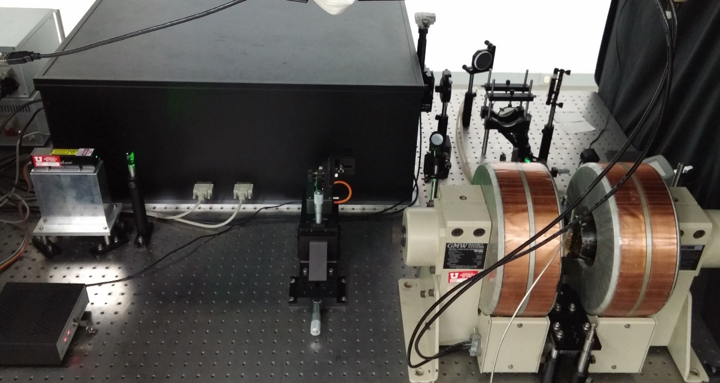
Brillouin scattering spectrometer for magnon spectroscopy
Acoustic phonon
Stokes
Anti-Stokes
magnon II
magnon I

Slide 36
Impact of FRG3
Optical devices based on PT symmetry; commercialization
Realization of PT symmetry in nonlinear optics
Achieving magnonic gain in FM
Magnetic devices based on magnetic PT symmetry; commercialization

Slide 37
Research Effort for IRG
Trainees
3 Postdocs
5 PhD students
4 REU students
Collaborations
Univ. Wisconsin
NREL
Oakridge Natl. Lab
Georgia Tech Wesleyan, LANL
Materials Development:
Design, optimization
Materials Characterization:
Optical spectroscopy, FM resonance
Applications:
Digital metamaterial devices, Random
lasing cryptography, Unidirectional optical devices.
Mathematical
Modeling and
Computation
Industrial Partnerships
Intel, Simpetus, LLC
LumArray Corp., Samsung
International Collaborations
Technion, Sogang U (Korea),

Slide 38
What defines success of the IRG?
Significant advances in the mathematics of material design.
Create a library of DMM-based integrated devices for commercial applications.
Finding unique properties of RL in chiral materials.
Commercialization of RL imaging in medical applications.
Optical devices based on PT symmetry; commercialization.
Achieving magnonic gain in FM.

