Slide 1
Math 5750 / 6880
Mathematics and Climate
Kenneth M. Golden

Slide 2
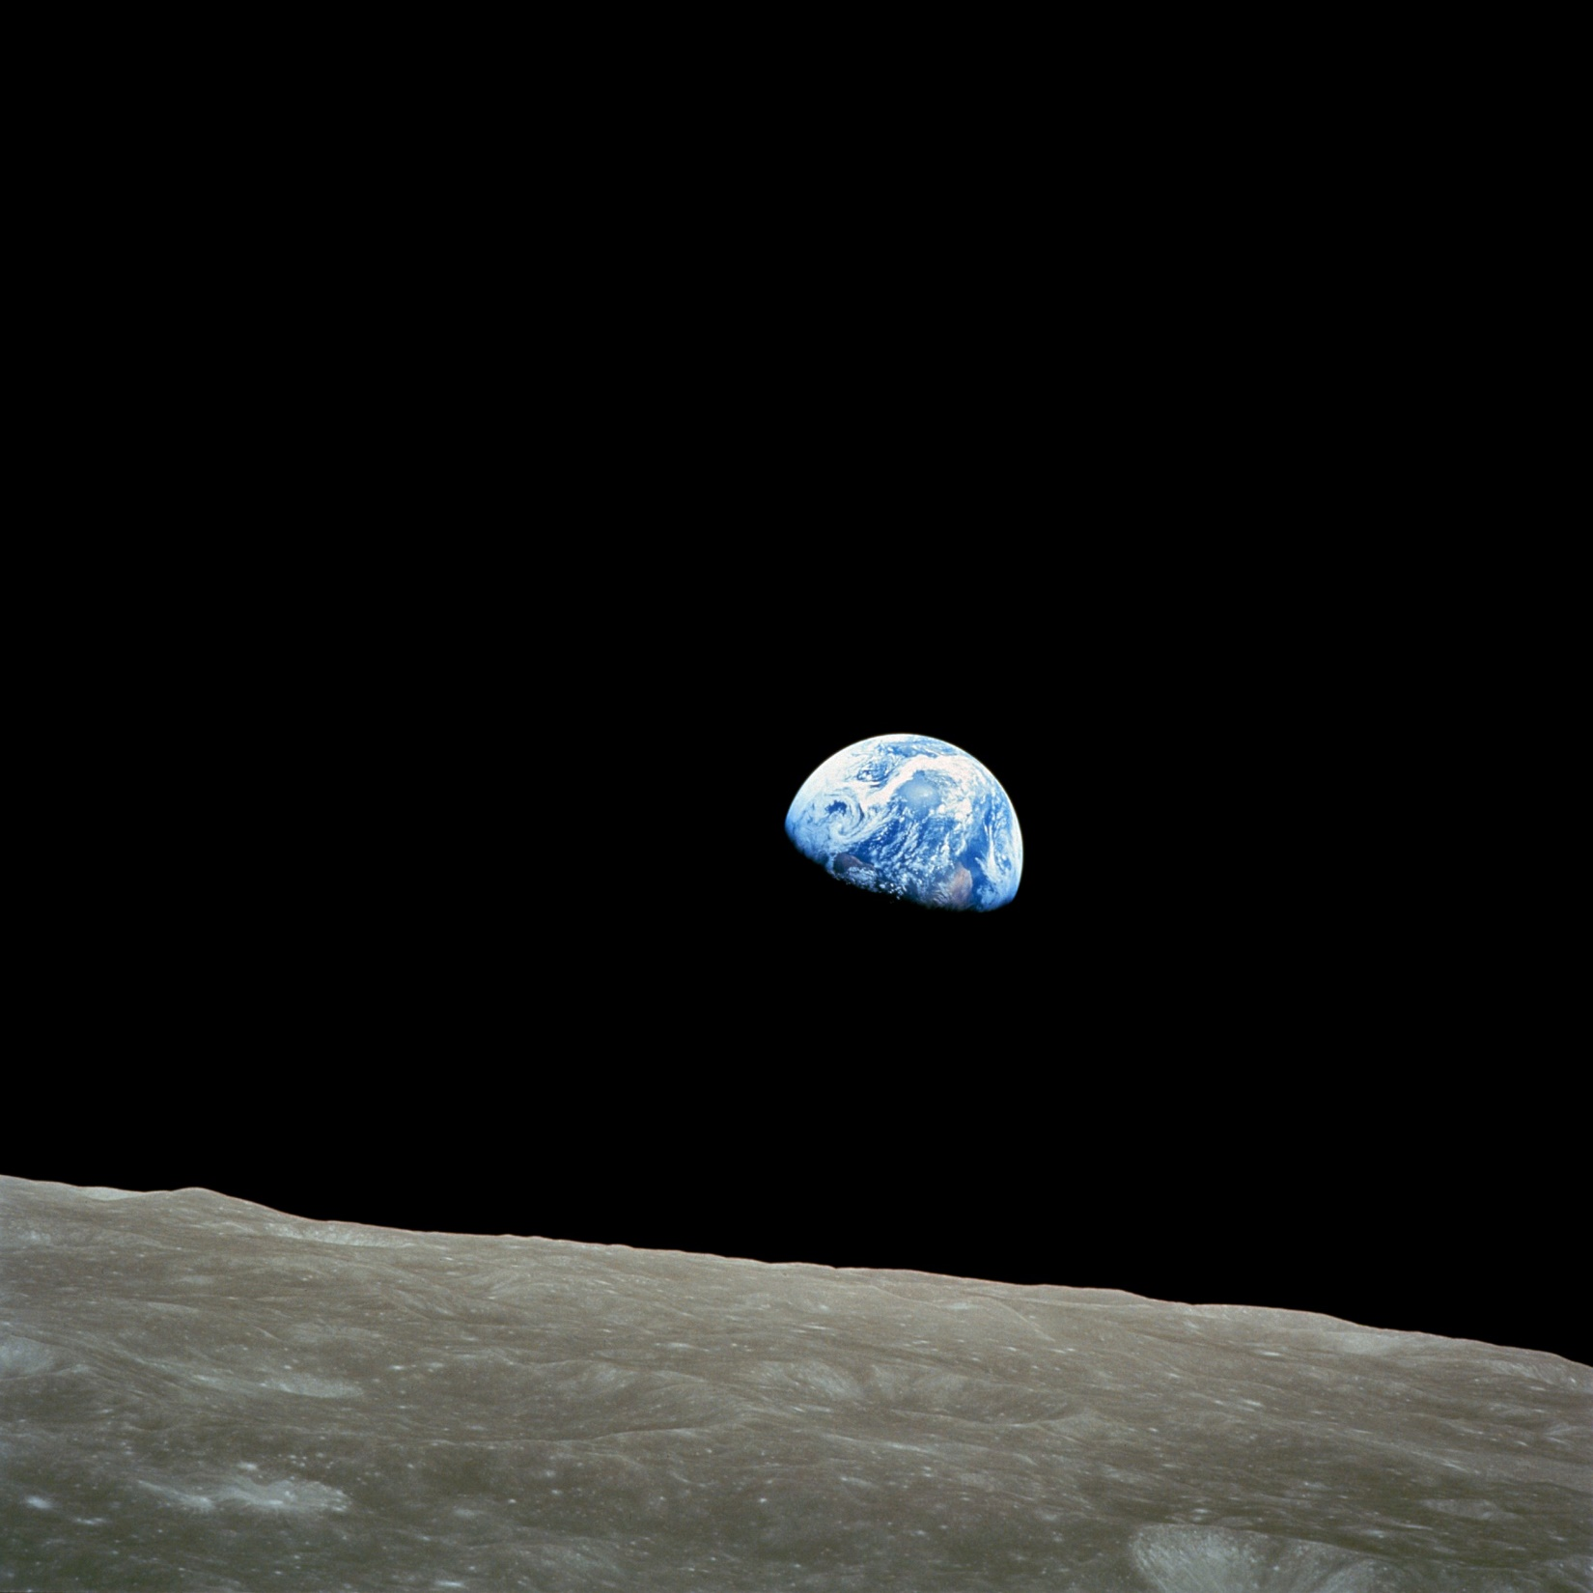

Slide 3
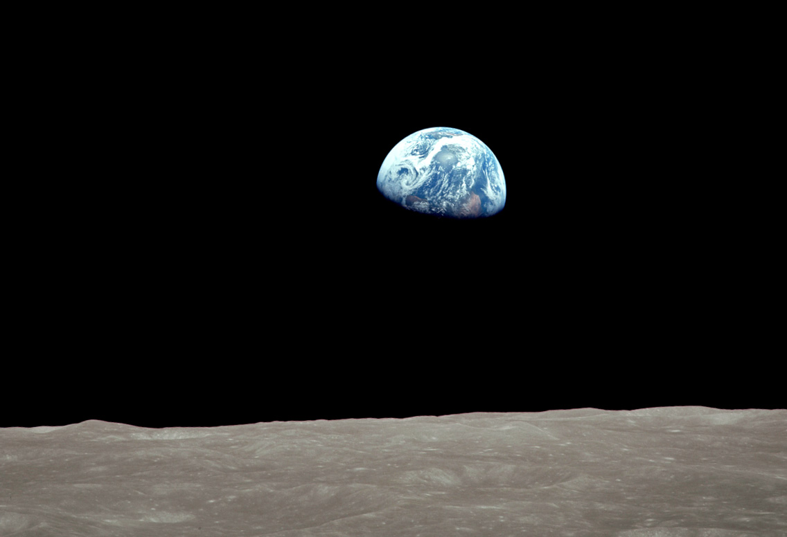

Slide 4
Earthrise December 24, 1968 William Anders NASA

Slide 5
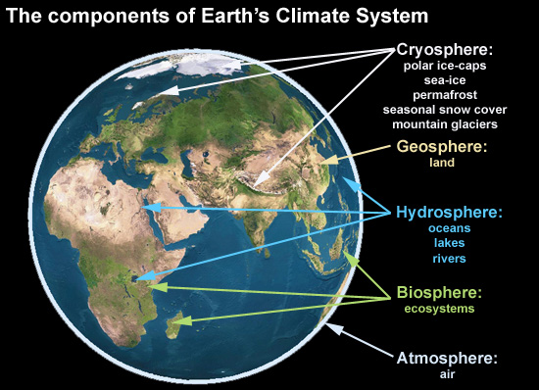

Slide 6
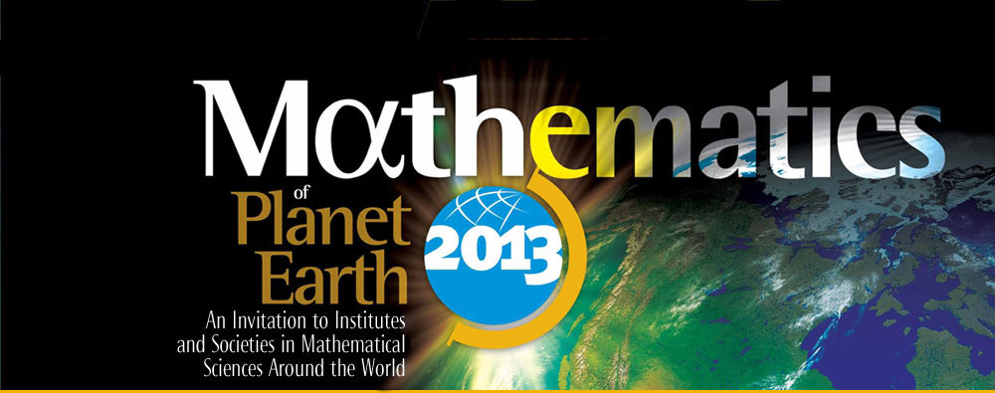
Mathematics of Planet Earth 2013
A Worldwide initiative, involving:
North America: US and Canadian Math Institutes, Societies, etc.
Partners worldwide: Europe, Africa, India…

Slide 7
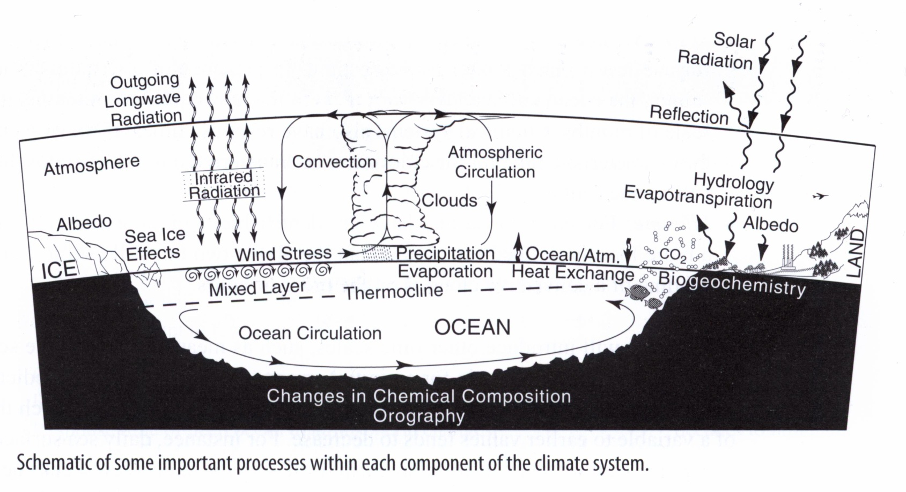
Basics of global climate
Basic components: cryosphere – land ice, snow, sea ice, permafrost
biosphere – sum total of all living things
lithosphere – solid Earth – ocean basins, mountain ranges
atmosphere, hydrosphere (oceans, seas, rivers, …)

Slide 8
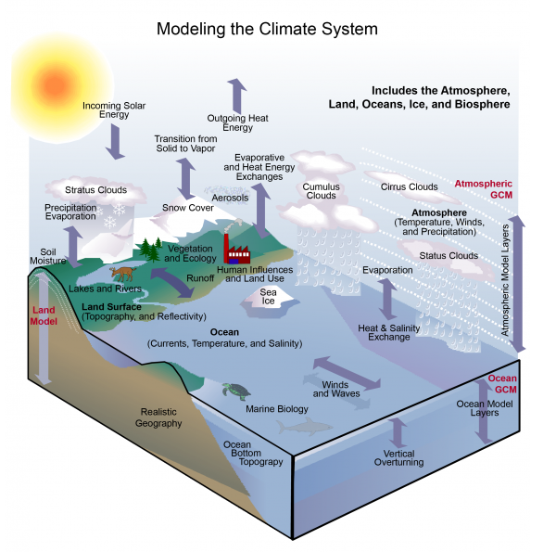

Slide 9
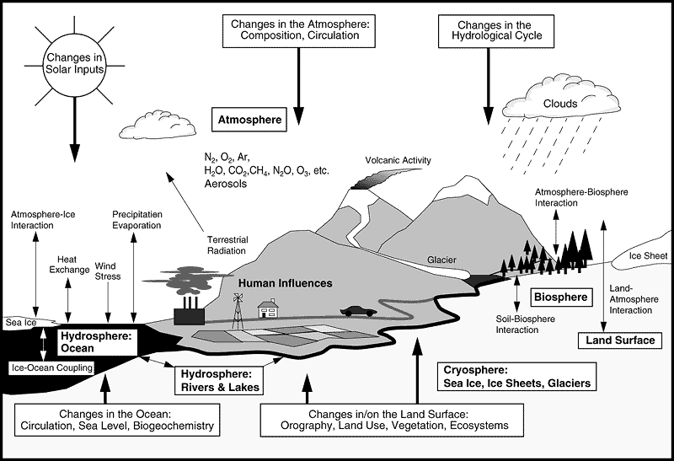
Schematic view of Earth’s climate system (IPCC).
Snow
permafrost

Slide 10
Evidence of a Changing Climate
Intergovernmental Panel on Climate Change (IPCC):
Warming is “unequivocal”
Dots: yearly average
Curve: decadal average
Blue: uncertainty interval
Notes:
We’re going to focus on global mean temperature
(mean over planet and over a year)

Slide 11
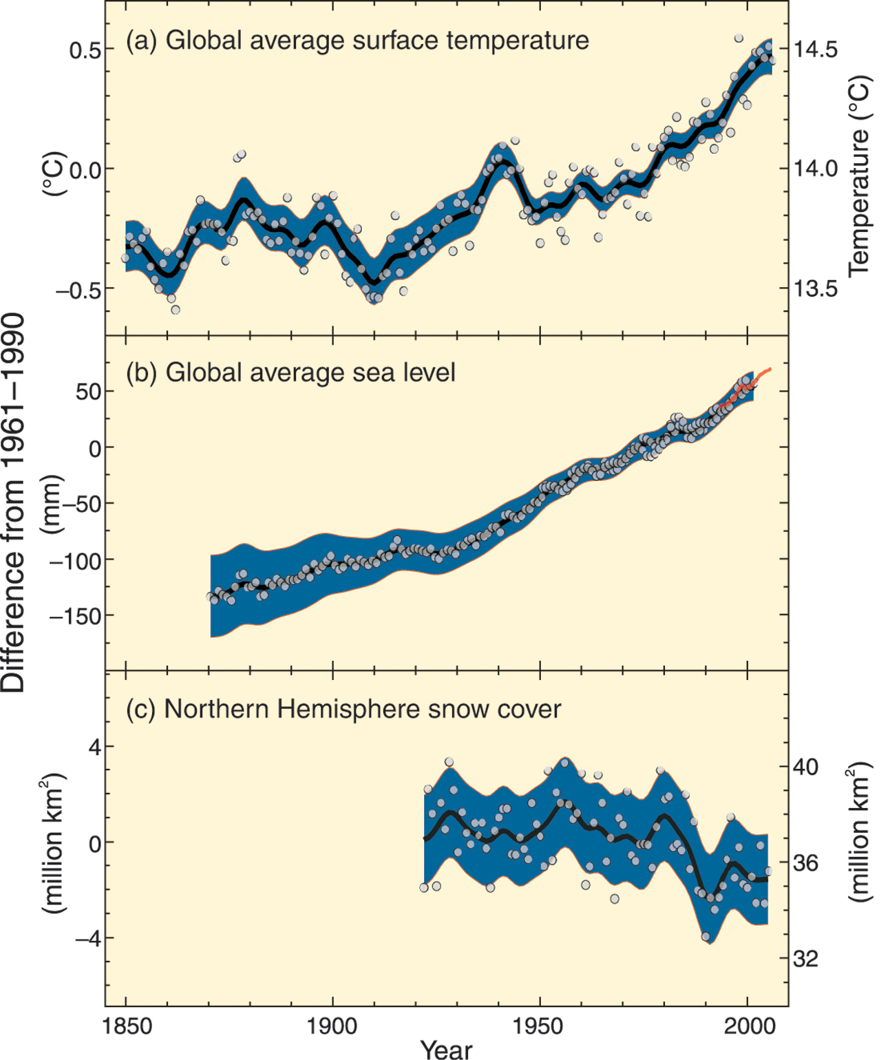
IPCC: Warming is “unequivocal”
Global mean surface temp
Global mean sea level
Northern Hemisphere snow cover (March-April)
Dots: yearly average
Curve: decadal average
Blue: uncertainty interval
1850
2000

Slide 12
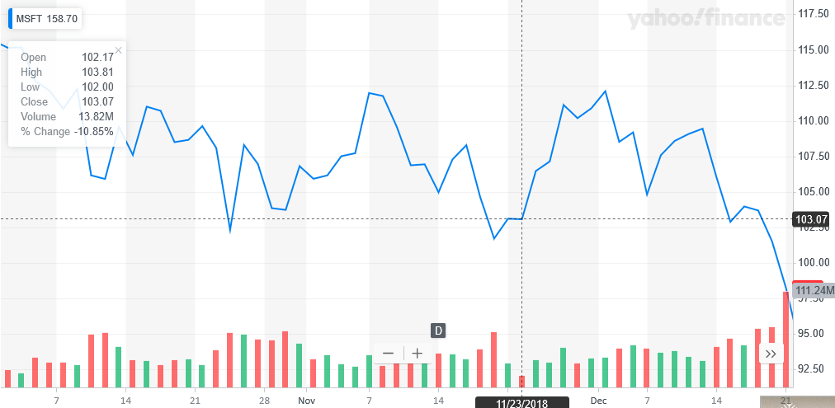
IIIIIIIIIIII
IIIIIIIIIII
IIIIIIIIII

Slide 13
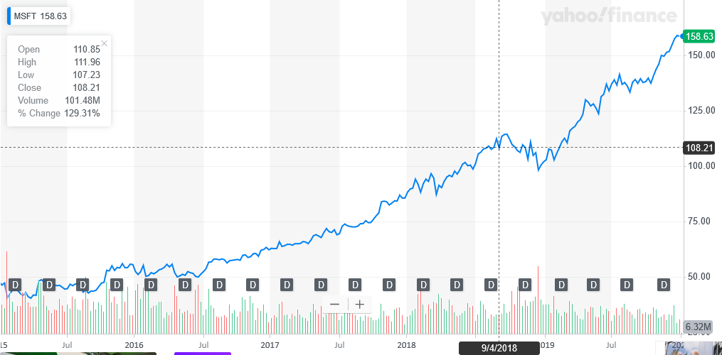
IIIIIIIIIIII
IIIIIIIIIII
IIIIIIIIII
TTTTT

Slide 14
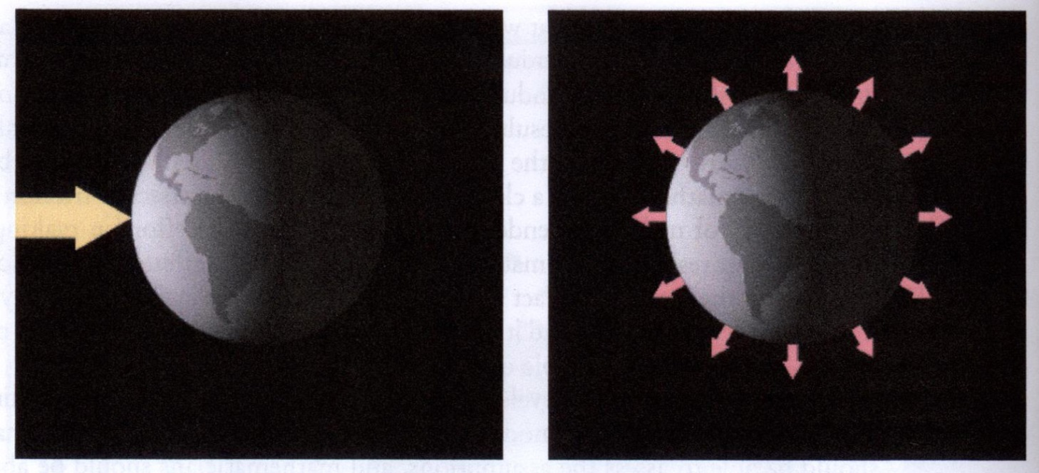
Earth’s energy balance
E_{in}
E_{out}
incoming shortwave radiation
sunlight
outgoing longwave radiation
heat
if E_{out} > E_{in} planet cools
if E_{out} < E_{in} planet warms

Slide 15
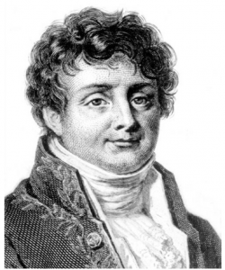
Basics of global warming date back to the 1800’s
Jean Baptiste Joseph Fourier (1768-1830), French mathematician and natural philosopher, did groundbreaking work in mathematics and the theory of heat. He was the first to propose that the Earth's atmosphere acts to raise the planet's temperature.
“As a dam built across a river causes a local deepening of the stream, so our atmosphere, thrown as a barrier across the terrestrial rays, produces a local heightening of the temperature at the Earth’s surface.”
Thus in 1862 John Tyndall described the key to climate change. He had discovered in his laboratory that certain gases, including water vapor and carbon dioxide ( CO2 ) are opaque to heat rays. He understood that such gases high in the air help keep our planet warm by interfering with escaping radiation.

Slide 16
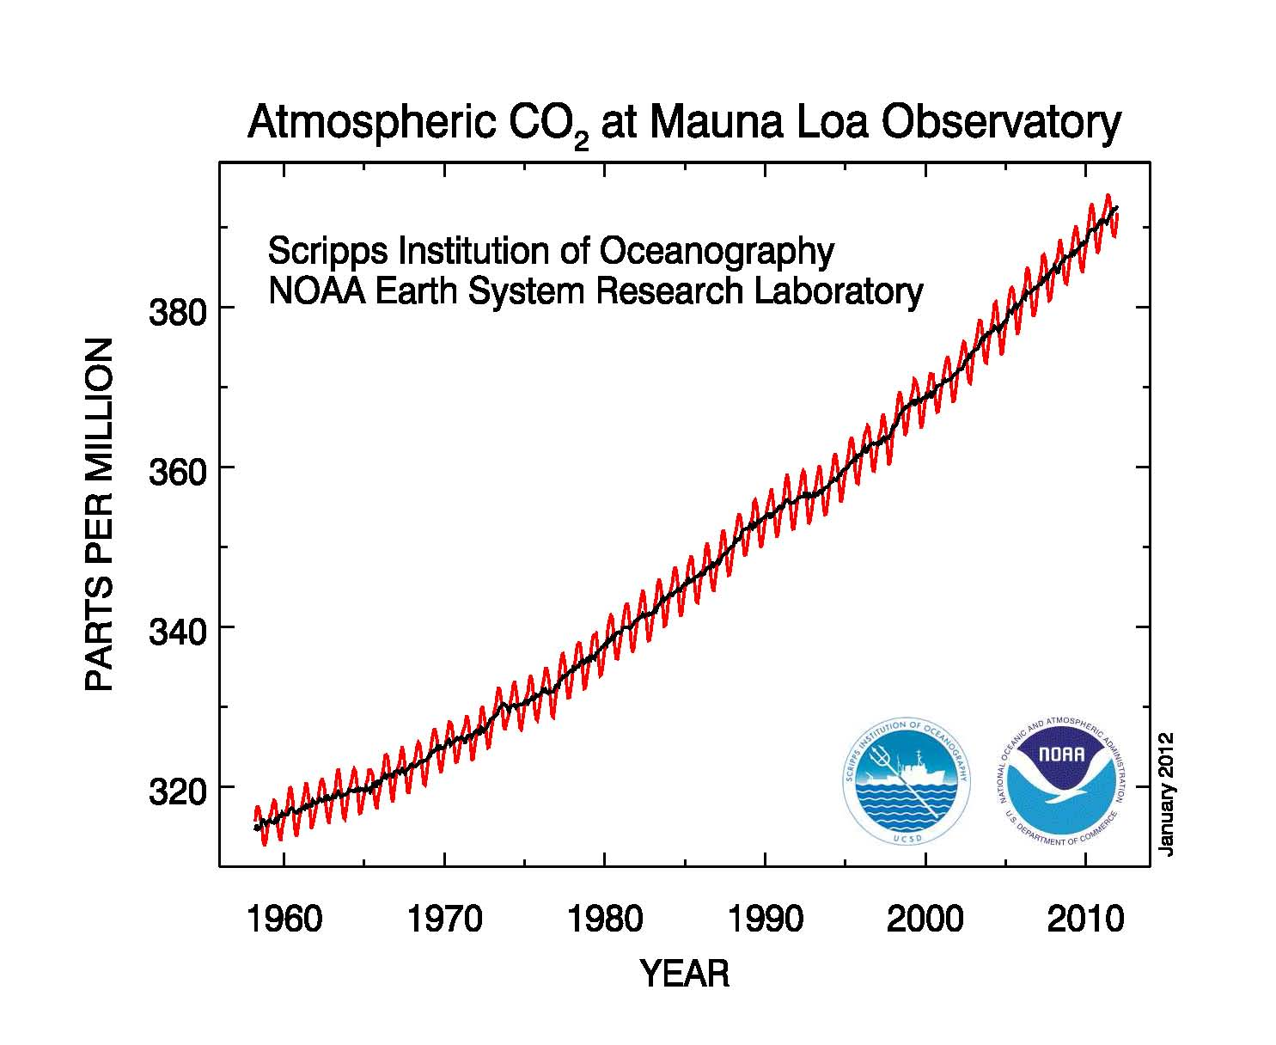
Monthly average carbon dioxide concentration. Seasonal cycle is thought to be driven by the terrestrial biosphere; net consumption of carbon dioxide by biomass in the summer (abundance of light and heat) and net respiration in winter.

Slide 17
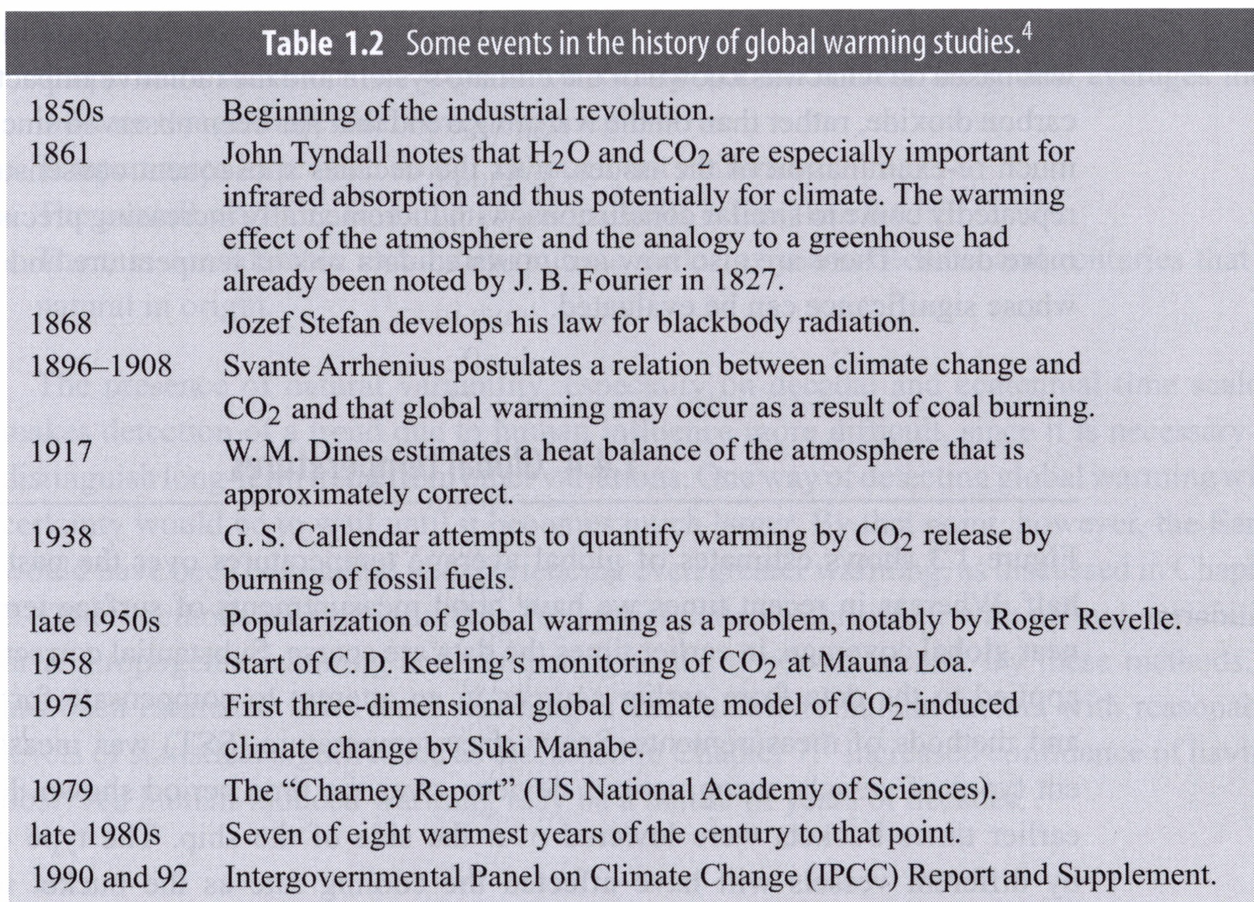

Slide 18
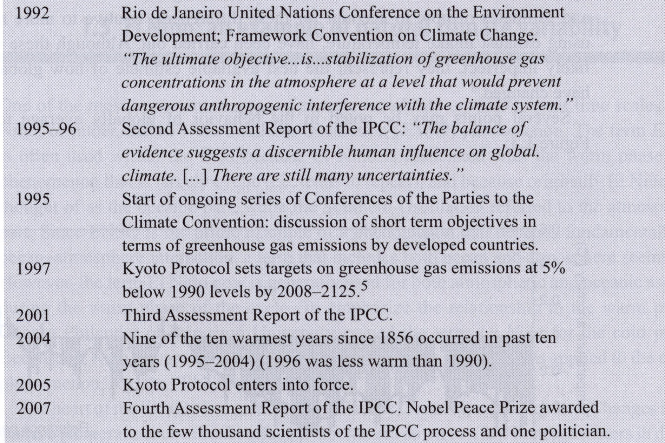

Slide 19
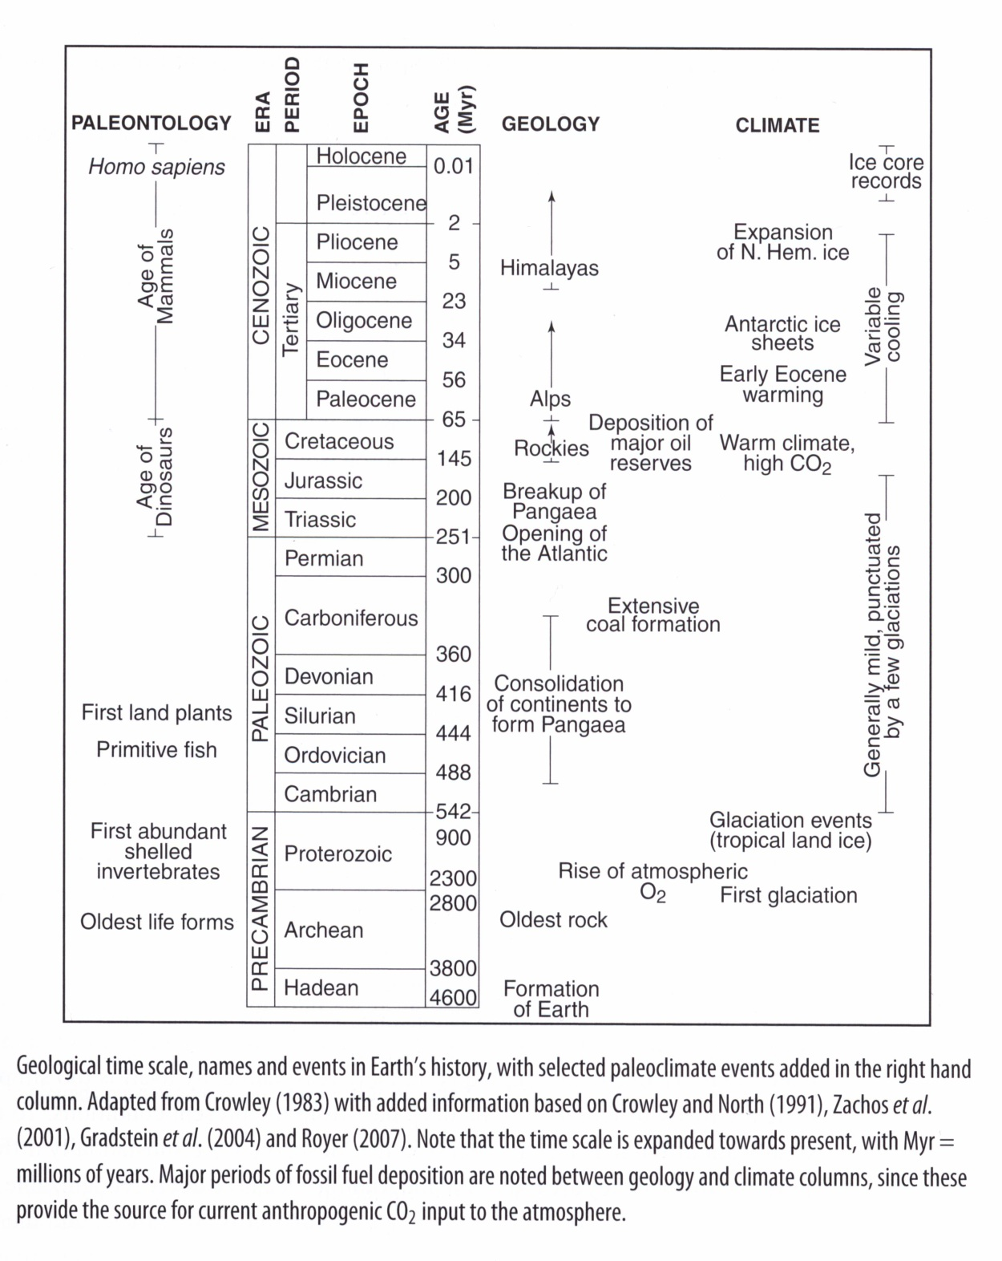

Slide 20
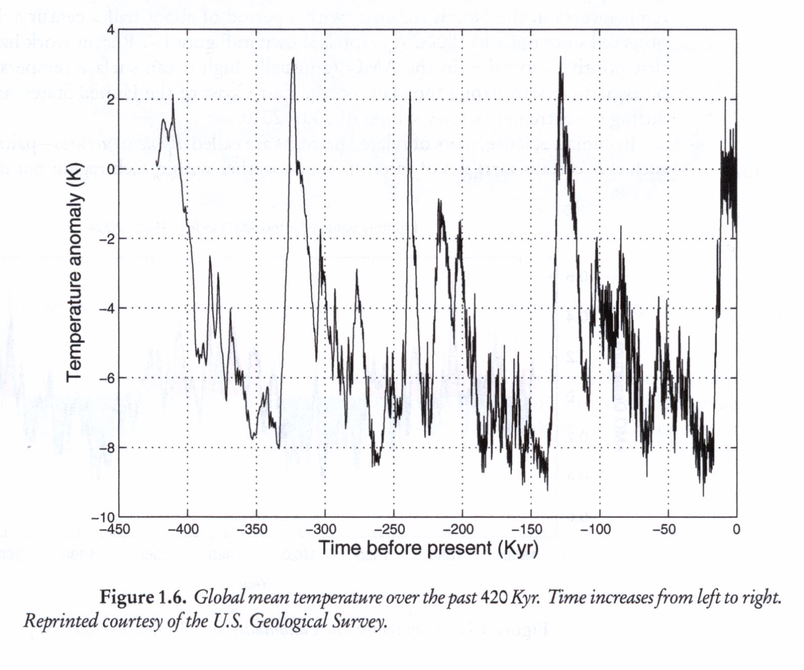
climate variability vs. climate change

Slide 21
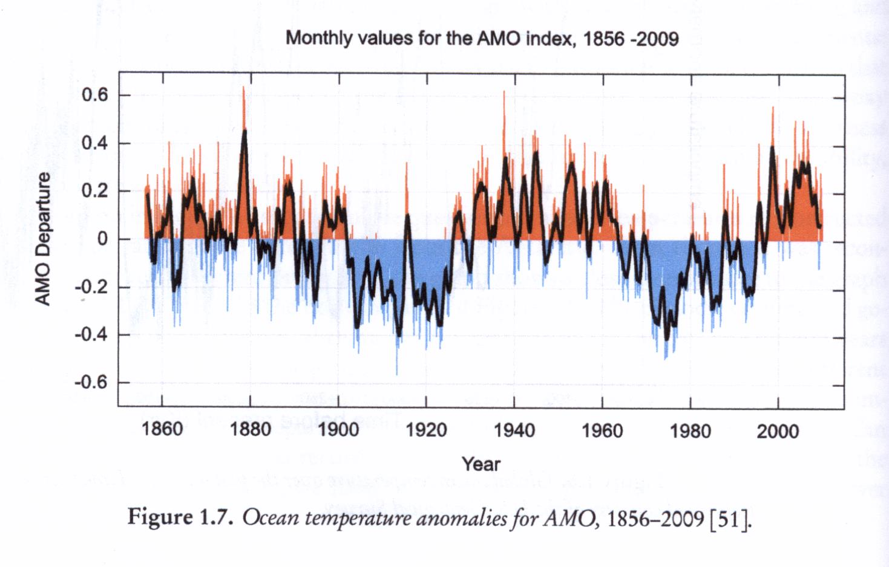
Sir Gilbert Walker (1868-1958) -- observed years of reduced rainfall over Australia and Indonesia (high air pressure over western Pacific) correlated with low pressure over central and eastern Pacific – SOUTHERN OSCILLATION
His observations vindicated when connected to ocean temperature oscillations observed by fishermen off the coast of South America around Christmas – called “El Nino”
ENSO – El Nino Southern Oscillation
NAO – North Atlantic Oscillation – pressure difference – Icelandic low, Azores high
AMO – Atlantic Multidecadal Oscillation (~ 50 yrs) – sea surface temps in North Atlantic
positive anomalies – high ocean surface temps – associated with strong snowfall
in East Coast, as in 2009-2010.

Slide 22
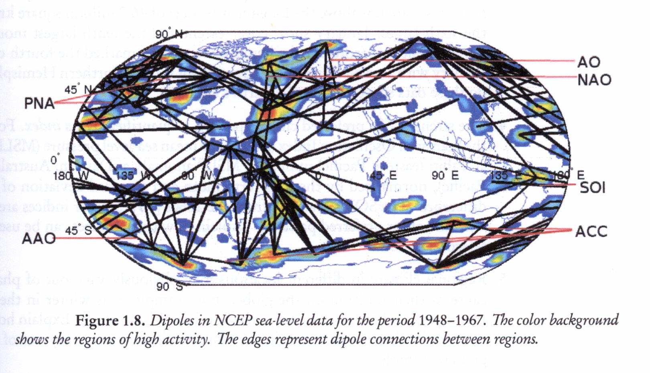
DIPOLE Teleconnections

Slide 23
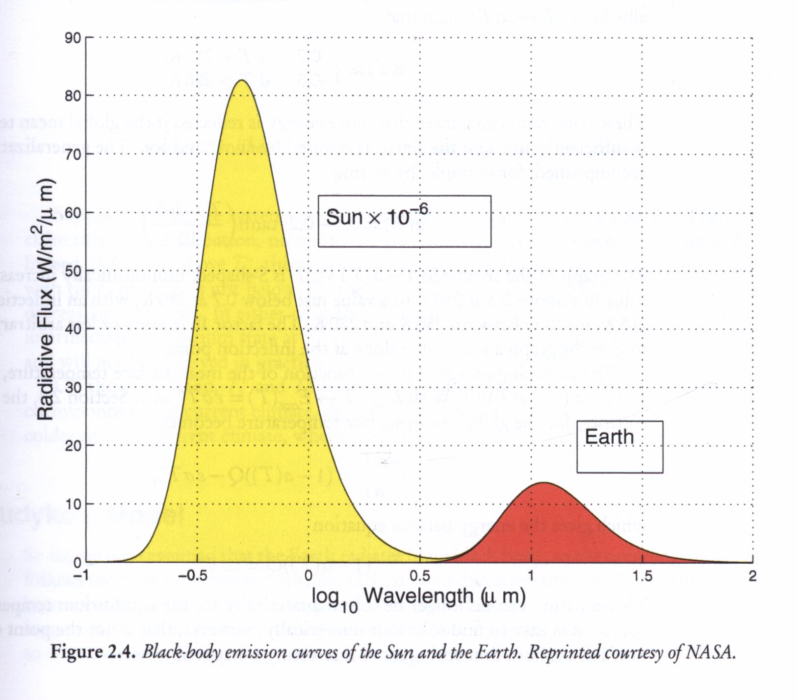
Blackbody emission curves for Sun and Earth.
A perfect blackbody is one that absorbs all incoming light and does not reflect any; it emits electromagnetic radiation (thermal radiative energy) with spectrum that depends on temperature T according to Plank’s law.

Slide 24
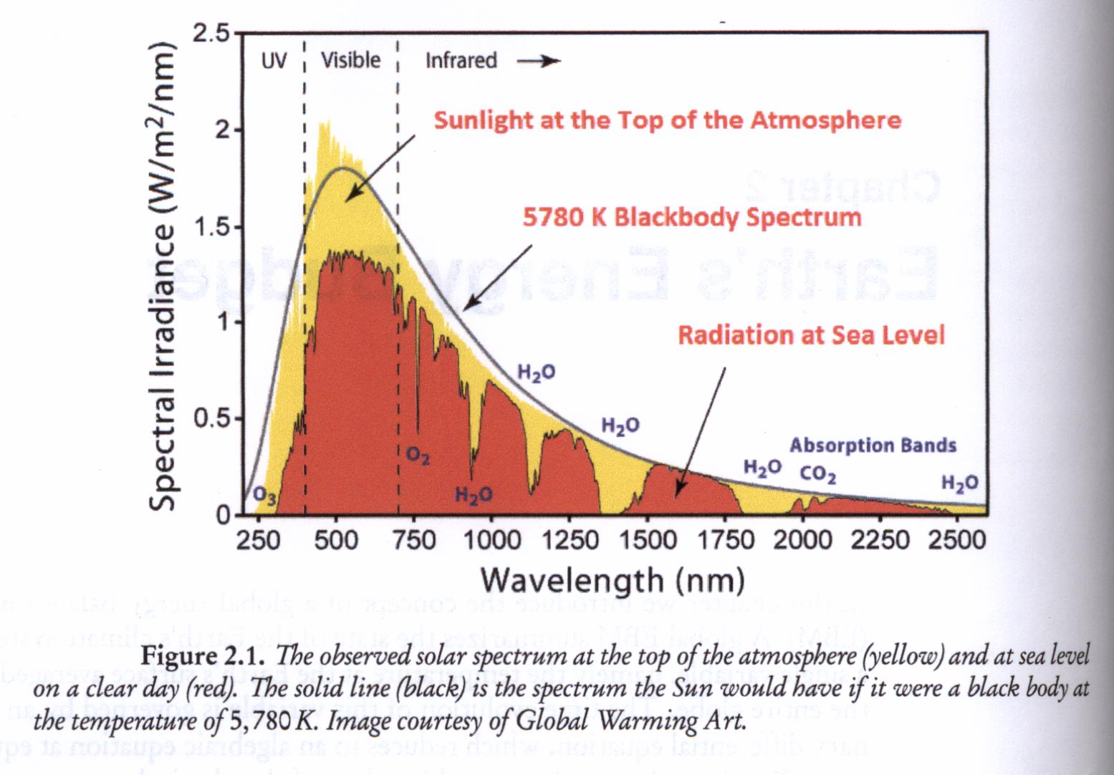
Observed solar spectrum at top of atmosphere and at sea level

Slide 25
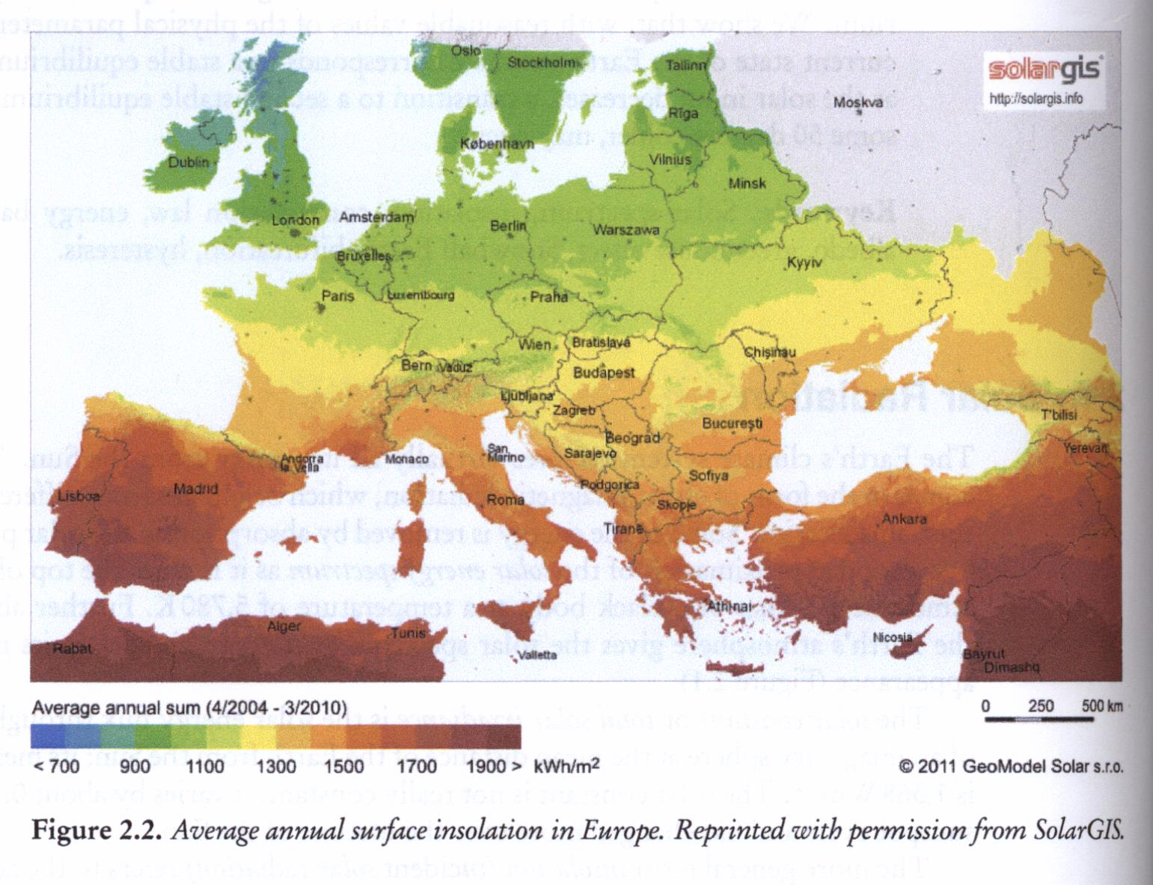
Surface insolation in Europe.

Slide 26
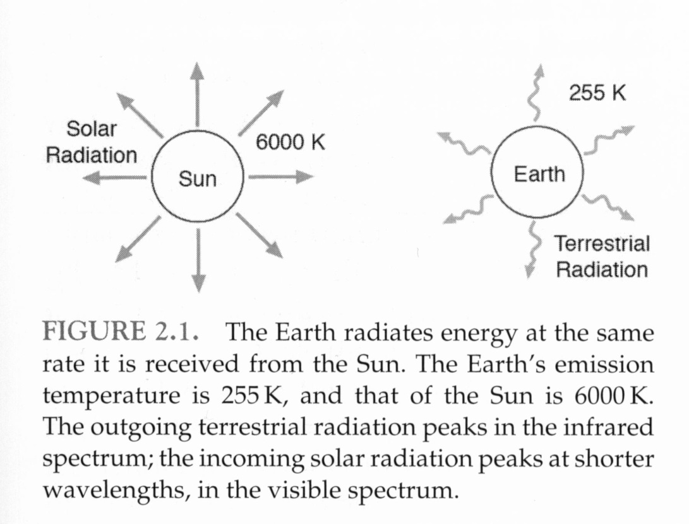
The global energy balance
Consider the radiative equilibrium temperature of Earth. To maintain equilibrium, it warms up (absorbs solar energy) and radiates energy away at same rate it is received. We’ll see the emission temperature is 255 K and a body at this temperature radiates primarily in infrared. But atmosphere is strongly absorbing at these wavelengths (H2O and CO2) thus raising surface temperature above emission temperature – GREENHOUSE EFFECT.

Slide 27
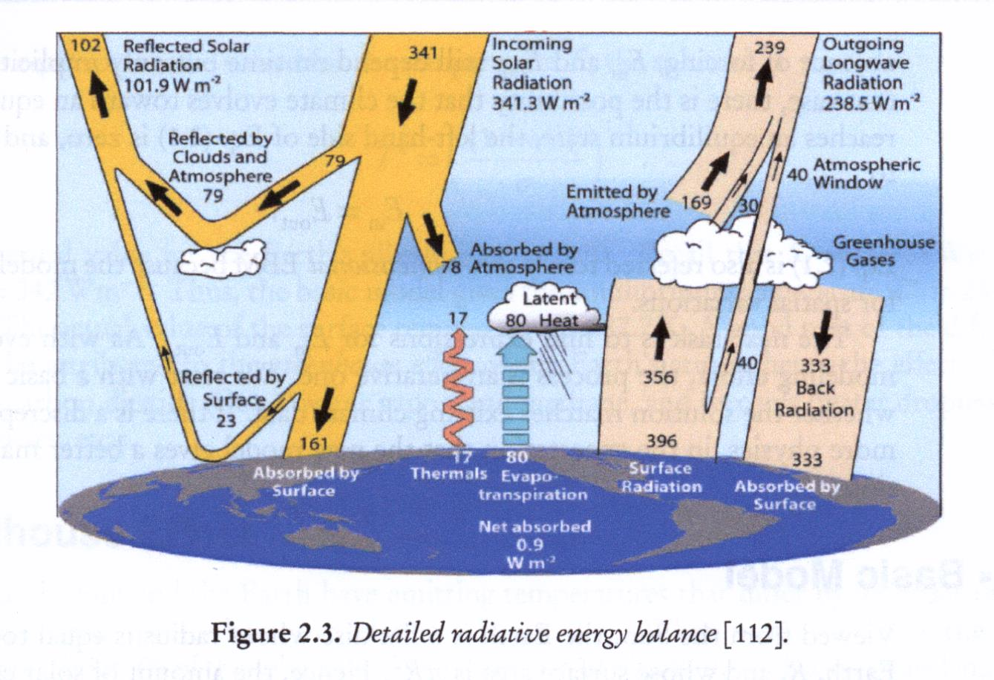
radiative energy balance

Slide 28
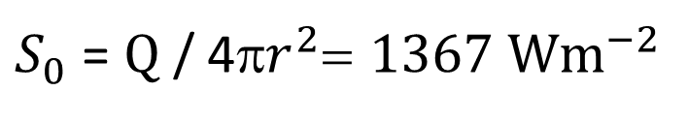

solar “constant”
Sun emits energy at rate Q = 3.87 x ${10}^{26}$ W
Flux of solar energy at Earth is called solar constant
$S_{0}$ = Q / 4π$r^{2}$= 1367 W$m^{−2}$
r = distance from Sun to Earth

Slide 29
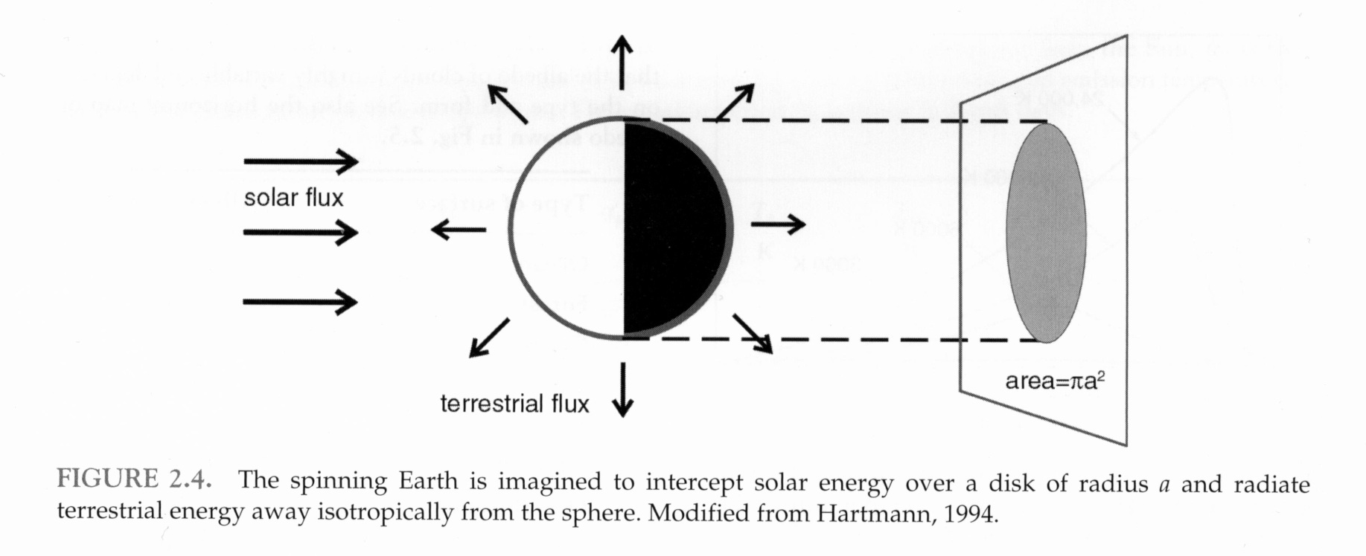
solar power incident on Earth

Slide 30
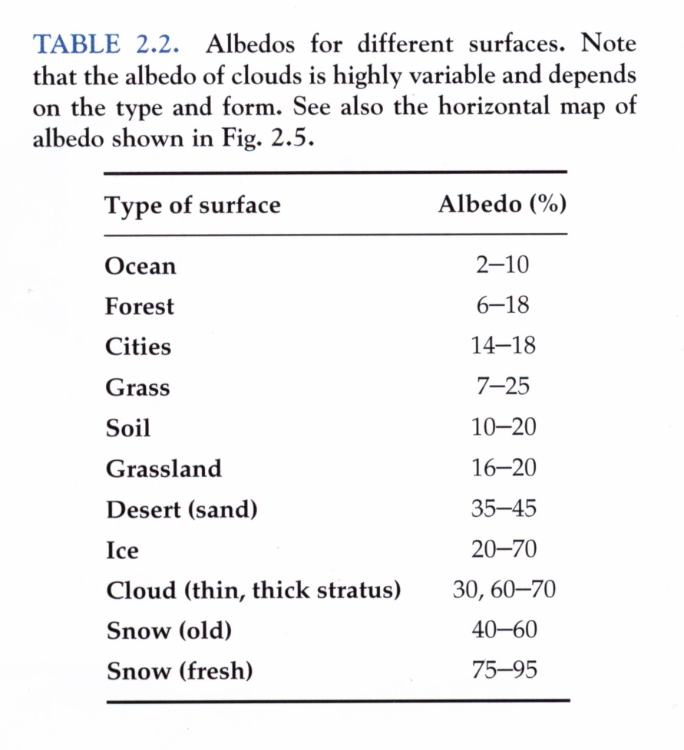
Not all radiation absorbed, some reflected
ratio of reflected to
incident solar energy
= albedo = α

Slide 31
Not all radiation absorbed, some reflected
ratio of reflected to
incident solar energy
= albedo = α

Slide 32
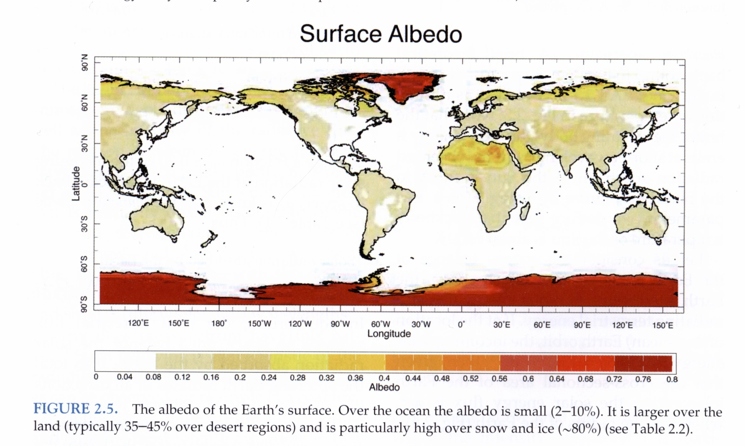
Albedo depends on the nature of the reflecting surface, large for clouds, light surfaces like deserts, and especially snow and ice.
Under present terrestrial conditions of cloudiness and snow and ice cover, on average a fraction α ∼ 0.3 of incoming

Slide 33
Planetary albedo
Albedo depends on the nature of the reflecting surface, and is large for clouds, light surfaces like deserts, and especially snow and ice.
Under present terrestrial conditions of cloudiness and snow and ice cover, on average a fraction
α_{p} ∼ 0.3
of incoming solar radiation is reflected back to space.
α_{p} is known as the planetary albedo

Slide 34
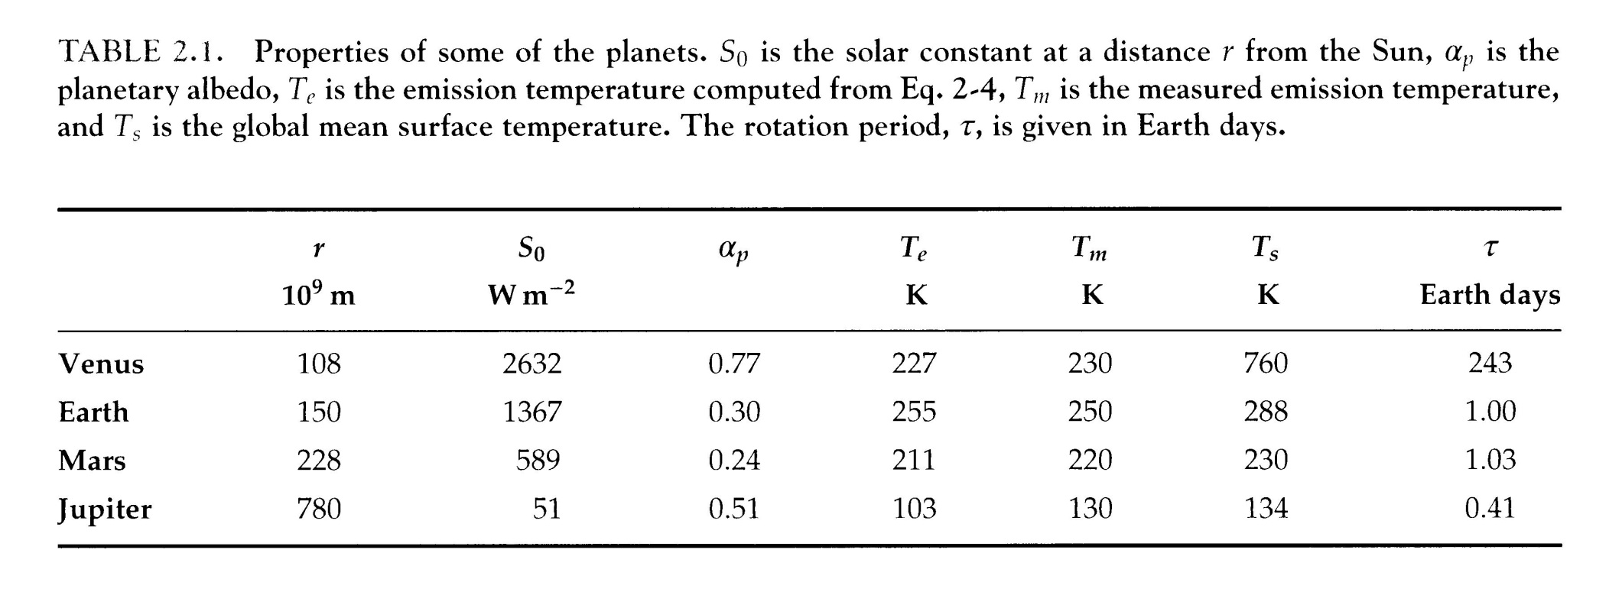
Planetary properties

Slide 35
Blackbody emission curves for Sun and Earth.

Slide 36
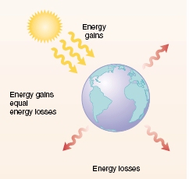
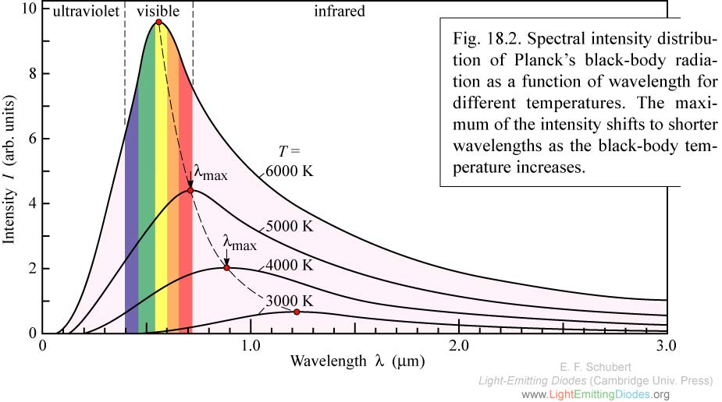
Black Body Radiation - Planck
Energy gains
Spectral Intensity
vs
Wavelength
For black bodies at different temperatures (0°C=273K)
Energy gains
equal
Energy losses
Intensity (arb. units)
Energy losses
Wavelength (μm)
Sun: ~6000K, emits mainly in visible spectrum (shortwave)
Earth: ~300K, emits mainly in IR (longwave)
Integrate over wavelength for temp T to get total emission flux σT⁴ -- Stefan-Boltzmann
Notes:
Two black bodies, each radiating energy according to their temperature
Degrees K and C are the same size
Not a coincidence that sun emits in visible spectrum.
Doubtless a consequence of evolution that vision has evolved to optimize use of available spectrum ☺
.

Slide 37
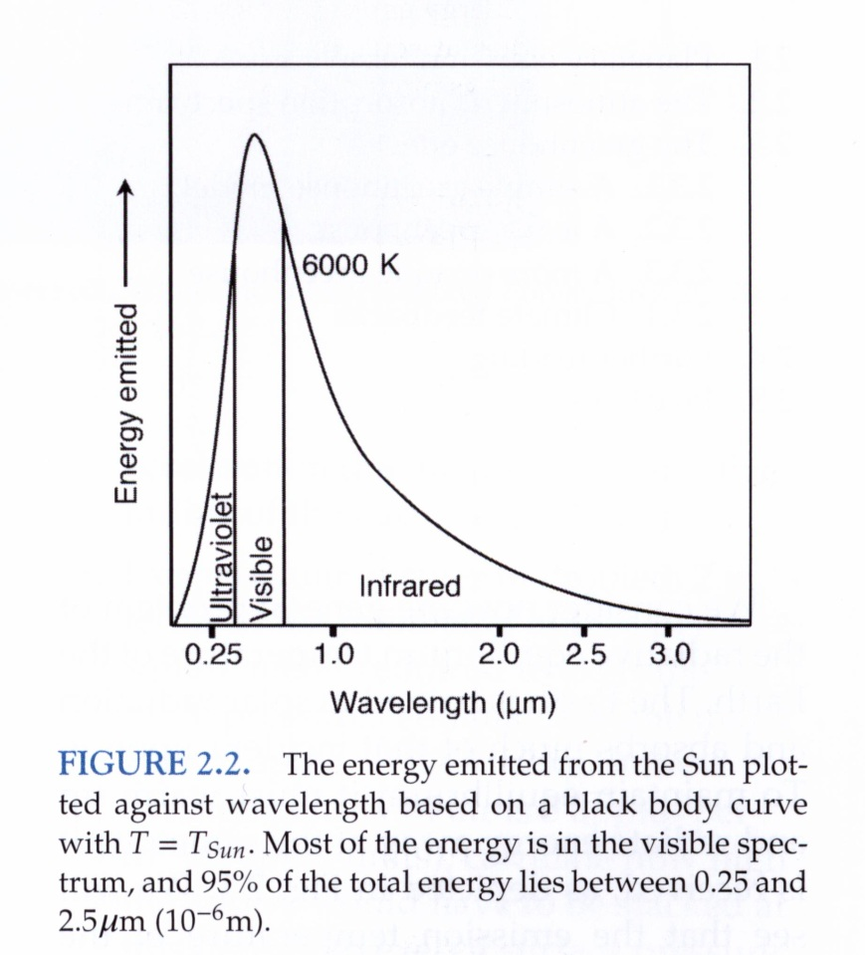
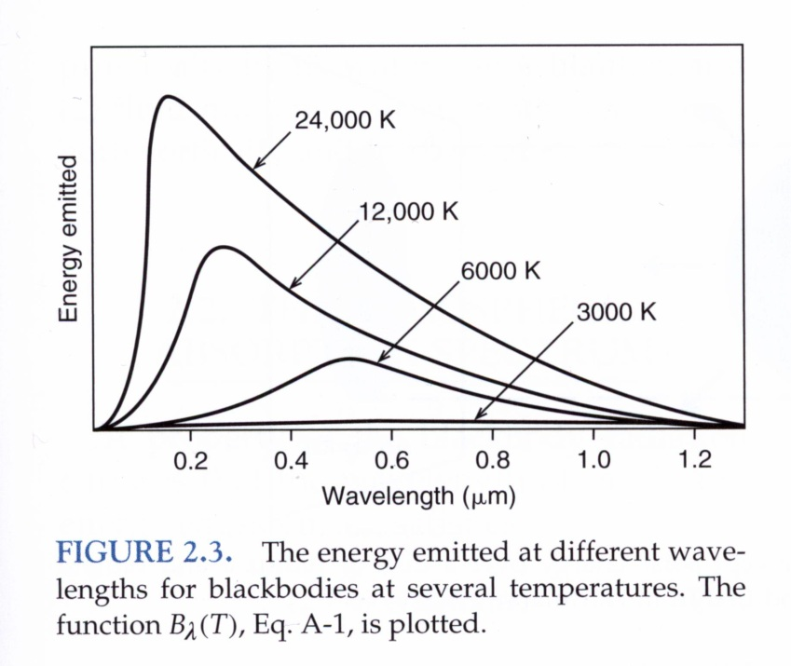
Radiation emitted by an incandescent material.
Incandescence is the emission of light (visible electromagnetic radiation) from a hot body as a result of its temperature.
Planck or blackbody spectrum: wavelength at which the intensity of radiation is a max, and the flux of emitted radiation, depend only on the temperature of the body. The hotter the radiating body, the more energy it emits at shorter wavelengths. If the observed radiation spectrum is fitted to the blackbody curve using T as a free parameter, then the blackbody temp of the sun is 6000 K.

Slide 38
Planck’s radiation curve – the Planck function
A blackbody absorbs 100% of incident radiation.
It therefore reflects no radiation and appears perfectly black.
Planck showed the power emitted by a blackbody per unit area, per unit solid angle, per unit wavelength, is given by
Figures 2.2 and 2.3 are plots of vs. wavelength for various
h is Planck’s constant, c is the speed of light, k is Boltzmann’s constant

Slide 39
Integrate over all wavelengths, obtain blackbody radiance
Stefan-Boltzmann constant

Slide 40
Albedo depends on the nature of the reflecting surface, large for clouds, light surfaces like deserts, and especially snow and ice.
Under present terrestrial conditions of cloudiness and snow and ice cover, on average a fraction α ∼ 0.3 of incoming

Slide 41
Solar radiation absorbed by Earth =
( 1 – α_{p}) S₀ π a² = 1.22 x 10¹⁷ W
In equilibrium, the total terrestrial flux radiated to space must balance the solar radiation absorbed by Earth
If the spinning Earth radiates in all directions like a black body of uniform temperature
T_{e} known as the effective planetary temperature
or the emission temperature of the Earth
The Stefan-Boltzman law gives
emitted radiation per unit area =

Slide 42
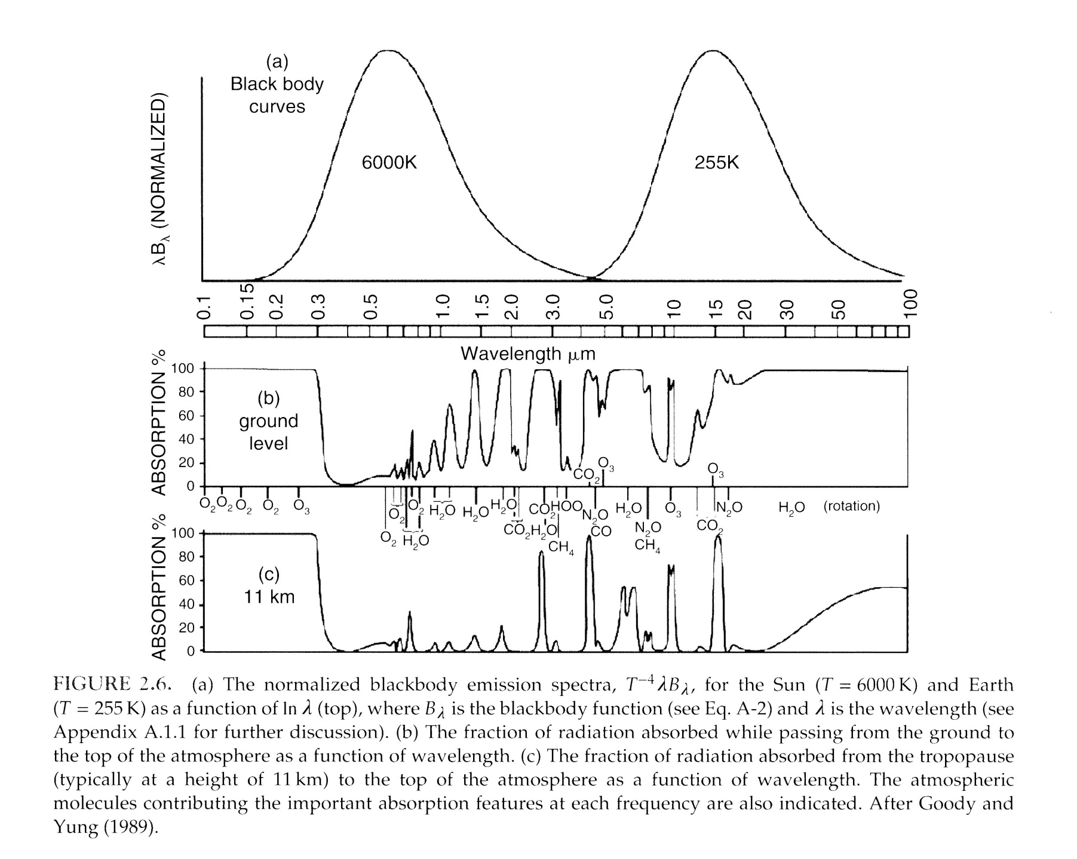

Slide 43
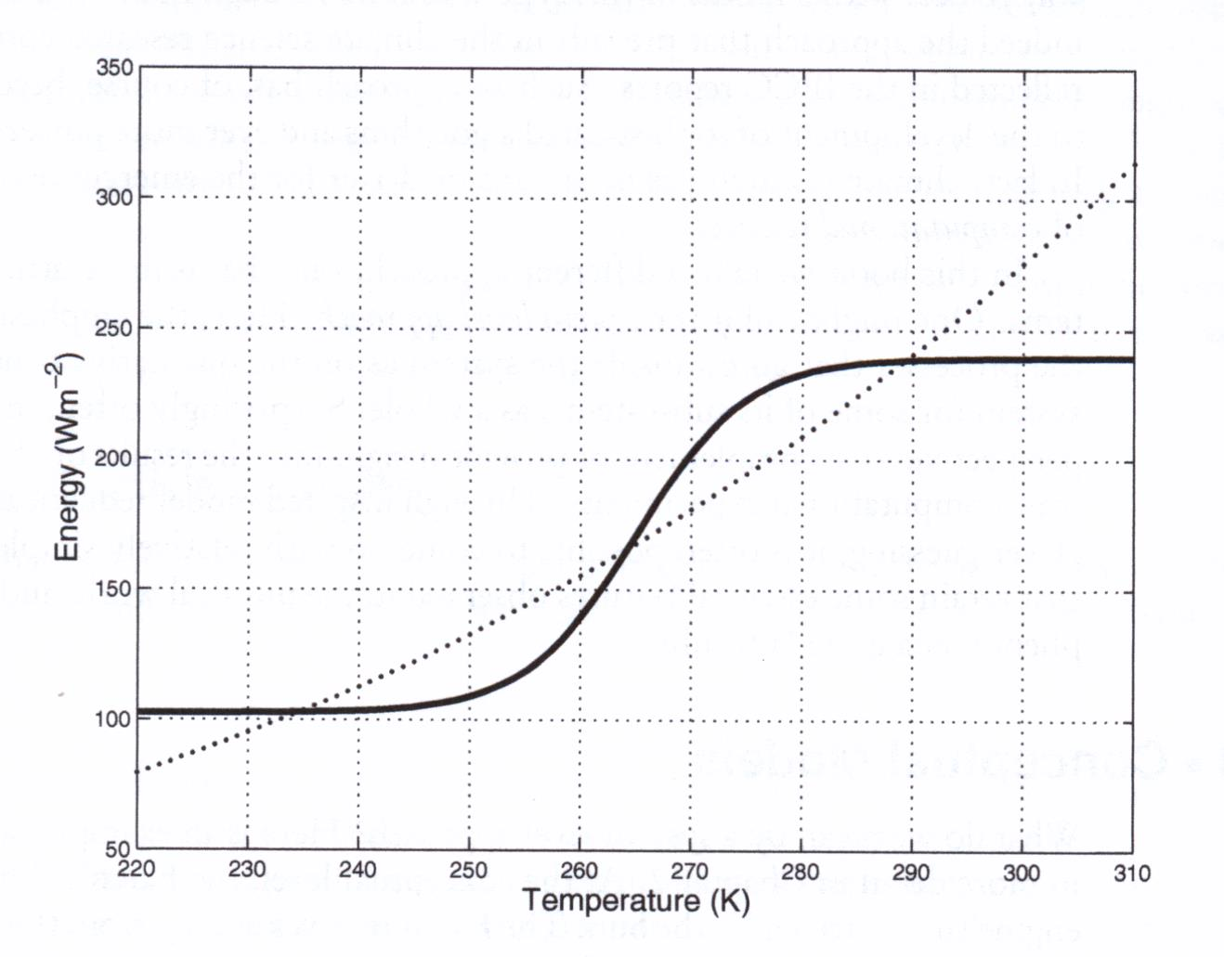
Energy balance model with multiple equilibria for Earth’s climate.
outgoing energy
incoming energy
Outgoing : increasing – a warmer planet radiates more energy.
Incoming : S – shaped from albedo of ice/snow vs. land/ocean.

Slide 44
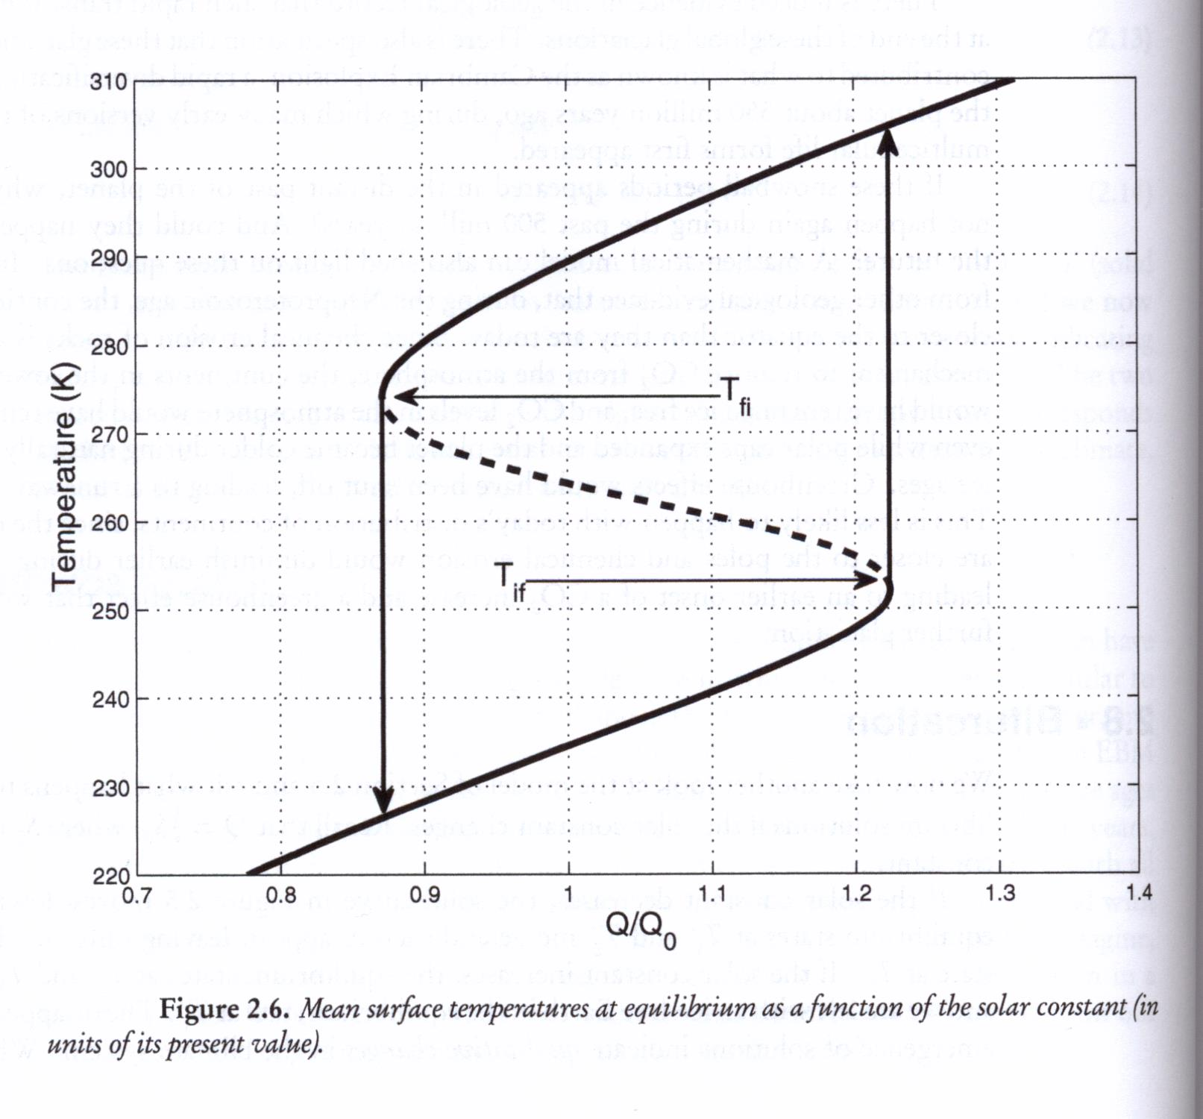
Bifurcation in surface temperature for forced system.

Slide 45
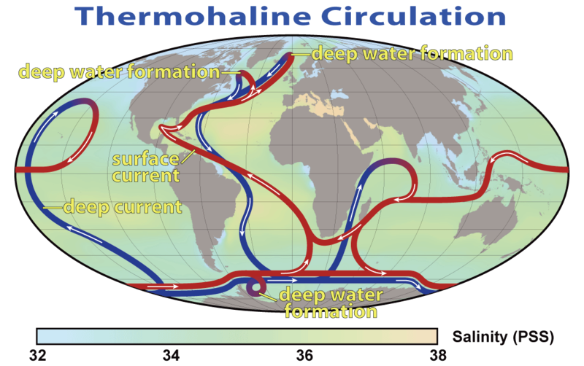
Global Thermohaline Conveyor Belt
brine expulsion from freezing sea water results
in sinking of dense, saltier water to great depths
melting sea ice inputs fresher water into the upper ocean
deep-water formation drives
circulation in the world’s oceans

Slide 46
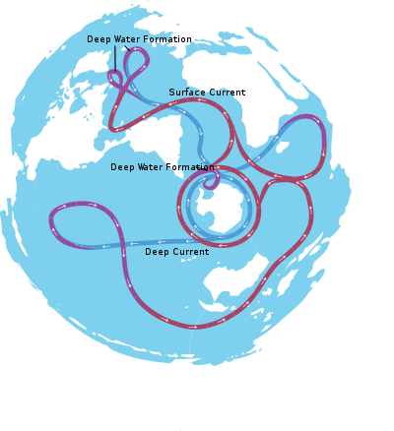

Slide 47
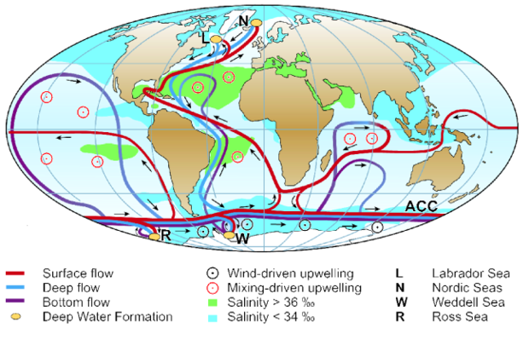

Slide 48
Ocean Circulation
Schematic of the ocean circulation (from Kuhlbrodt et al., 2007) associated with the global Meridional Overturning Circulation (MOC), with special focus on the Atlantic section of the flow (AMOC). The red curves in the Atlantic indicate the northward flow of water in the upper layers. The filled orange circles in the Nordic and Labrador Seas indicate regions where near-surface water cools and becomes denser, causing the water to sink to deeper layers of the Atlantic. This process is referred to as “water mass transformation,” or “deep water formation.” In this process heat is released to the atmosphere. The light blue curve denotes the southward flow of cold water at depth. At the southern end of the Atlantic, the AMOC connects with the Antarctic Circumpolar Current (ACC). Deep water formation sites in the high latitudes of the Southern Ocean are also indicated with filled orange circles. These contribute to the production of Antarctic Bottom Water (AABW), which flows northward near the bottom of the Atlantic (indicated by dark blue lines in the Atlantic). The circles with interior dots indicate regions where water upwells from deeper layers to the upper ocean (see Section 2 for more discussion on where upwelling occurs as part of the global MOC).

Slide 49
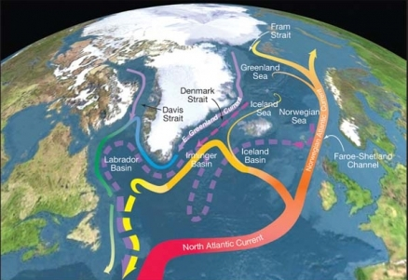
http://www.eoearth.org/view/article/156548/

Slide 50
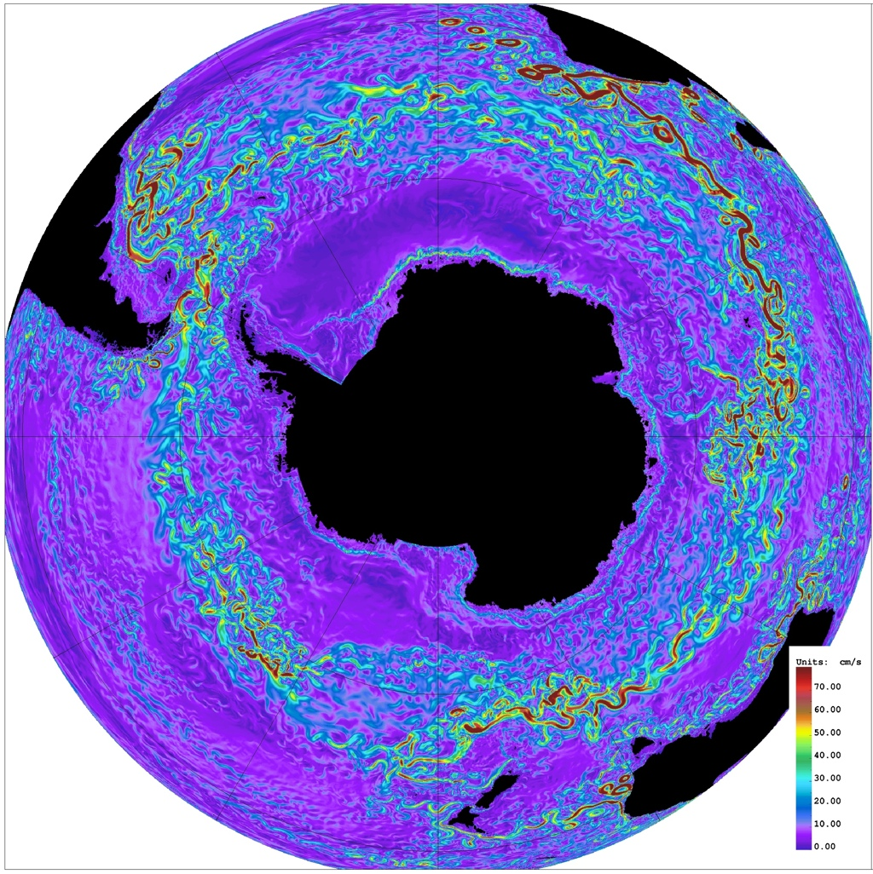
Andrew Thompson
Environmental Science & Engineering
Physical Oceanography at Caltech

Slide 51
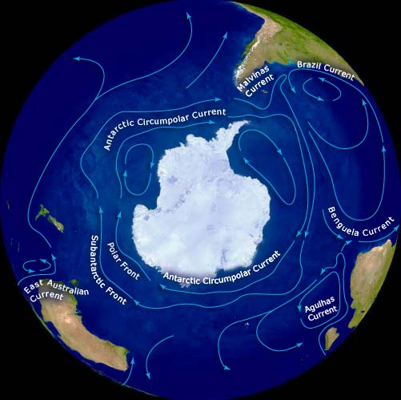

Slide 52
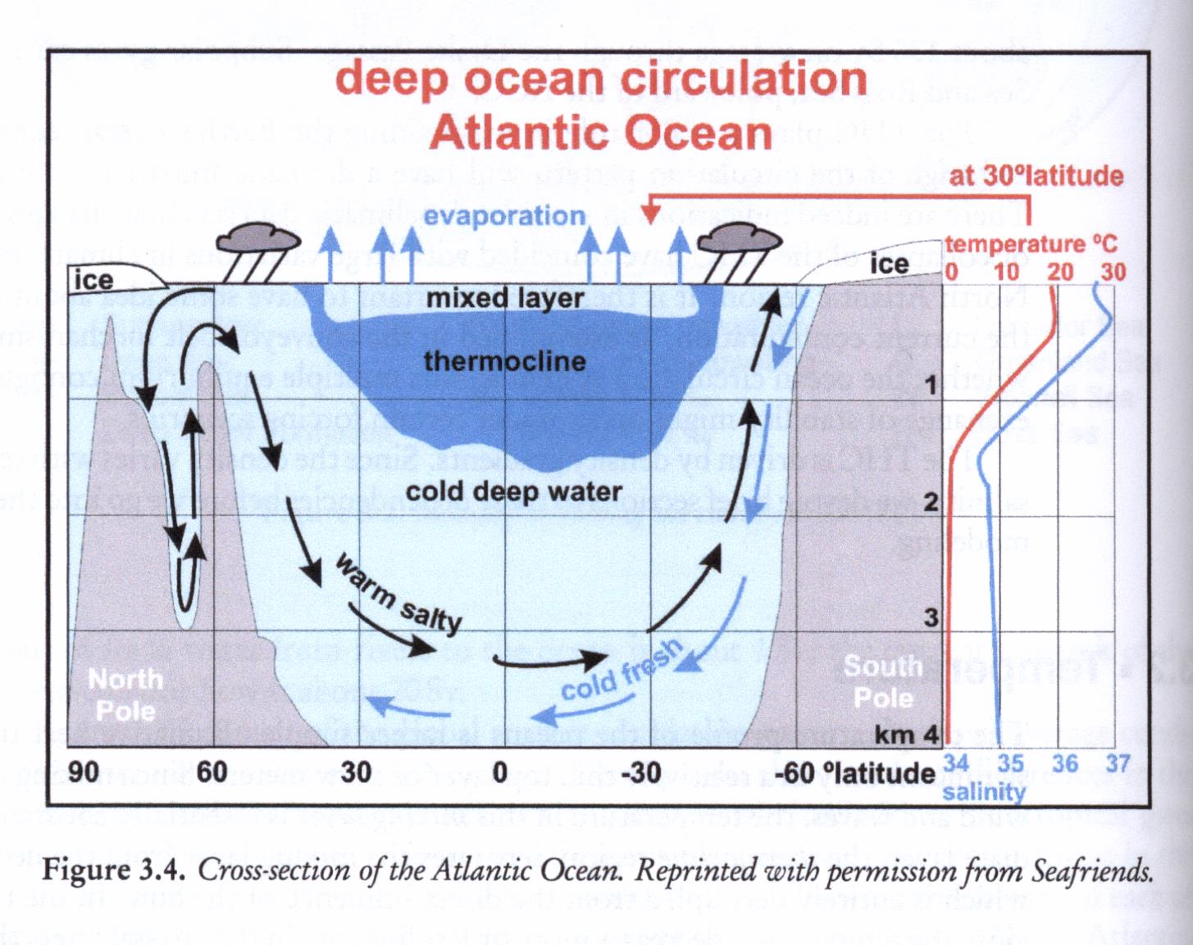

Slide 53
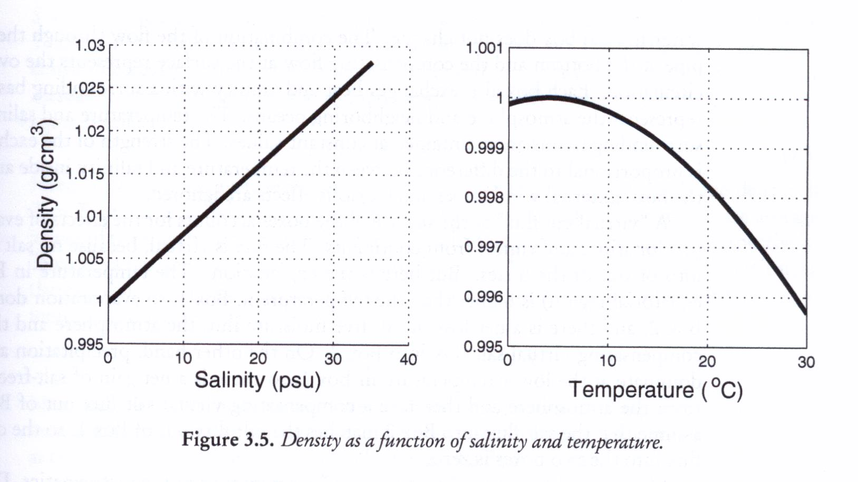

Slide 54
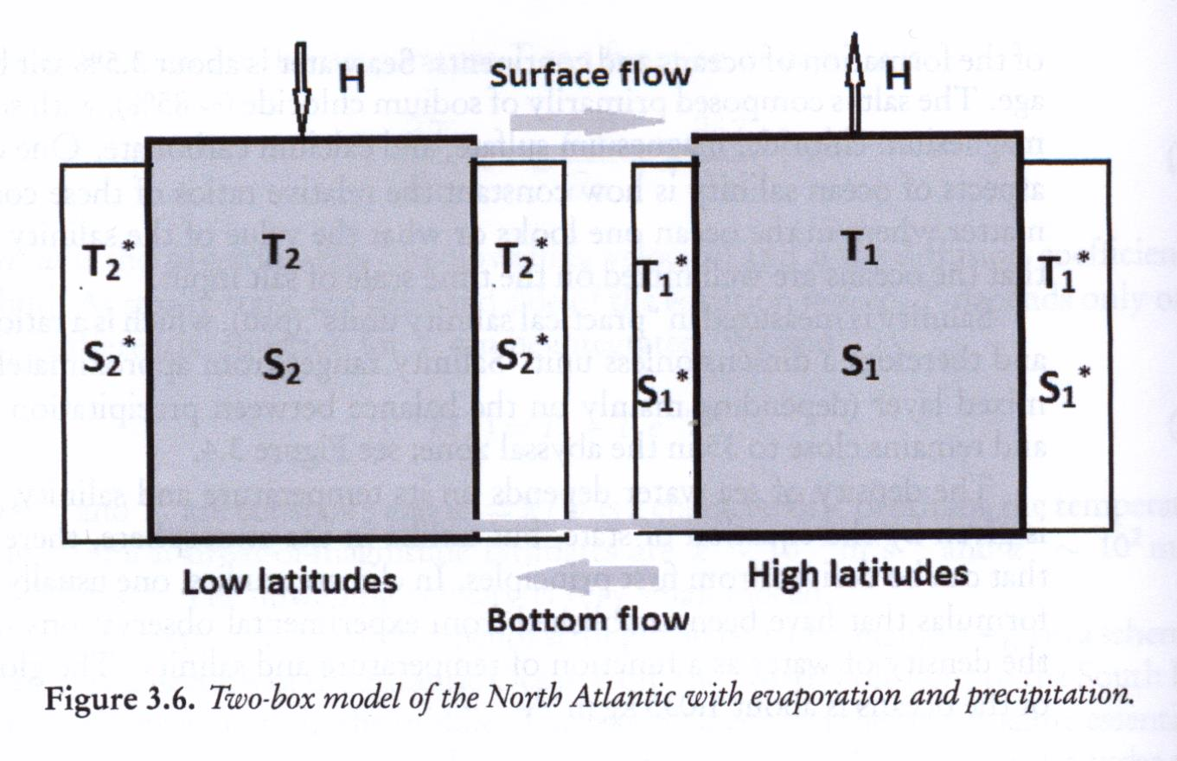
Oceanic Box Models

