Slide 1
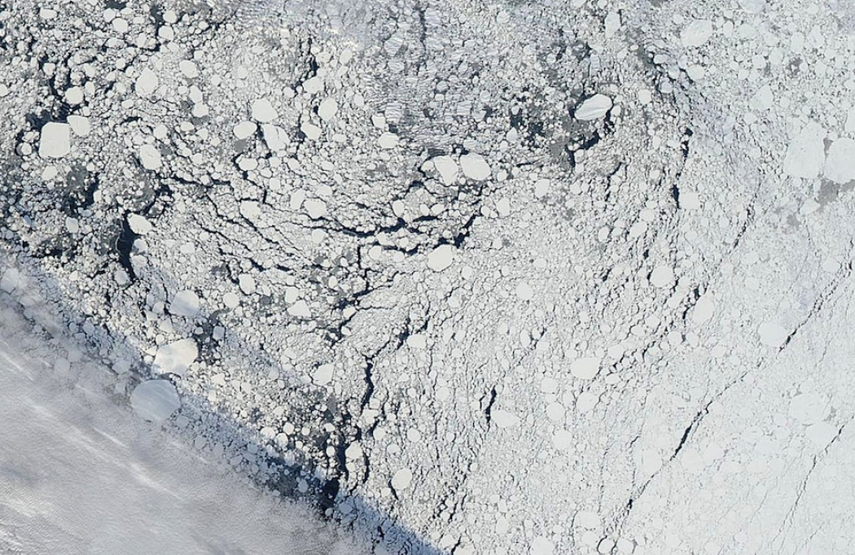
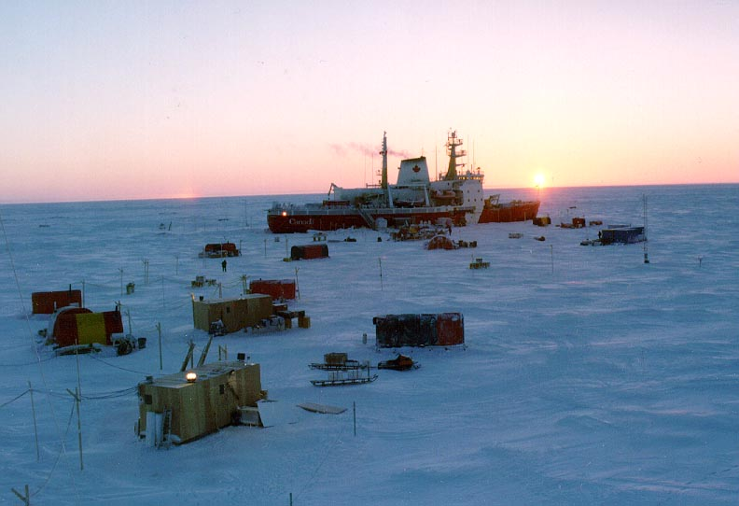
The Arctic sea ice cover
The frozen ocean at the top of the world
Vast areal extent
Thin veneer of sea ice only a few meters thick
Only a few months to a few years old
Floating, moving ice
Driven by winds and currents
Excellent reflector
An indicator and amplifier of climate change

Slide 2
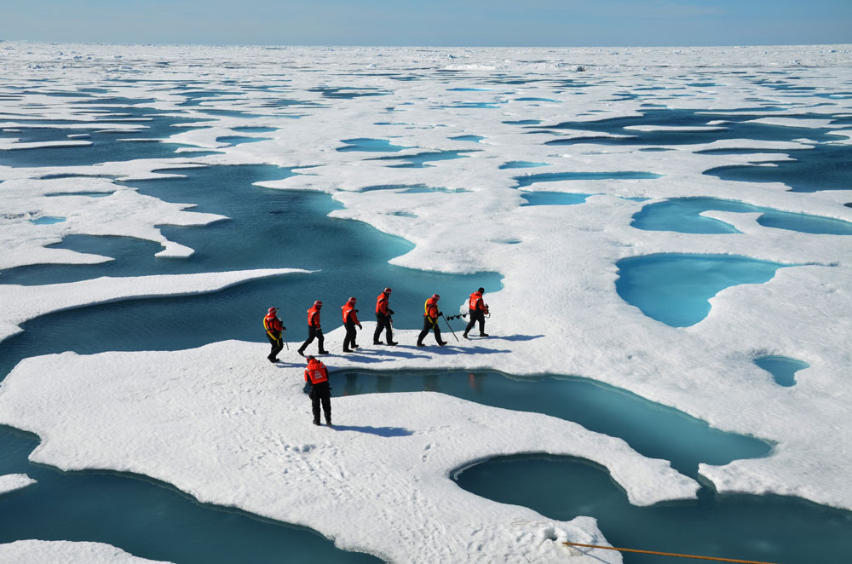
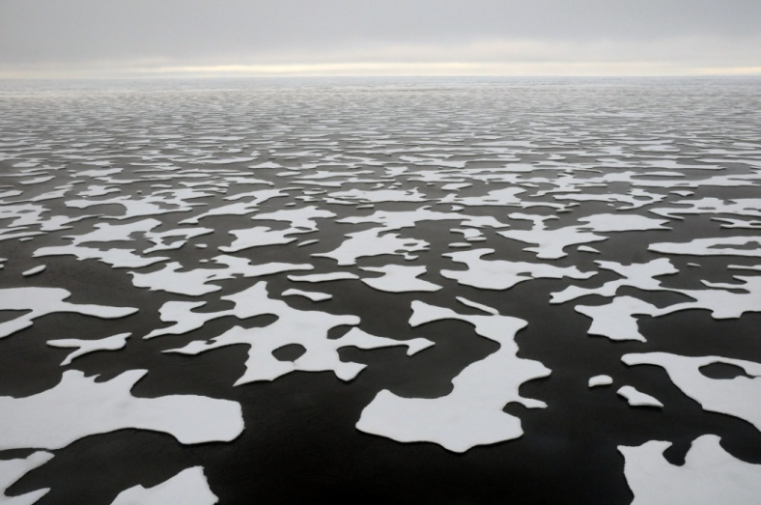
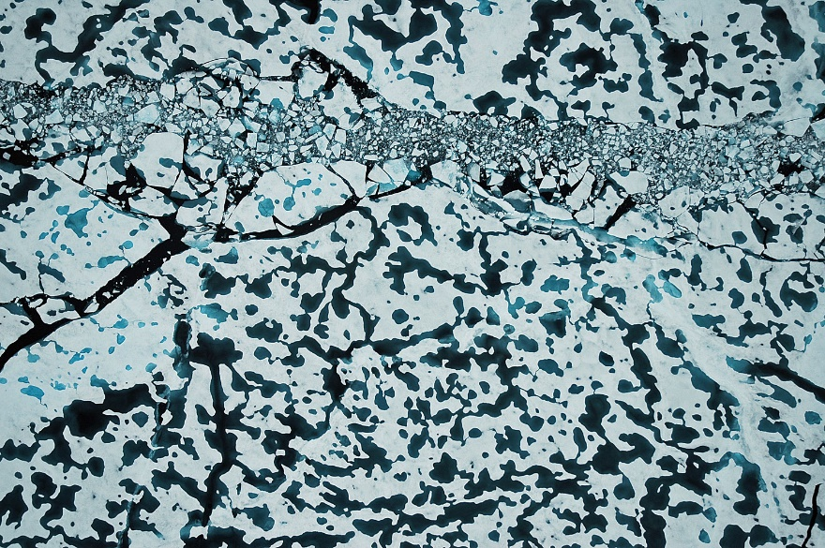
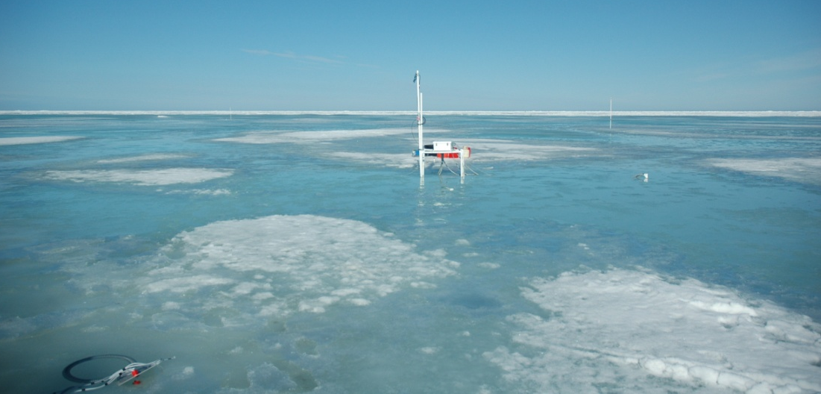
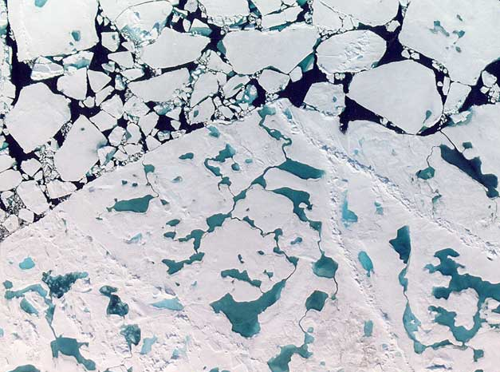
Arctic sea ice: A material near its melting point
An indicator of climate change

Slide 3
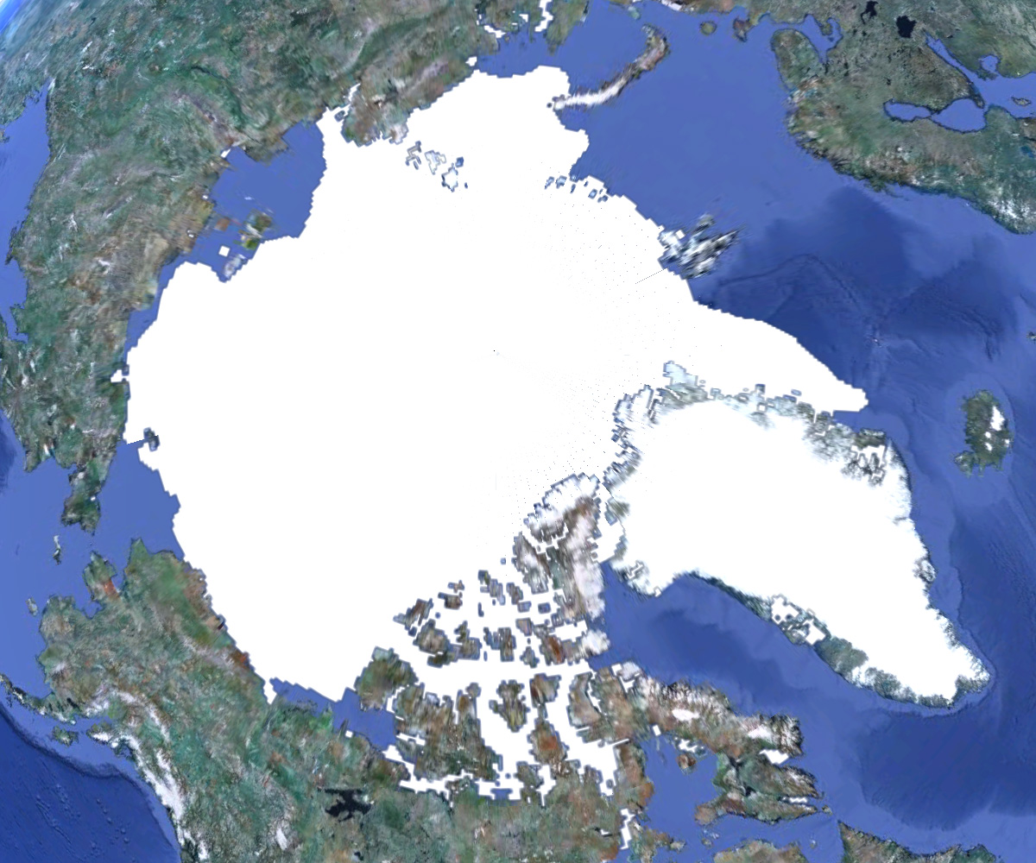
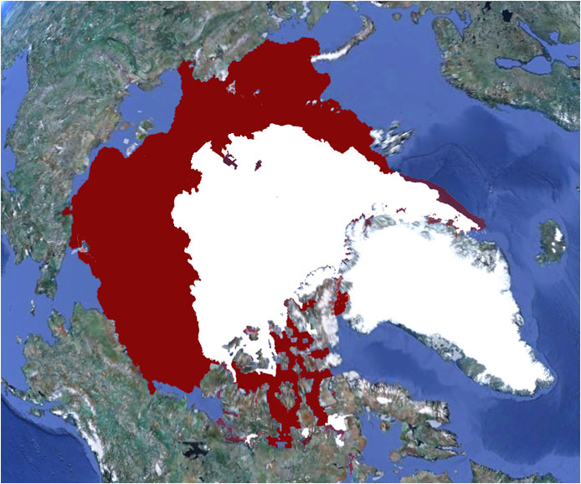
Sea ice extent – September
Sept 1980
Norway
The Arctic sea ice cover
Siberia
Greenland
Alaska
7.8 million km²
Sept 2012
3.4 million km²
Ice loss about 13% per decade

Slide 4
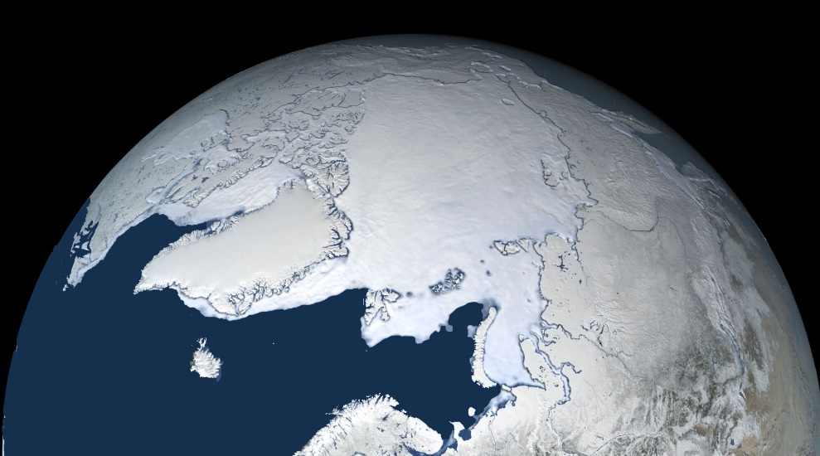
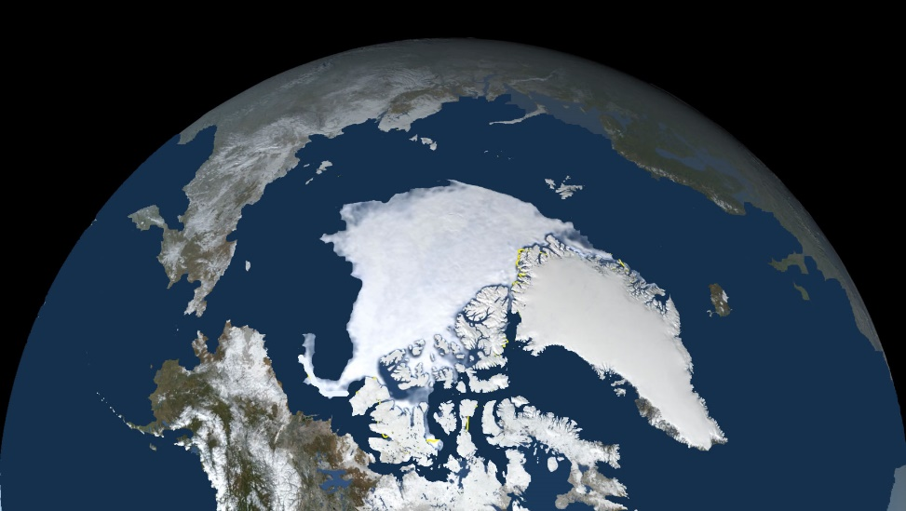
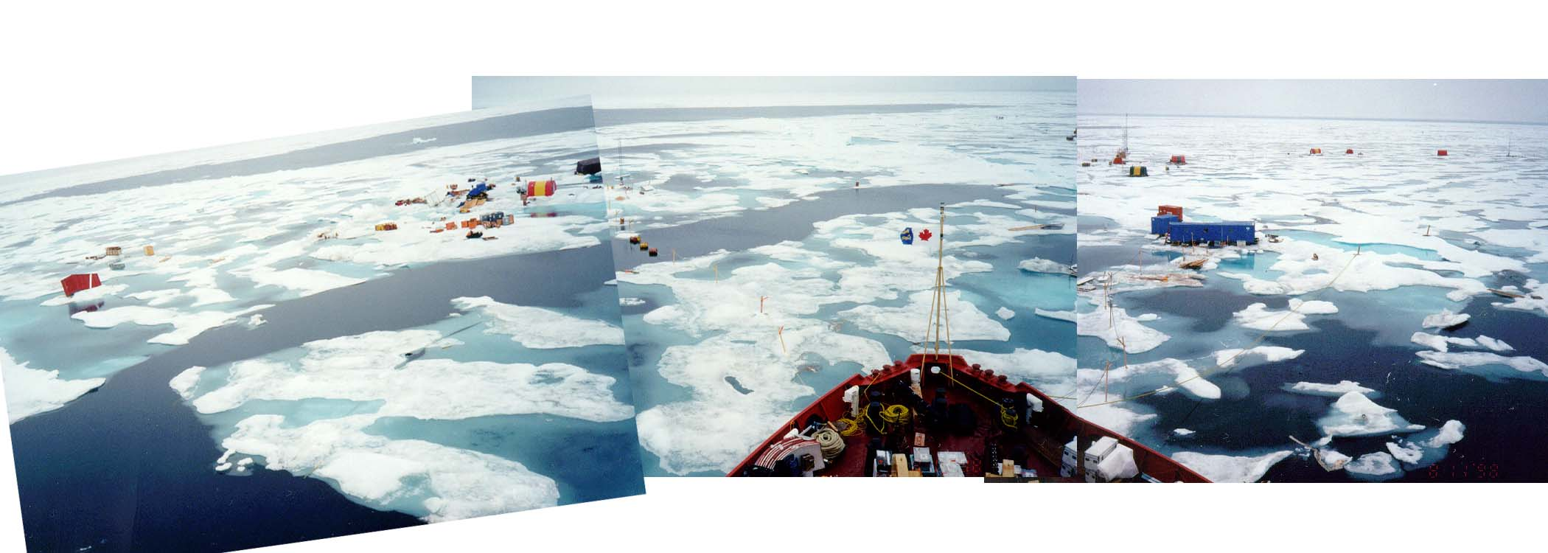
Ice Albedo Feedback: An amplifier of climate change
Spring
Summer
Melting decreases the albedo

Slide 5
Ice Albedo Feedback: An amplifier of climate change
Spring
Melting
+
+
Absorbed
sunlight
Summer
Lower albedo
+
A feedback that accelerates melting

Slide 6
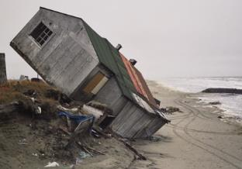
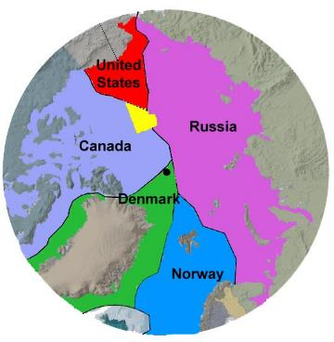
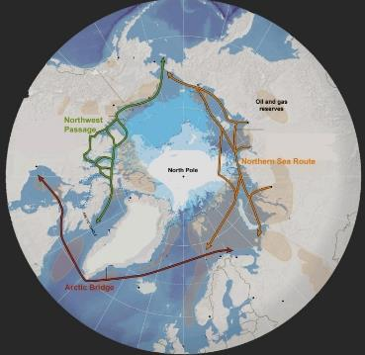
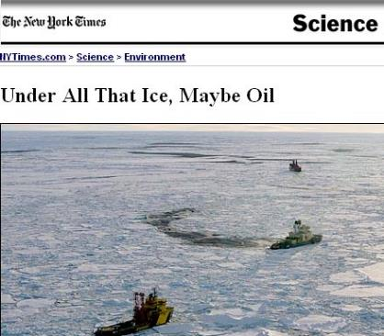
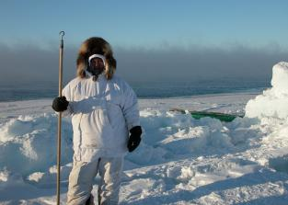
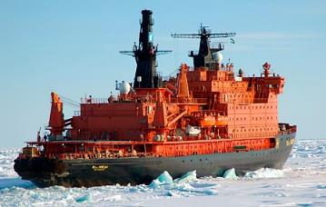
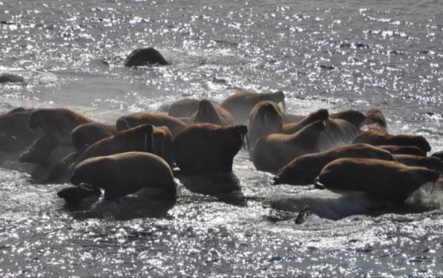
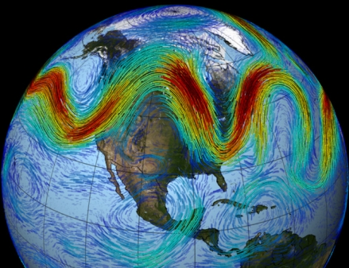
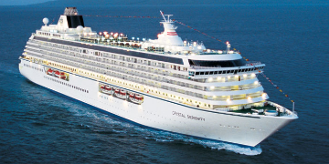
There are consequences today
Communities
Natural resources
Geopolitical
Shipping
Tourism
Ecosystems
Mid-latitude weather
Loss of sea ice is impacting systems and people – now!
Notes:
6

