Slide 1
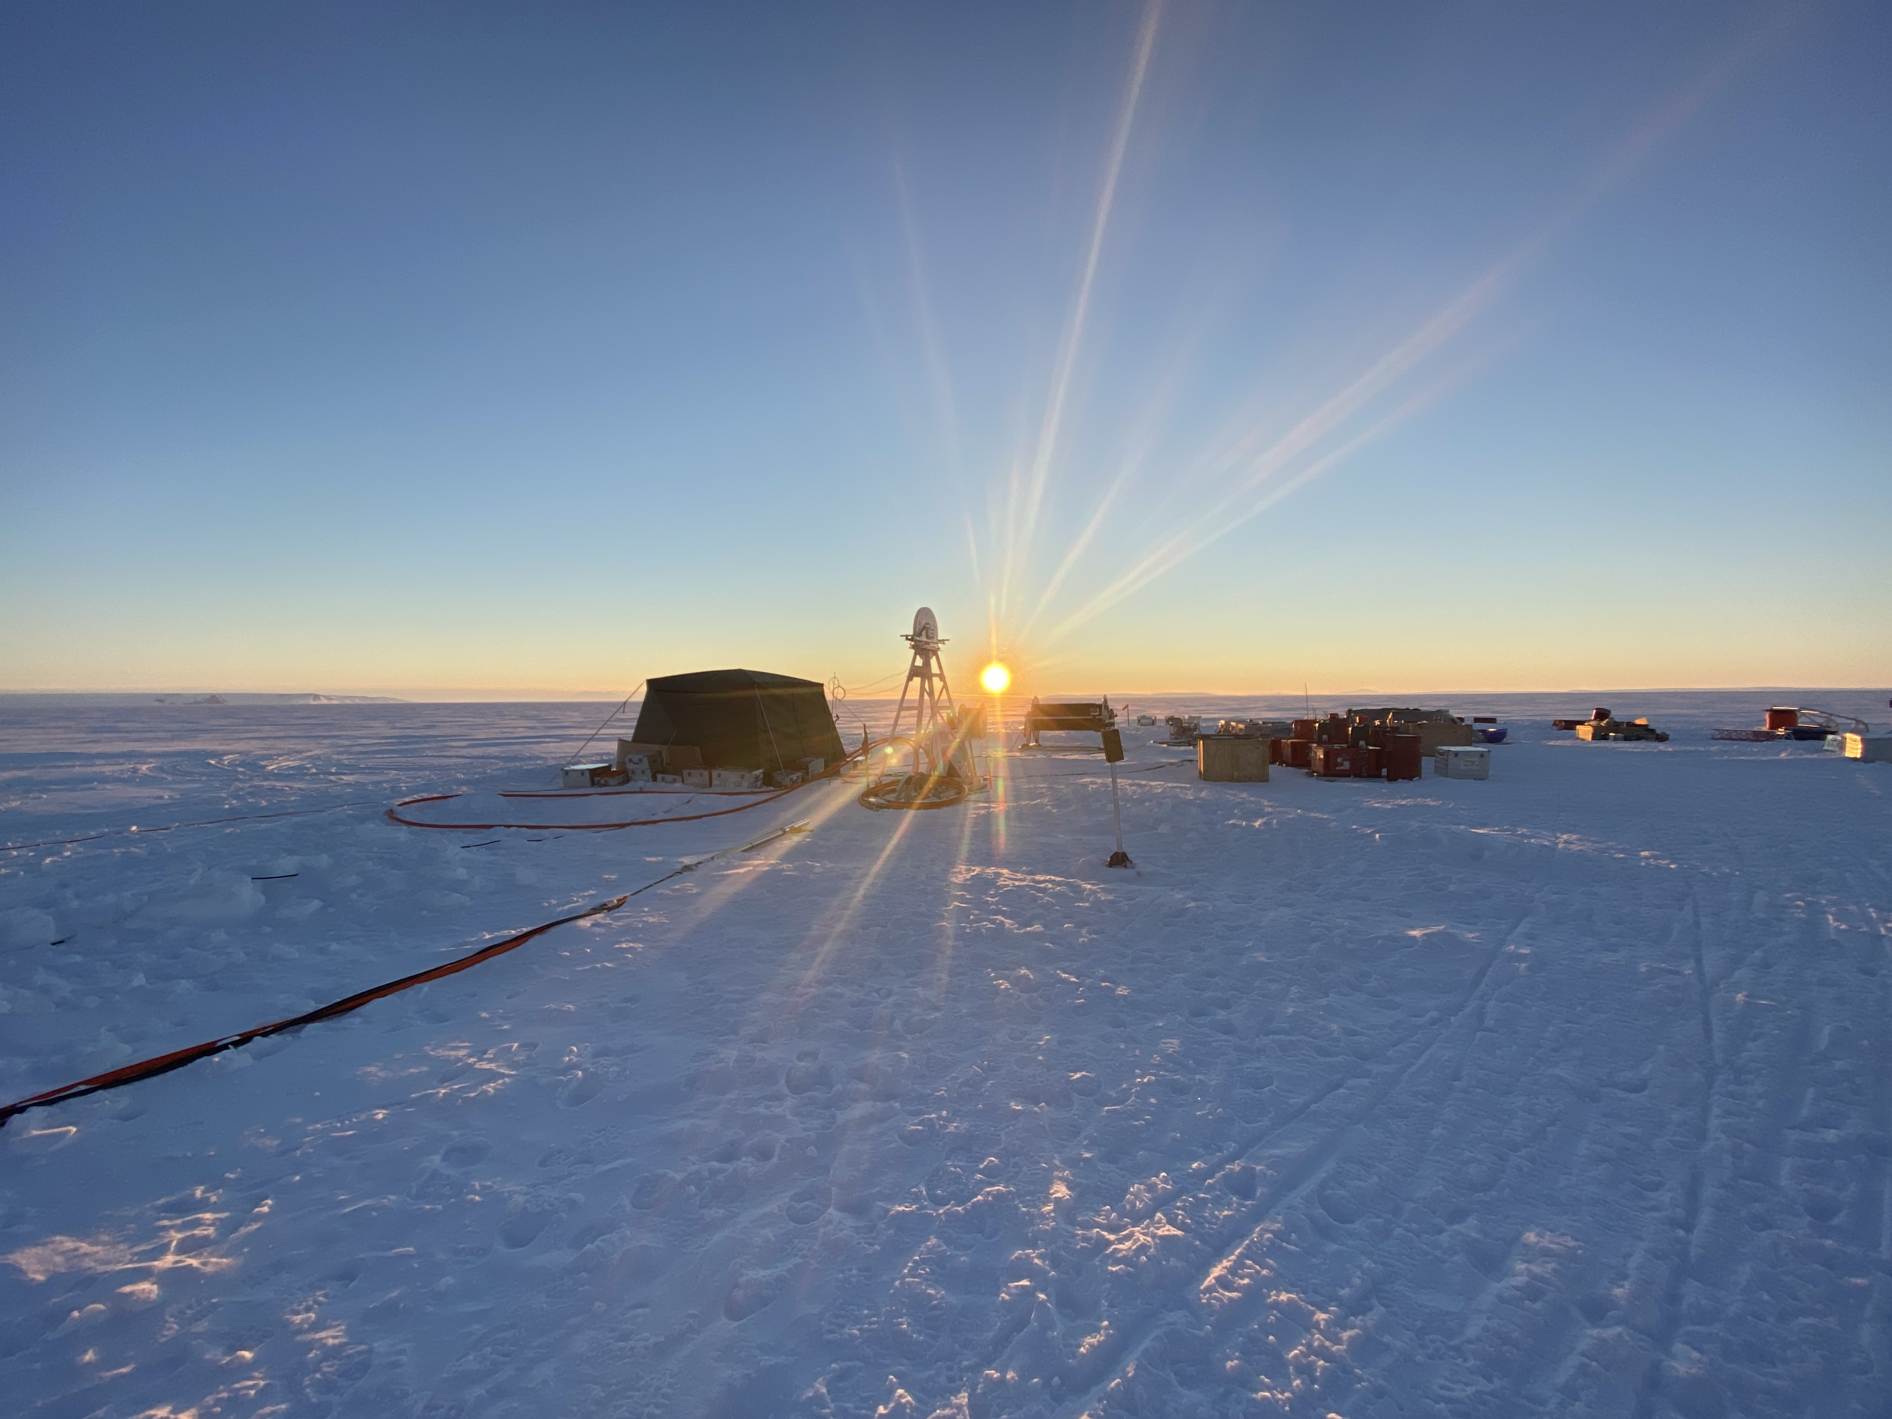
The Great Ice Sheets
are Melting in a Warming World
David Holland
May 2023

Slide 2
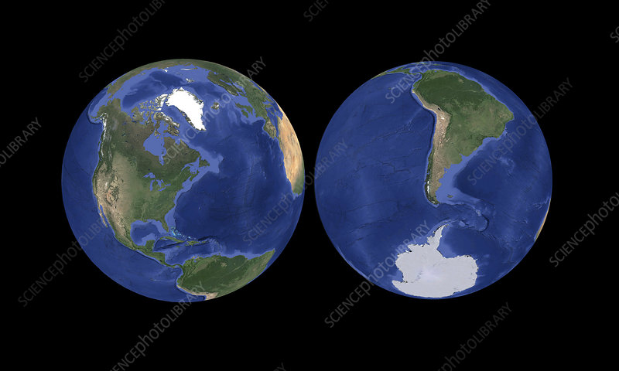
Notes:
What is an ice sheet? How does it form?
Today, we have Greenland and Antarctica.
Last ice age Canada covered

Slide 3
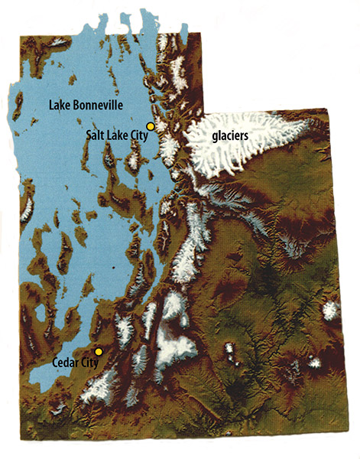
Notes:
Ice age climates are different from now
Cooler climate let to enormous lake Bonneville 18K yr ago

Slide 4
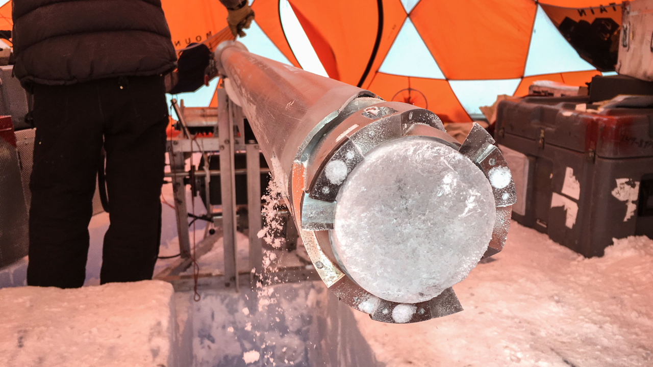
Notes:
- Temperature changes of 5 degrees c (10 fahrenheit) in a few years
https://www.science.org/content/article/record-shattering-27-million-year-old-ice-core-reveals-start-ice-ages
https://www.scientificamerican.com/article/ice-cores-from-greenland-unlock-ancient-climate-secret/

Slide 5
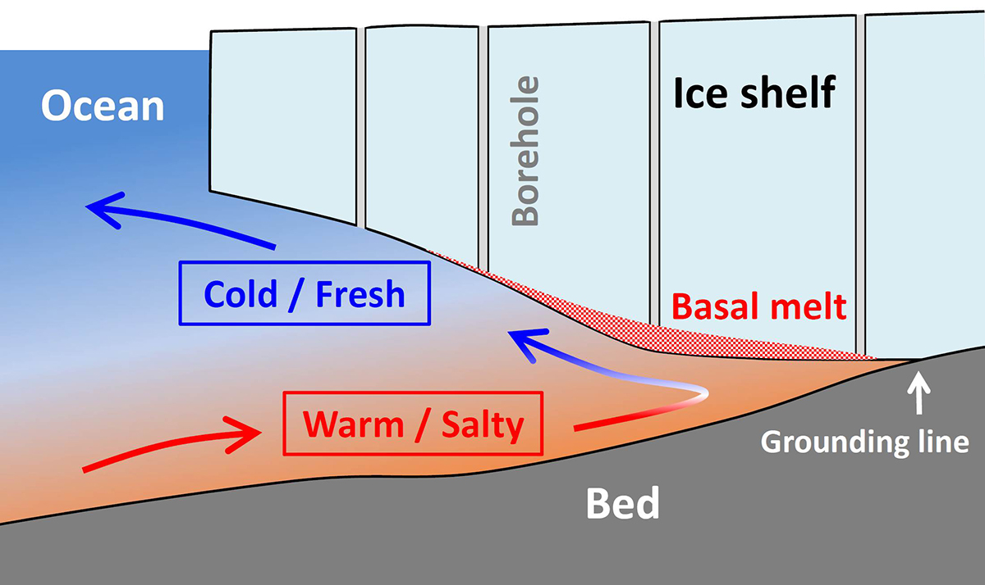
Notes:
My research regards rapid current change
Surprise discovery of carbon air wind ocean glacier sea level
Now happening west Greenland and west antartica
- https://www.openaccessgovernment.org/mass-loss-of-the-antarctic-ice-sheet-driven-by-ice-ocean-interaction/94998/

Slide 6
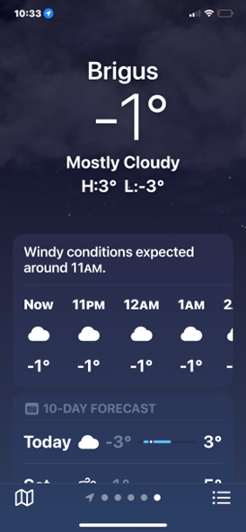
Notes:
Ice is ultimate arbitrator of climate and life on earth
Our research goal is to create a global ice forecast app
More challenging than our existing weather app
Intersection of observing planet and math modeling

