Slide 1
Wilkes Climate Summit: Polar Climate ad Ecosystems Panel
Jody W. Deming
Karl M. Banse Professor
School of Oceanography
UW Astrobiology Program
University of Washington
Seattle, WA 98195
Wilkes Climate Summit, May 16–17, 2023
Wilkes Center for Climate Science and Policy
University of Utah, Salt Lake City, UT
Notes:
Thank you, Ken, for the invitation to serve on this exceptional panel today

Slide 2
Opening comments
Golden et al., 2020
Microscale habitats within sea ice
Gas exchange between sea ice and atmosphere
Mass production of ice-algal biomass in support of the larger ecosystem
Ecosystem implications of climate-driven thinner ice and snow cover, delayed ice formation, and earlier melting
Notes:
In the next few minutes I will touch upon these topics, spannng from the microscale in sea ice to the ocean scale

Slide 3
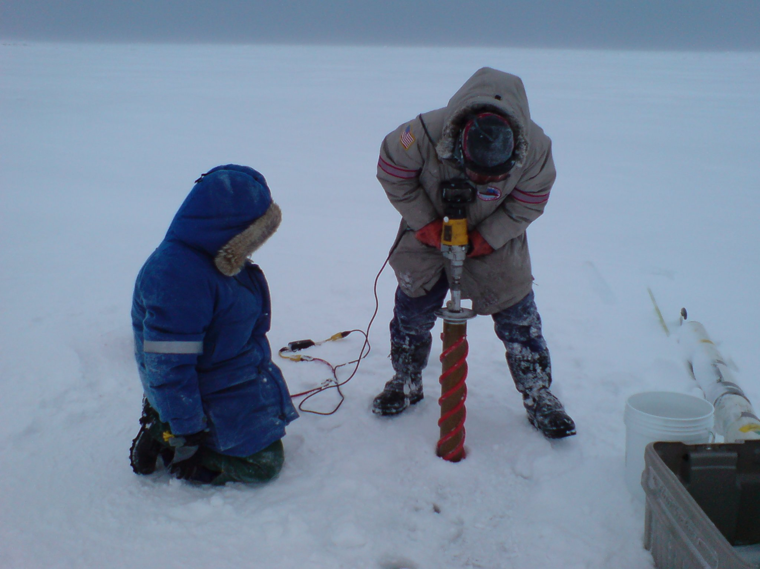
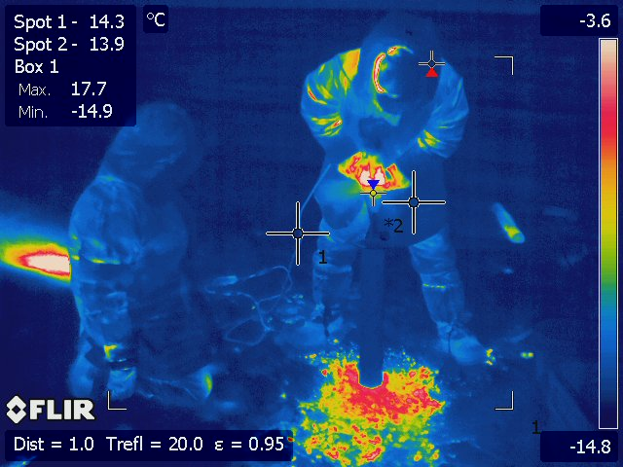
Coring winter sea ice off Utqiagvik, AK (Feb 2010)
Jesse Colangelo-Lillis
Marcela Ewert
Photo by J. Deming, 11 Feb 2010
Infra-red camera
Notes:
My own interests in sea ice began from an astrobiological perspective, which meant seeking the coldest winter sea ice. Here, student Jesse is drilling into what feels like cement. With an IR camera, you can see the temperature setting – Jesse working hard, the generator helping him to drill, and the warmer shaved bits of ice during the coring process.

Slide 4
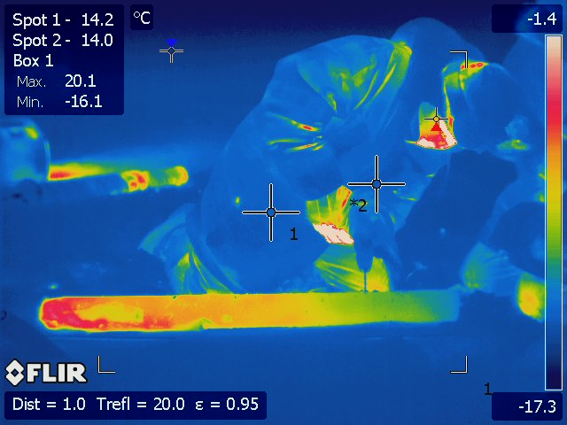
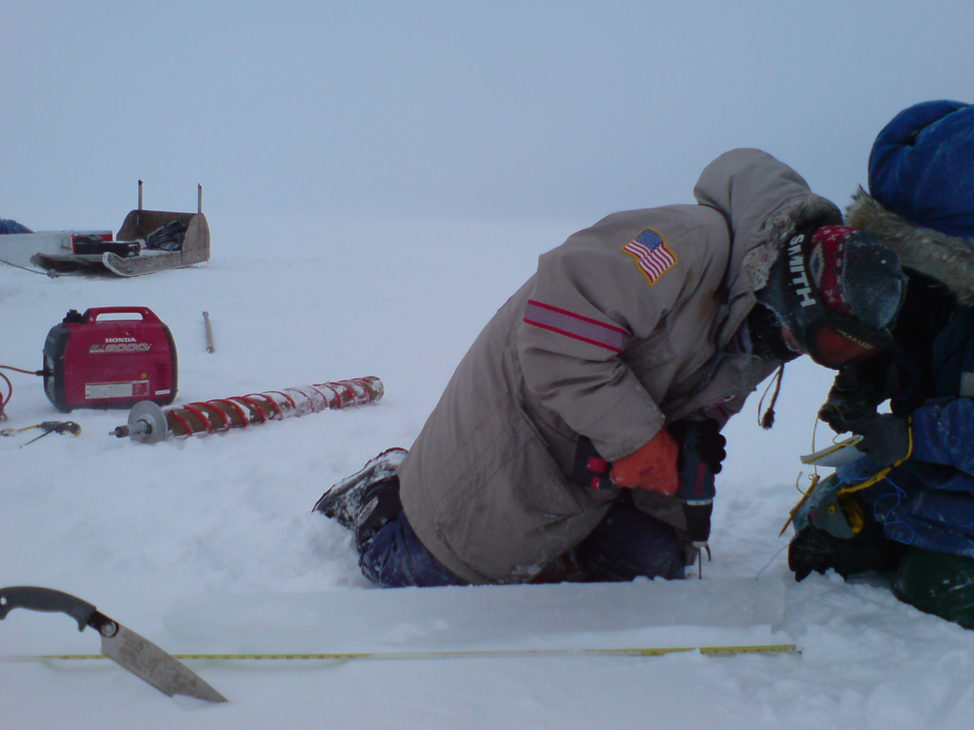
Notes:
Here Jesse is using a thermoprobe to measure temperature in the extracted core. But the IR snapshot immediately shows youithe temperature gradient across the ice, from near the the cold atmosphere to the warmer interface with the ocean below -- a natural laboratory for exploring life across an extreme gradient. And every bit of Earth’s sea ice is inhabited. How is that possible?

Slide 5
On the small scale:
temperature determines sea ice microstructure
brine-concentrating effect
36 ppt
220 ppt
30 mm
–1.5°C
21% liquid
–2.4°C
17%
–30°C
2%
Adapted from Eicken et al., 1999
Notes:
Life as we know it requires liquid water. If you consider a 30-millimeter cross section of sea ice at a warm temperature, you find that a good percentage of it is liquid -- a virtual water-world for micrometer-sized microbes. As the ice gets colder, the inhabitable space shrinks, until an extreme winter temperature when pore space is minimal. Not only is the temperature extreme but so is the salt concentration, as sea salts concentrate in the pore spaces as they shrink. Regardless, these pores contain living microbes.
Ikaite begins to precipitate at –2.2°C

Slide 6
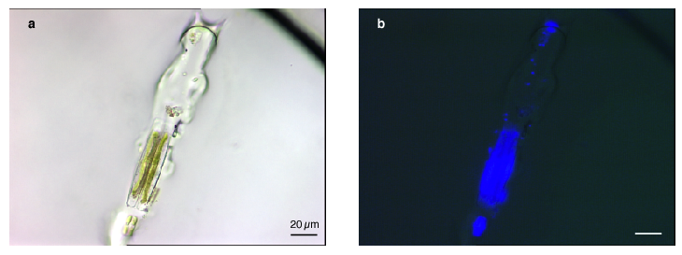
Transmitted light
No stain
Epifluorescent light
Stained for DNA
bacteria
diatoms
–15°C
Junge et al., 2001 Annals Glaciol
Notes:
We know this because we have developed microscopic techniques to peer into unmelted sea ice, to witness the microbes in their unaltered habitats -- ice algae or diatoms visible due to their green chloroplasts for photosynthesis, and the smaller but more numerous bacteria that do the work of recycling nutrients and gases for the ecosystem.

Slide 7
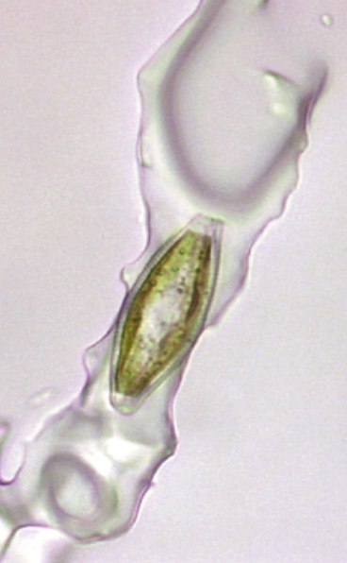
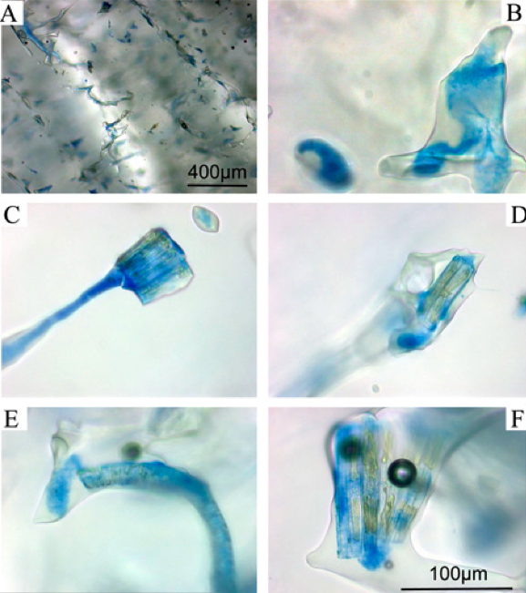
No stain Stained for Exopolymers
anti-freeze
–10°C
Krembs et al., 2011 PNAS
Notes:
Sea ice microbes produce goopy exopolymers, visible on the left without staining, visible in every pore on the right with staining. These exopolymers function as antifreeze, protecting the microbes against their extreme conditions and also literally altering the physics of their inhabitable space to their benefit.

Slide 8
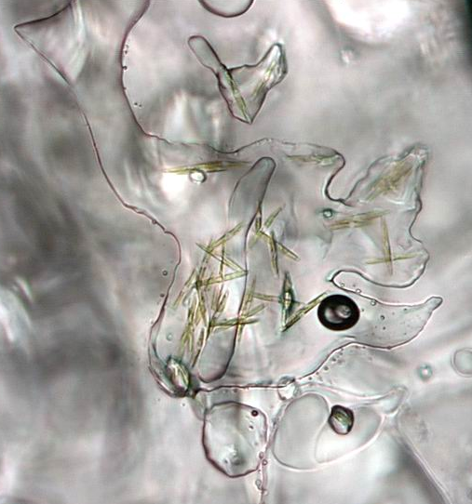
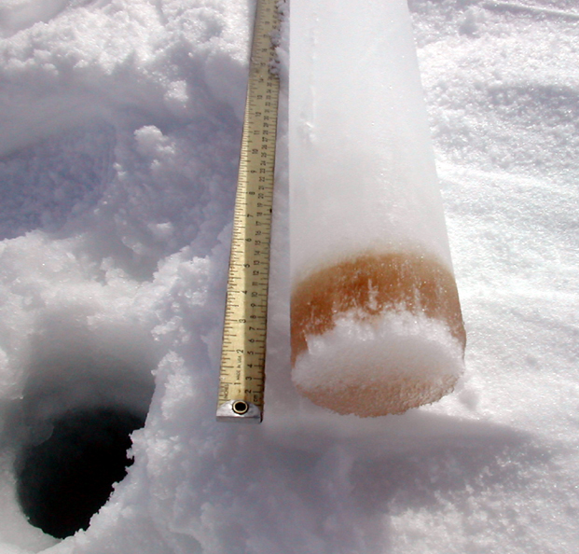
Ice-algal bloom
(visible brown band)
in bottom sea ice
Pennate diatoms ~100 μm
long in a brine pocket
in sea ice
Notes:
Sea ice algae can be so dense, many thousands on the centimeter scale, as to be visible to the naked eye as a dark band in the ice.

Slide 9
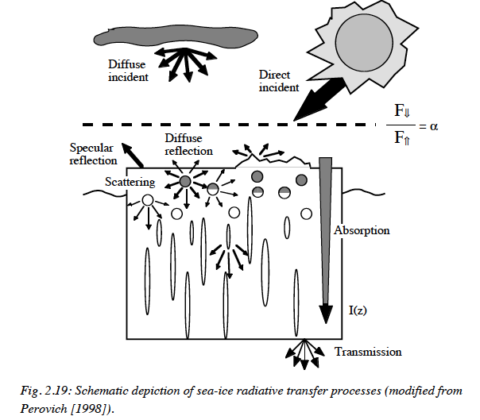
Shade-adapted algae
Bloom
Notes:
Microalgae typically live at the bottom of the ice to access seawater nutrients, but there the light for photosynthesis is limited due to the reflection and scattering of light by snow and ice. They have adapted to this condition – they are shade-adapted. Yet, when conditions allow for light to penetrate more directly through the ice, then they ramp up their photosynthetic machinery and bloom.

Slide 10
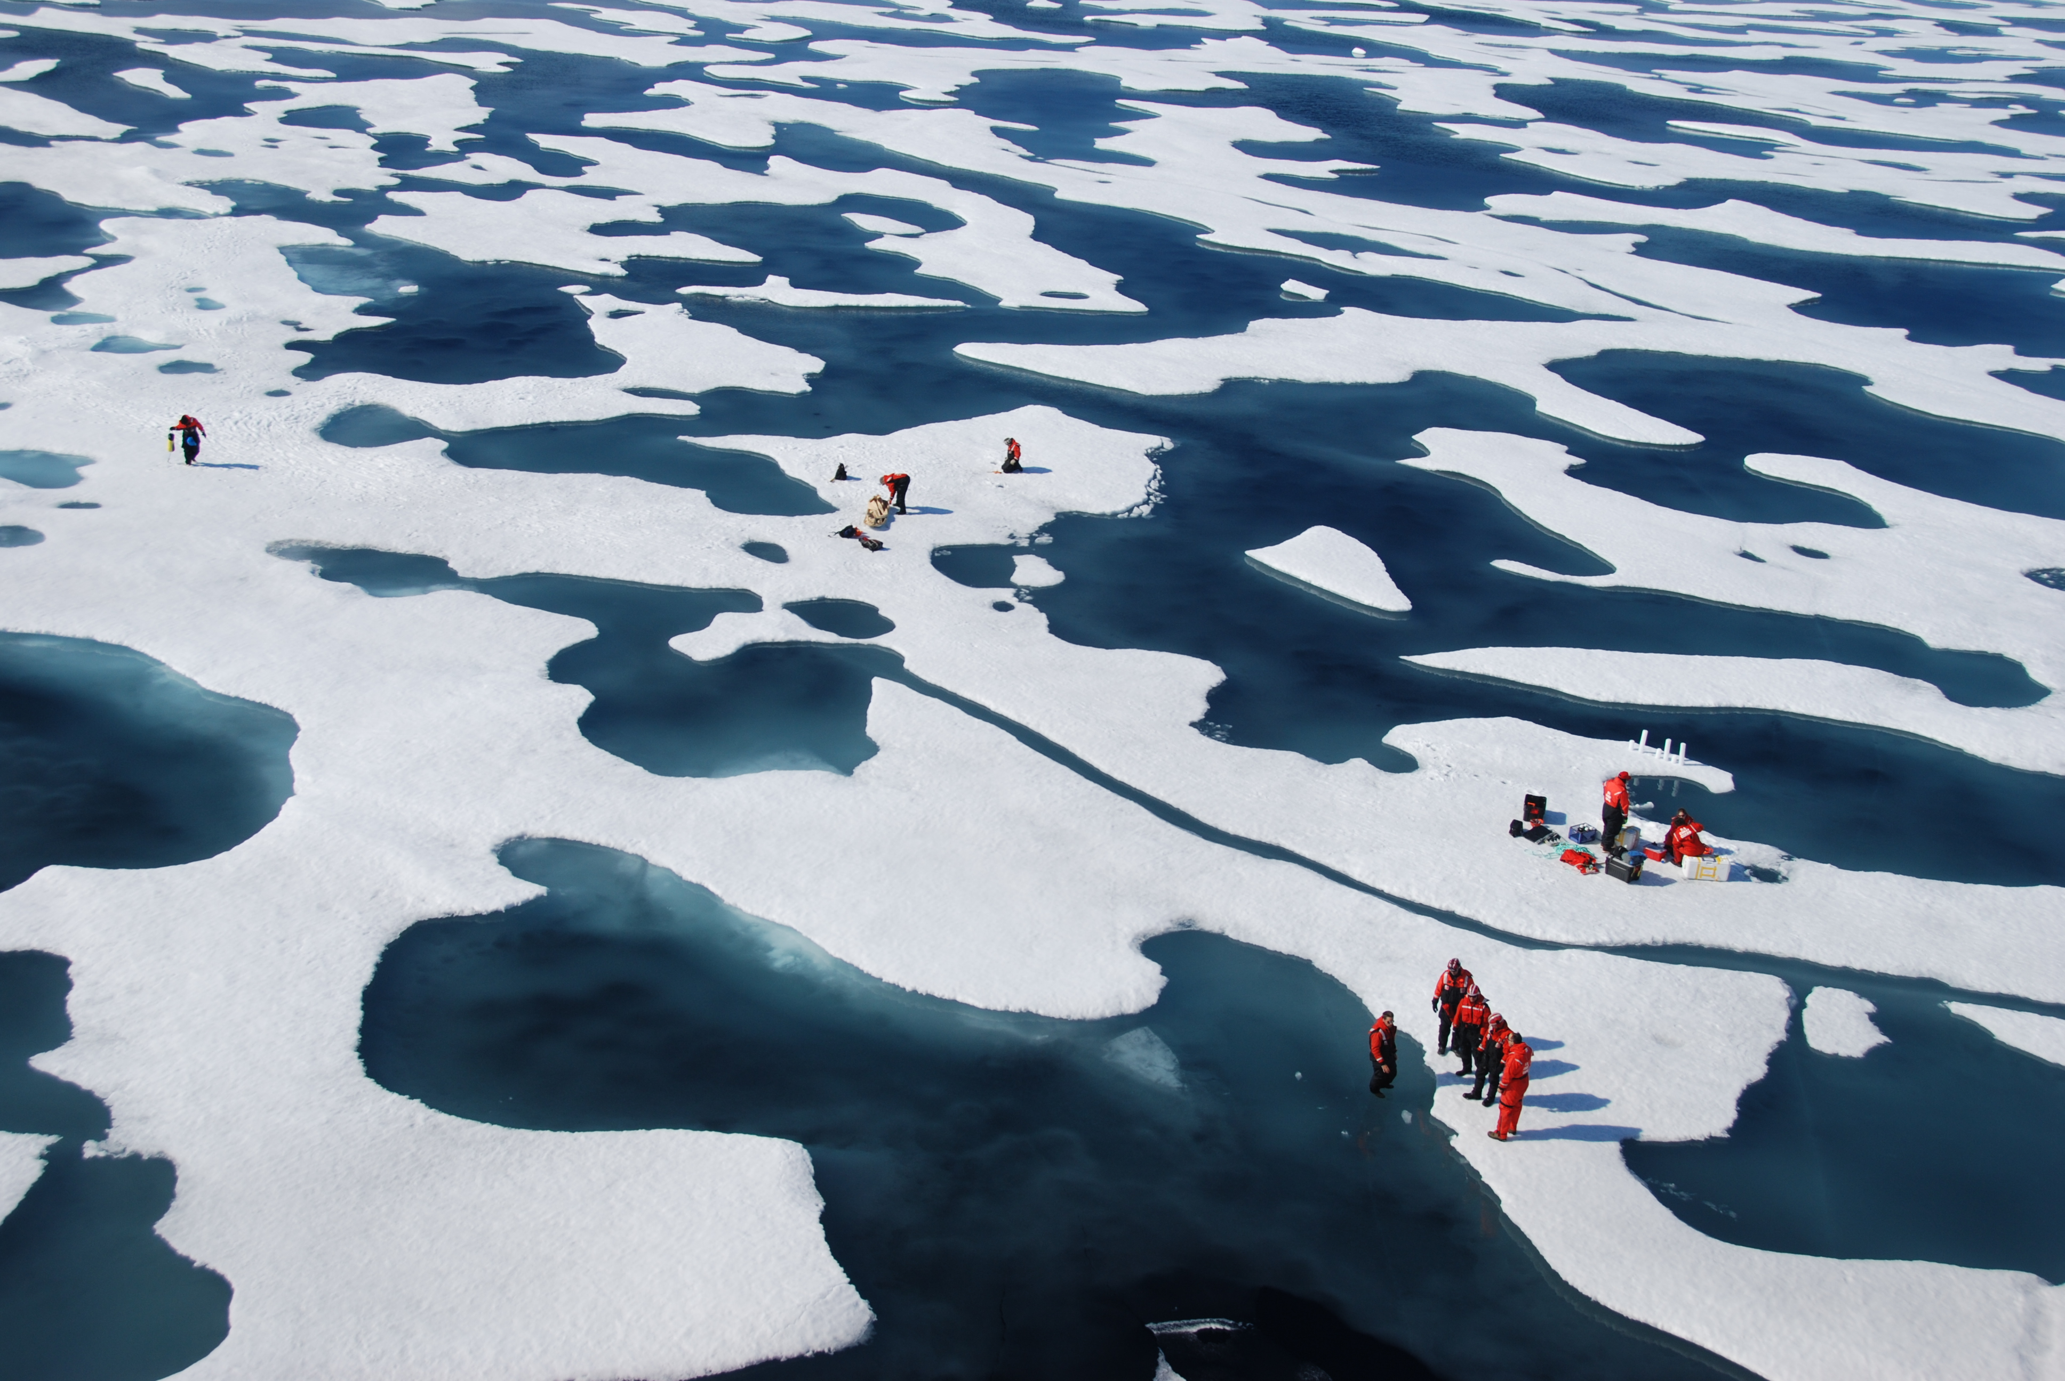
(Photo from B. Light, APL)
Notes:
Such conditions occur when snow melts on the surface of the ice. And such melt ponds are increasing in the Arctic with climate change.

Slide 11
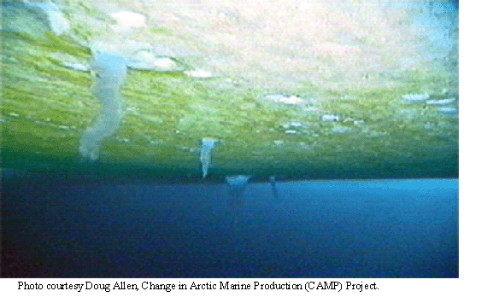
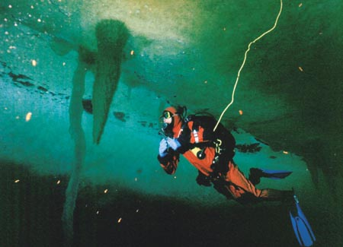
On the meter–kilometer scale: massive production
Notes:
So we can find massive blooms of ice algae during springtime when both light and nutrients are optimal. Unlike open water blooms, these under-ice blooms can’t be seen by satellites for a larger scale view. We are slowly gaining one through the use of under-ice remotely controlled vehicles, gliders and floats.

Slide 12
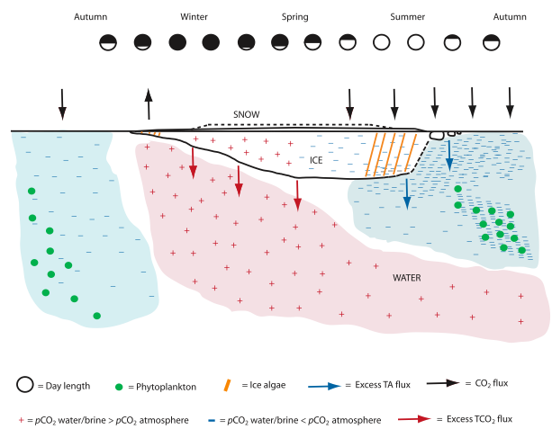
Winter efflux of CO₂
CO₂ sink
ICE
ALGAE
PHYTOPLANKTON
PHYTOPLANKTON
Rysgaard et al., 2011
Notes:
What is clear is their seasonal occurrence and contribution to the drawdown of CO2 as they photosynthesize and convert gas to organic matter. The Arctic has been consdiered a carbon sink but recent work at the microscale has revealed an abiotic process that produces CO2, making sea ice a potential source of CO2 in the wintertime.
Rysgaard et al., 2011

Slide 13
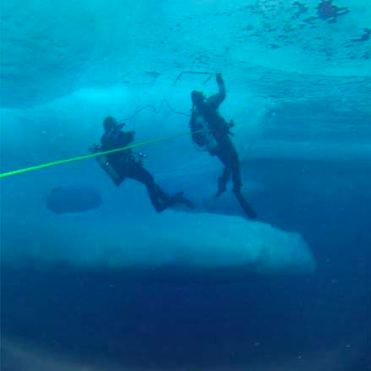
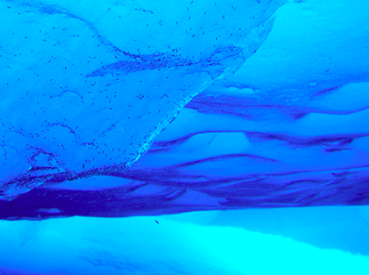
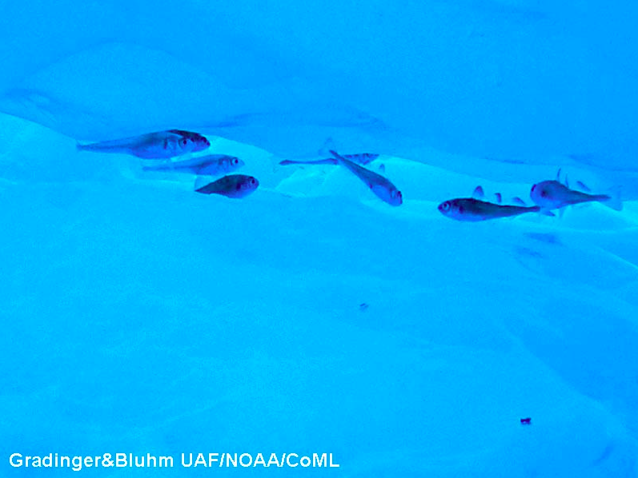
Algal food for under-ice fauna
Refuge from predators
Notes:
What is also clear is that ice algae provide food for under-ice fauna, and the sculpted bottom of the ice provides shelter from predators for the crustaceans and juvenile fish that feed on them.

Slide 14
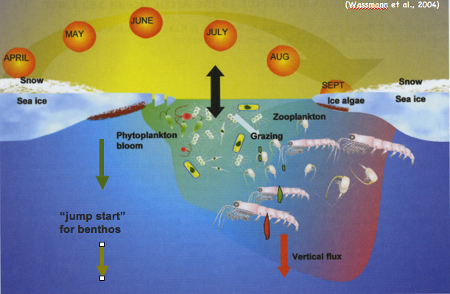
Early season support for a whole ecosystem
(adapted from Wassmann et al., 2004)
Ice algae
Currently all
tightly coupled
Polar bear
Seal
Fish
Narwal
Notes:
Indeed ice algae help support the entire Arctic ecosystem. Because they bloom before open water is prevalent, and slough from the ice to the seafloor, they jumpstart the benthos, as well as fauna under the ice. Currently, the entire system is closely coupled in time, but as sea-ice forms later and melts earlier, things get thrown off. There is a kind of race for organisms to acclimate and re-time their various life processes or succumb to other forces, including invasive species. In the meantime, this classic system supports a food chain that leads to fish, seals, whales and polar bears. So what is their fate?

Slide 15
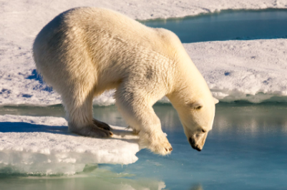
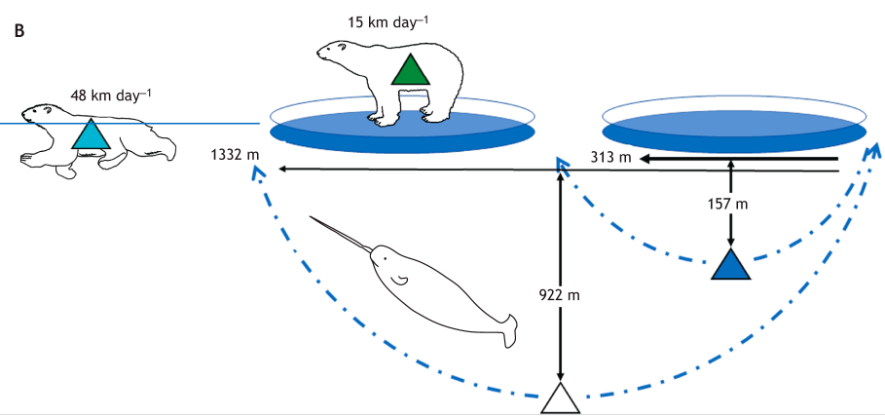
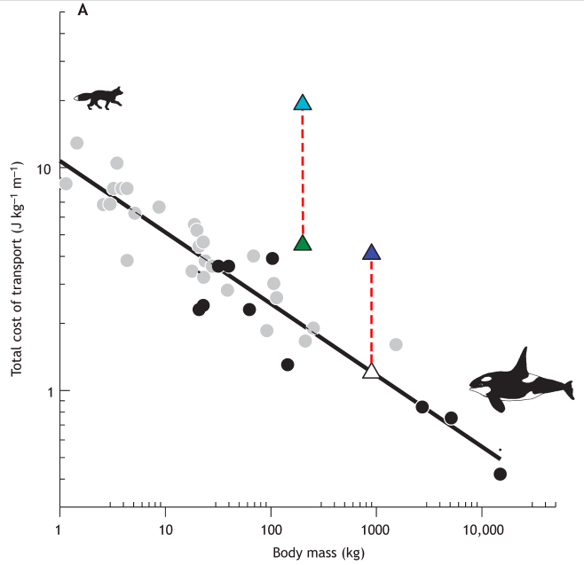
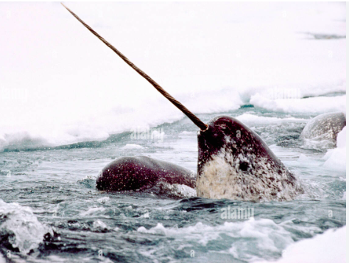
The energetic costs of sea ice loss
Polar bear
Narwal
Pagano and Williams, 2021 Exp Biol
Notes:
Consider the relationship between the energetic costs of moving and body size and we find that the polar bear and the narwal fall above the line. They require more energy to engage in behaviors increasingly demanded of them as sea ice changes. When polar bears have to swim more because of less ice as a hunting platform, then they require more energy than can be gained from the hunt. Not a sustainable situation. Can the bears acclimate? Time will tell. Same for the narwal uniquely adapted to slow deep dives to feed on benthos that were jumpstarted by ice algae. With increasingly unpredictable ice overhead, finding a breathing hole after a 19-minute dive requires more oxygen and energy than currently feasible. Can they acclimate? Only time will tell.

Slide 16
On the ocean scale, primary production is increasing
as thinner ice with less snow forms later and melts earlier
1981–1995
2006–2017
Difference
Not only due to warming and increased light transmission
Available nutrients are essential
Polyakov et al., 2020 Frontiers
Notes:
On the ocean scale, we know that overall primary production is increasing in the changing Arctic. But the positive effects of warming and increased light are not limitless. Without enough nutrients, the observed recent increases will stall and the ecosystem will again have to adjust.

Slide 17
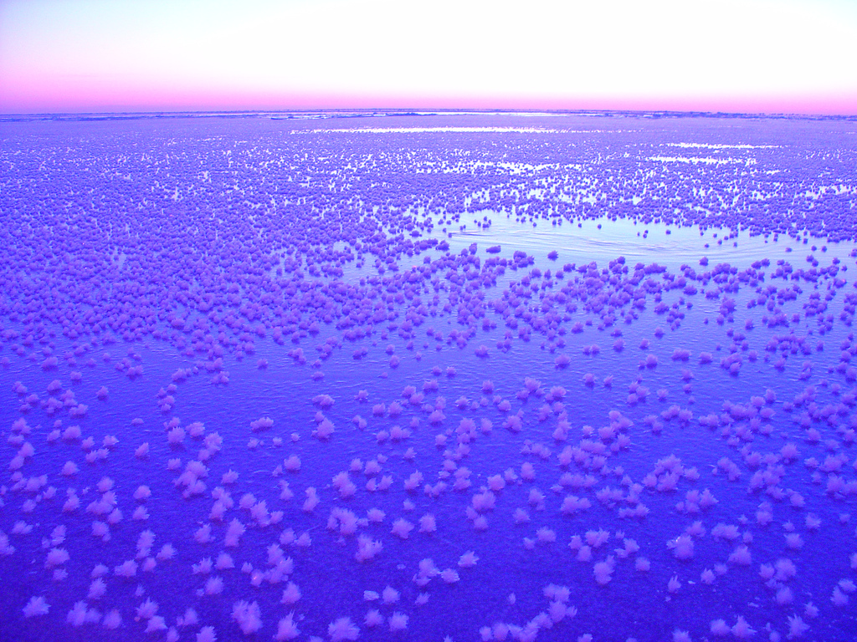
Sea ice is fully inhabited
It functions seasonally as a gas sink or source
Ice algal blooms support the larger ecosystem
Changes in sea ice will lead to an altered ecosystem
Frost flowers on new ice, Dec 2008; photo by RE Collins
Notes:
Thank you!

