Slide 1
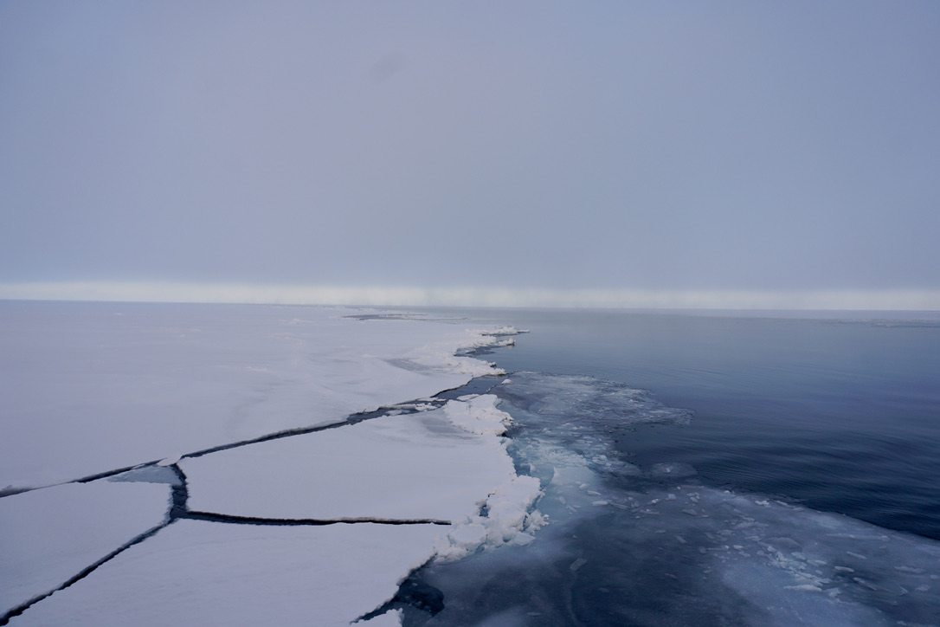
Ice and Climate
Professor Cecilia Bitz
University of Washington
Photo: Vince Cooper, UW

Slide 2
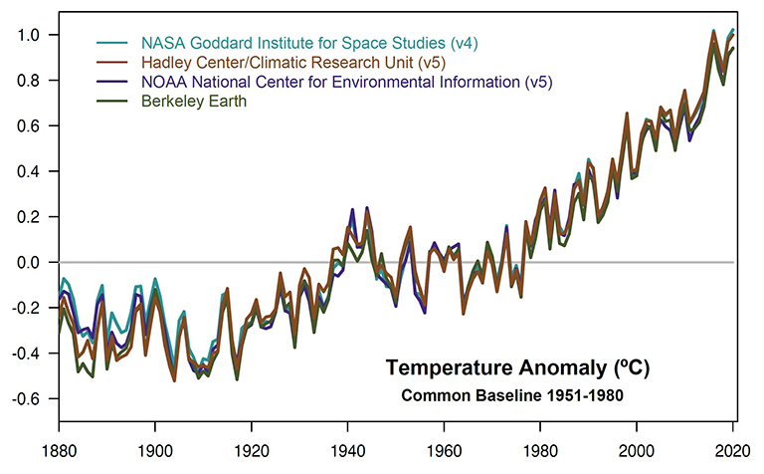
Global warming has been observed across multiple datasets
(1.8 ˚F)
Degrees Celsius
NASA GISS/Gavin Schmidt

Slide 3
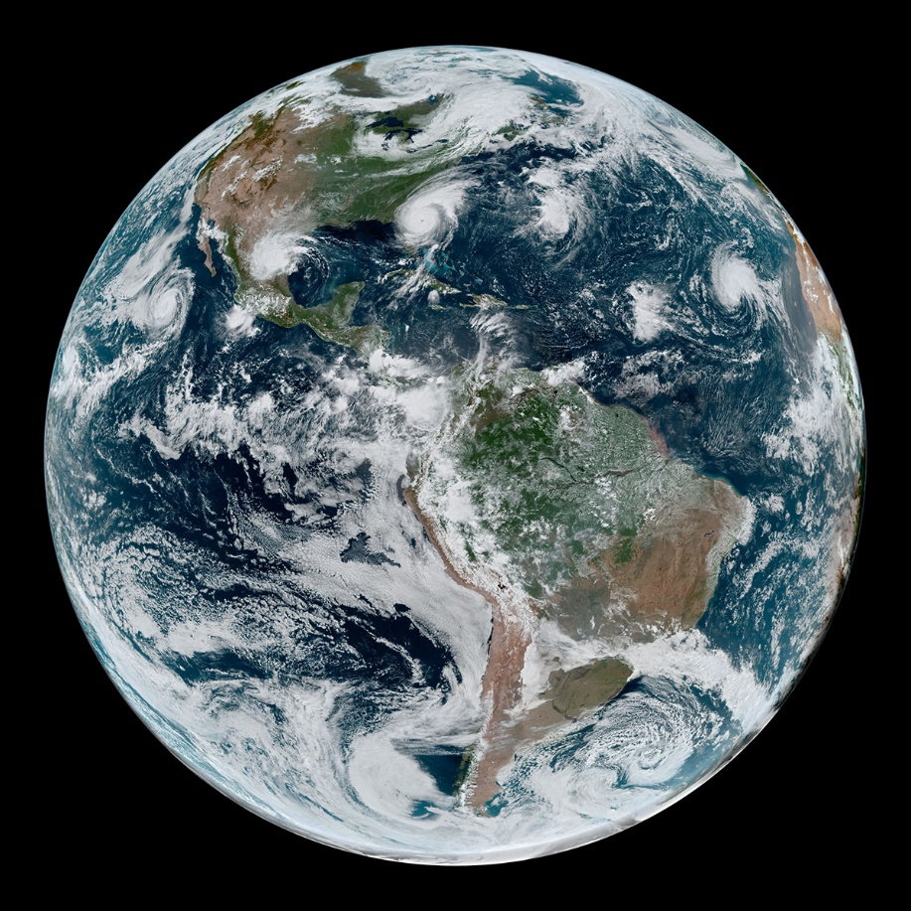
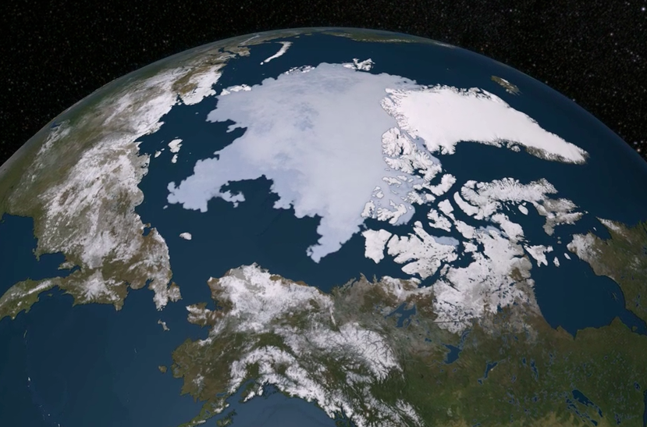
Schedule
Which region of the Earth is warming most?
The Arctic
Sea Ice
floating on the ocean
Greenland
Russia
Alaska
Canada
Land has ice sheets, glaciers, and snow
NASA Earth Observatory/Joshua Stevens;
NOAA National Environmental Satellite, Data, and Information Service
NASA's Scientific Visualization Studio
Tropics? Arctic? Antarctic?

Slide 4
Arctic amplified warming
Preindustrial: 280 ppm
Present-day: 420 ppm

Slide 5
Why is the Arctic warming so quickly?
Climate feedback: a change in the climate system that can speed up or slow down an initial warming
Albedo (reflectivity) Feedback
Preindustrial: 280 ppm
Present-day: 420 ppm

Slide 6
Why is the Arctic warming so quickly?
Climate feedback: a change in the climate system that can speed up or slow down an initial warming
Albedo (reflectivity) Feedback
Present-day: 420 ppm

Slide 7
Why is the Arctic warming so quickly?
Climate feedback: a change in the climate system that can speed up or slow down an initial warming
Albedo (reflectivity) Feedback
Melt ice, expose ocean
Absorb more sunlight
Preindustrial: 280 ppm
Present-day: 420 ppm

Slide 8
Why is the Arctic warming so quickly?
Climate feedback: a change in the climate system that can speed up or slow down an initial warming
Albedo (reflectivity) Feedback
Melt ice, expose ocean
Absorb more sunlight
Preindustrial: 280 ppm
Present-day: 420 ppm

Slide 9
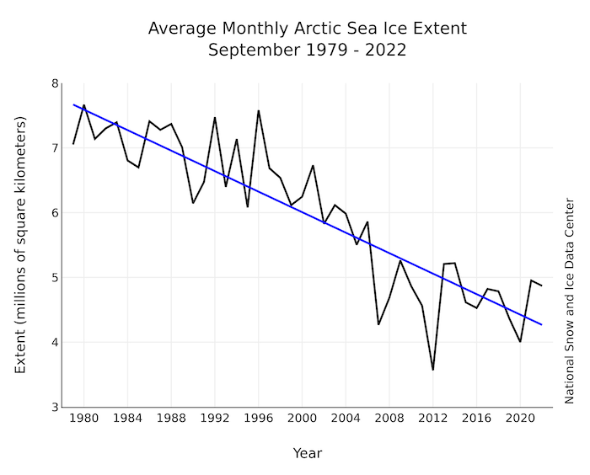
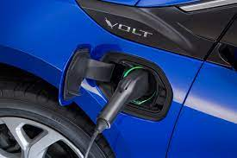

Slide 10
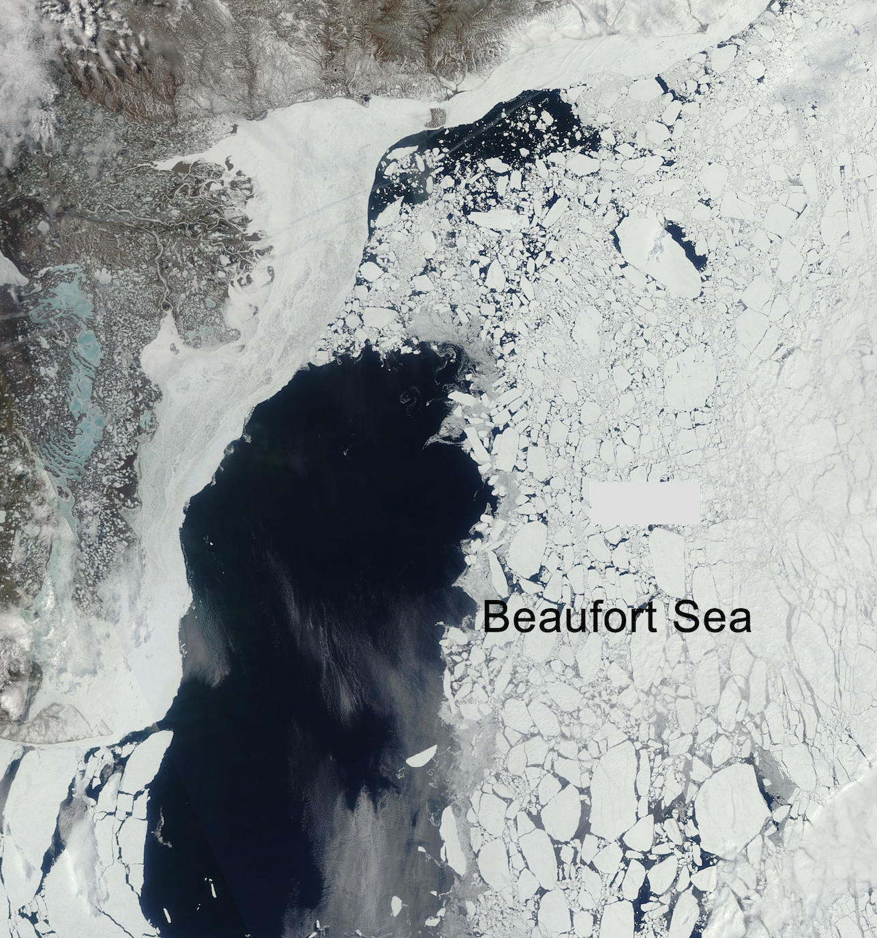
Satellites allow us to visualize ice
Melt ice, expose ocean
Absorb more sunlight
Alaskan coast
Present-day: 420 ppm
50 km
Modis image
Notes:
Sea ice is disappearing from shores first, where people depend on it the most.

Slide 11
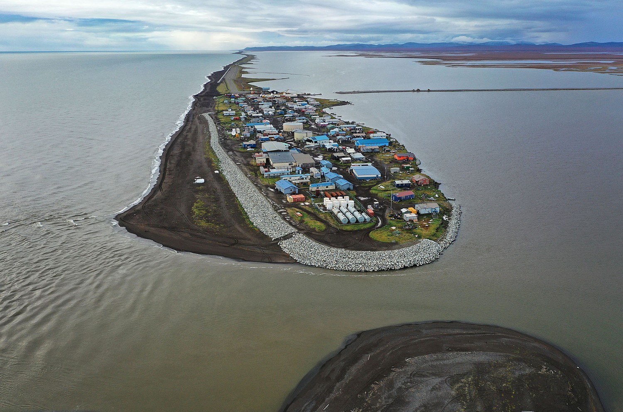
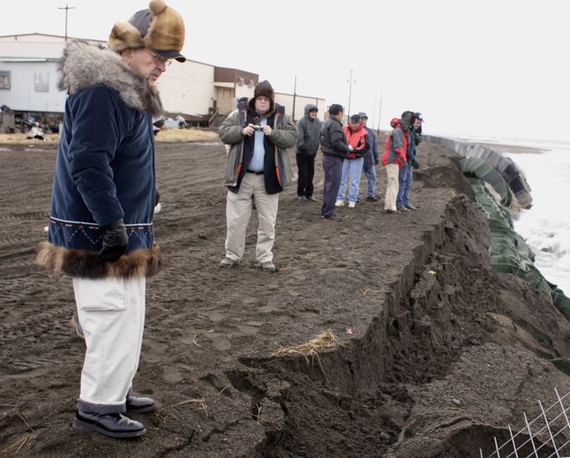
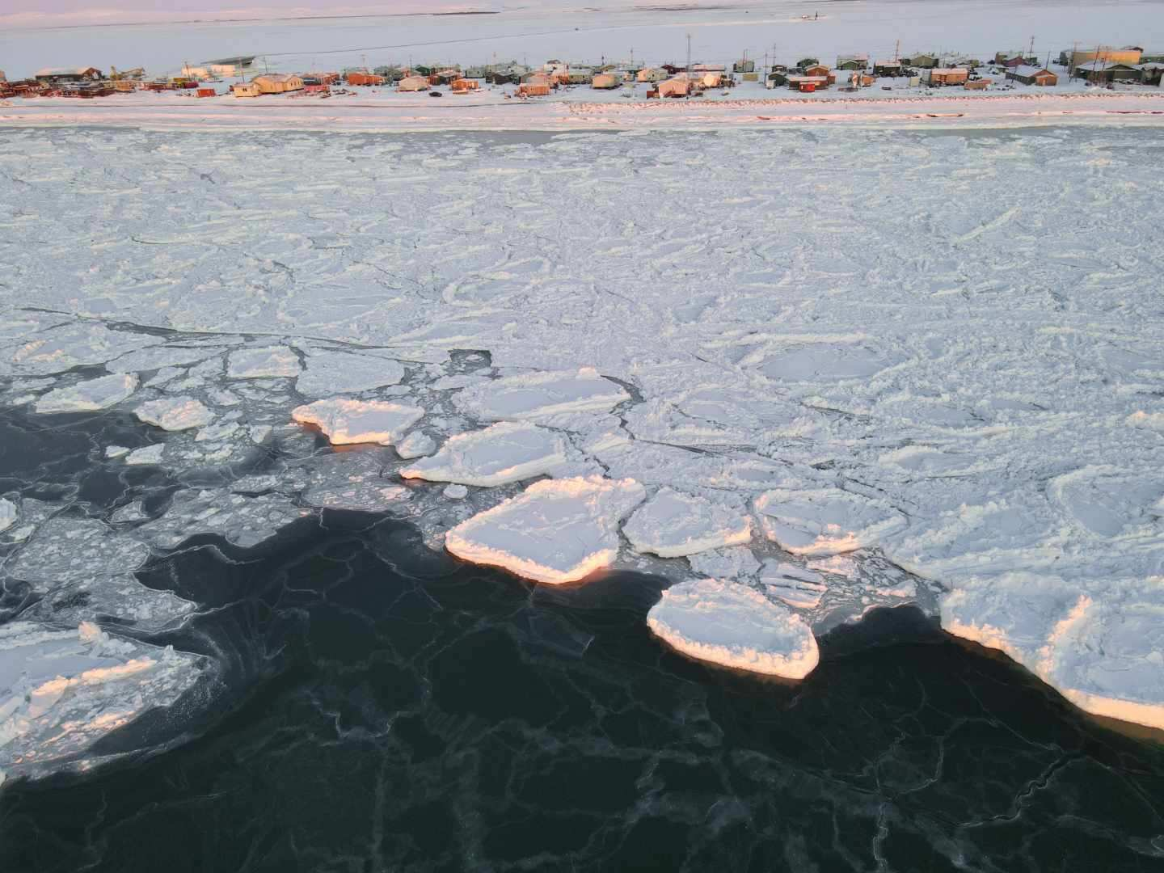
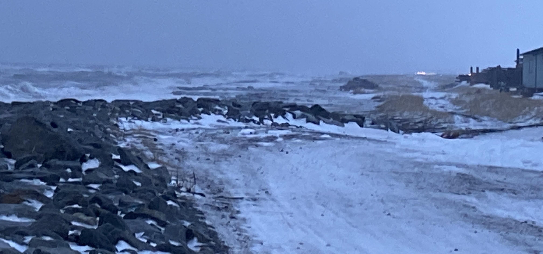
Kivalina is on a Barrier Island, Exposed to Pacific Storms
Alaska interior
Open Ocean
Lagoon
Senator Ted Stevens inspecting their last sea wall in 2006
Senator Ted Stevens inspecting their last sea wall in 2006
Sea Wall
Built by U.S Army Corp of Engineers in 2008
Joe Raedle, Getty, in The Atlantic
James Mason, Associated Press
James Mason, Associated Press
Notes:
400 Inupiat live there

Slide 12
The Arctic is an ocean surrounded by land
The Antarctic is a continent surrounded by ocean

Slide 13
Why is the Arctic warming faster than the Antarctic?
Warm Atlantic currents flow into the Arctic at the surface
Strong circumpolar winds drive flow away from Antarctica

Slide 14
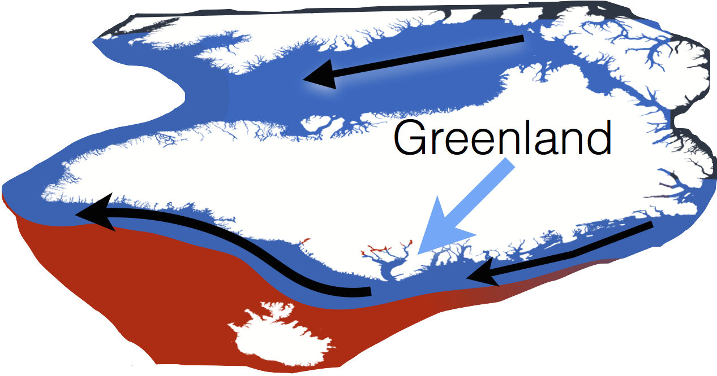
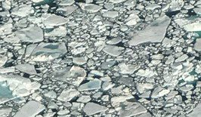
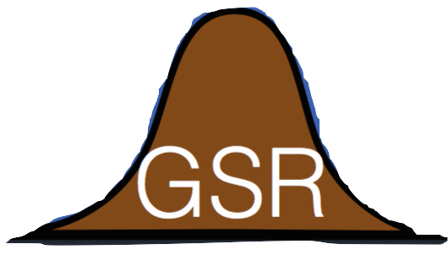
Arctic, receives heat from the south
Heat from CO₂
surface
outflow
Atlantic
inflow
Overturning circulation
depth
longitude
overflow
latitude
Heat from CO₂ is carried northward by ocean surface currents, accelerating Arctic warming
adapted from Nick Beaird & Kyle Armour

Slide 15
Southern Ocean, heat is transported northward
Heat from CO₂
Antarctic Circumpolar Current
Antarctica
Overturning circulation
Antarctic Bottom Water
depth
longitude
latitude
Heat from CO₂ is carried northward by ocean surface currents, slowing warming around Antarctica
adapted from Nick Beaird & Kyle Armour

Slide 16
Summary
Climate change: driven by increasing CO2 concentrations in the atmosphere
Polar warming: the Arctic is warming faster than the rest of the planet
Climate feedbacks: in the Arctic, these amplify the initial warming to support faster warming than elsewhere
Polar sea ice and ice sheets are rapidly changing, with important effects on local ecosystems
Preindustrial: 280 ppm
Present-day: 420 ppm

