Slide 1
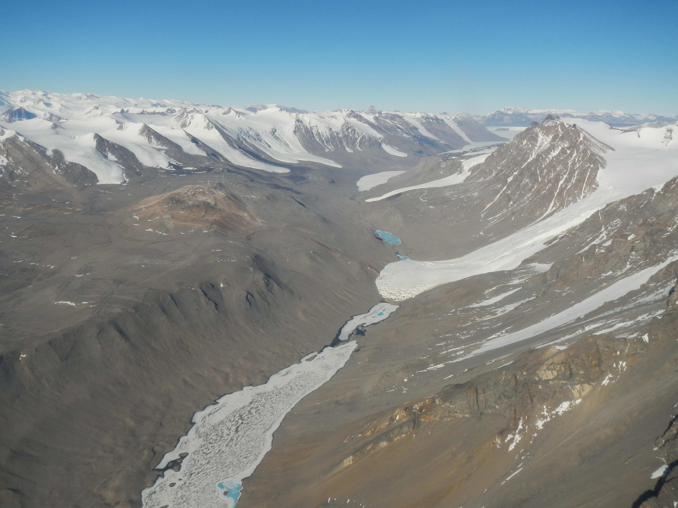
Antarctic Terrestrial Ecosystems
Byron Adams
Brigham Young University
Wilkes Climate Summit
May 16-17, 2023
Notes:
TITLE SLIDE: Site name, presenter name, Any burning site news (new PI’s, key personnel, major new funding, etc.)

Slide 2
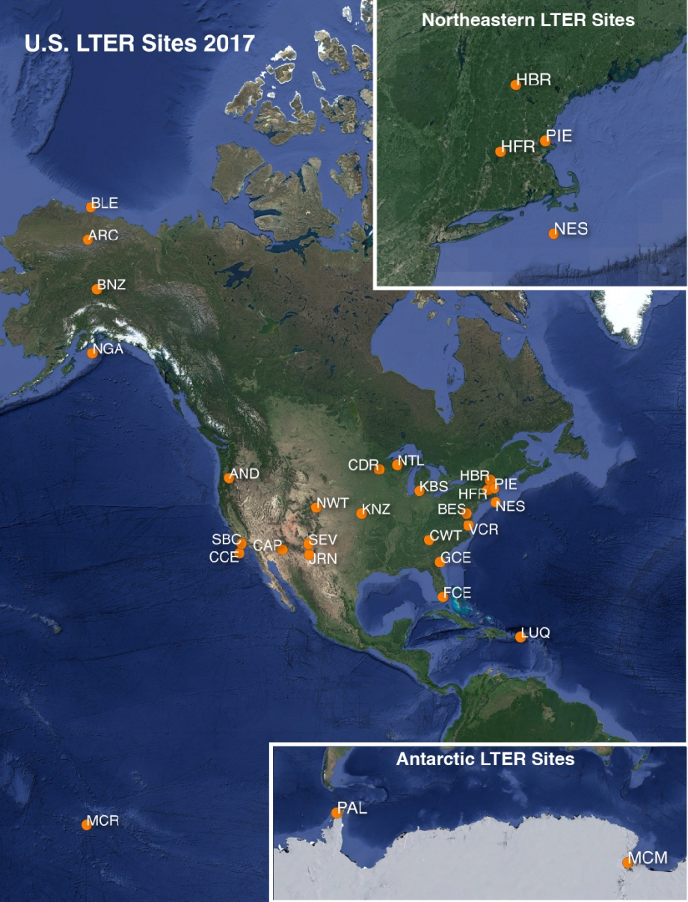
Long Term Ecological Research Program (LTER)
Funded by the National Science Foundation
Supported by the United States Antarctic Program
What is the McMurdo LTER?

Slide 3
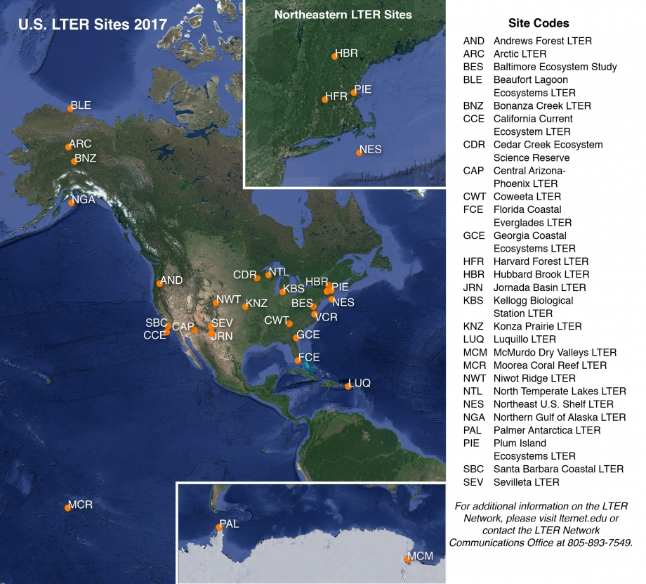
Long-Term Ecological Research
What is the McMurdo LTER?
Science + Monitoring
6-yr grants
Short and long-term perspectives
Network → synthesis
Notes:
Moorea, coral reef system, French Polynesia

Slide 4
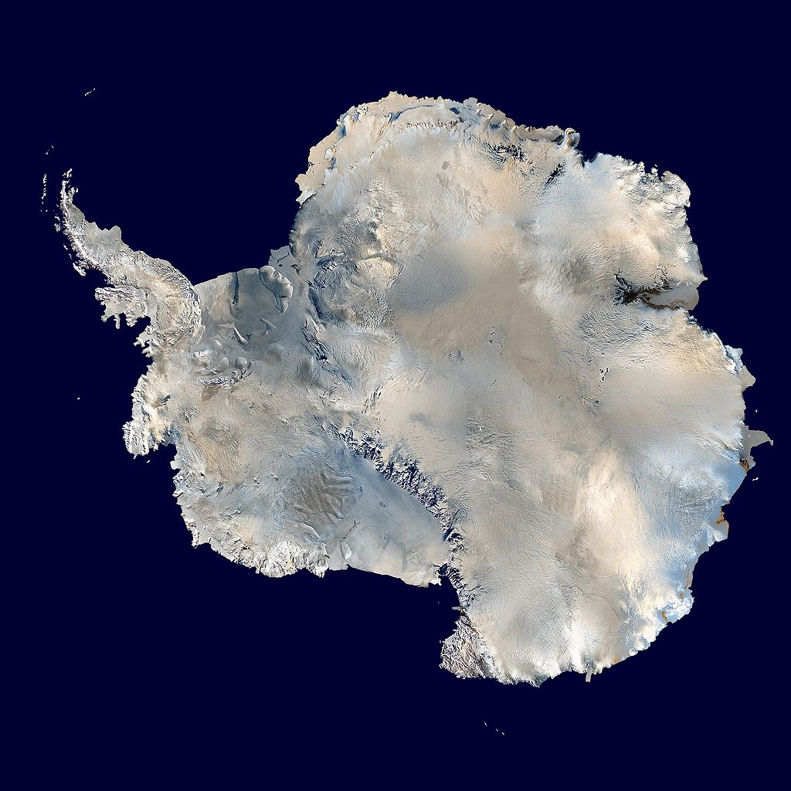
Meteorology
glaciology
physiology
Ice melt
Ecosystem Change
primary production
Hydrology
weathering
Biology
Nutrient cycles
geochemistry
biogeochemistry
Chemistry

Slide 6
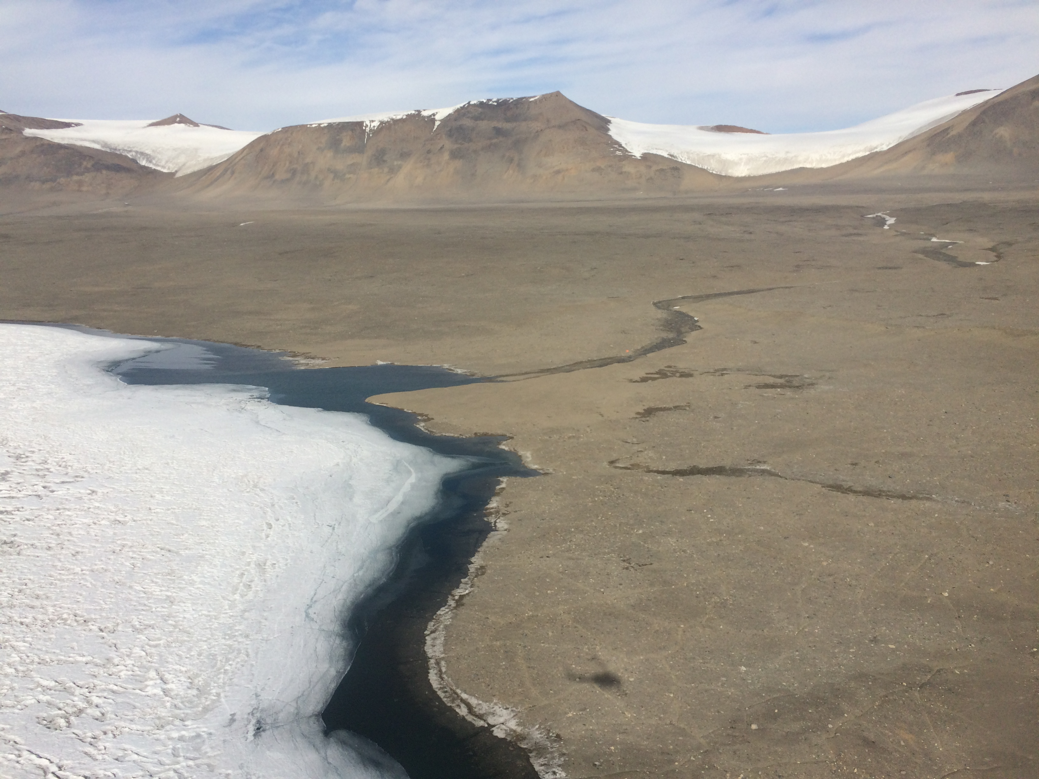
Notes:
Has looked basically like this since the Neogene: past 20 million years hyper arid polar desert; low diversity, polar climate
Simple ecosystems
So this is what prime real-estate in the McMurdo Dry Valleys looks like! – notice lack of anything alive that’s above ground – Life here is limited to the presence of liquid water. For a few weeks each year it gets warm enough for glaciers and soil ice to melt. Streams flow into permanently ice covered lakes, and moats form.

Slide 7
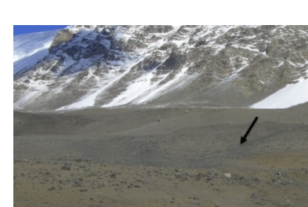
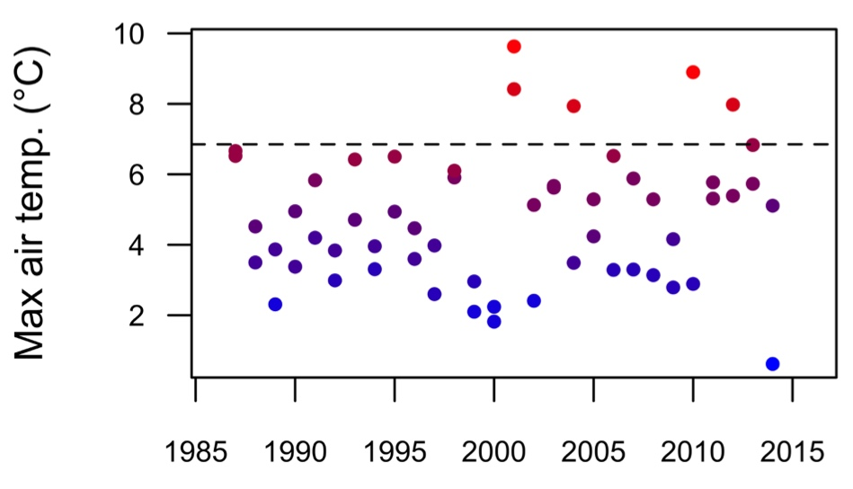
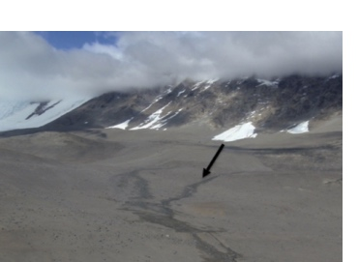
The Dry Valleys have entered a new climatic phase
More frequent “heat waves” and pulses of water availability
Maxima Dec-Jan
Notes:
Nielsen et al 2012. Ecosphere 3:art17.

Slide 8
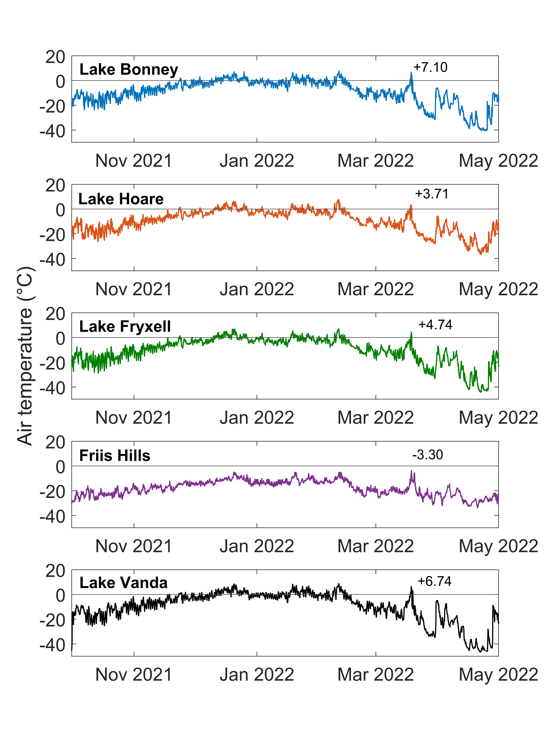
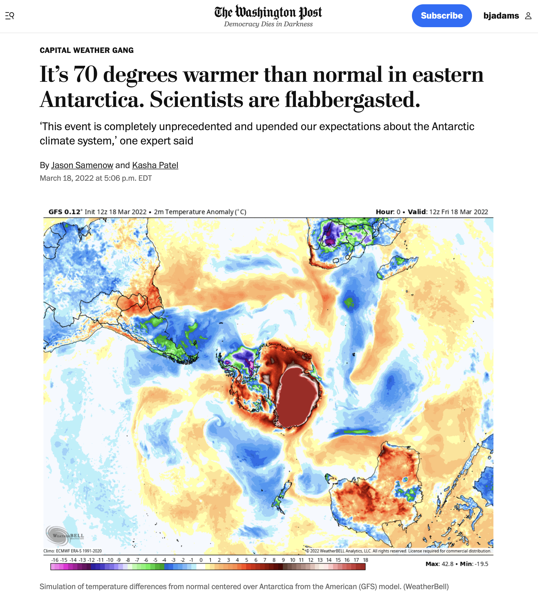
Notes:
Talk about increased freeze-thaw cycles; stress to biota

Slide 9
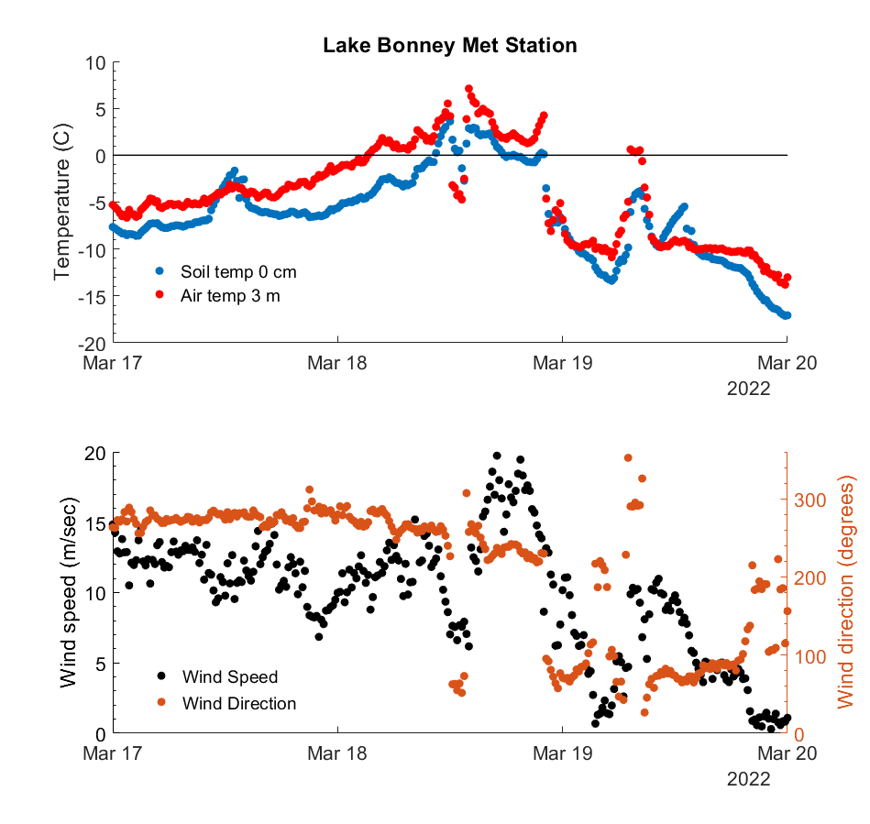

Slide 10
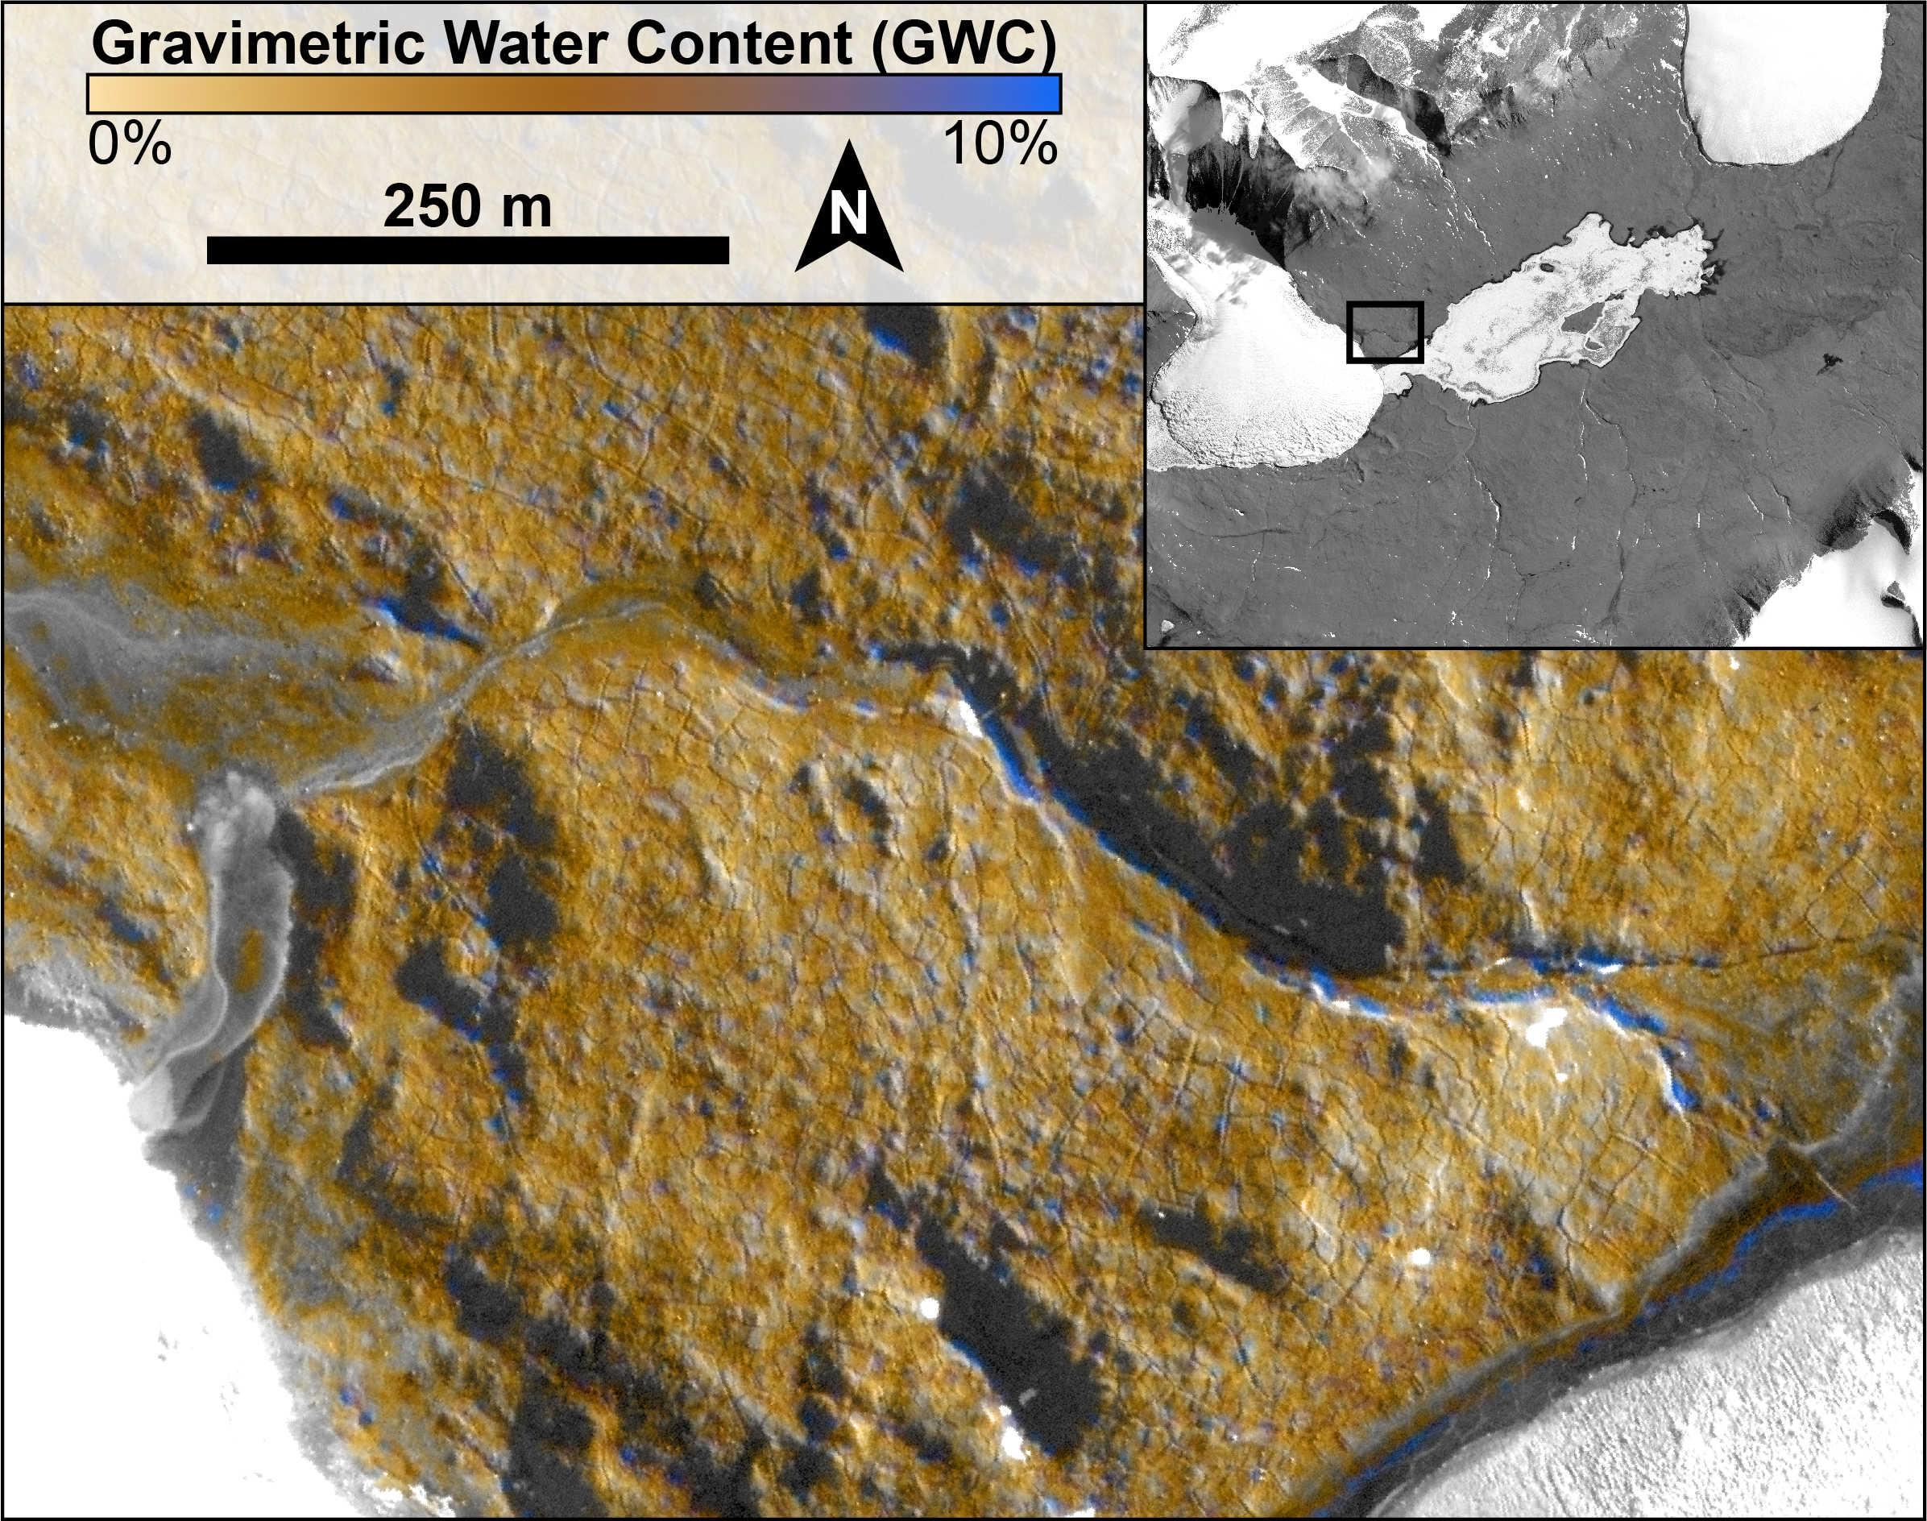
March 20, 2022 WordView-2 DigitalGlobe.

Slide 11
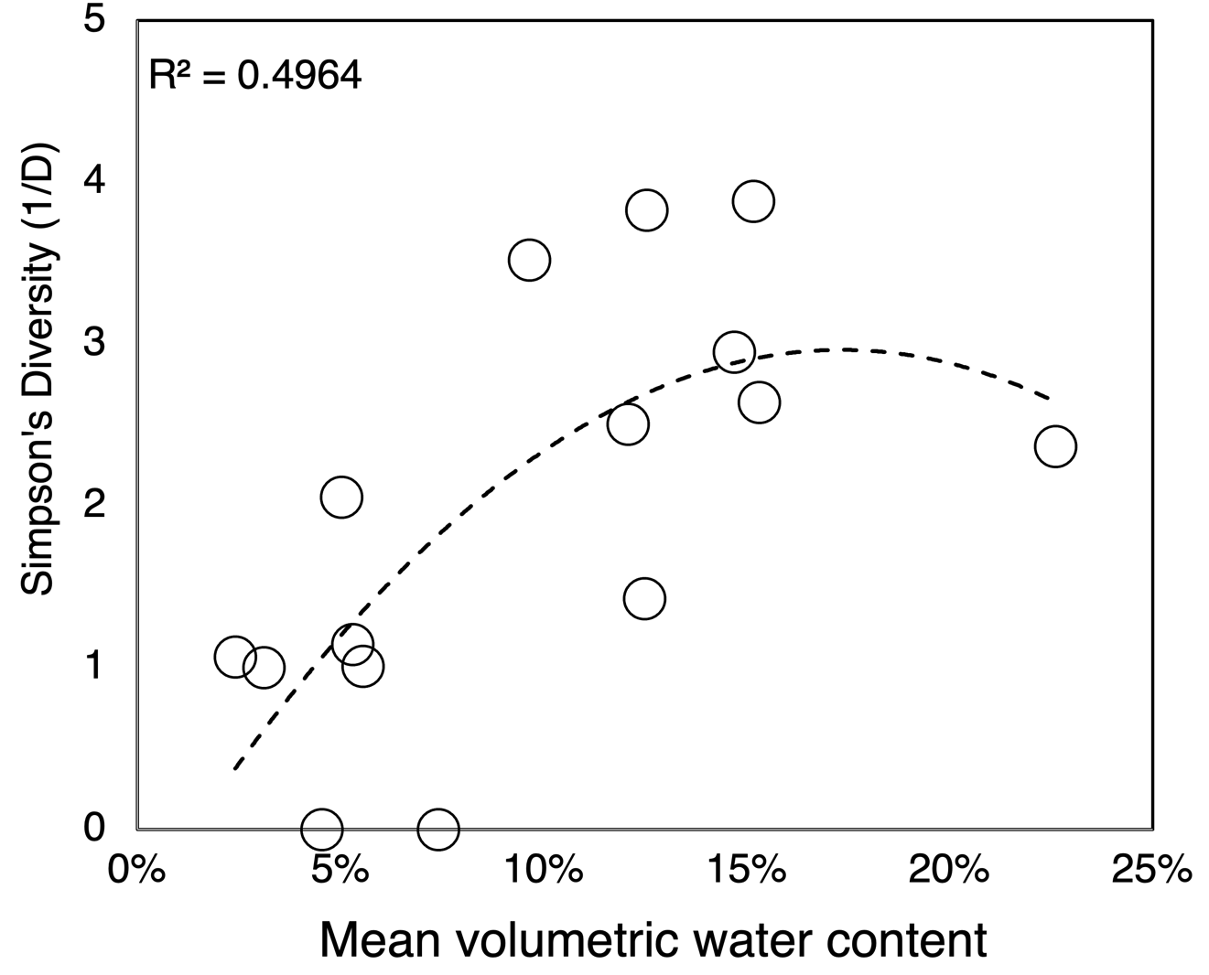
Simpson’s Diversity (1/D) for soil and sediment invertebrate communities in the Canada Stream Antarctic Specially Protected Area.
Invertebrates typically revive from anhydrobiosis in soils above 10% soil water content typically, as was observed following the March 18th weather anomaly.
Notes:
Simpson’s Diversity (1/D) for soil and sediment invertebrate communities in the Canada Stream Antarctic Specially Protected Area. Invertebrates typically revive from anhydrobiosis in soils above 10% soil water content typically, as was observed following the March 18th weather anomaly.
50% of the variability in the outcome data cannot be explained by the model

Slide 12
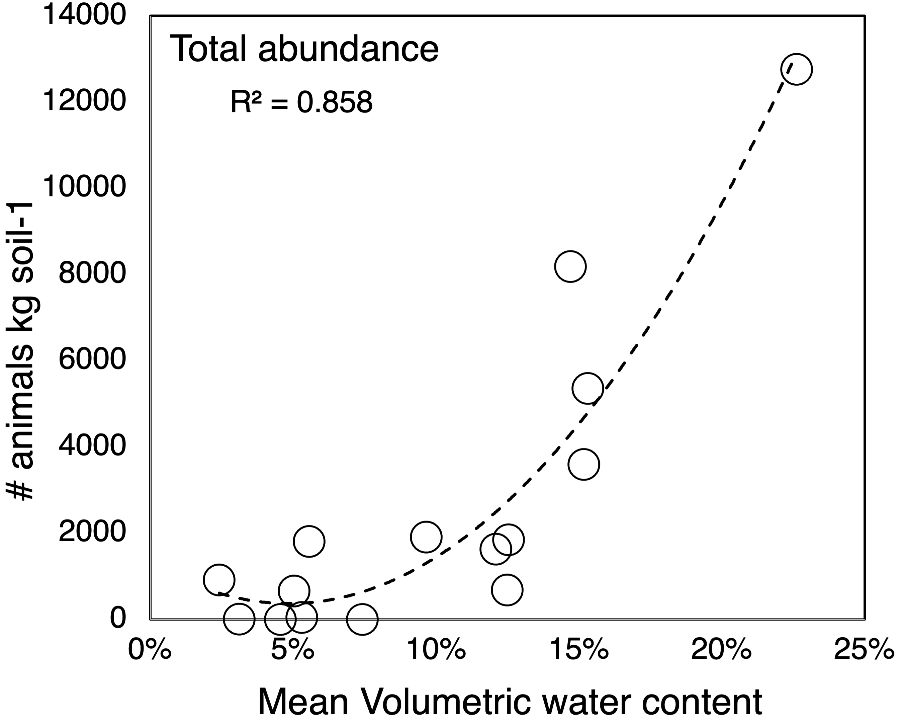
Total invertebrate abundance for soil and sediment invertebrate communities in the Canada Stream Antarctic Specially Protected Area.
Invertebrate abundance increased following the March 18th weather anomaly.
Notes:
Simpson’s Diversity (1/D) for soil and sediment invertebrate communities in the Canada Stream Antarctic Specially Protected Area. Invertebrates typically revive from anhydrobiosis in soils above 10% soil water content typically, as was observed following the March 18th weather anomaly.
50% of the variability in the outcome data cannot be explained by the model

Slide 13
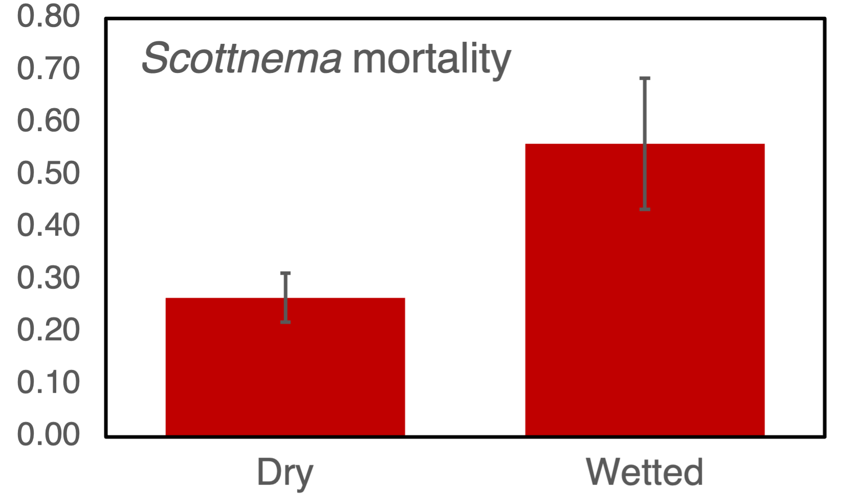
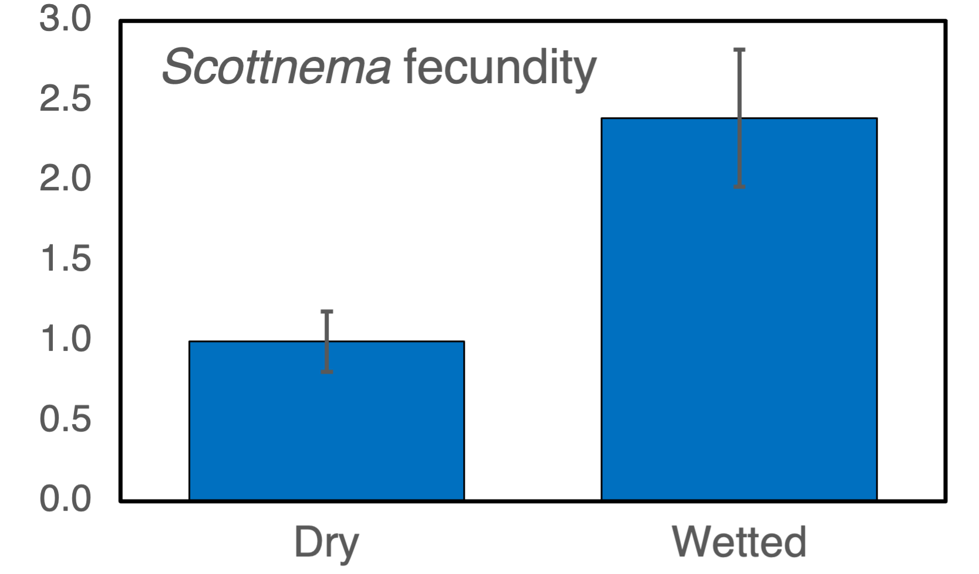
Warming event resulted in significant mortality
…. but also increased fecundity

