Slide 1
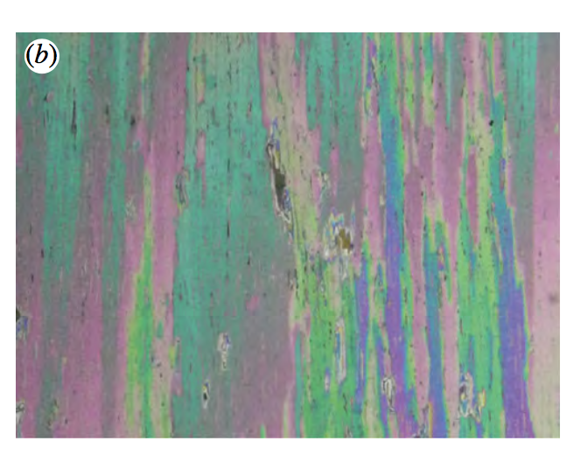
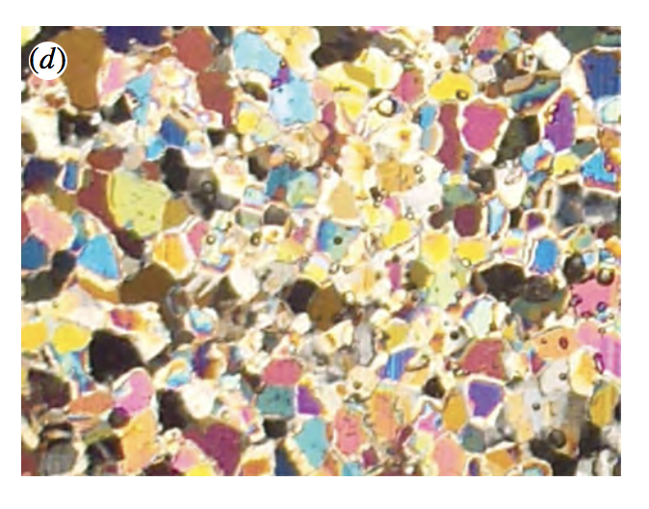
Bounds on the Complex Permittivity of Anisotropic Polycrystalline Sea Ice
McKenzie McLean, Dr. Elena Cherkaev, Dr. Kenneth Golden, University of Utah Department of Mathematics
Abstract
One can use remote sensing techniques to gather information on the properties of the system, and in particular the complex electromagnetic permittivity.
Once they have been gathered, these data can be used to recover information about the composition and crystalline structure, as well as fluid flow properties.
Results
The polycrystalline geometry of sea ice strongly influences many of the properties that help determine its role in the climate system:
Flow of fluids and nutrients
Mechanical properties
Thermal properties
One can relate the polycrystalline structure of sea ice to its electromagnetic behavior, which can be measured remotely. Here we derive rigorous bounds on the effective electromagnetic behavior of polycrystalline sea ice, in particular the complex permittivity.
The bounds give us insight into distinguishing between different sea ice types, such as columnar vs. granular, which have different fluid transport and mechanical properties. This means that one can gain a great deal of information about the sea ice in the Artic and Antarctic using data which can be collected remotely, without having to actually go there.
This graph shows the first order bounds on the complex permittivity of columnar sea ice. The cluster of blue bounds represents the horizontally isotropic case when the brine volume fraction (BVF) is 3, 3.5 and 4%, respectively. The green cluster represents the same BVFs for the horizontally anisotropic case.
Fig 2: Left - A cross sectional view of sea ice. Right – images showing the typical polycrystalline structure of sea ice moving from the top through to the bottom.
Conclusions
Introduction
Methods
It is possible to bound the complex permittivity in the primarily horizontally anisotropic case.
When the electric field is along the axis of the crystals, the complex permittivity of the horizontally anisotropic ice has a larger magnitude than in the horizontally isotropic case.
These bounds could be inverted to gain information about the crystalline geometry of the sea ice, as well as its fluid transport and thermal properties.
To obtain the bounds, one must consider an integral representation for F(s) , which gives information about $ε^{∗}$, the effective complex permittivity tensor.
$$F\left(s\right)=1−\frac{ε^{∗}}{ε_{2}}=\int_{0}^{1}{\frac{dμ(z)}{s−z}}$$
with $s=\frac{1}{1−h}$ , $h=\frac{ε_{1}}{ε_{2}} ,$
where $ε_{1,2}$ are the complex permittivities of a single ice crystal in the vertical and horizontal directions, respectively.
If one only has partial information about the statistical properties of the crystalline structure, such as the mean orientation, then one can obtain first order bounds which are:
$ε_{u}^{∗ }(z)=ε_{2}$ - $ε_{2}$($\frac{\left\langle e_{k}^{T}R\right.\left.e_{k}\right\rangle }{s−z}$)
$ε_{l}^{∗ }(z)={ε_{1}\text{ (1 − }\frac{1−\left\langle e_{k}^{T}R\right.\left.e_{k}\right\rangle }{s−z}\text{) }}^{−1}$ ,
where the real parameter z varies from 0 to 1.
Sea ice is a two phase composite material composed of ice and brine inclusions. These brine inclusions allow water to flow through the ice. Understanding the crystalline structure of the ice gives insight into the fluid flow properties of sea ice. The two types of ice that are of primary concern here are granular and columnar ice (Fig 1). Columnar ice is normally associated with congelation growth in quiescent conditions, while granular ice tends to form in more turbulent conditions. When there is a consistent ocean current the columnar sea ice typically forms with the crystals oriented in a preferred direction (Fig 2).
Works Cited
A. Gully et al. , 2015, Proc. R. Soc. A, 417:1-17.
G. Cox and W. Weeks, 1983, J. Glaciology, 29:306-316.
Fig 1: Columnar (left ) vs. granular (right) sea ice.
(Gully et al. , 2015)
Acknowledgements
Thanks to the ACCESS program for supporting this project. Thanks also to Huy Dinh and Rebecca Hardenbrook for their guidance throughout.

