Slide 1

College of Science

Slide 2
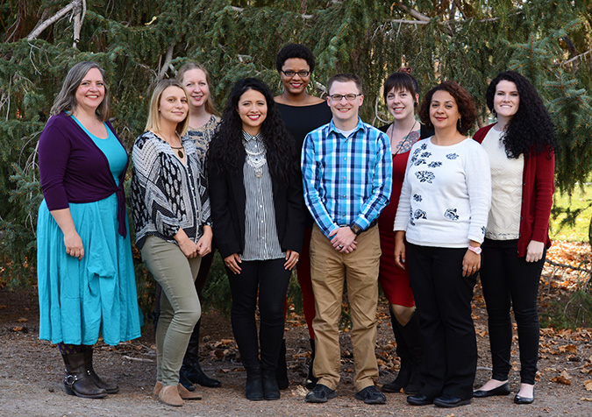
Advisors are here to help!

Slide 3

Scheduling in the Sciences
Prerequisites
Which science courses have prerequisites? ALL of them!
General Education
Spread general education over all 4 years
Science LEAP!

Slide 4
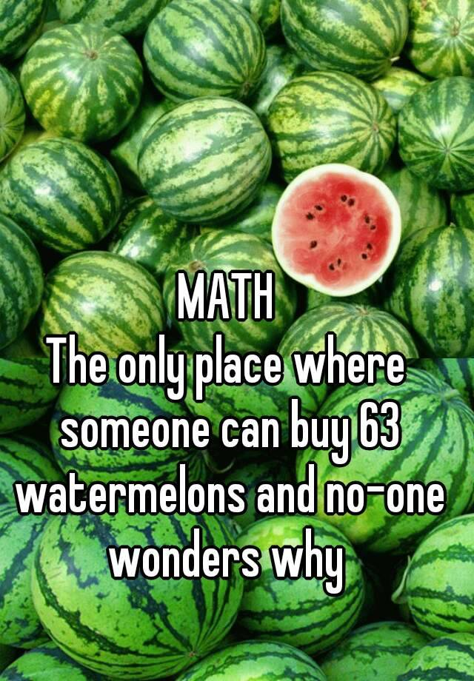
Math Course Sequencing
Math 980 → Math 1010 → Math 1050 → Math 1060 → Math 1210 (Calc I)
Math 1080
Math 1030, 1040, 1070, 1090
DON’T TAKE THEM

Slide 5
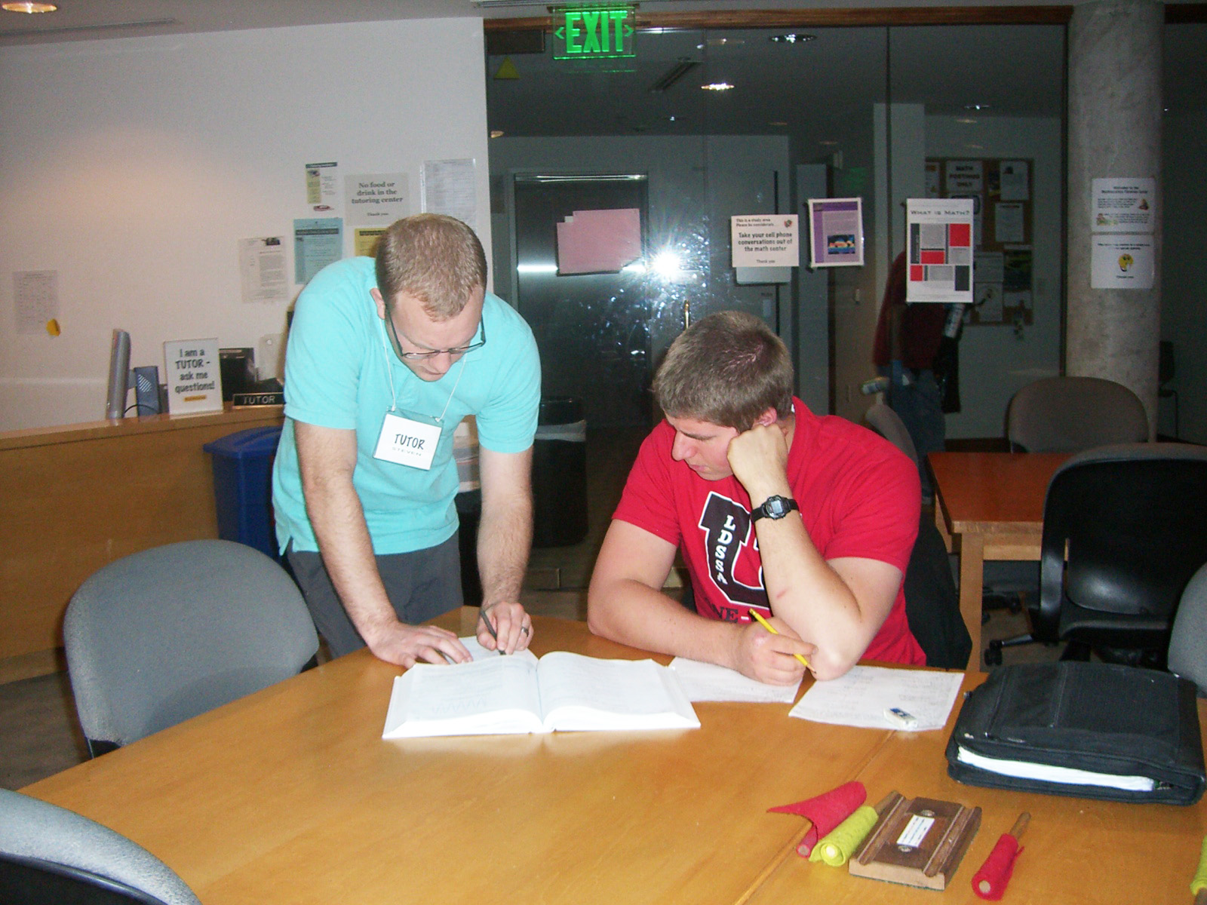
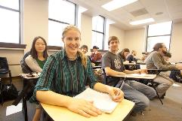
Student Opportunities
Tutoring Centers in every department
  Get help with coursework
  Work as a tutor
Work as a lab or teaching assistant

Slide 6
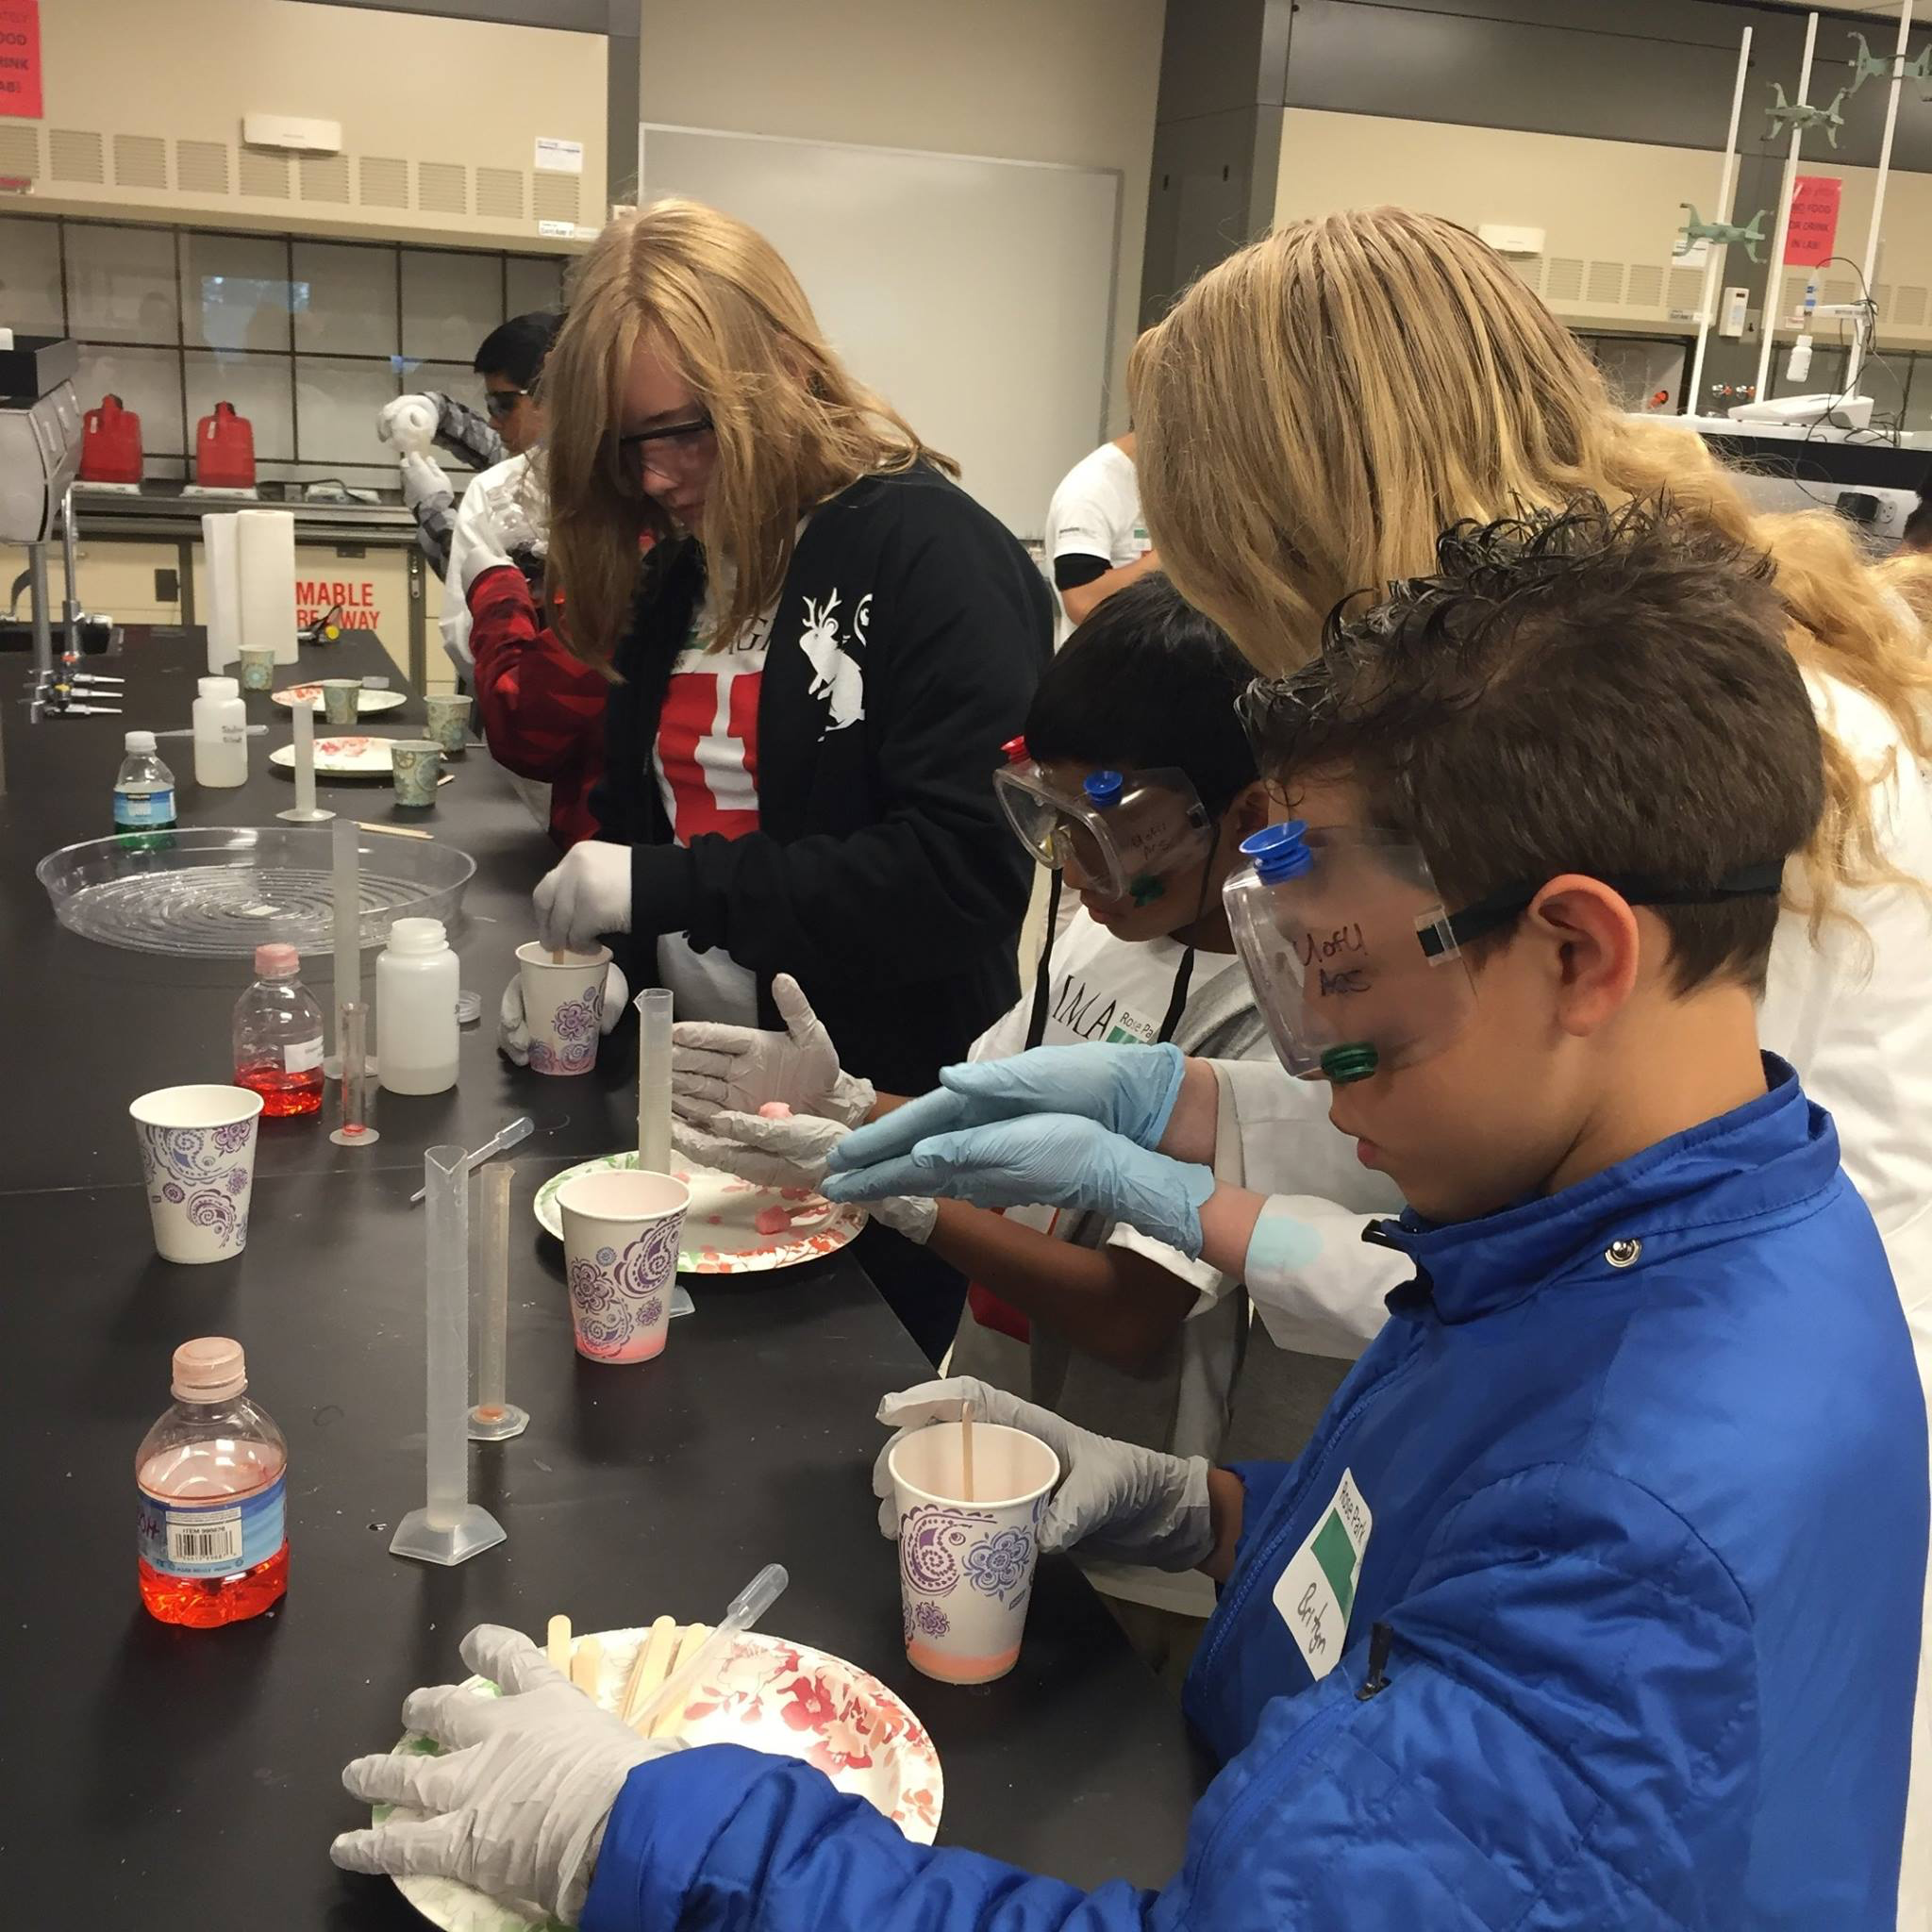
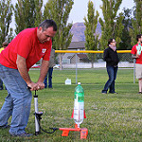
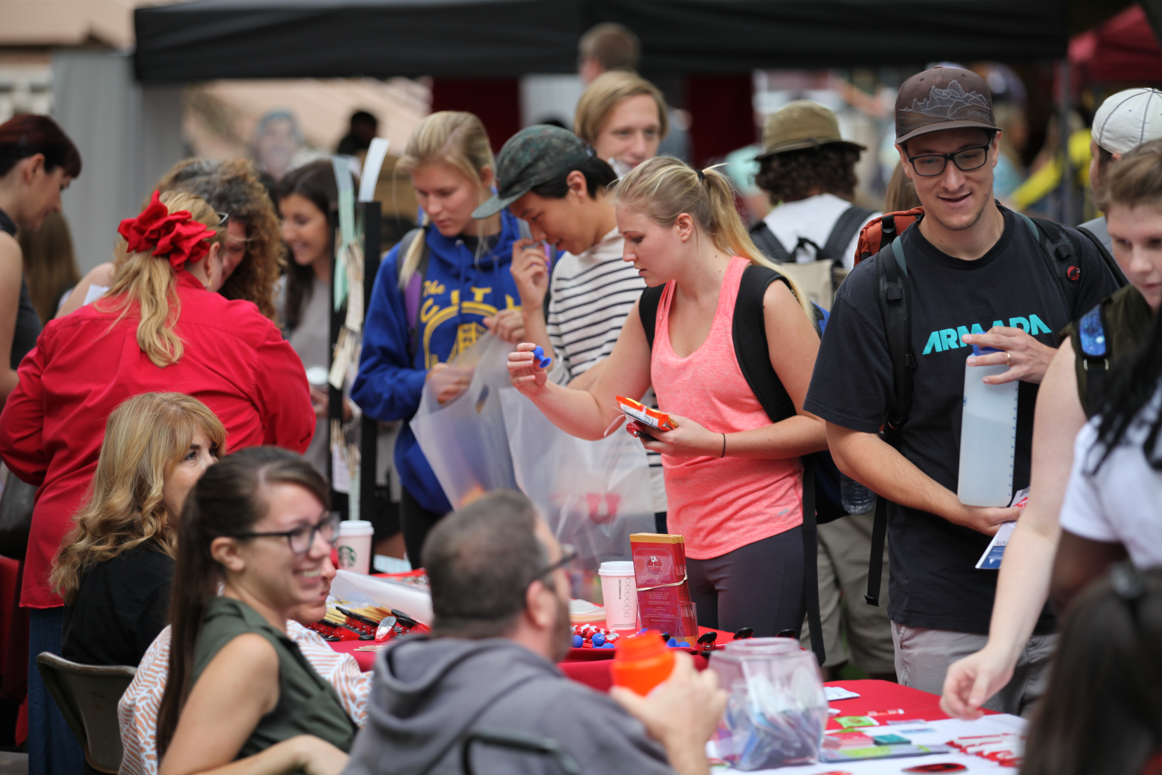
Student Opportunities
Student Organizations
  Association for Women in Mathematics – AWM
  Society for Industrial and Applied Mathematics – SIAM
  American Chemical Society – ACS
  Society of Physics Students – SPS
  Women in Physics & Astronomy – WomPA
  Bioscience Undergraduate Research Club (BSURC)
  In-STEM
  And more….

Slide 7
College of Science Instagram
https://www.instagram.com/uofu_science/
College of Science, in-STEM, Facebook
https://www.facebook.com/groups/inSTEMcos/

Slide 8
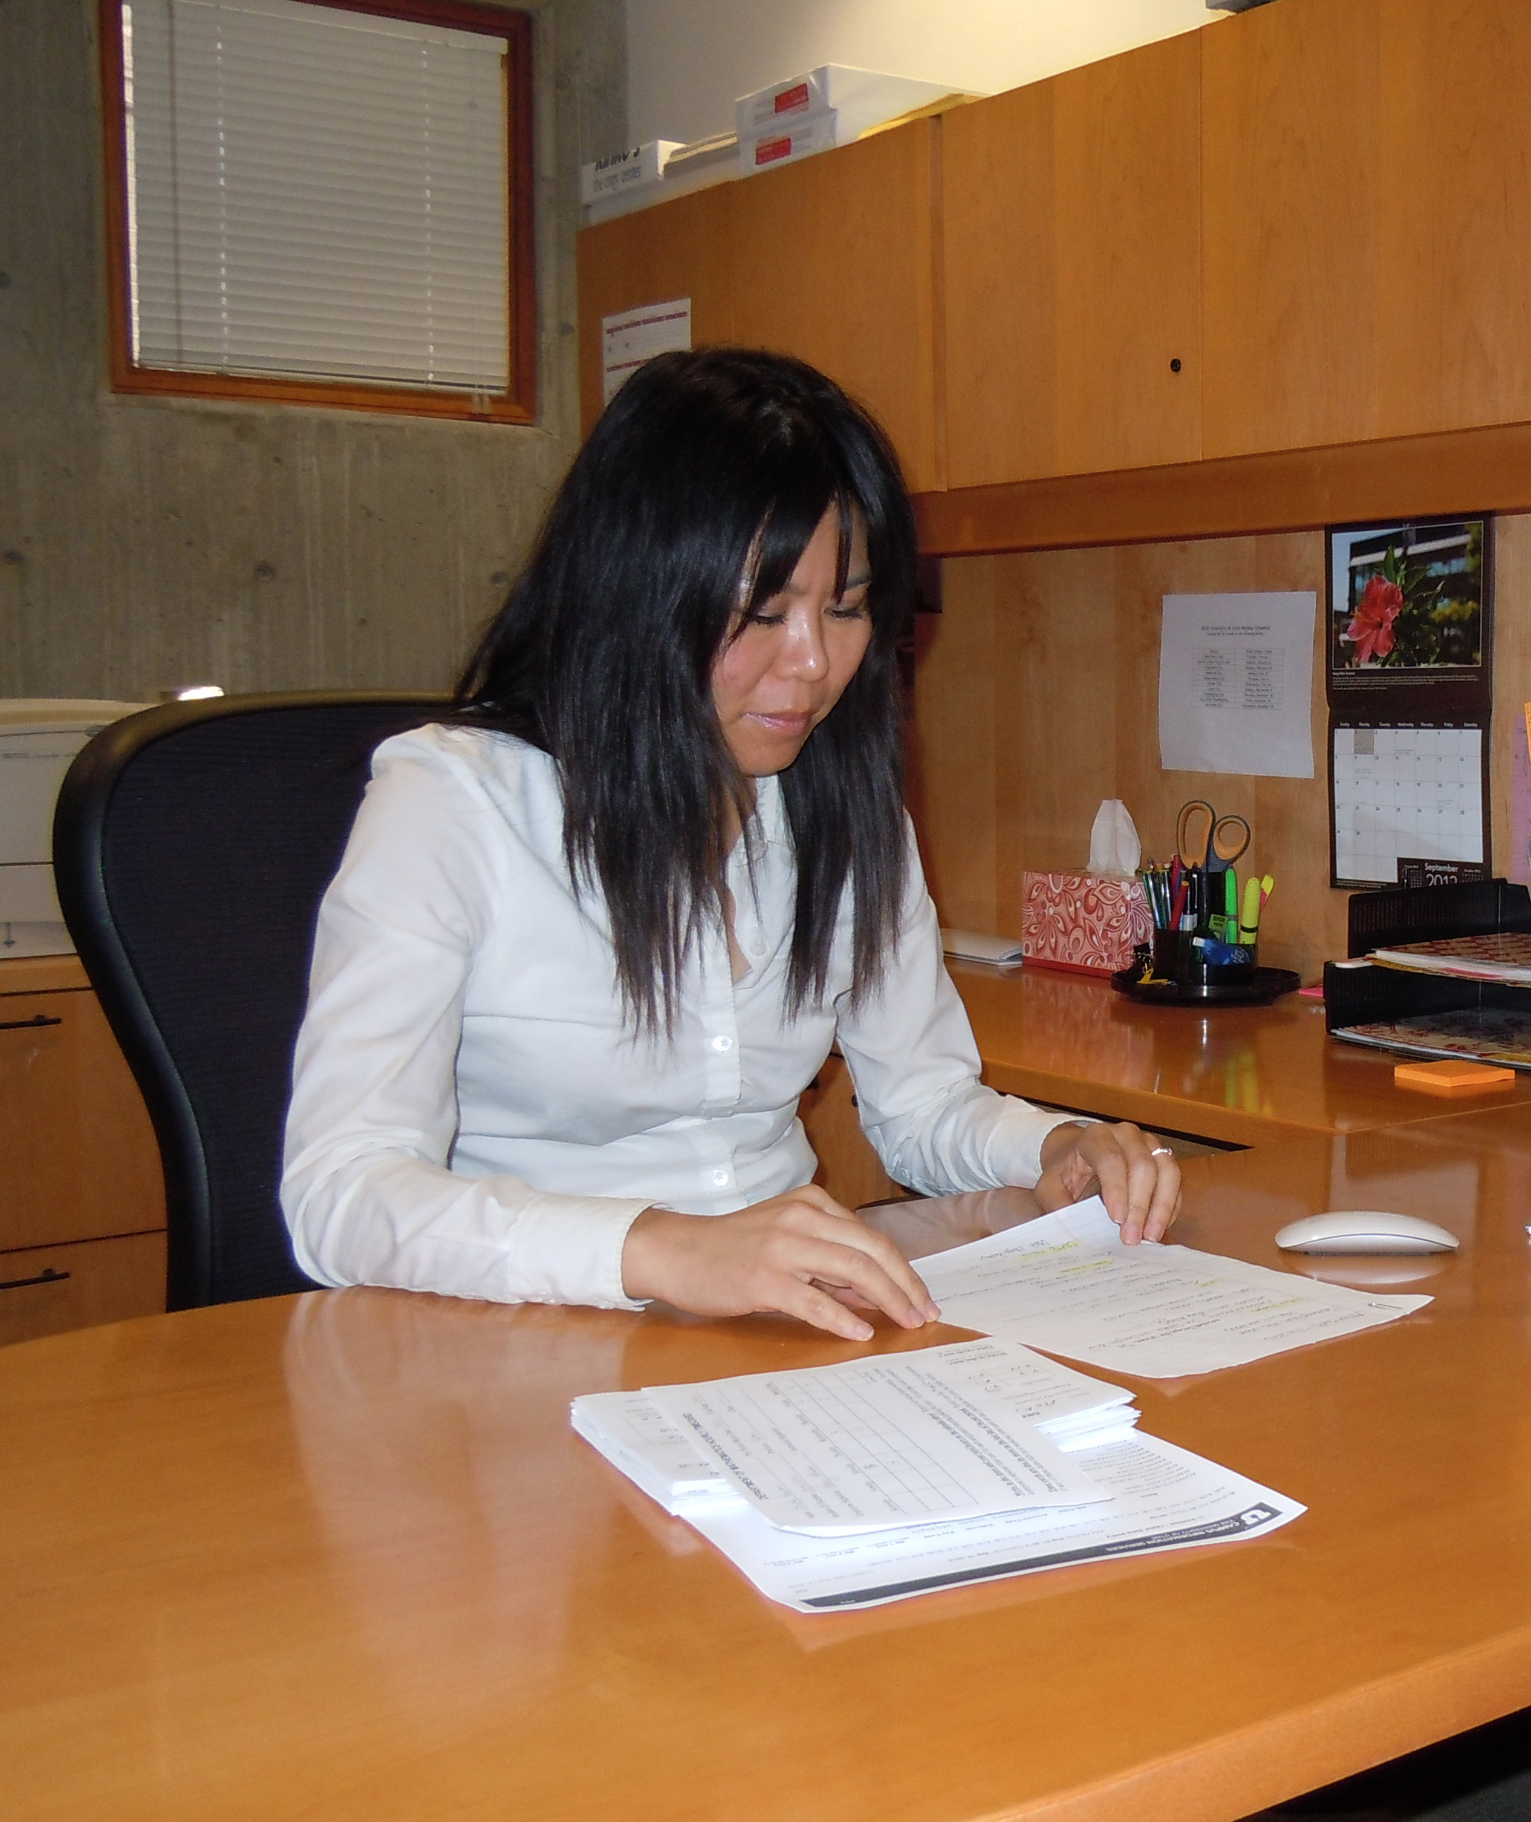

Internship Opportunities
Gain real world experience
in an internship

Slide 9
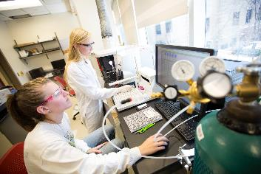
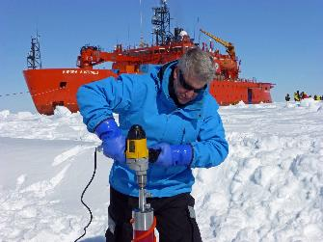
Research Opportunities
  Work with distinguished faculty on cutting edge research as an undergraduate!

Slide 10
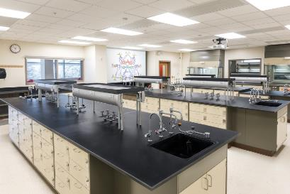
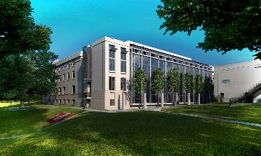
Crocker Science Center
  The Crocker Science Center brings new educational opportunities, new interdisciplinary research collaborations, and a new kind of science community to the U of U campus, Salt Lake City, and the State of Utah.

Slide 11
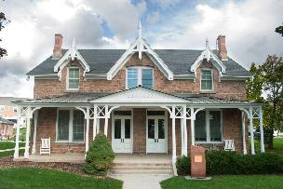
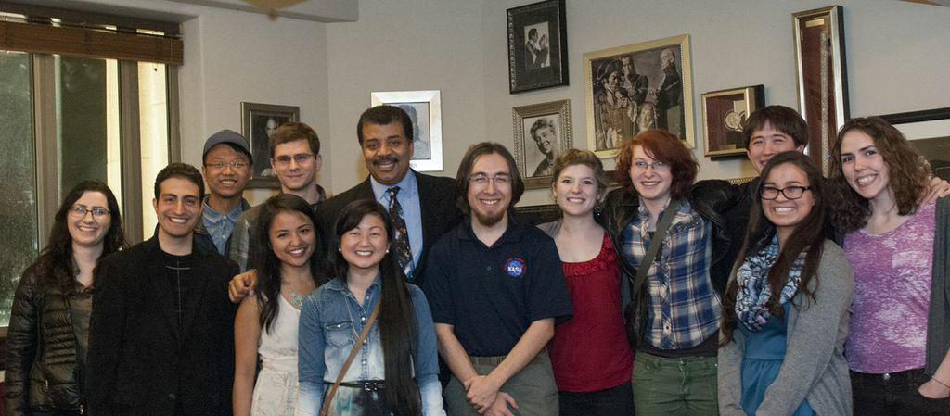
Crocker Science House
  Twelve undergraduate students
  A unique living, learning community
  Special events for residents

Slide 12
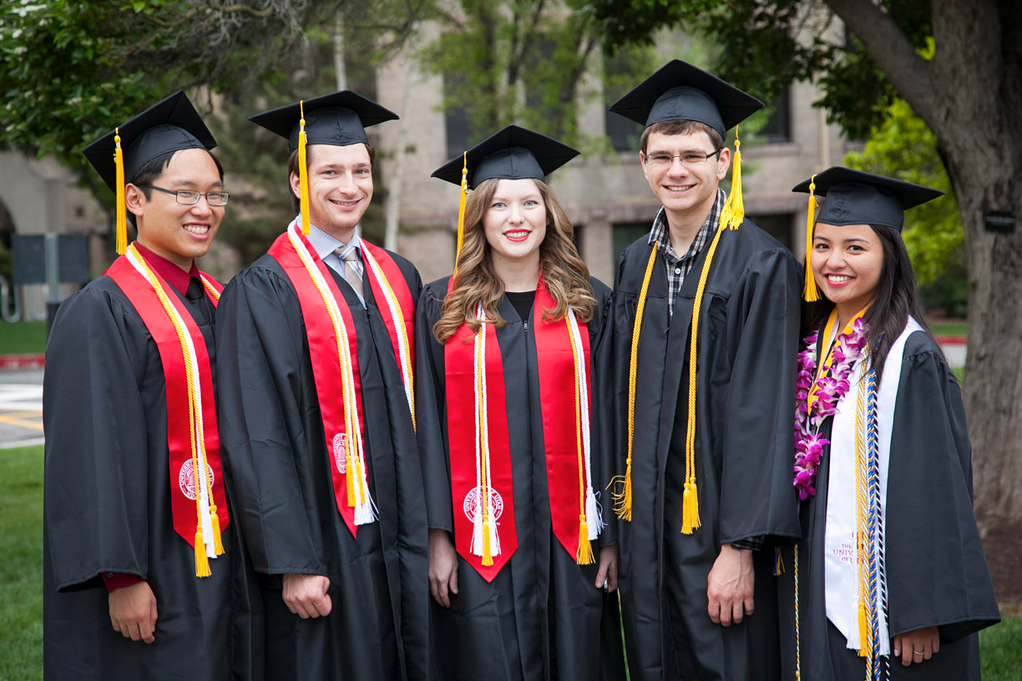
College of Science

