Slide 1
CHAPTER 5:
Regression
Basic Practice of Statistics
^{7th} Edition
Lecture PowerPoint Slides

Slide 2
In chapter 5, we cover …
Regression lines
The least-squares regression line
Examples of technology
Facts about least-squares regression
Residuals
Influential observations
Cautions about correlation and regression
Association does not imply causation
Correlation, prediction, and big data*
Notes:
*denotes optional material, not required for later parts of the text

Slide 3
Linear Regression
Objective: To quantify the linear relationship between an explanatory variable (x) and response variable (y).
We can then predict the average response for all subjects with a given value of the explanatory variable.

Slide 4
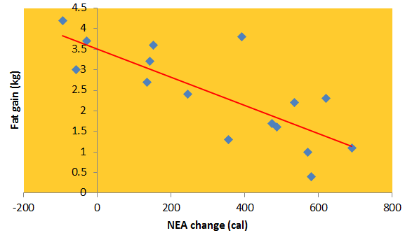
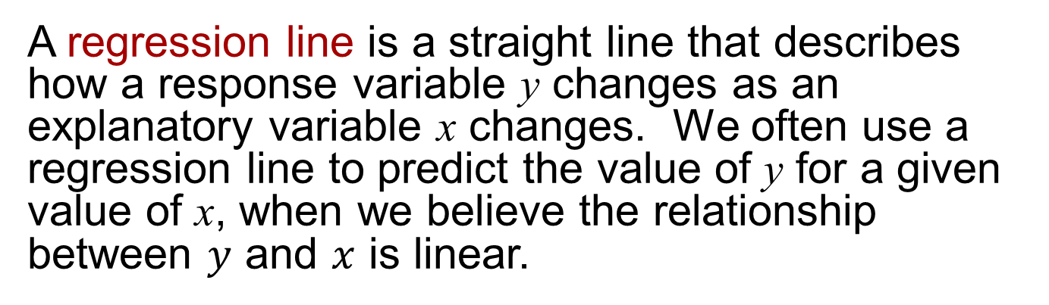
Regression line (1 of 2)
A regression line is a straight line that describes how a response variable y changes as an explanatory variable x changes. We often use a regression line to predict the value of y for a given value of x, when we believe the relationship between $y$ and $x$ is linear.
Example: Predict the gain in fat (in kilograms) based on the change in Non-Exercise Activity (NEA change, in calories).
If the NEA change is 400 calories, what is the expected fat gain?
This regression line describes the overall pattern of the relationship

Slide 5

Regression line (2 of 2)
Review of straight lines
Suppose that $y$ is a response variable (plotted on the vertical axis) and $x$ is an explanatory variable (plotted on the horizontal axis). A straight line relating $y$ to $x$ has an equation of the form
$$y=a+bx$$
In this equation, $b$ is the slope—the amount by which $y$ changes when $x$ increases by one unit. The number $a$ is the intercept—the value of $y$ when $x = 0$.
To plot the line on the scatterplot, use the equation to find the predicted $y$ for two values of $x$, one near each end of the range of $x$ in the data. Plot a line each $y$ above its $x$-value, and draw the line through the two points.

Slide 6
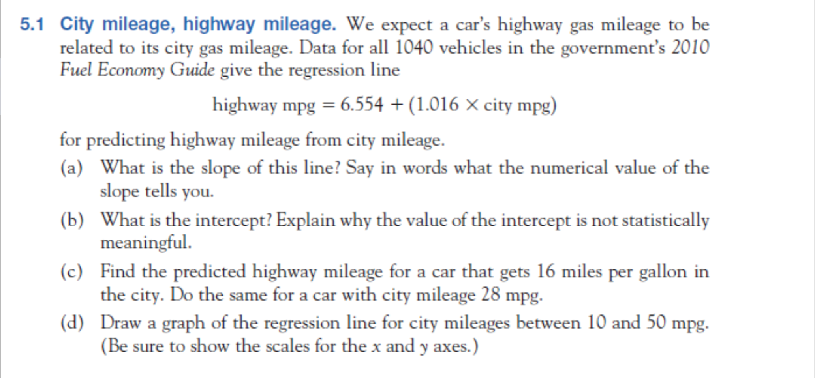
Apply your knowledge

Slide 7
Regression Line
The regression line for body fat index (bfi) as a function of triceps thickness (in mm) is given below.
bfi = 14.59 + (0.74 × triceps thickness)
In this equation, bfi is the ______________ variable and triceps thickness is the ______________ variable.
explanatory; response
response; explanatory

Slide 8
Regression Line
The regression line for body fat index (bfi) as a function of triceps thickness (in mm) is given below.
bfi = 14.59 + (0.74 × triceps thickness)
What is the average amount by which bfi changes when triceps thickness increases by 1 mm?
0.74
1.48
14.59
15.33

Slide 9
Regression Line
The regression line for body fat index (bfi) as a function of triceps thickness (in mm) is given below.
bfi = 14.59 + (0.74 × triceps thickness)
Predict the bfi for individuals with triceps thickness of 35 mm.
14.59 + 0.74 = 15.33
14.59 + 35 = 49.59
14.59 + (0.74 × 35) = 40.49
0.74 × 35 = 25.9

Slide 10
Regression Line
The regression line for body fat index (bfi) as a function of triceps thickness (in mm) is given below.
bfi = 14.59 + (0.74 × triceps thickness)
What is 14.59 in this equation?
the predicted bfi when triceps thickness = 0 mm
the bfi intercept
Both of the answer options are correct.

Slide 11
Regression Line
Consider the following regression line.
MPG = 48.74 − 0.0082 (weight)
Calculate the predicted value of MPG when the weight is 3000 pounds.
30.5
24.14
28.2
17.5

Slide 12
Regression Line
Consider the following regression line, where y is motor vehicle fatalities per 100,000 residents and x is percent population for ages 18 to 24.
y = −10 + 2.7x
Which of the following correctly predicts the number of motor vehicle fatalities in a state with 25% population age 18 to 24?
2.7(25) = 67.5
−10 + 2.7(25) = 57.5
−10(25) = −250
−10(25) + 2.7 = −247.3

Slide 13
Regression Line
Consider the following regression line, where y is motor vehicle fatalities per 100,000 residents and x is percent population for ages 18 to 24.
y = −10 + 2.7x
For every one unit increase in x, the model predicts a change of _________ in the predicted value of y.
−10
2.7(−10)
2.7
−10 + 2.7x

Slide 14
Least Squares
Used to determine the “best” line
Least Squares: use the line that minimizes the sum of the squares of the vertical distances of the data points from the line
Draw a picture

Slide 15
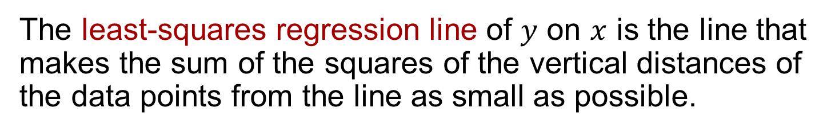

The least-squares regression line
The least-squares regression line of $y$ on $x$ is the line that makes the sum of the squares of the vertical distances of the data points from the line as small as possible.
Equation of the Least-squares regression line
We have data on an explanatory variable $x$ and a response variable $y$ for $n$ individuals. From the data, calculate the means $\overline{x}$ and $\overline{y}$ and the standard deviations $s_{x}$ and $s_{y}$ of the two variables and their correlation $r$. The least-squares regression line is the line
$$\hat{y}=a+bx$$
with slope
$$b=r\frac{s_{y}}{s_{x}}$$
and intercept
$$a=\overline{y}−b\overline{x}$$

Slide 16
Least Squares Regression Line
^
Regression equation: y = a + bx
  x is the value of the explanatory variable
  “y-hat” is the average value of the response variable (predicted response for a value of x)
  note that a and b are just the intercept and slope of a straight line
  note that r and b are not the same thing, but their signs will agree

Slide 17
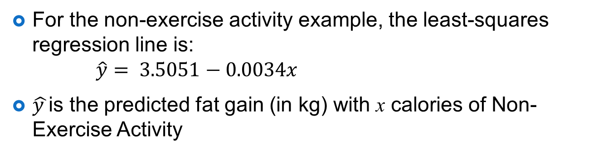

Prediction via regression line
For the non-exercise activity example, the least-squares regression line is:
$\hat{y}= 3.5051−0.0034x$
$\hat{y }$is the predicted fat gain (in kg) with x calories of Non-Exercise Activity
Suppose we know someone has an increase of 400 calories of NEA. What would we predict for fat gain?
For someone with 400 calories of NEA, we would predict fat gain of:
This is the predicted response for someone with an of 400 calories of NEA
$$3.5051−0.0034\left(400\right)=2.1451 \text{kg}$$

Slide 18
Regression Calculation
Case Study
Per Capita Gross Domestic Product
and Average Life Expectancy for
Countries in Western Europe

Slide 19
Regression Calculation
Case Study
Country | Per Capita GDP (x) | Life Expectancy (y)
Austria | 21.4 | 77.48
Belgium | 23.2 | 77.53
Finland | 20.0 | 77.32
France | 22.7 | 78.63
Germany | 20.8 | 77.17
Ireland | 18.6 | 76.39
Italy | 21.5 | 78.51
Netherlands | 22.0 | 78.15
Switzerland | 23.8 | 78.99
United Kingdom | 21.2 | 77.37

Slide 20
Regression Calculation
Case Study
Linear regression equation:
^
y = 68.716 + 0.420x

Slide 21
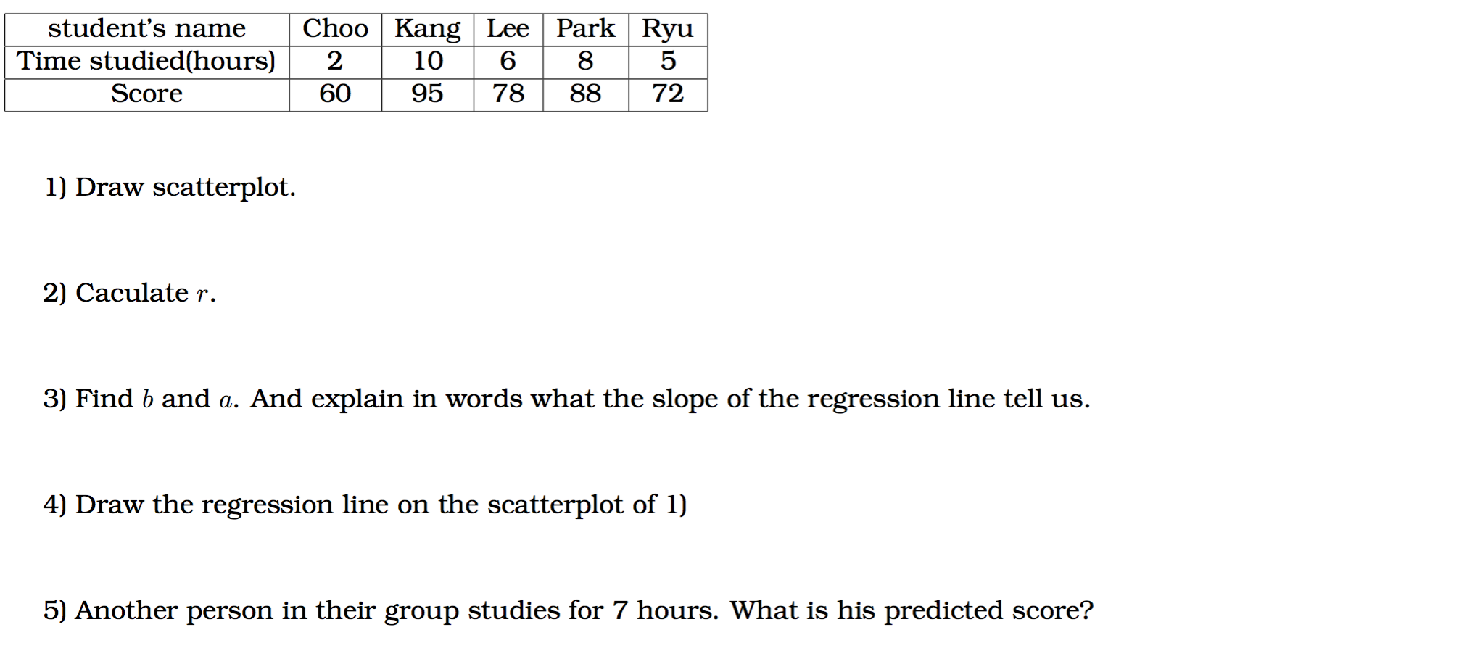
Apply your knowledge

Slide 22
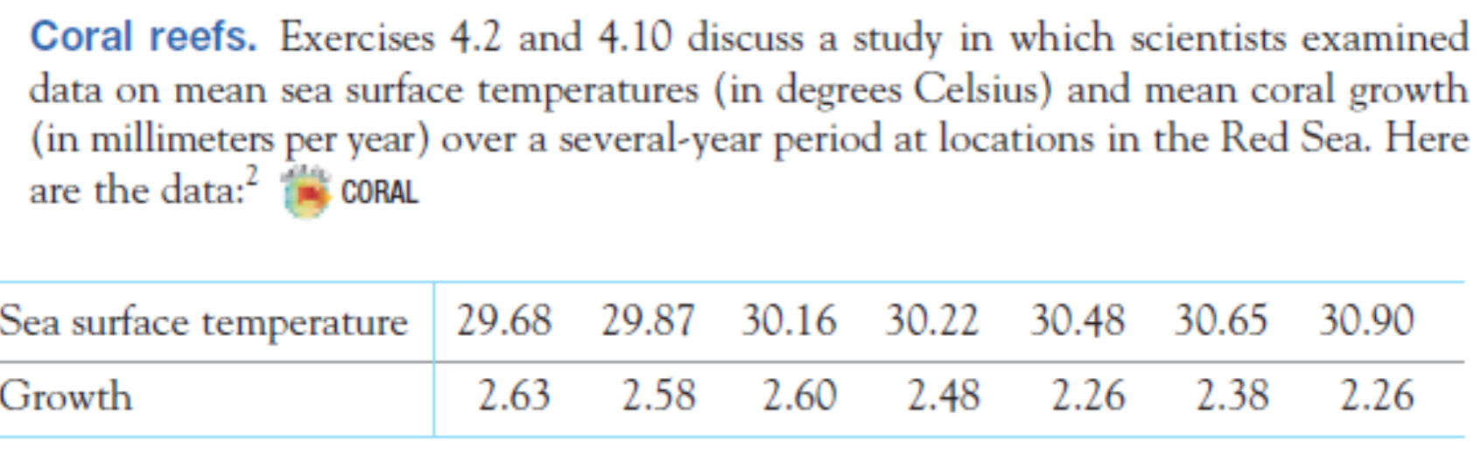
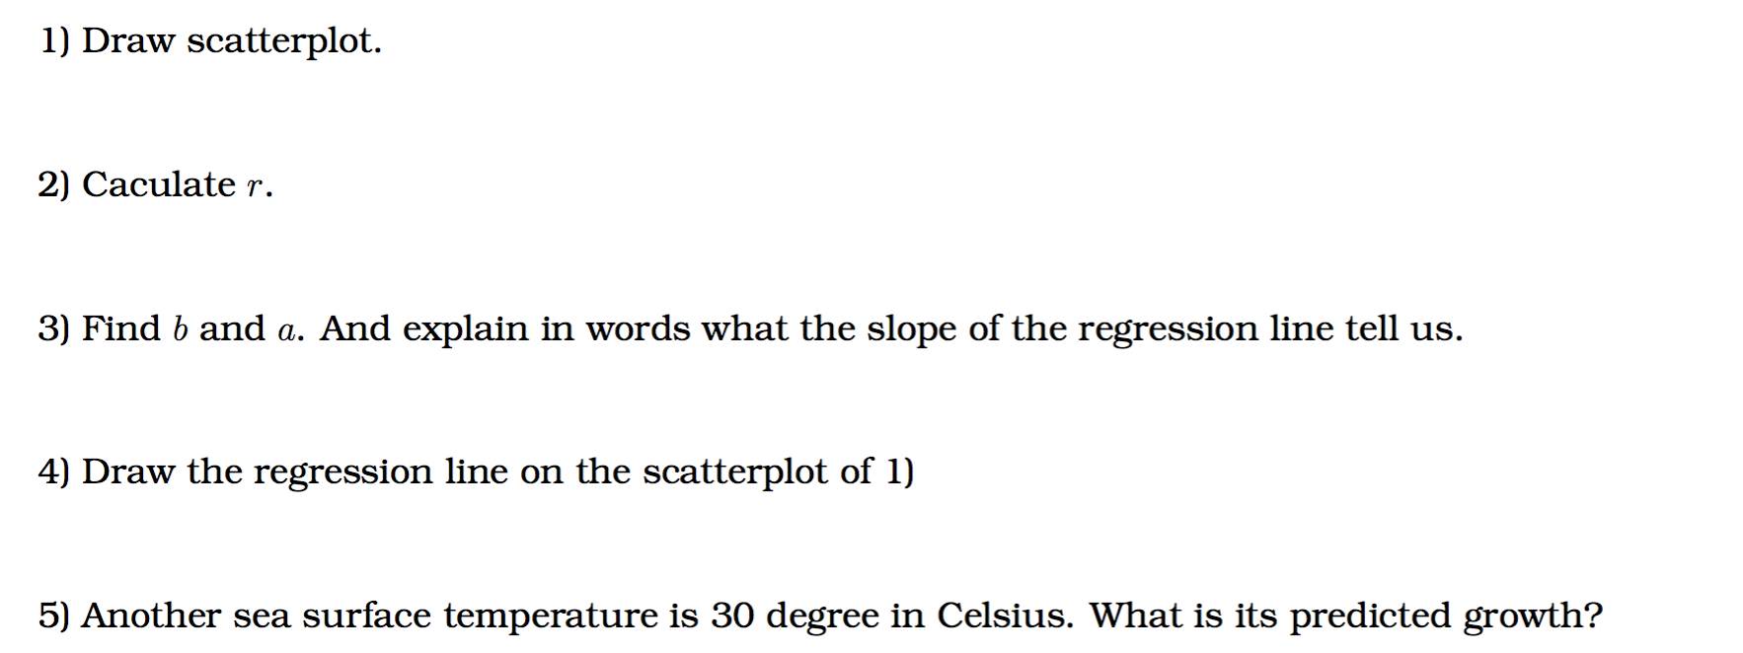

Slide 23
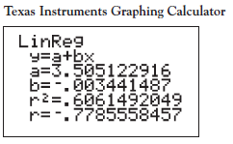
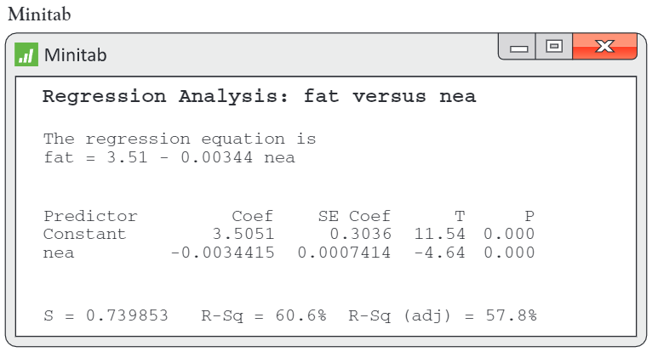
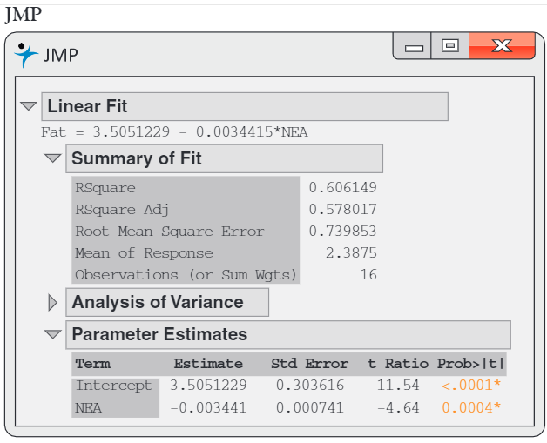
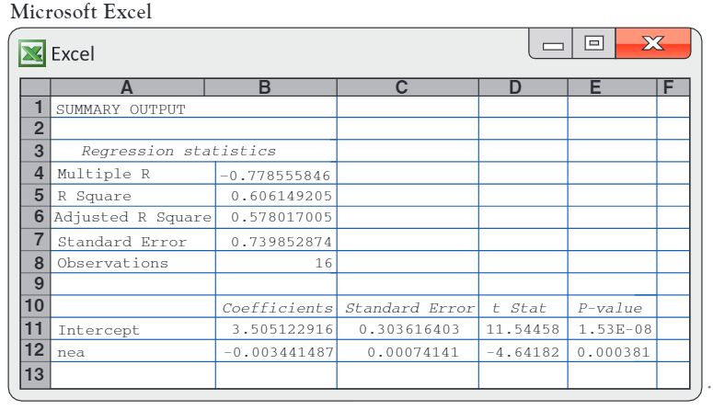
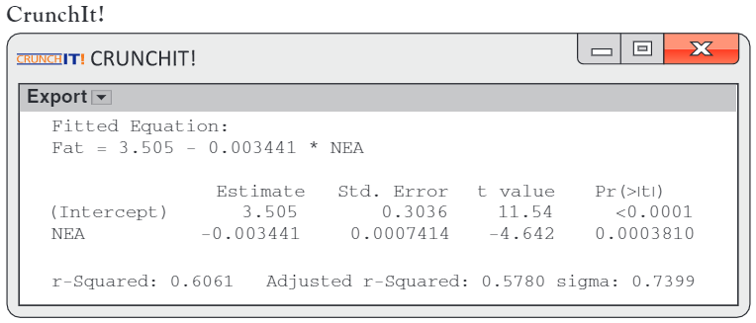
Examples of technology

Slide 24
Least-Squares Regression Line (1 of 2)
Look at the following least-squares regression line. Compare the squared errors from the points A and B.
Point A’s squared errors would be greater than Point B’s.
Point A’s squared errors would be less than Point B’s.
Point A’s squared errors would be equal to Point B’s.
The answer cannot be determined from the information given.

Slide 25
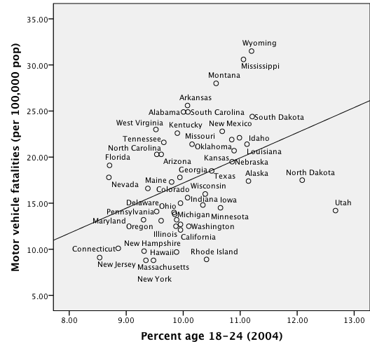
Least-Squares Regression Line (2 of 2)
What will happen to the slope of the least-squares regression line if we remove Utah and North Dakota?
increase (more positive)
decrease (more negative)
remain the same
The answer cannot be determined from the information given.

Slide 26
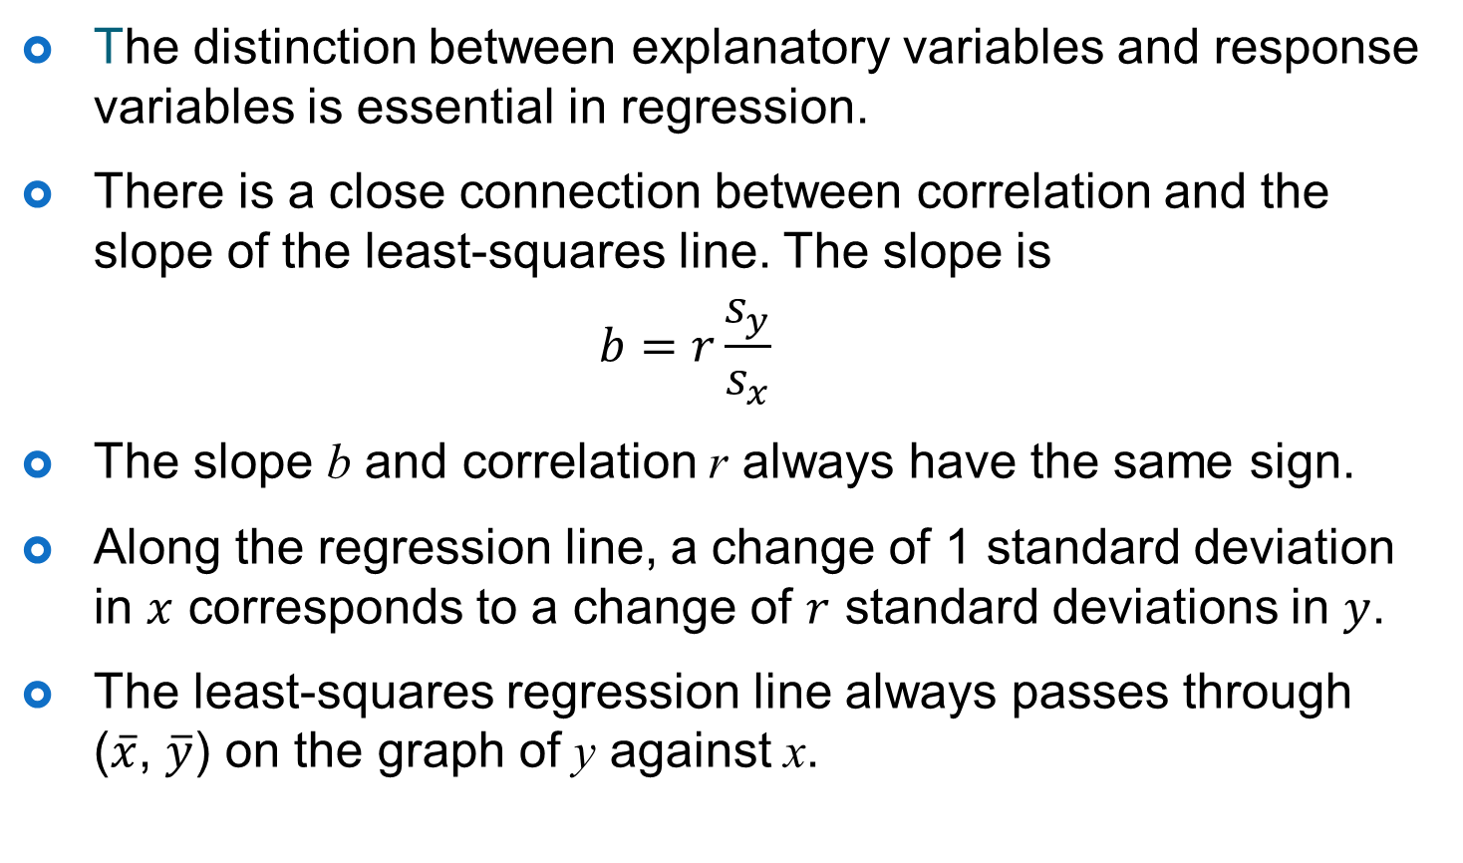
Facts about least-squares regression
The distinction between explanatory variables and response variables is essential in regression.
There is a close connection between correlation and the slope of the least-squares line. The slope is
$$b=r\frac{s_{y}}{s_{x}}$$
  The slope b and correlation r always have the same sign.
  Along the regression line, a change of 1 standard deviation in $x$ corresponds to a change of $r$ standard deviations in $y$.
The least-squares regression line always passes through ($\overline{x}$, $\overline{y}$) on the graph of y against x.

Slide 27
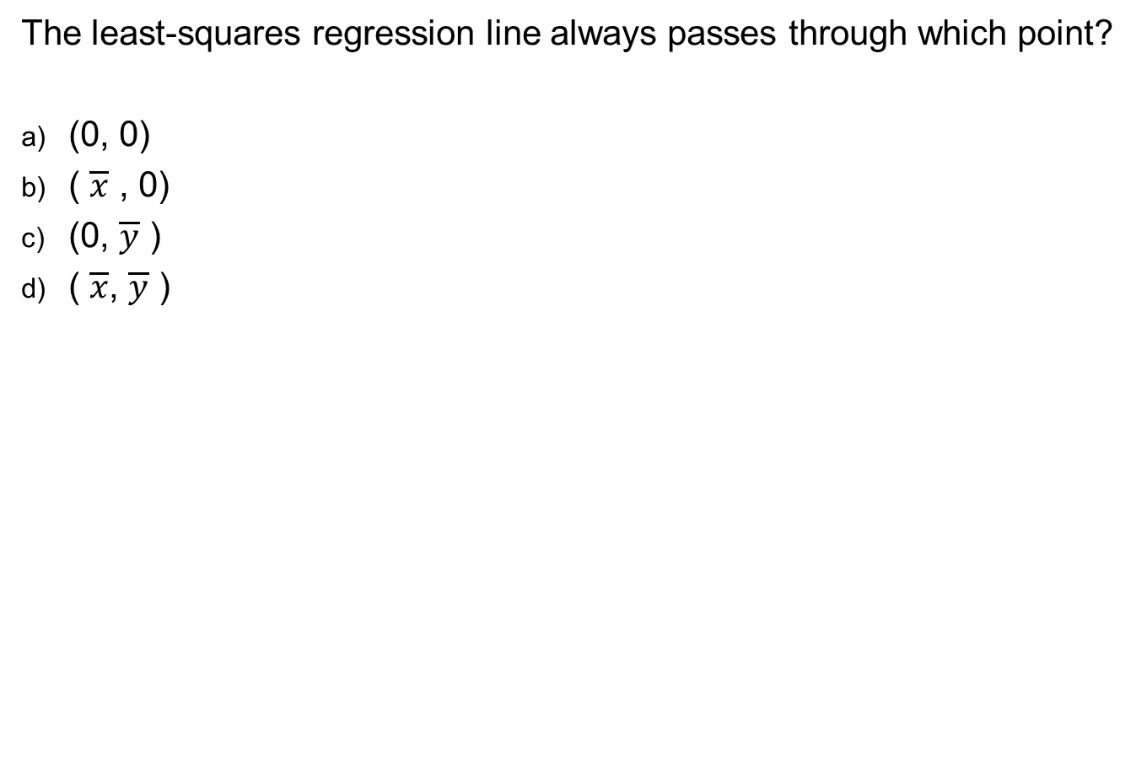
Facts about Least Squares
The least-squares regression line always passes through which point?
(0, 0)
( $\overline{x}$ , 0)
(0, $\overline{y}$ )
( $\overline{x}$, $\overline{y}$ )

Slide 28
Facts about Least Squares
If y is the response variable and x is the explanatory variable, what does the regression line allow you to do that correlation does not?
calculate the exact value of x, given a value for y
calculate the predicted value of x, given a value for y
calculate the exact value of y, given a value for x
calculate the predicted value of y, given a value for x

Slide 29
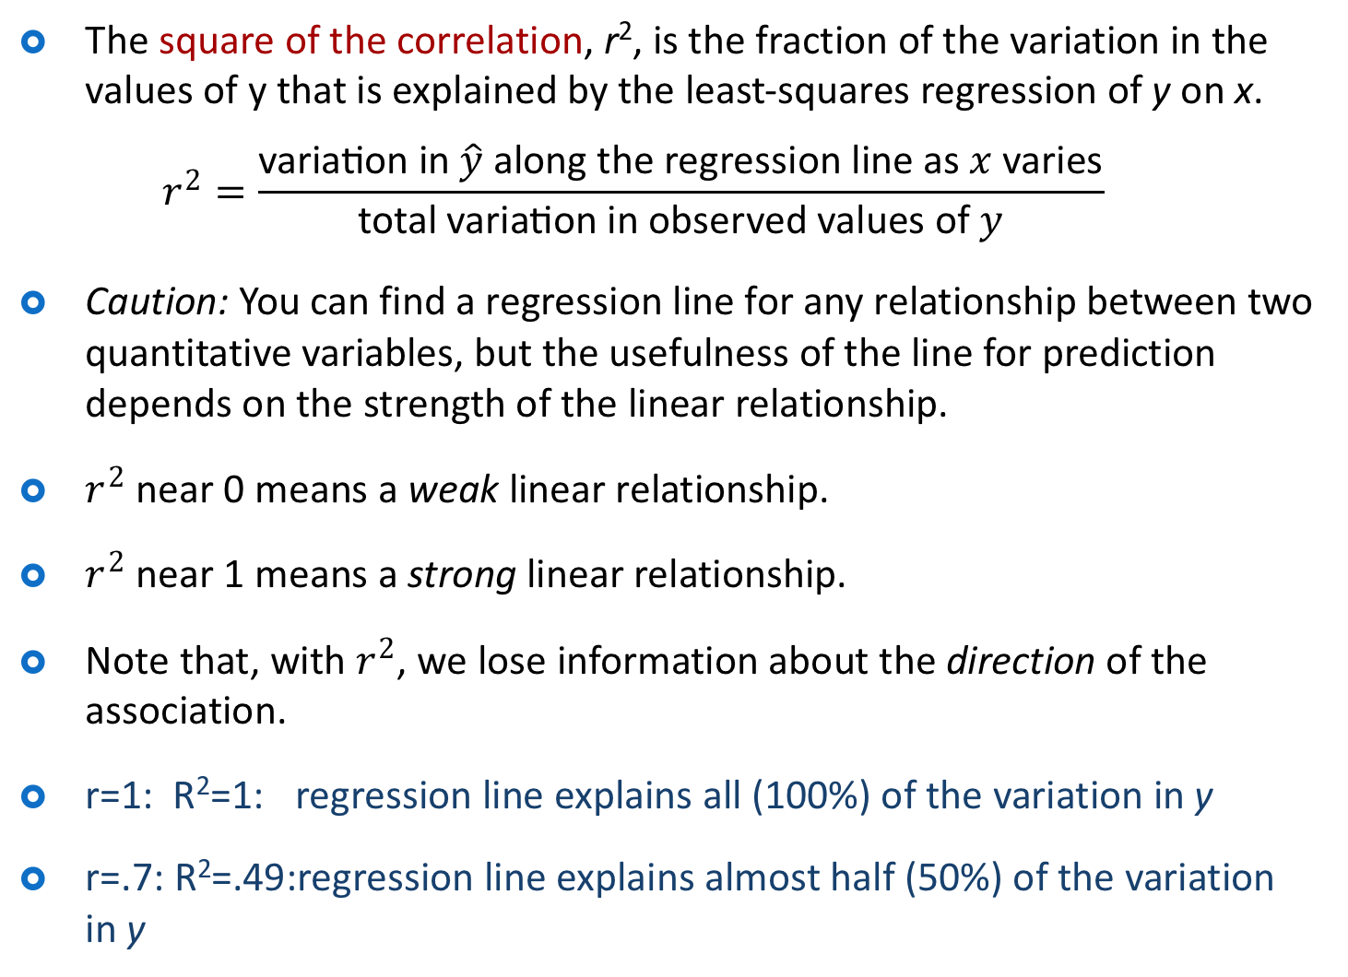
The square of the correlation
The square of the correlation, r², is the fraction of the variation in the values of y that is explained by the least-squares regression of y on x.
$$r^{2}=\frac{\text{variation} \text{in} \hat{y} \text{along} \text{the} \text{regression} \text{line} \text{as} x \text{varies}}{\text{total} \text{variation} \text{in} \text{observed} \text{values} \text{of} y}$$
Caution: You can find a regression line for any relationship between two quantitative variables, but the usefulness of the line for prediction depends on the strength of the linear relationship.
$r^{2}$ near 0 means a weak linear relationship.
$r^{2}$ near 1 means a strong linear relationship.
Note that, with $r^{2}$, we lose information about the direction of the association.
r=1: R²=1: regression line explains all (100%) of the variation in y
r=.7: R²=.49:regression line explains almost half (50%) of the variation in y

Slide 30
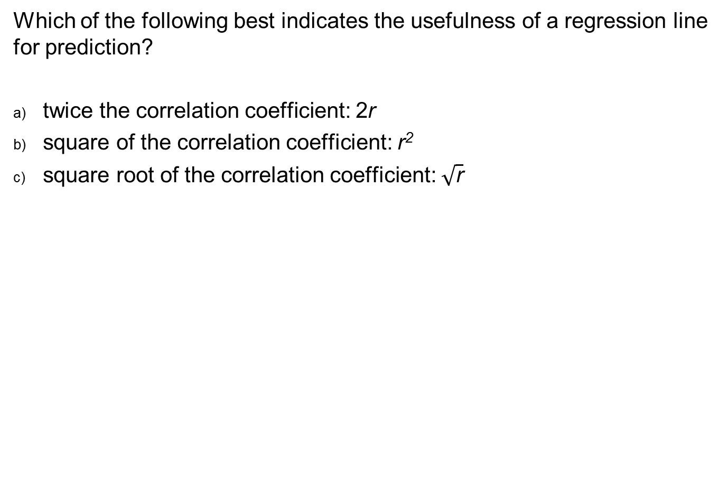
Facts about Least Squares
Which of the following best indicates the usefulness of a regression line for prediction?
twice the correlation coefficient: 2r
square of the correlation coefficient: r²
square root of the correlation coefficient: $\sqrt{\text{r}}$

Slide 31
Facts about Least Squares
The squared correlation (r²) of bfi and triceps thickness is 0.72. The squared correlation (r²) of bfi and neck thickness is 0.18. Which regression line is more useful for prediction of bfi?
bfi vs. triceps thickness
bfi vs. neck thickness
Both answer options are equally good.
The answer cannot be determined from the information given.

Slide 32

Residuals (1 of 2)
A residual is the difference between an observed value of the response variable and the value predicted by the regression line. That is, a residual is the prediction error that remains after we have chosen the regression line:
$$\begin{matrix}\text{r}\text{esidual} & = & \text{observed} y−\text{predicted} y \\ & = & y−\hat{y}\end{matrix}$$
Residuals represent “leftover" variation in the response after fitting the regression line.

Slide 33
Residuals (2 of 2)
The residuals from the least-squares line have a special property: the mean of the least-squares residuals is always zero.
Residual plots
A residual plot is a scatterplot of the regression residuals against the explanatory variable.
Residual plots help us assess how well a regression line fits the data.
Look for a “random” scatter around zero.

Slide 34
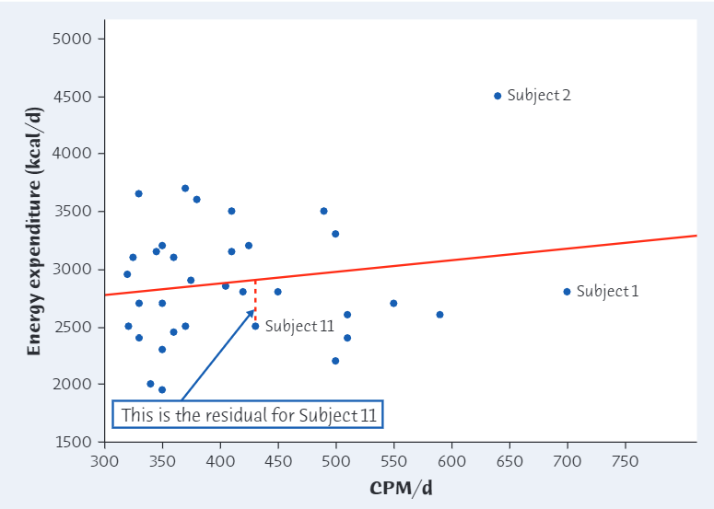
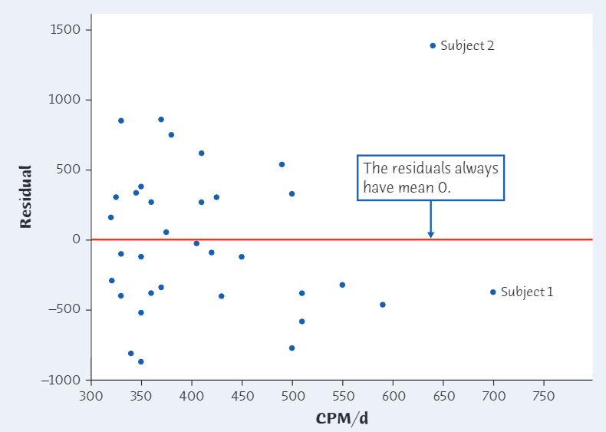
Residual plot
Physical Activity and Weight Loss

Slide 35
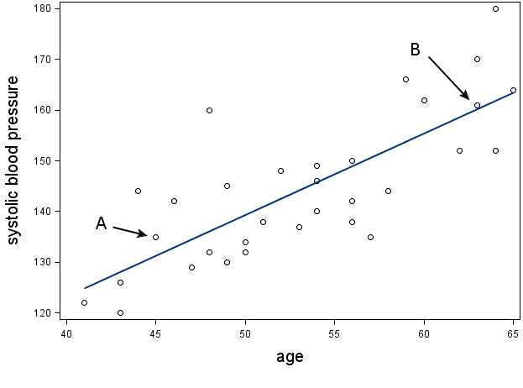
Residuals (1 of 4)
Which point, A or B, has a larger residual?
point A
point B
The answer cannot be determined from the information given.

Slide 36
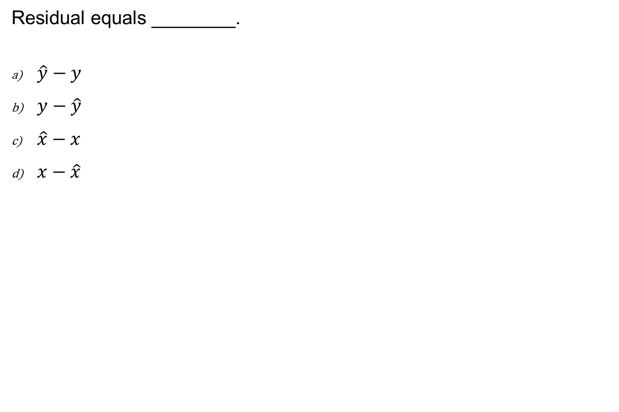
Residuals (2 of 4)
Residual equals ________.
$\hat{y}−y$
$y−\hat{y}$
$\hat{x}−x$
$x−\hat{x}$

Slide 37
Residuals (3 of 4)
The residual plot is used to:
examine the relationship between two variables.
identify the mean and spread of the residuals.
check for independence of observations.
examine how well a regression line fits the data.

Slide 38
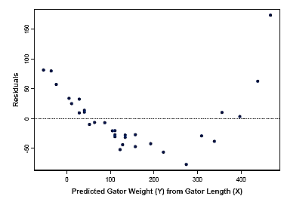
Residuals (4 of 4)
What does this residual plot indicate?
The relationship between X and Y can be modeled with a straight line.
The relationship between X and Y cannot be modeled with a straight line.
Neither of the answer options is correct.

Slide 39
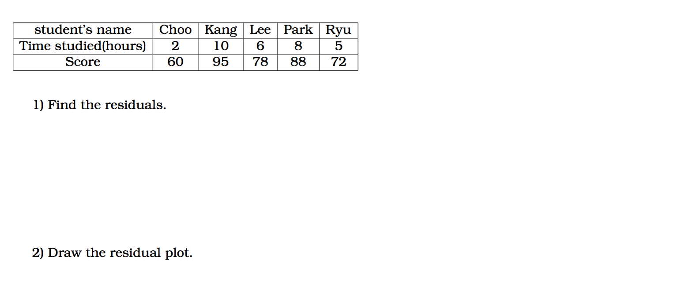
Apply your knowledge

Slide 40

Influential observations
An observation is influential for a statistical calculation if removing it would markedly change the result of the calculation.
The result of a statistical calculation may be of little practical use if it depends strongly on a few influential observations.
Points that are outliers, in either the $x$ or the$y$ direction of a scatterplot, are often influential for the correlation. Points that are outliers in the $x$ direction are often influential for the least-squares regression line.

Slide 41
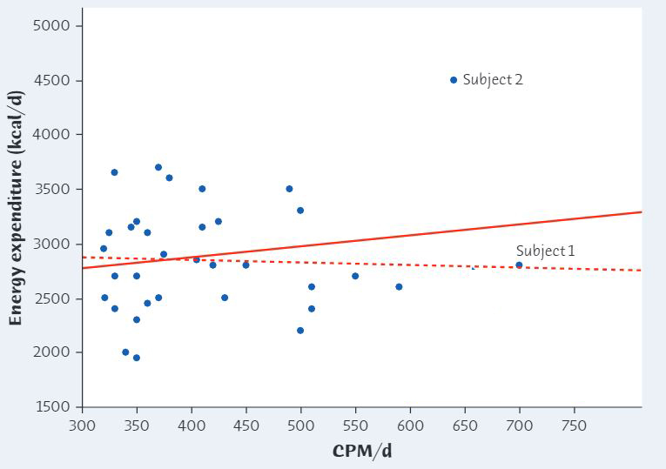


Outliers and influential points
Physical Activity and Weight Loss
From all of the data
$$r = 0.181$$
After removing subject 2
$$r =−0.043$$

Slide 42
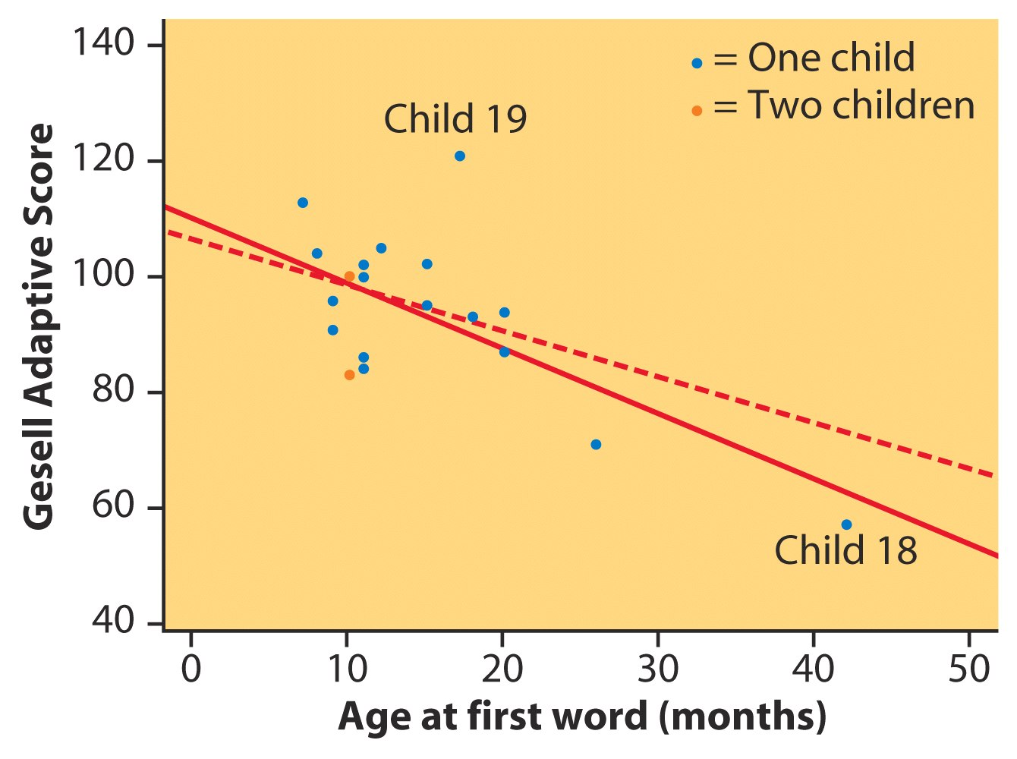
Outliers:
Case Study
Gesell Adaptive Score and Age at First Word
After removing child 18
r² = 11%
From all the data
r² = 41%

Slide 43
Influential Observation (1 of 3)
The graph indicates the presence of:
a non-influential outlier.
an influential outlier.
a lurking variable.
an outlier in the y direction only.

Slide 44
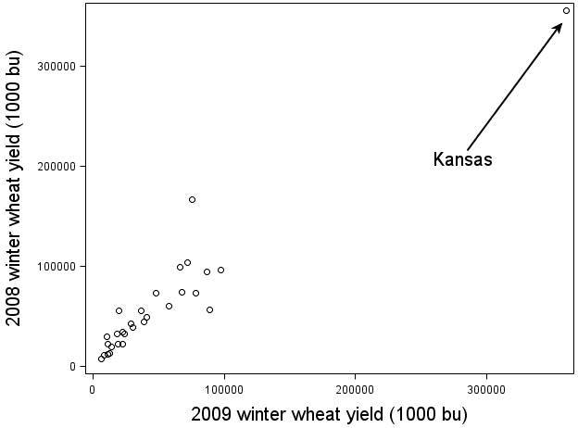
Influential Observation (2 of 3)
If Kansas was removed from the plot, the correlation would _________.
increase
decrease
The answer cannot be determined from the information given.

Slide 45
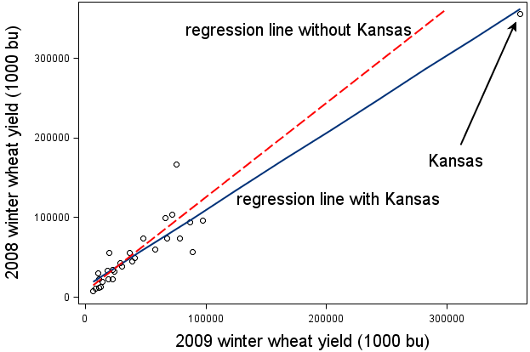
Influential Observation (3 of 3)
Kansas is an influential outlier.
true
false
The answer cannot be determined from the information given.

Slide 46
Cautions about correlation and regression
Correlation and regression lines describe only linear relationships.
Correlation and least-squares regression lines are not resistant.
Beware ecological correlation, or correlation based on averages rather than individuals.
A correlation based on averages rather than on individuals is called an ecological correlation.

Slide 47
Cautions about correlation and regression
Beware of extrapolation—predicting outside of the range of x.
Beware of lurking variables—these have an important effect on the relationship among the variables in a study, but are not included in the study.
A lurking variable is a variable that is not among the explanatory or response variables in a study and yet may influence the interpretation of relationships among those variables.
Correlation does not imply causation!
An association between an explanatory variable x and a response variable y, even if it is very strong, is not by itself good evidence that changes in x actually cause changes in y.

Slide 48
Caution: beware of extrapolation (1 of 2)
Sarah’s height was plotted against her age.
Can you predict her height at age 42 months?
Can you predict her height at age 30 years (360 months)?

Slide 49
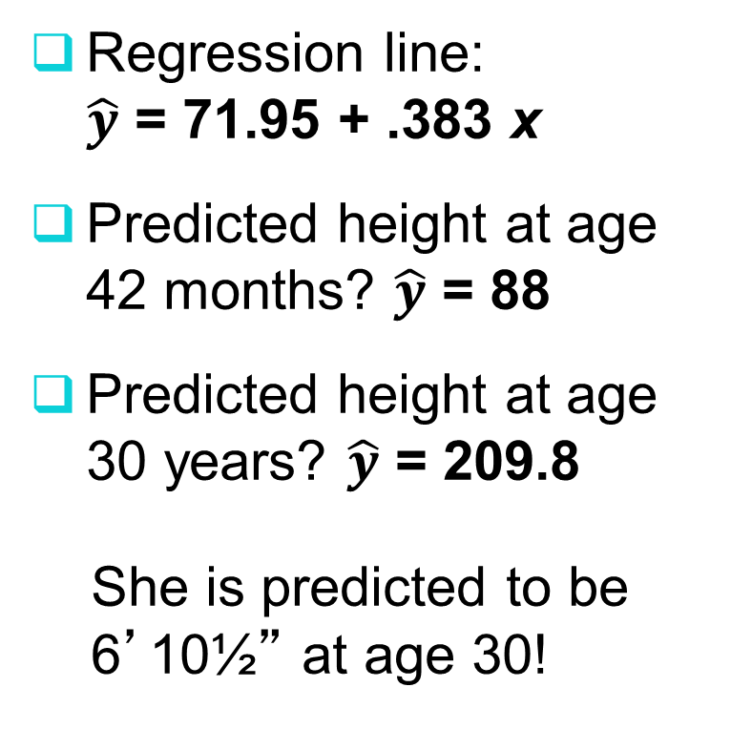
Caution: beware of extrapolation (2 of 2)
Regression line:
$\hat{y}$ = 71.95 + .383 x
Predicted height at age 42 months? $\hat{y}$ = 88
Predicted height at age 30 years? $\hat{y}$ = 209.8
  She is predicted to be 6’10½” at age 30!

Slide 50
Caution: beware of lurking variables
Example: Meditation and Aging
(Noetic Sciences Review, Summer 1993, p. 28)
Explanatory variable: observed meditation
practice (yes/no)
Response variable: level of age-related enzyme
General concern for one’s well-being may also be affecting the response (and the decision to try meditation).

Slide 51
Correlation does not imply causation
Even very strong correlations may not correspond to a real causal relationship (changes in x actually causing changes in y).
Correlation may be explained by a lurking variable
Social Relationships and Health
House, J., Landis, K., and Umberson, D. “Social Relationships and Health,” Science, Vol. 241 (1988), pp. 540-545.
Does lack of social relationships cause people to become ill?
(There was a strong correlation.)
  Or, are unhealthy people less likely to establish and maintain social relationships? (reversed relationship)
  Or, is there some other factor that predisposes people both to have lower social activity and to become ill?

Slide 52
Evidence of causation
A properly conducted experiment may establish causation.
Other considerations when we cannot do an experiment:
The association is strong.
The association is consistent.
Higher doses are associated with stronger responses.
Alleged cause precedes the effect in time.
Alleged cause is plausible (reasonable explanation).

Slide 53
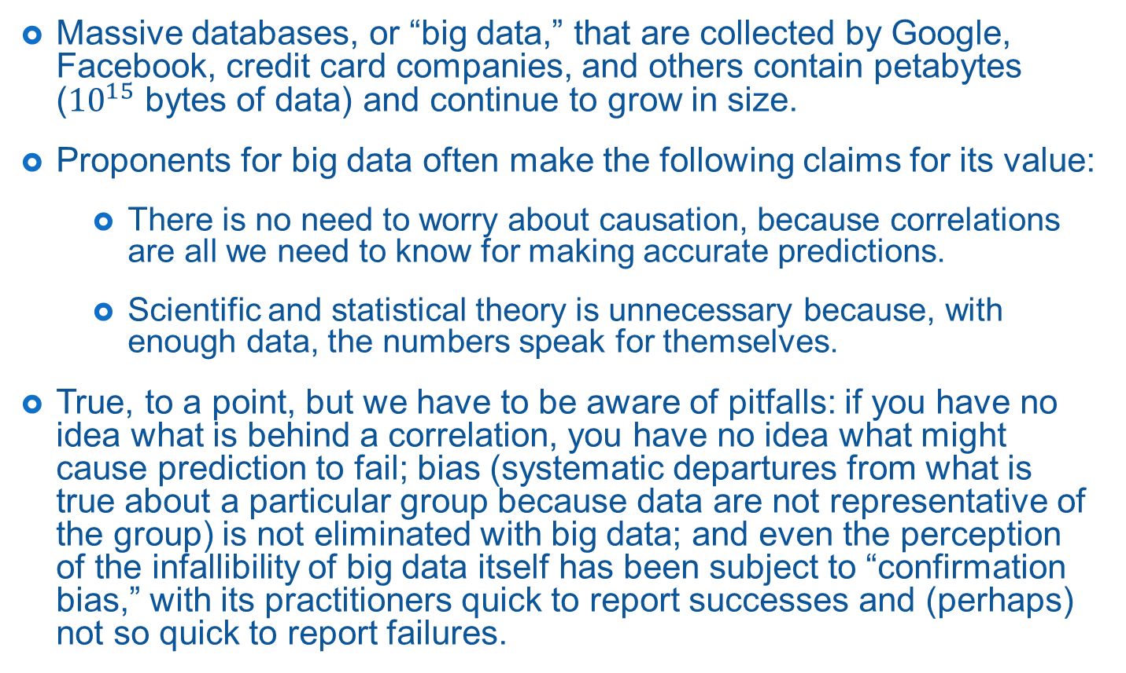
Correlation, prediction, and big data
Massive databases, or “big data,” that are collected by Google, Facebook, credit card companies, and others contain petabytes (${10}^{15}$ bytes of data) and continue to grow in size.
Proponents for big data often make the following claims for its value:
  There is no need to worry about causation, because correlations are all we need to know for making accurate predictions.
  Scientific and statistical theory is unnecessary because, with enough data, the numbers speak for themselves.
True, to a point, but we have to be aware of pitfalls: if you have no idea what is behind a correlation, you have no idea what might cause prediction to fail; bias (systematic departures from what is true about a particular group because data are not representative of the group) is not eliminated with big data; and even the perception of the infallibility of big data itself has been subject to “confirmation bias,” with its practitioners quick to report successes and (perhaps) not so quick to report failures.

Slide 54
Causation (1 of 3)
A 1999 observational study reported in the prestigious journal Nature found a positive correlation between ambient lighting in a baby’s room and the degree of myopia (nearsightedness) later in life. What should you do with this information?
Accept it without question.
Accept it tentatively.
Throw away your baby’s nightlight to prevent myopia.
Wait until an experiment is done.

Slide 55
Causation (2 of 3)
The myopia study referenced on the previous slide was later criticized. A second study showed no relationship. One of the following was suggested as a lurking variable in the first study. Which is it?
(Think carefully about which variable might have influenced the relationship. Who would have tended to both use nightlights and pass on myopia to their children?)
socioeconomic status
parental myopia
gender
nationality

Slide 56
Causation (3 of 3)
The graph shows the least-squares regression line for predicting diamond price from diamond size, for diamonds that are 0.35 carat or less. Using this relationship to predict the price of a diamond that is 1 carat is an example of _______.
prediction
an influential observation
a lurking variable
extrapolation

Slide 57
Big Data (1 of 2)
We don’t worry about correlation versus causation in big data, because correlation is all we need for _______.
unbiased estimation
making predictions
significance
extrapolation

Slide 58
Big Data (2 of 2)
Despite the very large data sets associated with big data, _______ due to recording errors and non-random sampling does not go away.
correlation
bias
significance
regression

