Slide 1
CHAPTER 12: Introducing Probability
Basic Practice of Statistics
^{7th} Edition
Lecture PowerPoint Slides

Slide 2
In Chapter 12, we cover …
The idea of probability
The search for randomness
Probability models
Probability rules
Finite probability models
Continuous probability models
Random variables
Personal probability

Slide 3
Idea of Probability
Probability is the science of chance behavior: theoretical basis for statistics
Chance behavior is unpredictable in the short run but has a regular and predictable pattern in the long run
this is why we can use probability to gain useful results from random samples and randomized comparative experiments

Slide 4
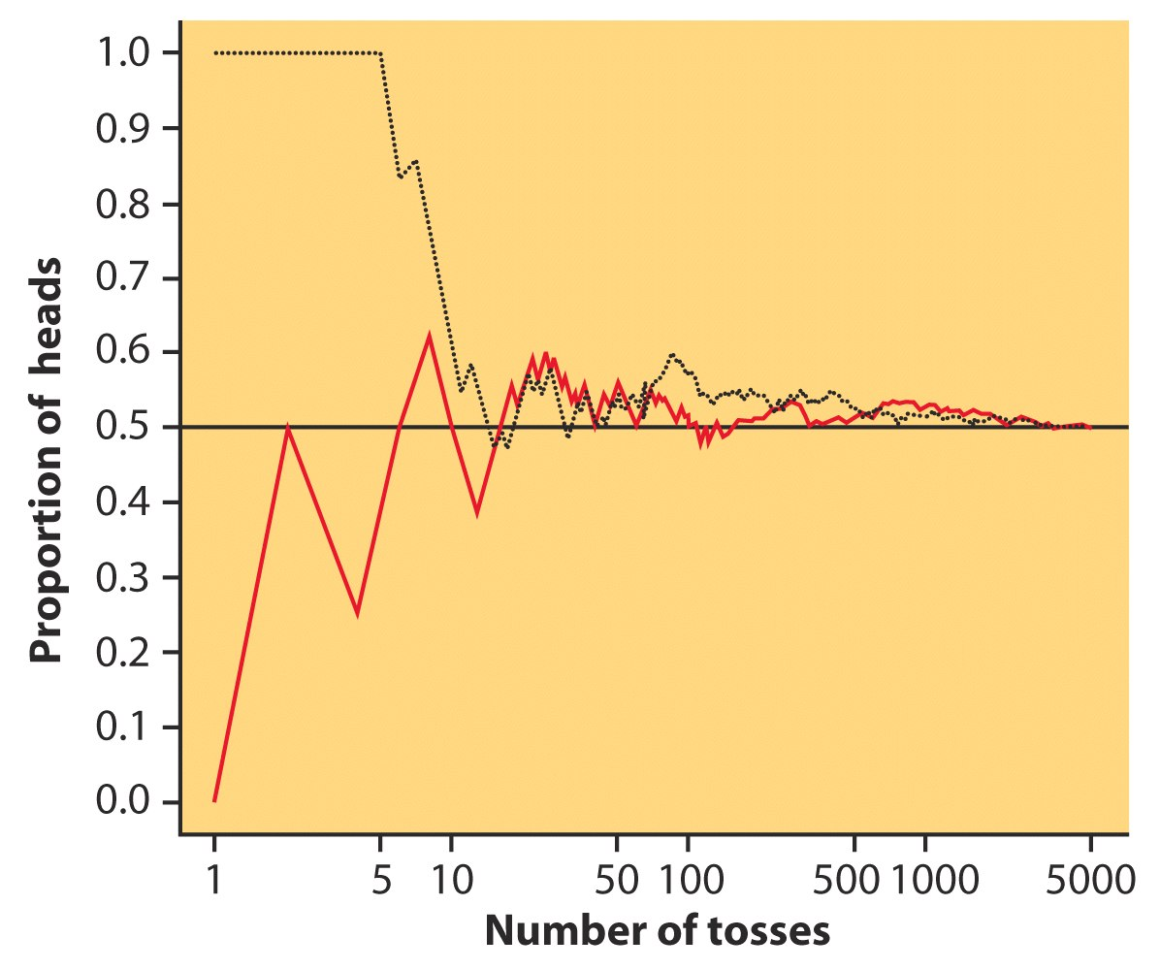
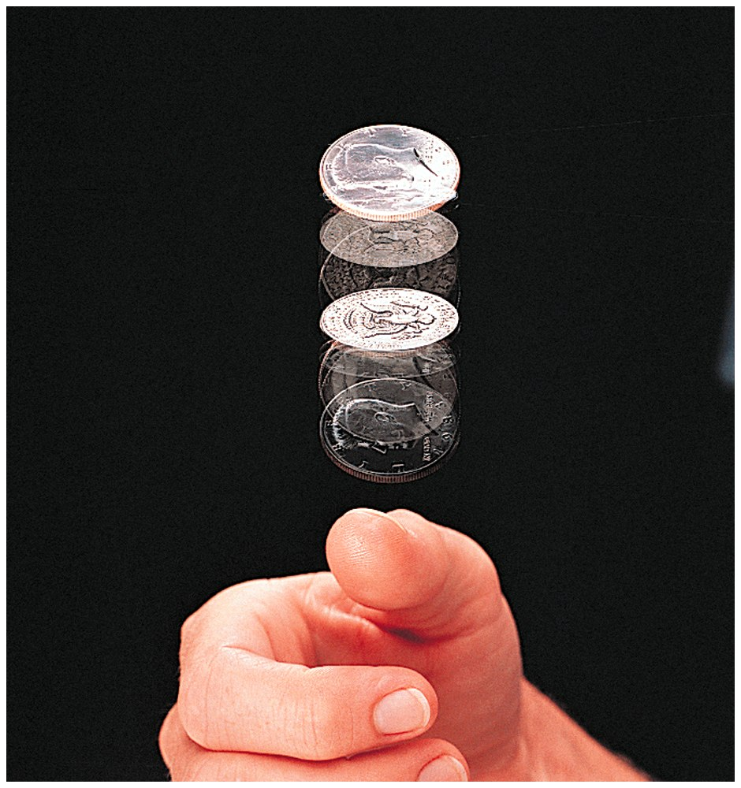
Relative-Frequency Probabilities
Coin flipping:

Slide 5
Probability models (part I)
Descriptions of chance behavior contain two parts: a list of possible outcomes and a probability for each outcome.
The sample space S of a random phenomenon is the set of all possible outcomes.
An event is an outcome or a set of outcomes of a random phenomenon. That is, an event is a subset of the sample space.
A probability model is a mathematical description of a random phenomenon consisting of two parts: a sample space S and a way of assigning probabilities to events.

Slide 6
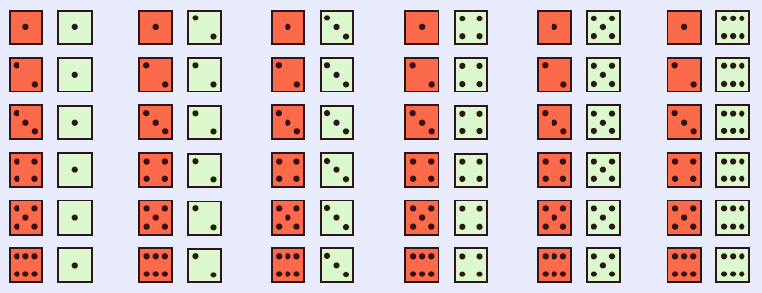
Probability models (part II)
Example: Give a probability model for the chance process of rolling two fair, six-sided dice―one that is red and one that is green.
Sample space
36 outcomes
Since the dice are fair, each outcome is equally likely.
Each outcome has probability 1/36.

Slide 7
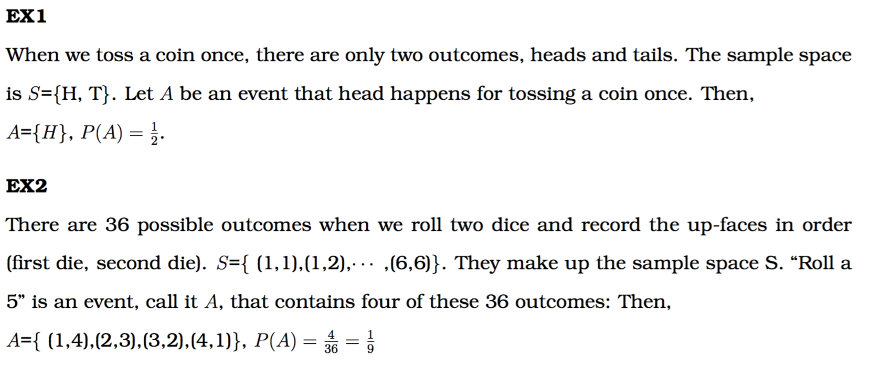
EX3
The sample space for tossing two coins is S={ (H,H), (H,T), (T,H), (T,T) }. Let A be an even that the number of heads is 1. Then, A={(H,T),(T,H)}. P(A)=2/4=1/2.

Slide 8
Probability Models (1 of 2)
The sample space for the experiment of flipping a coin three times is {HHH, HHT, HTH, THH, TTH, THT, HTT, TTT}. What is the probability of two tails?
1/8
3/8
6/8
7/8

Slide 9
Probability Models (2 of 2)
Which is the sample space for the random phenomenon of flipping a coin twice?
{H, T}
{HH, TT}
{HH, HT, TT}
{HH, HT, TH, TT}

Slide 10
Probability rules (part I)
Any probability is a number between 0 and 1. Any proportion is a number between 0 and 1, so any probability is also a number between 0 and 1.
All possible outcomes together must have probability 1. Because some outcome must occur on every trial, the sum of the probabilities for all possible outcomes must be exactly 1.
If two events have no outcomes in common, the probability that one or the other occurs is the sum of their individual probabilities.
The probability that an event does not occur is 1 minus the probability that the event does occur. The probability that an event occurs and the probability that it does not occur always add to 1, or 100%.

Slide 11
Probability rules (part II)
The probability rules in formal language:
Rule 1. The probability $P\left(A\right)$ of any event $A$ satisfies $0≤P(A)≤1.$
Rule 2. If $S$ is the sample space in a probability model, $P\left(S\right)=1.$
Rule 3. Two events $A$ and $B$ are disjoint if they have no outcomes in common and, thus, can never occur together. If $A$ and $B$ are disjoint,
$$P\left(A \text{or} B\right)=P\left(A\right)+P\left(B\right)$$
This is the addition rule for disjoint events.
Rule 4. For any event $A,$
$$P\left(A \text{d}\text{o}\text{es} \text{not} \text{occur}\right)=1−P\left(A\right)$$

Slide 12
Probability Rules: Mathematical Notation
Random phenomenon: roll pair of fair dice and count the number of pips on the up-faces.
Find the probability of rolling a 5.
P(roll a 5) = P( )+P( )+P( )+P( )
= 1/36 + 1/36 + 1/36 + 1/36
= 4/36
= 0.111

Slide 13
Probability rules (example)
The first digits of numbers in legitimate financial records often follow a model known as Benford’s law. Call the first digit of a randomly chosen record X. Benford’s law gives the following probability model for X.
First digit (X) | 1 | 2 | 3 | 4 | 5 | 6 | 7 | 8 | 9
Probability | 0.301 | 0.176 | 0.125 | 0.097 | 0.079 | 0.067 | 0.058 | 0.051 | 0.046
Show that this is a legitimate probability model.
Find the probability that the first digit for the chosen number is not a 9.
Each probability is between 0 and 1, and $0.301+0.176+…+0.046=1$
$$\begin{matrix}P(\text{not} 9) & = & \begin{matrix}1 – P(9) & \end{matrix} \\ & = & \begin{matrix}1 – 0.046 & = 0.954\end{matrix}\end{matrix}$$

Slide 14
Probability Rules
Let X be the number of girls in a family of three children. Does the table below show a valid assignment of probabilities to values of X?
X | 0 | 1 | 2 | 3
Probability | 0.125 | 0.375 | 0.375 | 0.125
No, because X could take on other values.
No, because it is not possible for X to be equal to 0.
Yes, because all possible values of X are included.
Yes, because all probabilities are between 0 and 1 and they sum to 1.

Slide 15
Finite probability models
One way to assign probabilities to events is to assign a probability to every individual outcome, then add these probabilities to find the probability of any event. This idea works well when there are only a finite (fixed and limited) number of outcomes.
A probability model with a finite sample space is called a finite probability model.
To assign probabilities in a finite model, list the probabilities of all the individual outcomes. These probabilities must be numbers between 0 and 1 that add to exactly 1. The probability of any event is the sum of the probabilities of the outcomes making up the event.
Finite probability models are sometimes called discrete probability models. Statisticians often refer to finite probability models as discrete.
The Benford’s law probability model was finite.

Slide 16
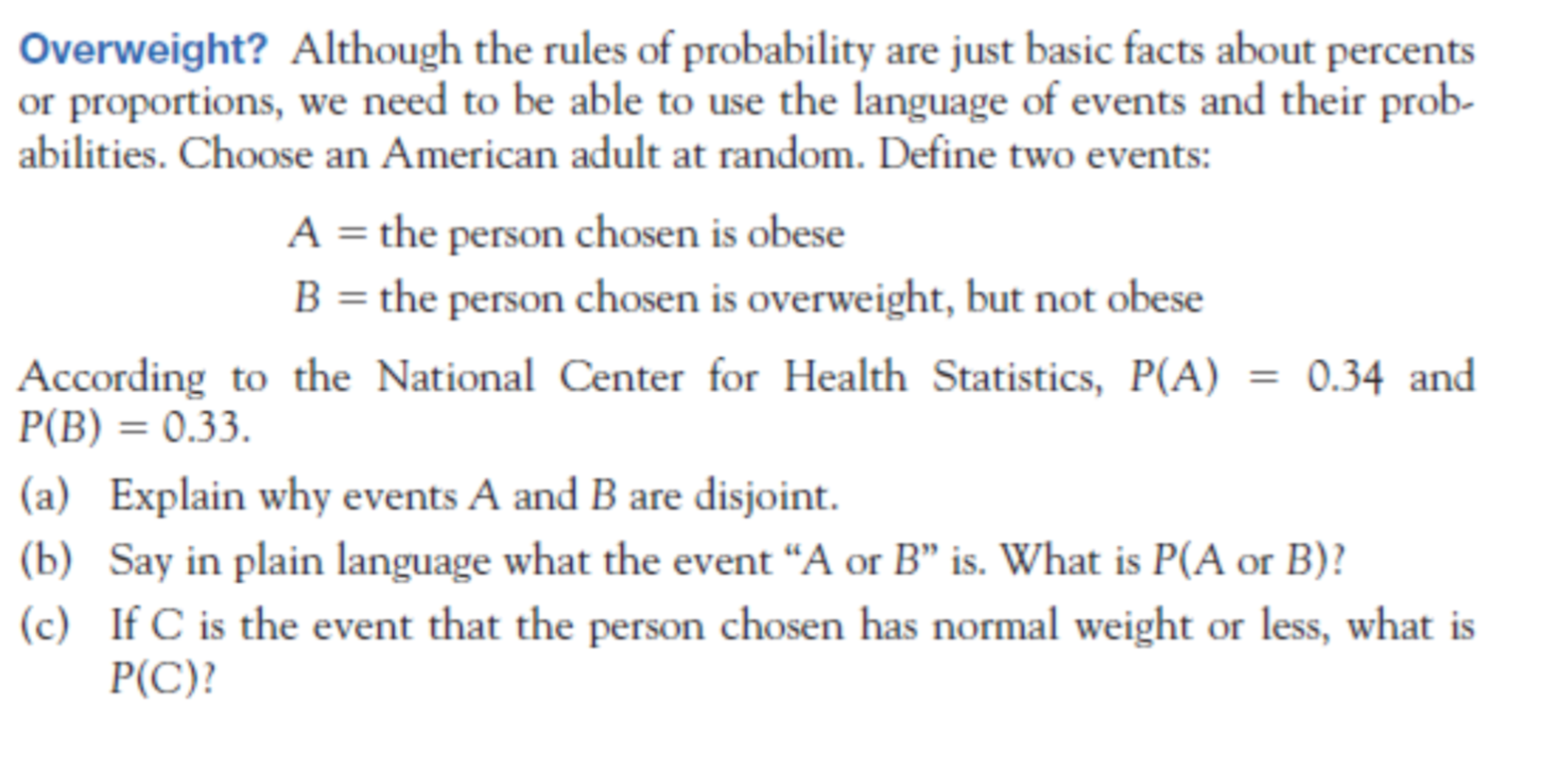

Slide 17
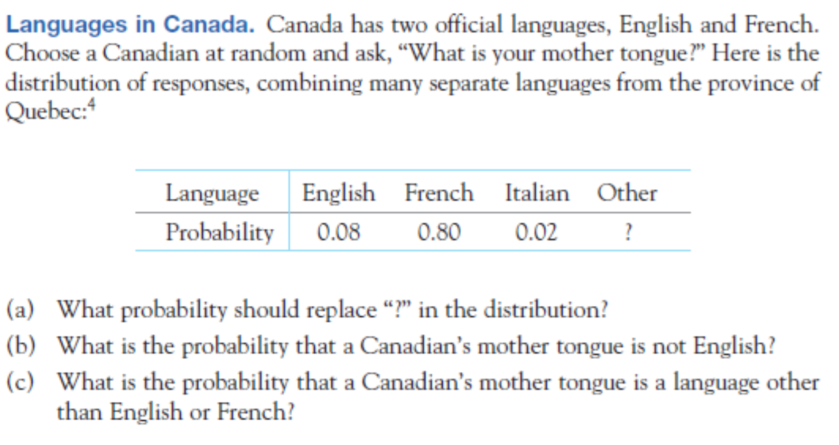

Slide 18
Finite Probability Models (1 of 6)
For the probability distribution below, what is the missing probability?
X | 0 | 1 | 2 | 3
Probability | 0.5 | 0.2 | 0.2 | ?
0.9
0.1
1
0.5

Slide 19
Finite Probability Models (2 of 6)
Let X be the number of girls in a family of three children. What is the probability that the number of girls is not three?
X | 0 | 1 | 2 | 3
Probability | 0.125 | 0.375 | 0.375 | 0.125
0.125
0.125
0.125 + 0.375 = 0.5
1 – 0.125 = 0.875

Slide 20
Finite Probability Models (3 of 6)
Let X be the number of girls in a family of three children. What is the probability that the family has either one or two girls?
X | 0 | 1 | 2 | 3
Probability | 0.125 | 0.375 | 0.375 | 0.125
0.375
0.375 + 0.375 = 0.75
1 − 0.125 = 0.875
0.5

Slide 21
Finite Probability Models (4 of 6)
Let X be the number of girls in a family of three children. What is the probability that the family has more than one girl?
X | 0 | 1 | 2 | 3
Probability | 0.125 | 0.375 | 0.375 | 0.125
1 − 0.125 = 0.875
0.375
0.375 + 0.125 = 0.5
0.125

Slide 22
Finite Probability Models (5 of 6)
A candy company manufactures bags of colorful candies. The company reports that it makes 10% each of green and red candies, and 20% each of yellow, blue, and orange candies. The rest of the candies are brown. If you pick a candy at random, what is the probability that it is brown?
0.1
0.2
0.3
0.4

Slide 23
Finite Probability Models (6 of 6)
A candy company manufactures bags of colorful candies. The company reports that it makes 10% each of green and red candies, and 20% each of yellow, blue, and orange candies. The rest of the candies are brown. If you pick a candy at random, what is the probability that it is either blue or orange?
0.1
0.2
0.3
0.4

Slide 24
Continuous probability models
Suppose we want to choose a number at random between 0 and 1, allowing any number between 0 and 1 as the outcome.
We cannot assign probabilities to each individual value because there is an infinite continuum of possible values.
A continuous probability model assigns probability as an area under a density curve. The area under the curve and above any range of values is the probability of an outcome in that range.
Example: Find the probability of getting a random number that is less than or equal to 0.5 or greater than 0.8.
$$P\left(X≤0.5 \text{or} X>0.8\right)$$
$$=P\left(X≤0.5\right)+P\left( X>0.8\right)$$
$$=0.5+0.2=0.7$$
Uniform
Distribution

Slide 25
Normal probability models (part I)
We can use any density curve to assign probabilities. The density curves that are most familiar to us are the Normal curves.
Normal distributions are continuous probability models as well as descriptions of the data.
Like all continuous probability models, the Normal assigns probability 0 to every individual outcome.
Notes:
The technique for finding such probabilities is found in Chapter 3.

Slide 26
Normal probability models (part II)
If we look at the heights of all young women, we find that they closely follow the Normal distribution, with mean $μ=64.3$ inches and standard deviation $σ=2.7$ inches.
What is the probability that a randomly chosen young women has a height ($X$) between 68 and 70 inches?
$$P(68≤X≤70)\text{ = }\text{P}\left(\frac{68−64.3}{2.7} ≤ \frac{X−64.3}{2.7} ≤ \frac{70−64.3}{2.7}\right)$$
$$\text{ = }\text{P}\left(1.37 ≤z ≤2.11\right)$$
$$\text{ = }\text{P}\left(z ≤2.121\right) −P\left(z≤1.37\right)$$
$$\text{ = 0.9826 − 0.914 = 0.0679}$$
If we repeat the random choice many times, the distribution of values of $X$ is the same Normal distribution that describes the heights of all young women.
Notes:
Photo credit: Peathegee Inc/Getty Images

Slide 28
Continuous Probability Models (1 of 4)
A random phenomenon results in a number in the range of −2 to +2. All numbers in the range are equally likely, so the density curve is flat. What is the height of the curve?
1
4
0.25
0.5

Slide 29
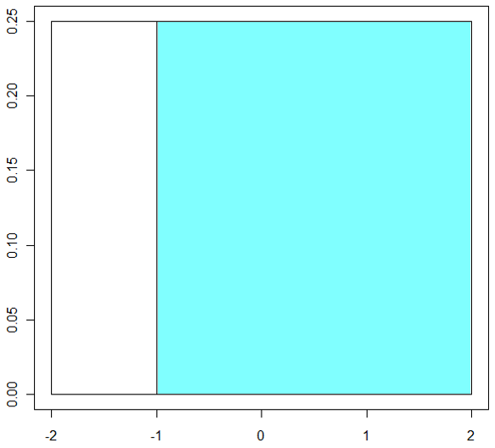
Continuous Probability Models (2 of 4)
A random phenomenon results in a number in the range of −2 to +2. All numbers in the range are equally likely, so the density curve is flat, as shown below. What is the probability that the number will be between −1 and +2?
1
0.5
0.25
0.75

Slide 30
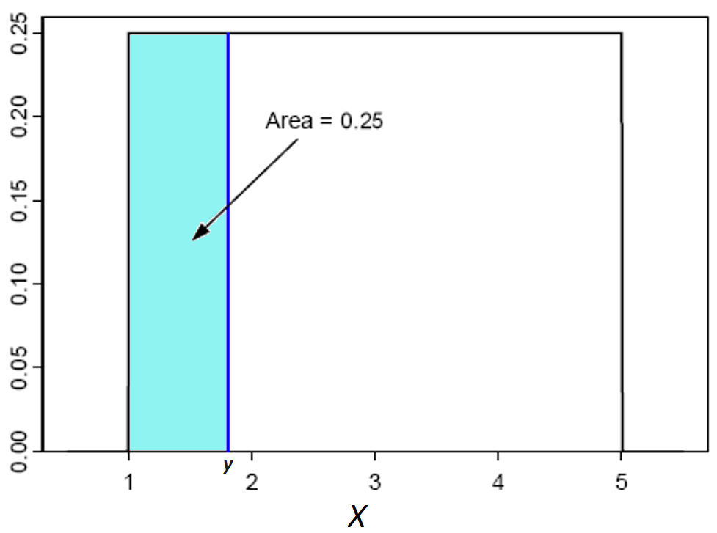
Continuous Probability Models (3 of 4)
A random phenomenon results in a number in the range of 1 to 5. All values in the range are equally likely, so the density curve is flat, as shown below. What must y be such that the probability of a number between 1 and y is 25%?
1.5
2
2.5
4

Slide 31
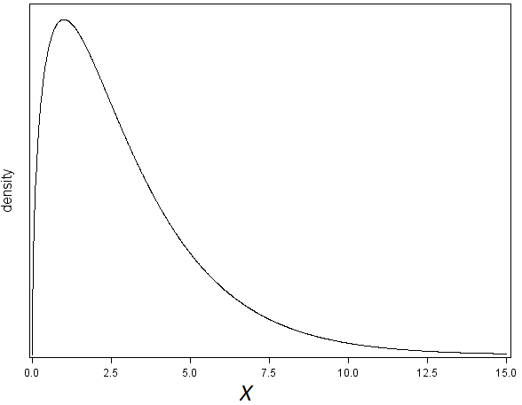
Continuous Probability Models (4 of 4)
A random phenomenon results in a number in the range of 0 to 15. The density curve is shown below. How does the probability that the number is between 2.5 and 5 compare with the probability that the number is between 5 and 7.5?
It is the same.
It is smaller.
It is greater.
There is not enough information to determine the answer.

Slide 32
Random variables
A random variable is a variable whose value is a numerical outcome of a random phenomenon.
The probability distribution of a random variable $X$ tells us what values $X$ can take and how to assign probabilities to those values.
A finite random variable has a finite list of possible outcomes.
Random variables that can take on any value in an interval, with probabilities given as areas under a density curve, are called continuous.

Slide 33
Random Variables (2 of 6)
Suppose X is the time required to run a marathon. Would the random variable X be discrete or continuous?
continuous
discrete

Slide 34
Random Variables (3 of 6)
Suppose X is the number of fans in a football stadium. Would the random variable X be discrete or continuous?
continuous
discrete

Slide 35
Random Variables (4 of 6)
The probability distribution of a random variable gives ________.
the values that the random variable can take
the way to assign probabilities
both the values that the random variable can take and the way to assign probabilities
neither the values that the random variable can take and the way to assign probabilities

Slide 36
Random Variables (5 of 6)
Suppose X is the distance a car could drive with only one gallon of gas. Would the random variable X be discrete or continuous?
continuous
discrete

Slide 37
Random Variables (6 of 6)
A random variable X and its distribution can be ________ or ________. The distribution of a ________ random variable with finitely many possible values gives the probability of each value. A ________ random variable takes all values in some interval of numbers.
discrete; continuous; continuous; discrete
discrete; continuous; discrete; discrete
discrete; continuous; discrete; continuous
None of the answer options is correct.

Slide 38
Personal probability
A personal probability of an outcome is a number between 0 and 1 that expresses an individual’s judgment of how likely the outcome is.
To be legitimate, a personal probability must obey Rules 1 to 4 of probability.
It may not match another individual’s personal probability of an event.

Slide 39
Personal Probabilities
Examples:
probability that an experimental (never performed) surgery will be successful
probability that the defendant is guilty in a court case
probability that you will receive an ‘A’ in this course
probability that your favorite baseball team will win the World Series in 2020

