Slide 1
Chapter 13
Contingency tables and goodness of fit

Slide 2
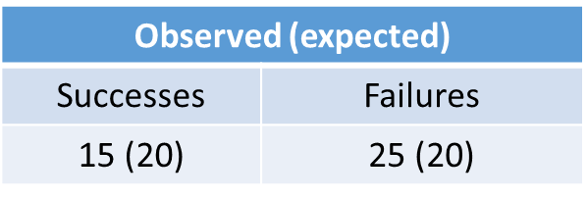
Part 1 - Contingency Tables
A contingency table is a table of frequencies
We’ll begin with a simple example and then extend it to create a very general test.

Slide 3
Example
X_{i} ~ i.i.d. BER(p)
H₀: p = p₀
H₁: p ≠ p₀
Derive an asymptotic test and show that it is of the form:
sum of (observed – expected)²/expected
Identify the distribution of the test statistic (under the null).
Notes:
Outcome of test statistic = 5/2.
P-value = 1 - pchisq(5/2, df = 1) = 0.11

Slide 4
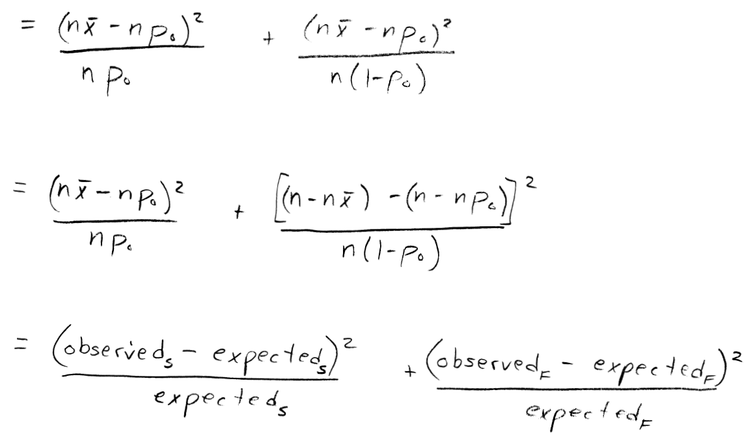
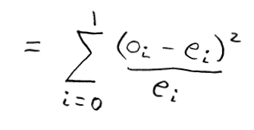

Slide 5
Find the p-value with the following data (p₀ = ½):

Slide 6
Example 13.4.1
A 6-sided die is rolled 60 times, and we want to test if it is fair.
Find the test statistic and its distribution under the null.
Discuss the term ‘degrees of freedom.’
Compute the p-value.
Number | Observed (expected)
1 | 8 (10)
2 | 11 (10)
3 | 5 (10)
4 | 12 (10)
5 | 15 (10)
6 | 9 (10)
Notes:
Outcome of test statistic = 6
P-value = 1-pchisq(6,df=5) = 0.31

Slide 7
Example 13.3.1
A certain characteristic is believed to be present in
20% of Race 1
20% of Race 2
20% of Race 3
From a sample we find the characteristic present in
20/50 from Race 1
25/100 from Race 2
15/50 from Race 3
Write the 2-way contingency table (race by characteristic status) with expected and actual counts.
Identify the test statistic and its distribution under the null.
Calculate the outcome of the test statistic and the p-value.
Notes:
Outcome of test statistic is 17.8.
P-value is 1-pchisq(17.8, df = 3) = 0.00048.
Breast cancer is one such characteristic. Incidence rates do vary by race.

Slide 8
Example 13.3.2
Repeat the previous example with the null hypothesis that the presence of the characteristic is the same in each race (but not any value in particular).
H₀: p₁ = p₂ = p₃
Notes:
Demonstrate how to estimate p and use it to obtain expected counts.
Demonstrate that both rows and columns add to zero, so df = 2.
You can also think about this as losing a degree of freedom for each parameter estimated. The reason this happens is because by estimating the parameter, you are making expected cell counts more closely match the observed counts and thus shrinking the test statistic.
Outcome of test statistic = 3.57.
P-value = 1 - pchisq(3.57, df=2) = 0.17

