Slide 1
Notations for probability of error and power
β = P(Type II error | H₀ is false)
β(θ) = P(Not rejecting H₀ | true parameter = θ)
α = P(Type I error | H₀ is true)
α = max _{θ ∈ Ω0} P(Rejecting H₀ | true parameter = θ)
π = P(Correctly rejecting H₀| H₀ is false)
π (θ) = P(Rejecting H₀| true parameter = θ)
π (θ) = 1 - β(θ)

Slide 2
Example: simple hypotheses
X_{i} ~ i.i.d. N(μ, 2)
N = 15
H₀: μ = 8
H₁: μ = 12
Test statistic: sample mean
Find a rejection region such that α = 0.05

Slide 3
Example: composite hypotheses
X_{i} ~ i.i.d. N(μ, 2)
N = 15
H₀: μ ≤ 8
H₁: μ > 8
Test statistic: sample mean
Find a rejection region such that α = 0.05

Slide 4
Identify rejection region, error probabilities, and power.
Notes:
Show where the type I error rate is.

Slide 5
Example continued: power
X_{i} ~ i.i.d. N(μ, 2)
N = 15
H₀: μ ≤ 8
H₁: μ > 8
Find the power of the test as a function of the true mean, μ.

Slide 6
Example continued: β
X_{i} ~ i.i.d. N(μ, 2)
N = 15
H₀: μ ≤ 8
H₁: μ > 8
Find β(μ).
Notes:
Don’t really do the math. It’s just 1 – power.

Slide 7
Example: Two-sided alternative
X_{i} ~ i.i.d. N(μ, 2)
N = … (do for arbitrary N)
H₀: μ = -8
H₁: μ ≠ -8
Test statistic: sample mean
Find a rejection region such that α = 0.05
Find the power

Slide 8
Notes:
This is the power as a function of the true value of the parameter. I can’t remember what value of N and sigma I used for this figure, but the shape is the same either way.

Slide 9
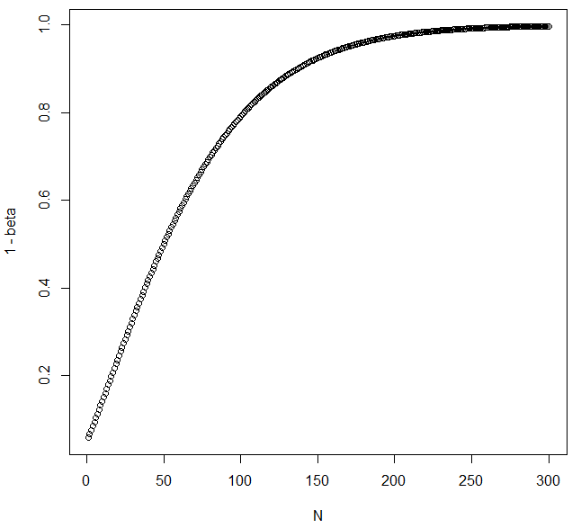
Notes:
This shows the power as a function of the sample size. I don’t know what value of sigma I used for the figure, but the basic shape is the same regardless.

