Slide 1
Chapter 12
Hypothesis testing

Slide 2
Is it plausible?
That Ron shoots 70% from the free-throw line?
That M&M color is independent of type (peanut vs. regular)?
That NZT does not improve IQ at all?
That the parameter of interest is zero?
That the parameter of interest is larger than 5?
That the parameter of interest is between -2 and 2?

Slide 3
Free throws
My friend claims he makes 70% of his free throws.
A statement about a population’s distribution is called a hypothesis. In this case, the hypothesis is that the distribution is BER(0.7).
The initial hypothesis is called the ‘null hypothesis.’ We assume it is true unless the data collected is not consistent with it.

Slide 4
How it works
We state a hypothesis
We collect data, e.g. from an experiment
We ask if the hypothesis is plausible, i.e. consistent with the data

Slide 5
Free throws
I decide to watch him shoot 20 times.
If he makes less than 11 shots, I won’t believe his claim.
The set of outcomes for which I’ll reject his initial claim is called the ‘rejection region.’ Rejection region = {0, 1, 2, 3, …, 10}.
He makes only 10 shots (50%).

Slide 6
Simple and Composite Hypotheses
Simple hypotheses completely specify the distribution.
E.g., BER(0.70).
Composite hypotheses only partially specify the distribution.
E.g., N(μ, 1), with μ <=0.

Slide 7
How to determine a good rejection region?
These are usually specified in terms of an MLE or a sufficient statistic.
In the free throw example, we decided to reject his claim (null hypothesis) if he made too few shots.
More on how to choose the exact number of shots later.

Slide 8
Errors happen
Unfortunately errors are possible.
I concluded before that my friend was exaggerating and that he cannot actually make 70% of his free throws.
But it is possible that he made only 10 simply by chance (bad luck).
A person that makes 70% on average would make <= 10 out of 20 with probability 4.8%.
So, although it isn’t too likely, it’s possible that his claim is true.

Slide 9
Types of errors

Slide 10
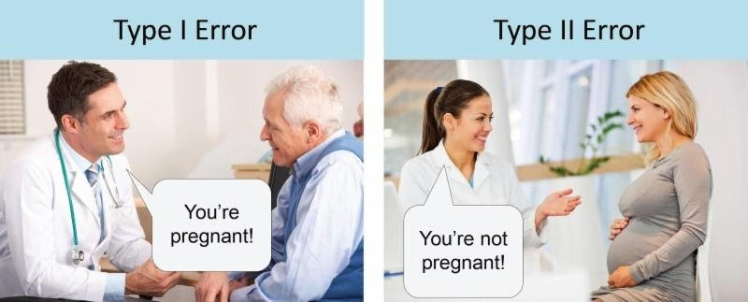
What type of error…
H₀: not pregnant.

Slide 11
What type of error…
If a guilty man is found ‘not guilty?’
If an innocent man is found ‘guilty?’
If a guilty woman is found ‘guilty?’

Slide 12
What type of error…
If a guilty man is found ‘not guilty?’
If an innocent man is found ‘guilty?’
If a guilty woman is found ‘guilty?’

Slide 13
What type of error…
If a guilty man is found ‘not guilty?’
Type II
If an innocent man is found ‘guilty?’
Type I
If a guilty woman is found ‘guilty?’
Justice (i.e. no error at all)

Slide 14
What type of error…
H₀: NZT doesn’t improve IQ.
Researchers conclude that it does?

Slide 15
What type of error…
H₀: NZT doesn’t improve IQ.
Researchers conclude that it does?

Slide 16
What type of error…
H₀: NZT doesn’t improve IQ.
Researchers conclude that it does?
Type I

Slide 17
What type of error…
Is a pharmaceutical company interested in keeping small?
H₀: drug doesn’t work.
Notes:
What type of error does a drug company care about? Both. Type II error because they want to make money and Type I error because they are decent human beings.

Slide 18
What type of error…
Is a pharmaceutical company interested in keeping small?
H₀: drug doesn’t work.
Notes:
What type of error does a drug company care about? Both. Type II error because they want to make money and Type I error because they are decent human beings.

Slide 19
What type of error…
Is a pharmaceutical company interested in keeping small?
H₀: drug doesn’t work.
Notes:
What type of error does a drug company care about? Both. Type II error because they want to make money and Type I error because they are decent human beings.

