Slide 1
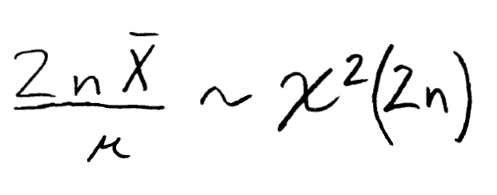
Pivotal quantity
A pivotal quantity is a function of the random sample and the parameter of interest whose distribution does not depend on unknown stuff, e.g. the parameter of interest.
The first step in deriving a CI is to write down a probability statement. It is super convenient if this involves a pivotal quantity.
Example 11.1.1
Example: Pivotal quantity based on a random sample from a normal population.

Slide 2
Population is N(μ,1). Which of these is pivotal?
Advance the slide when you’re done to see the answers.

Slide 3
Population is N(μ,1). Which of these is pivotal?
Advance the slide when you’re done to see the answers.

Slide 4
Population is N(μ,1). Which of these is pivotal?

Slide 5
Finding pivotal quantities
A location parameter is one that shifts the ‘location’ of the distribution, i.e. f(x, θ) = f₀(x-θ).
Example
Consider the density function for EXP(1, η): f(x, η) = e^{-(x-η)} 1{x-η>0}.
Theorem
If
X_{i} ~ i.i.d. f(x, θ)
θ is a location parameter
MLE is a maximum likelihood estimator for θ
Then MLE – θ is a pivotal quantity for θ.

Slide 6
Examples of finding pivotal quantities
Example 1: Find a CI for μ based on a random sample from N(μ, 1).
Example 2: Find a CI for η based on a random sample from EXP(1, η).
Example 3: Find a CI for σ² based on a random sample from N(0, σ²).
Can it be done?

Slide 7
Finding pivotal quantities
A scale parameter is one that satisfies, i.e. f(x, θ) = (1/θ)f₀(x/θ).
Theorem
If
X_{i} ~ i.i.d. f(x, θ)
θ is a scale parameter
MLE is a maximum likelihood estimator for θ
Then MLE/θ is a pivotal quantity for θ.
Notes:
You can think of a scale parameter as simply multiplying a random variable by a parameter. This can be checked to fit the definition using the transformation method.

Slide 8
Examples of finding pivotal quantities
Example 3: Remember this from 11.1.1 (exponential population):
Example 4: Find a CI for σ² based on a random sample from N(0, σ²).
Example 5: Find a CI for μ based on a random sample from N(μ, σ²).
Can it be done?

Slide 10
Finding pivotal quantities
Theorem
If
X_{i} ~ i.i.d. f(x, θ₁, θ₂)
θ₁ is a location parameter
θ₂ is a scale parameter
MLE₁ and MLE₂ are maximum likelihood estimators for θ₁ and θ₂, respectively.
Then
(MLE₁ - θ₁)/MLE₂ is a pivotal quantity for θ₁; AND
(MLE₂)/θ₂ is a pivotal quantity for θ₂.

Slide 11
Examples of finding pivotal quantities
Example 4: Find a CI for μ based on a random sample from N(μ, σ²).

Slide 12
Example 5: Find a CI for σ² based on a random sample from N(μ, σ²).

Slide 13
Confidence interval for functions of parameters
(3, 4) is a 95% CI for λ
Can I find a 95% CI for e^{λ} without doing hard work?
What about e^{-λ}?
(-5, 10) is a 99% CI for μ
Can I find a CI for μ² without doing hard work?
Notes:
We could find a conservative confidence interval for μ².

