Slide 1
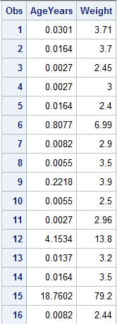
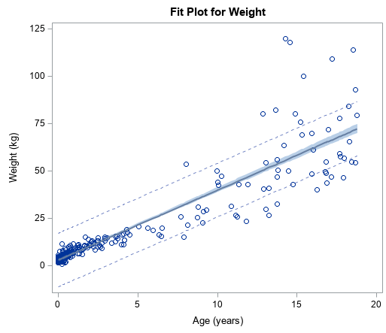

Slide 2
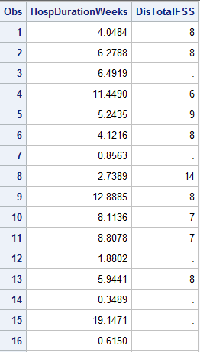
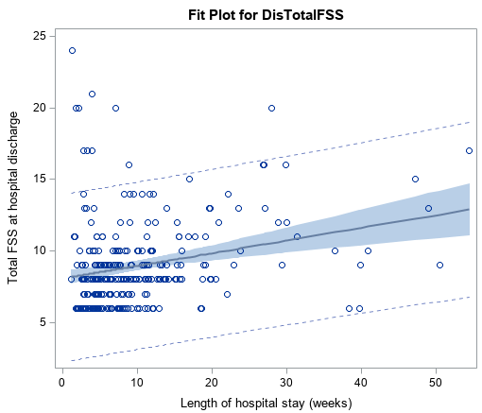

Slide 4
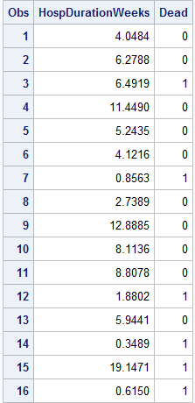
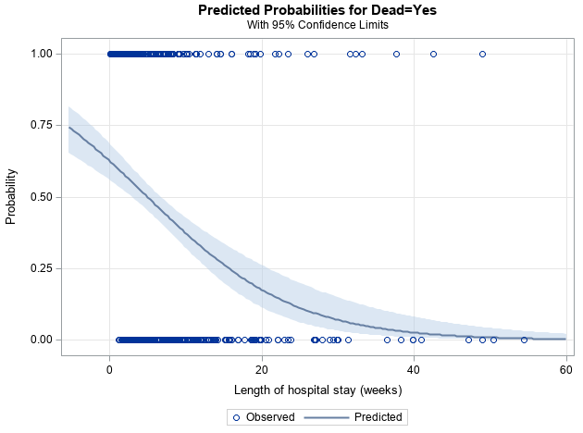

Slide 5
Logistic regression:
Y is Normal Bernoulli distributed with
f(E(Yi)) = β₀ + β₁x_{i}
f(.) is a monotonic function that takes values between 0 and 1 and maps them to a real number;
this is important because Y is Bernoulli, and the expected value is a probability. f(.) is called the link function.
For ‘logistic regression’ f(.) is the logit function, log[p/(1-p)].
Thus, Y_{i} ~ BER(logit⁻¹[β₀ + β₁ * x_{i}])
~ BER( exp(β₀ + β₁x_{i}) / [1+exp(β₀ + β₁x_{i})] )

Slide 6
How to interpret results from logistic regression
The estimated ‘slopes’ don’t mean a whole lot.
You can interpret them as the rate of increase in the log odds of [outcome] for each unit increase of the predictor.
Not that helpful.
Recall that log(p/(1-p)) = β₀ + β₁x_{i}
where p = E(Y_{i})
If you exponentiate both sides you get
p/(1-p) = exp(β₀ + β₁x_{i})
Note that the left hand side is the ‘odds’ that Y_{i} = 1, given the value of x_{i}.
The odds ratio (for x_{i} = x+1 vs. x_{i} = x) is
exp(β₀ + β₁(x_{i} +1)) / exp(β₀ + β₁x_{i}) = exp(slope)
Thus exponentiating the coefficient gives the odds ratio.

Slide 7
exp(β₀ + β₁(x_{i} +1)) / exp(β₀ + β₁x_{i})

Slide 8
Odds and odds ratios are not intuitive
People almost always interpret them as if they were relative risks.
Odds ratio: [p₁/(1-p₁)] / [p₂/(1-p₂)]
Relative risk (i.e. risk ratio): p₁ / p₂
Wouldn’t it be nice if we could model the relationship in such a way that would provide relative risks instead…
Use a different ‘link’ function.
Log(E(Y_{i})) = intercept + slope * x_{i}
Then, the relative risk (for x_{i} = x+1 vs. x_{i} = x) is
exp(β₀ + β₁(x_{i} +1)) / exp(β₀ + β₁x_{i}) = exp(β₁)
What are the possible values for E(Y_{i}) when using the log link function?
Notes:
E(Y) can be an positive real number. If it is larger than 1, however, it wouldn’t make sense for this to be the probability for a BER(p) distribution. That’s why we use Poisson.

