Slide 1

Chapter 15
Regression Modeling
(Understanding interesting relationships between variables)

Slide 2
Scatter Plots of Data with Various Correlation Coefficients
Y
Y
Y
X
X
X
r = -1
r = -.6
r = 0
Y
Y
Y
X
X
X
r = +1
r = +.3
r = 0
Slide from: Statistics for Managers Using Microsoft® Excel 4th Edition, 2004 Prentice-Hall
Notes:
We learned in 5010 that the correlation is a measure of the ‘linear relationship’ between two variables. Correlation is between -1 and 1. Absolute value near 1 means what?
Another way to think about a positive correlation is that when values of x are large, then values of y tend to be large.
We now want to move beyond just describing the strength of the relationship. We want to estimate the linear relationship, i.e. find the line that best fits the data.

Slide 3
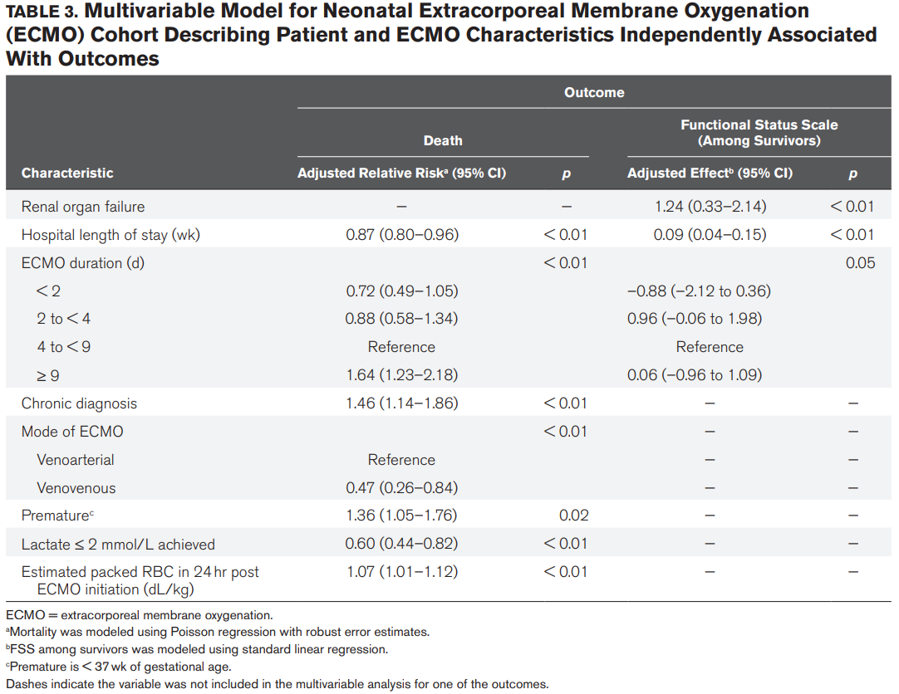

Slide 4
Linear and Non-Linear Relationships
Linear relationships
Curvilinear relationships
Y
Y
X
X
Y
Y
X
X
Slide from: Statistics for Managers Using Microsoft® Excel 4th Edition, 2004 Prentice-Hall

Slide 6
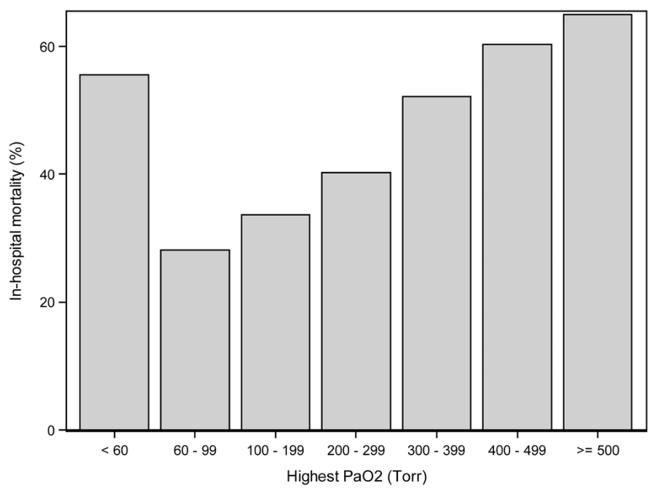
Notes:
PaO2 is the partial pressure of oxygen in arterial blood, and it measure how well oxygen is able to move from the lungs to the blood. Severe illness can impact this.

Slide 8

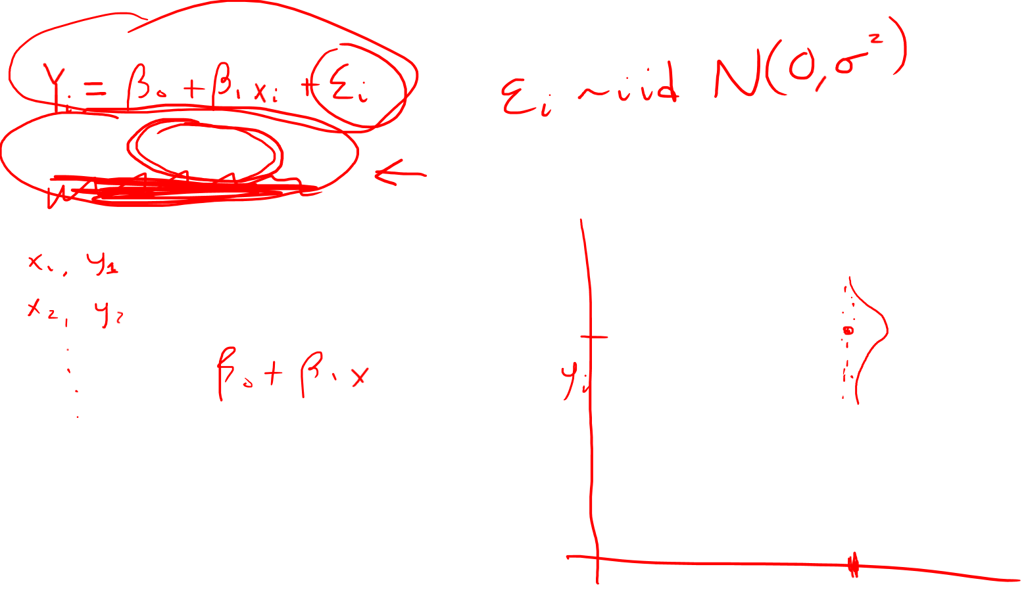
Another way to look at regression
Y_{i} ~ N(β₀ + β₁x_{i} , σ²)
x_{i}

Slide 9
Example:
Cognitive function and vitamin D
Hypothetical data loosely based on [1]; cross-sectional study of 100 middle-aged and older European men.
  Cognitive function is measured by the Digit Symbol Substitution Test (DSST).
  This measures a participant’s ability to quickly and precisely shift attention from one location to another, testing speed of processing and working memory.
1. Lee DM, Tajar A, Ulubaev A, et al. Association between 25-hydroxyvitamin D levels and cognitive performance in middle-aged and older European men. J Neurol Neurosurg Psychiatry. 2009 Jul;80(7):722-9.

Slide 10
Four hypothetical datasets
I generated four hypothetical datasets, with increasing TRUE slopes (between vitamin D and DSST):
  0
  0.5 points per 10 nmol/L
  1.0 points per 10 nmol/L
  1.5 points per 10 nmol/L

Slide 11
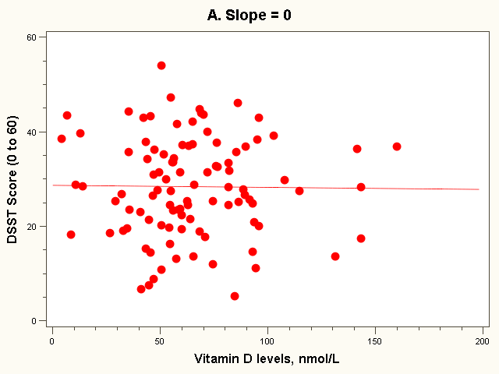
The “Best fit” line
Regression equation:
E(Y_{i}) = 28 + 0*vit D_{i} (in 10 nmol/L)

Slide 12
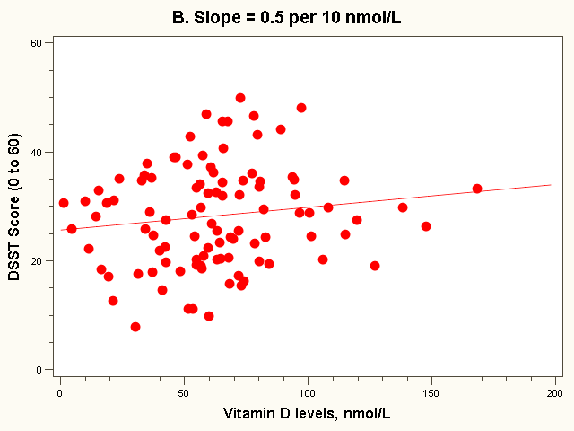
The “Best fit” line
Note how the line is a little deceptive; it draws your eye, making the relationship appear stronger than it really is!
Regression equation:
E(Y_{i}) = 26 + 0.5*vit D_{i} (in 10 nmol/L)

Slide 13
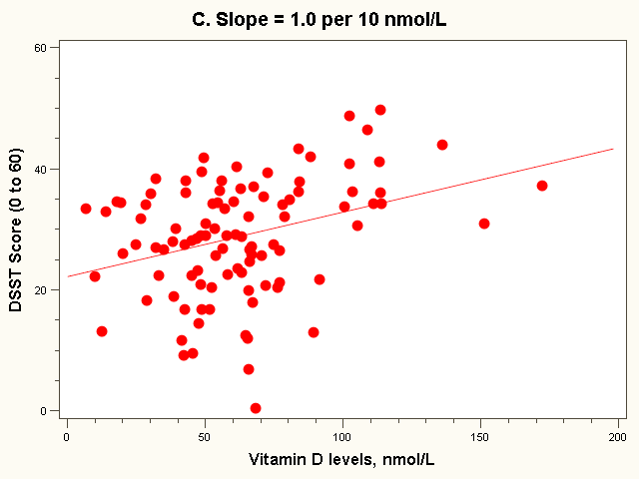
The “Best fit” line
Regression equation:
E(Y_{i}) = 22 + 1.0*vit D_{i} (in 10 nmol/L)

Slide 14
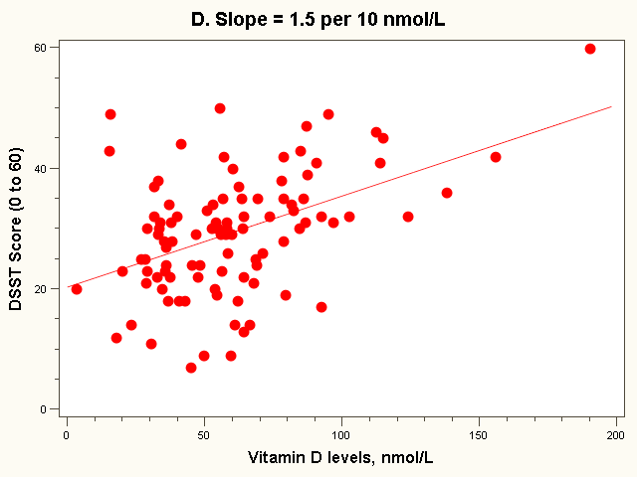
The “Best fit” line
Regression equation:
E(Y_{i}) = 20 + 1.5*vit D_{i} (in 10 nmol/L)

Slide 15
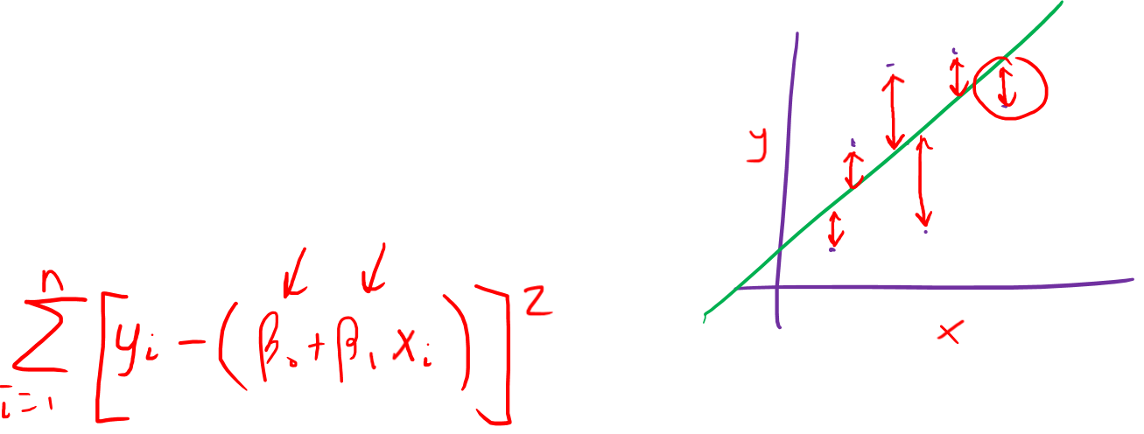
Estimating the parameters
Y_{i} ~ N(β₀ + β₁x_{i} , σ²)
Minimize the sum of squared residuals
Use maximum likelihood estimators
Notes:
Turns out, the results are the same under the present assumptions.

Slide 16
