Slide 1
Chapter 14
Non-parametric tests

Slide 2
A brief history
We learned what to do when the distribution family is known, e.g. Normal.
We learned to test whether the distribution is from a certain family.
Now, we’ll learn about tests that are completely valid regardless of the population distribution.
These are called ‘non-parametric’ tests.
We’ll also learn some non-parametric methods for deriving confidence intervals.

Slide 3
A caveat or two
Non-parametric tests are less powerful; AND
Non-parametric confidence intervals are wider.

Slide 4
So why use a non-parametric method?
They are valid—regardless of the underlying distribution.
We often have no idea what the underlying distribution is.
They are often insensitive to even the most extreme outliers.
The tests can be nearly as powerful.
The CIs can be nearly as narrow.

Slide 5
Academic (non-faculty) statistician salary
Notes:
This table is from the 2017-2018 academic, non-faculty statistician salary report by the American Statistical Association. I’ve circled in red typical salaries in my department based on years of experience.

Slide 6
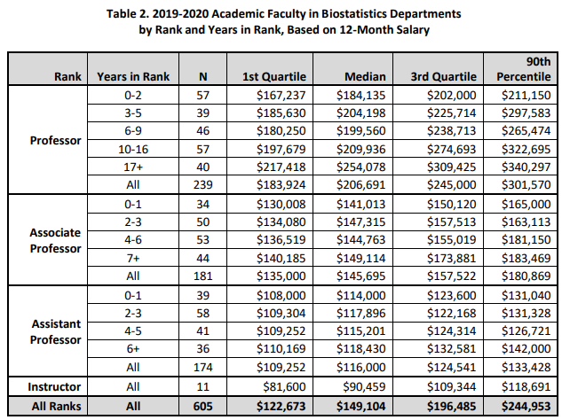
Academic (faculty) statistician salary
Notes:
This data is actually for a biostatistics department. A statistics department would pay less than this. A math department would pay less still, and industry would pay more. Essentially, you earn more the more applied the work is.

Slide 7
More salary information for statistics
http://www.amstat.org/ASA/Your-Career/Salary-Information.aspx

Slide 8
Example 14.2.1 – Statistician Salary
Suppose you surveyed 20 young statisticians and these are the reported salaries (in thousands of dollars per year):
60, 86, 87, 92, 93, 94, 97, 99, 99, 100, 107, 109, 113, 116, 117, 122, 136, 136, 139, 142
Test the null hypothesis that the median salary for young statisticians is 100k/year against the alternative that it is higher.
H₀: m = 100k
H₁: m > 100k
Σ 1{X_{i} ≥ 100k} ~ BIN(20,1/2) under the null hypothesis.
Notes:
P-value = 1-pbinom(10, size=20,p=1/2) = 0.412. Notice that 10 is used rather than 11 since we want the probability that the test statistic would be larger than or equal to 11, so we take 1 minus the probability that it would be 10 or less under the null.

Slide 9
Example – Statistician Salary
Suppose you surveyed 20 young statisticians and these are the reported salaries (in thousands of dollars per year):
60, 86, 87, 92, 93, 94, 97, 99, 99, 100, 107, 109, 113, 116, 117, 122, 136, 136, 139, 142
Test the null hypothesis that the 80th percentile of salary for young statisticians is 100k/year against the alternative that it is higher.
H₀: x_{0.80} = 100k
H₁: x_{0.80} > 100k
Σ 1{X_{i} ≥ 100k} ~ BIN(20,0.20) under the null hypothesis.
Notes:
P-value = 1-pbinom(10, size=20,p=0.20) = 0.0006.

Slide 10
Example 14.3.2 – Statistician Salary – CI
Suppose you surveyed 20 young statisticians and these are the reported salaries (in thousands of dollars per year):
60, 86, 87, 92, 93, 94, 97, 99, 99, 100, 107, 109, 113, 116, 117, 122, 136, 136, 139, 142
Find a CI for the median salary of young statisticians.
Begin with a probability statement, e.g. P(X_{5:20} ≤ x_{0.50} ≤ X_{15:20}).
Note that P(X_{5:20} ≤ x_{0.50}) = P[F(X_{5:20}) ≤ F(x_{0.50})] = P[U_{5:20} ≤ 0.50]
F is the cdf of the unknown distribution of young statistician salary,
U represents a UNIF(0,1) distribution,
x_{0.50} is the median of the unknown distribution.

Slide 11
Example 14.3.2 continued
P[U_{5:20} ≤ 0.50] = P(Σ 1{U_{i} ≤ 0.50} ≥ 5) = P[BIN(20,1/2) ≥ 5] = 0.994
P(x_{0.50} ≤ X_{15:20}) = P[F(x_{0.50}) ≤ F(X_{15:20})] = P[0.50 ≤ U_{15:20}]
= P(Σ 1{U_{i} ≥ 0.50} ≥ 6) = P[BIN(20,1/2) ≥ 6] = 0.979
How do we put this together for a single two-sided CI?
Let A = {X_{5:20} ≤ x_{0.50}} and B = {x_{0.50} ≤ X_{15:20}}
P(X_{5:20} ≤ x_{0.50} ≤ X_{15:20}) = P(A∩B)
= 1 – P(A^{c}∪B^{c}) = 1 – P(A^{c}) – P(B^{c}) + P(A^{c}∩B^{c})
= 1 – [1 – P(A)] – [1 – P(B)] = P(A) + P(B) – 1
= .994 + .979 – 1 = 0.973
Notes:
1-pbinom(4,size = 20, p=1/2) = 0.994
1-pbinom(5,size = 20, p=1/2) = 0.979

Slide 12
Example 14.3.2 continued
So what is a 97.3% CI?
Recall the data
60, 86, 87, 92, 93, 94, 97, 99, 99, 100, 107, 109, 113, 116, 117, 122, 136, 136, 139, 142
Recall our work
P(X_{5:20} ≤ x_{0.50} ≤ X_{15:20}) = 0.973
97.3% CI is [93, 117]
Notes:
P-value = 1-pbinom(10, size=20,p=0.20) = 0.0006.

