Slide 1
Goodness of fit
We can test whether observed data came from a particular distribution.
Notes:
Until now, we have assumed we knew the family that the population distribution belonged to. For example, to find the MLE, we must know the likelihood as a function of the unknown parameter. That assumes that the only thing we don’t know about the distribution is the parameter.

Slide 2
Example 13.7.1
Let X_{i} be the repair times for an airplane part.
H₀: X_{i} ~ i.i.d. POI(3)
How can we use a contingency table to test this hypothesis?
How do we determine expected cell counts?
Repair time (Days)
0 | 1 | 2 | 3 | 4 | 5 | 6 | 7+
1 | 3 | 7 | 6 | 10 | 7 | 6 | 0

Slide 3
Example 13.7.1
Expected counts can be determined based on the null hypothesis and the associated mass function.
H₀: X_{i} ~ i.i.d. POI(3)
There’s a problem. What is it? How do we fix it?
Repair time (Days)
0 | 1 | 2 | 3 | 4 | 5 | 6 | 7+
1 (2.00) | 3 (5.96) | 7 (8.96) | 6 (8.96) | 10 (6.72) | 7 (4.04) | 6 (2.00) | 0 (1.36)
Notes:
Rule of thumb for approximation not met. Too many cells with low expected cell count.

Slide 4
Example 13.7.1
Cells can be combined to create cells with larger expected counts.
There’s a problem. What is it? How do we fix it?
Compute the p-value.
Repair time (Days)
0 - 1 | 2 | 3 | 4 | 5+
4 (7.96) | 7 (8.96) | 6 (8.96) | 10 (6.72) | 13 (7.40)
Notes:
By arbitrarily choosing which bins to combine, I can get different p-values. I could choose bins in order to for the p-value to be lower or higher depending on what I want to show. Fix this by specifying the bins a priori.
P-value = 1-pchisq(9.22, df = 4) = 0.0558. Note that observed - expected sum to zero, because there are 40 observations and each one will be in a bin.

Slide 5
Example 13.7.2
Repeat the previous example with a composite null hypothesis.
H₀: X_{i} ~ i.i.d. POI(μ)
How do we determine expected cell counts?
Don’t forget to combine cells as needed.
(How and when to choose?)
Compute the p-value.
What conclusions can we make about the distribution at α = 0.05?
Repair time (Days)
0 - 1 | 2 | 3 | 4 | 5+
4 (4.84) | 7 (6.92) | 6 (8.44) | 10 (7.68) | 13 (12.12)
Notes:
By arbitrarily choosing which bins to combine, I can get different p-values. I could choose bins in order to for the p-value to be lower or higher depending on what I want to show. Fix this by specifying the bins a priori.
P-value = 1-pchisq(1.62, df = 3) = 0.6549. Note that a degree of freedom is lost for the parameter we estimated.
Technically the approximate p-value is between 1-pchisq(1.62, df = 3) = 0.6549 and 1-pchisq(1.62, df = 4) = 0.8052, since the expected counts are based on the regular MLE rather than the MLE for binned data.

Slide 6
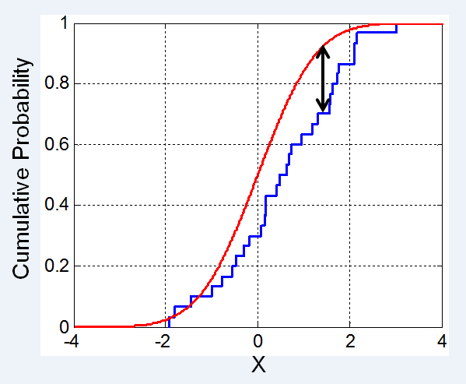
Other goodness of fit tests
Kolmogorov-Smirnov
Max abs(difference)
Anderson-Darling
Based roughly on the average difference
Shapiro-Wilk
For testing normality
Notes:
The Kolmogorov-Smirnov statistic is the maximum absolute difference between the CDF and the empirical CDF. The Anderson-Darling test is based on the weighted squared difference. As you might expect, the Anderson-Darling test can be more powerful. For testing normality, another test, whose test statistic is less intuitive, is a bit more powerful still.

