Slide 1
Chapter 15
Regression Modeling
(Understanding interesting relationships between variables)

Slide 2
Scatter Plots of Data with Various Correlation Coefficients
Y
Y
Y
X
X
X
r = -1
r = -.6
r = 0
Y
Y
Y
X
X
X
r = +1
r = +.3
r = 0
Slide from: Statistics for Managers Using Microsoft® Excel 4th Edition, 2004 Prentice-Hall
Notes:
We learned in 5010 that the correlation is a measure of the ‘linear relationship’ between two variables. Correlation is between -1 and 1. Absolute value near 1 means what?
Another way to think about a positive correlation is that when values of x are large, then values of y tend to be large.
We now want to move beyond just describing the strength of the relationship. We want to estimate the linear relationship, i.e. find the line that best fits the data.

Slide 3

Linear Regression Models
Y_{i} ~ N(β₀ + β₁x_{i} , σ²)
x_{i}

Slide 4
Linear and Non-Linear Relationships
Linear relationships
Curvilinear relationships
Y
Y
X
X
Y
Y
X
X
Slide from: Statistics for Managers Using Microsoft® Excel 4th Edition, 2004 Prentice-Hall

Slide 6
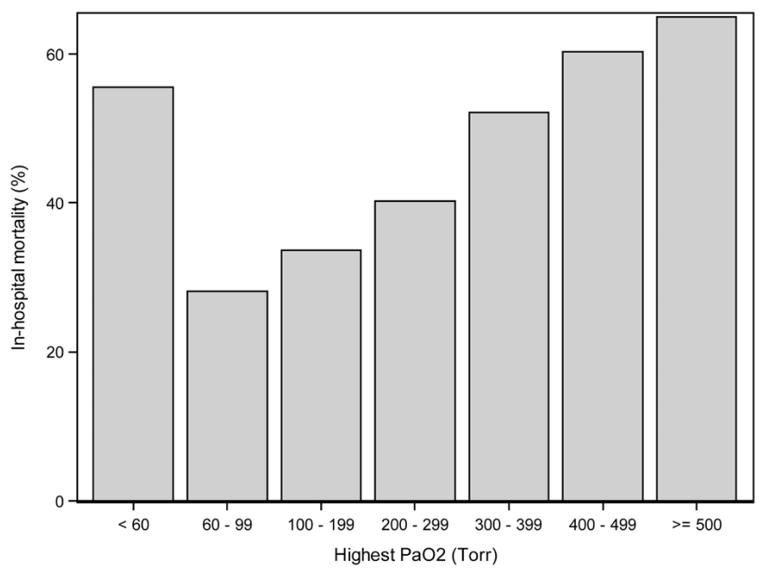
Notes:
PaO2 is the partial pressure of oxygen in arterial blood, and it measure how well oxygen is able to move from the lungs to the blood. Severe illness can impact this.

Slide 7
Duration of CPR predicting survival

Slide 8
Homework 0 on modelling
Read the book chapter on biostatistics and interpreting clinical studies

Slide 9
Modeling non-linear relationships
Change the form of the model from a straight line to whatever you want.
  Linear: Y_{i} ~ N(β₀ + β₁x_{i} , σ² )
Quadratic:
  Option 1: Y_{i} ~ N(β₀ + β₂x_{i}² , σ² )
  Option 2: Y_{i} ~ N(β₀ + β₁x_{i} + β₂x_{i}² , σ² )
Piecewise linear:
  Y_{i} ~ N(β₀ + β₁x_{i} + β₂1{x_{i} > 1}(x_{i}-1) + β₃1{x_{i} > 2}(x_{i}-2) , σ² )
Step function:
  Y_{i} ~ N(β₀ + β₁1{x_{i} ∈ (0,1)} + β₂1{x_{i} ∈ (1,2)} + … , σ² )

Slide 10
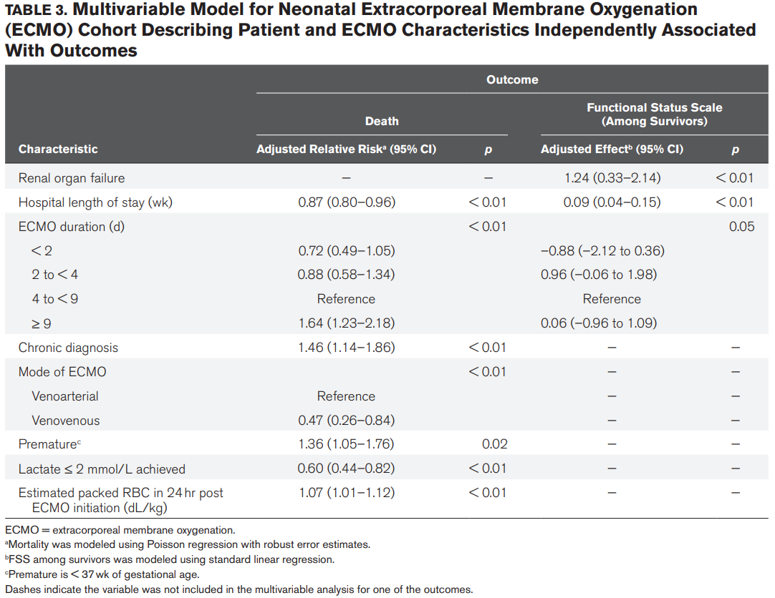
Notes:
What was the model and how do we interpret it?

Slide 13
How to estimate parameters from the data
Minimize the sum of squared residuals
Use maximum likelihood estimators
Notes:
Turns out, the results are the same under the present assumptions.

Slide 14
Hypothesis testing
H₀: slope is zero
Test statistic = MLE for slope
  Under null, it is normally distributed and centered at 0.
  Variance of MLE for slope is given in Theorem 15.3.4.

Slide 15
Confidence intervals
95% CI for the slope
Pivotal quantity = MLE for slope – true slope
Divide by standard deviation of the MLE (Theorem 15.3.4) and you’ll have a standard normal distribution.

Slide 16
Qualitative checks on plausibility of model assumptions
Examining residuals we can assess
  If the relationship between variables is linear
  If the variance of the error term is the same for all values of X (homoscedasticity)
  If the error term is normally distributed
  If error terms are independent

Slide 17
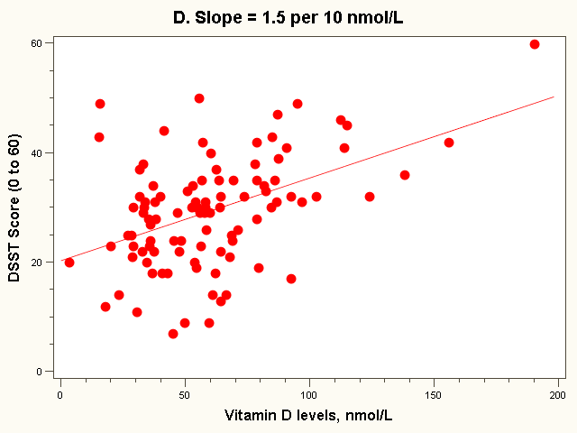
Residual = observed - predicted
X=95 nmol/L
34

Slide 18
Residual Analysis for Linearity
Y
Y
x
x
residuals
x
x
residuals
Not Linear
✓
Linear
Slide from: Statistics for Managers Using Microsoft® Excel 4th Edition, 2004 Prentice-Hall
Notes:
Solutions include:
Discretizing x.
Add a quadratic term in the regression.

Slide 19
Residual Analysis for
Homoscedasticity
Y
Y
x
x
residuals
x
x
residuals
✓
Non-constant variance
Constant variance
Slide from: Statistics for Managers Using Microsoft® Excel 4th Edition, 2004 Prentice-Hall
Notes:
Possible solutions include
Apply a variance stabilizing transformation, e.g. sqrt (weak) or log (strong).
Weighted least squares regression. This means that observations are weighted according to the amount of statistical information they provide. When the variance is large, the weight is smaller because each observation provides less information about the true underlying relationship (line).

Slide 20
Residual Analysis for Independence
Not Independent
✓
Independent
residuals
time
residuals
time
residuals
time
Slide from: Statistics for Managers Using Microsoft® Excel 4th Edition, 2004 Prentice-Hall
Notes:
Note that we can resolve this issue by controlling for time or season.

Slide 21
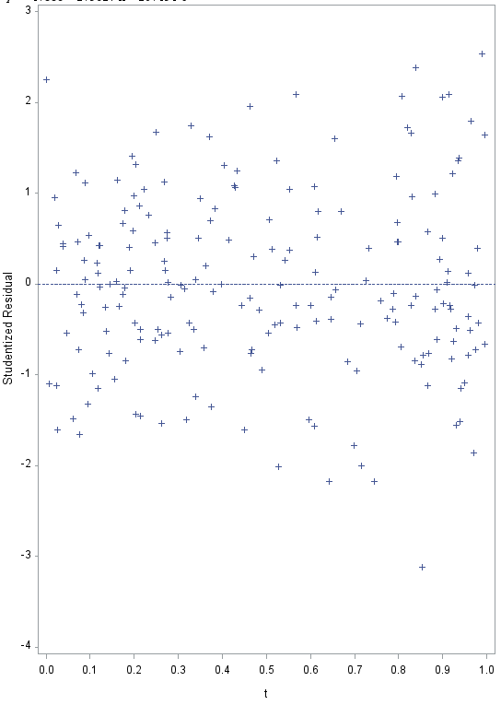
Notes:
%let b0 = 5;
%let b1 = 2;
%let b2 = 10;
data a;
do index = 1 to 200;
x= rand('NORMAL');
t= rand('UNIFORM');
y = &b0 + &b1*x + &b2*t + rand('NORMAL');
output;
end;
run;
proc reg data = a;
model y = x;
var t;
plot student.*t;
quit;

Slide 22
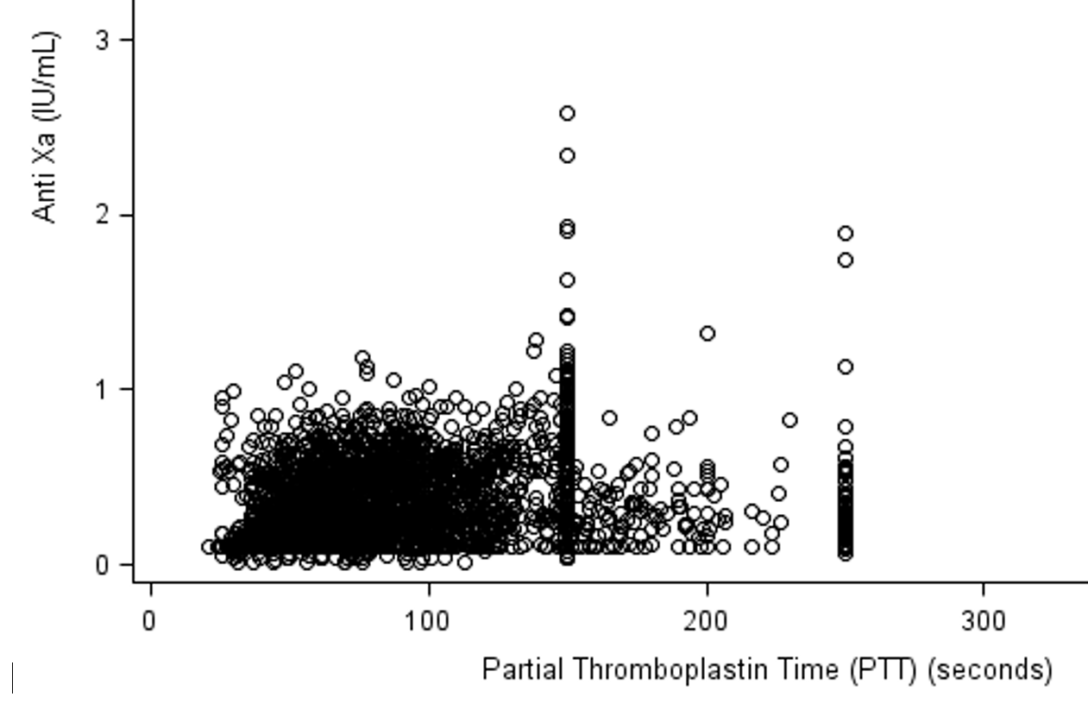

Slide 23
Homework 1 on modelling

Slide 24
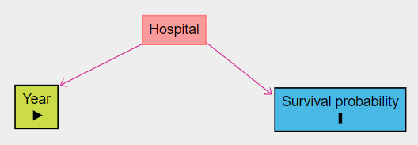
Avoiding Confounding
Is survival probability after CPR increasing over time?
  In the GWTG-R database, rate of survival is higher for later years.
  Could this simply be due to new hospitals joining that have better survival rates?
Controlling for hospital
  Y ~ N(β₀ + β₁*year + β₂*1{Hospital 2} + β₃*1{Hospital 3} + … , σ²)

Slide 25
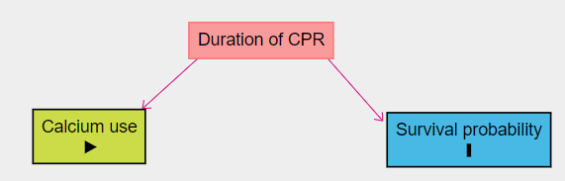
Avoiding Confounding
Does calcium increase survival probability in CPR?
  Longer duration makes calcium use more likely
  Calcium use improves survival (hypothetically)
  But longer duration worsens survival
  Result (without controlling for duration), calcium is neither helpful nor harmful.
If we control for duration, we see that calcium is beneficial.
  Y ~ N(β₀ + β₁*1{Calcium} + β₂*Duration, σ²)

Slide 26
Controlling or adjusting for more variables
Language
  Outcome
  Predictor(s)
    Primary predictor
    Covariates

Slide 27
multicollinearity
What if I put the same variable in the model twice:
  Y ~ N(β₀ + β₁*Age+ β₂*Age, σ²)
  There isn’t a unique best fit.
What happens if two variables are essentially the same thing with a different name:
  Y ~ N(β₀ + β₁*Age+ β₂*Age, σ²)
  There is a unique best fit, but a wide range of values for β₁ could be used with nearly identical fit.
  Result = Estimators have high variance; Confidence intervals are wide.
Notes:
If weight and age are nearly interchangeable,

Slide 28
What if my outcome is binary?
!@#$ (actually, it’s not too bad)
Previous model:
  Y_{i} is normally distributed with E(Y_{i}) = β₀ + β₁x_{i.}
  i.e. Y_{i} ~ N(β₀ + β₁x_{i}, σ²).
New model:
  Y is Normal Bernoulli distributed with
  f(E(Yi)) = β₀ + β₁x_{i}
  f(.) is a monotonic function that takes values between 0 and 1 and maps them to a real number;
    this is important because Y is Bernoulli, and the expected value is a probability. f(.) is called the link function.
  For ‘logistic regression’ f(.) is the logit function, log[x/(1-x)].
  Thus, Y_{i} ~ BER(logit⁻¹[β₀ + β₁ * x_{i}])
  ~ BER( exp(β₀ + β₁x_{i}) / [1+exp(β₀ + β₁x_{i})] )
Notes:
f(.) is called the link function.

Slide 29
How to interpret results from logistic regression
The estimated ‘slopes’ don’t mean a whole lot.
You can interpret them as the rate of increase in the log odds of [outcome] for each unit increase of the predictor.
  Not that helpful.
Recall that log(p/(1-p)) = β₀ + β₁x_{i}
  where p = E(Y_{i})
If you exponentiate both sides you get
  p/(1-p) = exp(β₀ + β₁x_{i})
  Note that the left hand side is the ‘odds’ that Y_{i} = 1, given the value of x_{i}.
The odds ratio (for x_{i} = x+1 vs. x_{i} = x) is
  exp(β₀ + β₁(x_{i} +1)) / exp(β₀ + β₁x_{i}) = exp(β₁)
  Thus exponentiating the coefficient gives the odds ratio.
  If the outcome is mortality, predictor is age in years, and exp(β₁) = 1.2, then the odds of mortality are 20% greater for each extra year of age.

Slide 30
Odds and odds ratios are not intuitive
People almost always interpret them as if they were relative risks.
  Odds ratio: [p₁/(1-p₁)] / [p₂/(1-p₂)]
  Relative risk (i.e. risk ratio): p₁ / p₂
Wouldn’t it be nice if we could model the relationship in such a way that would provide relative risks instead…
Use a different ‘link’ function.
  Log(E(Y_{i})) = intercept + slope * x_{i}
  Then, the relative risk (for x_{i} = x+1 vs. x_{i} = x) is
    exp(β₀ + β₁(x_{i} +1)) / exp(β₀ + β₁x_{i}) = exp(β₁)
What are the possible values for E(Y_{i}) when using the log link function?
What distribution is appropriate? (see next slide)
Notes:
E(Y) can be an positive real number. If it is larger than 1, however, it wouldn’t make sense for this to be the probability for a BER(p) distribution. That’s why we use Poisson.

Slide 31
What distribution?
When using the Bernoulli distribution, the logit link function is typically used (logistic regression).
If you want to use the log link (nicer interpretation), the Poisson distribution is typically used.
But… the outcome variable is binary. It certainly isn’t Poisson.
If I use a Poisson distribution (mean = variance), I will overestimate my variance… Unless…
It has been shown that a Poisson model is very useful for a binary outcome as long as you separately estimate mean and variance for using a ‘robust estimator.’
The model is referred to as ‘modified Poisson regression’ or ‘Poisson regression with robust error estimates.’

Slide 32
Another look
Ordinary linear regression
  Y_{i} ~ N(β₀ + β₁x_{i} , σ²)
Logistic regression
  Y_{i} ~ BER( exp(β₀ + β₁x_{i}) / [1+exp(β₀ + β₁x_{i})] )
Poisson regression
  Y_{i} ~ POI( exp(β₀ + β₁x_{i}) )
  If outcomes are actually binary, be sure to estimate mean and variance separately.

Slide 33
Yet another look
Simple linear regression
  Distribution Normal.
  E(Y_{i}) = β₀ + β₁x_{i}
Logistic regression
  Distribution Bernoulli
  Logit[E(Y_{i})] = β₀ + β₁x_{i}
Poisson regression
  Distribution Poisson
  Log[E(Y_{i})] = β₀ + β₁x_{i}
  If outcomes are actually binary, be sure to estimate mean and variance separately.

Slide 34

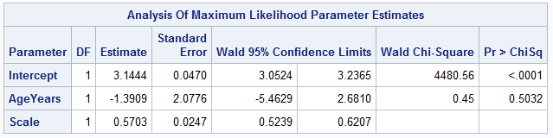
Interpretation exercise 1

Slide 35

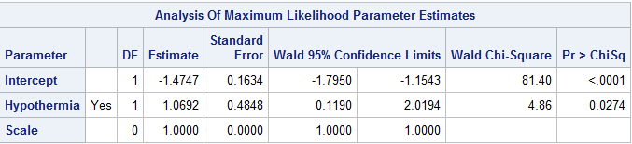
Interpretation exercise 2

Slide 36

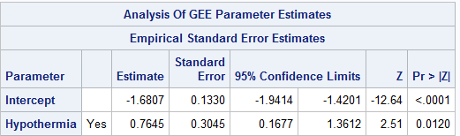
Interpretation exercise 3

Slide 37
Stopped here.

Slide 38

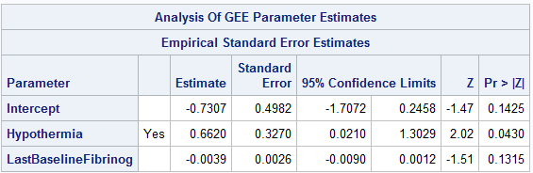
Interpretation exercise 4

Slide 39

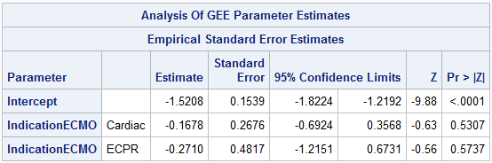
Interpretation exercise 5
Notes:
Note that indication for ECMO is a nominal variable with three levels: Respiratory, Cardiac, and eCPR.

Slide 40
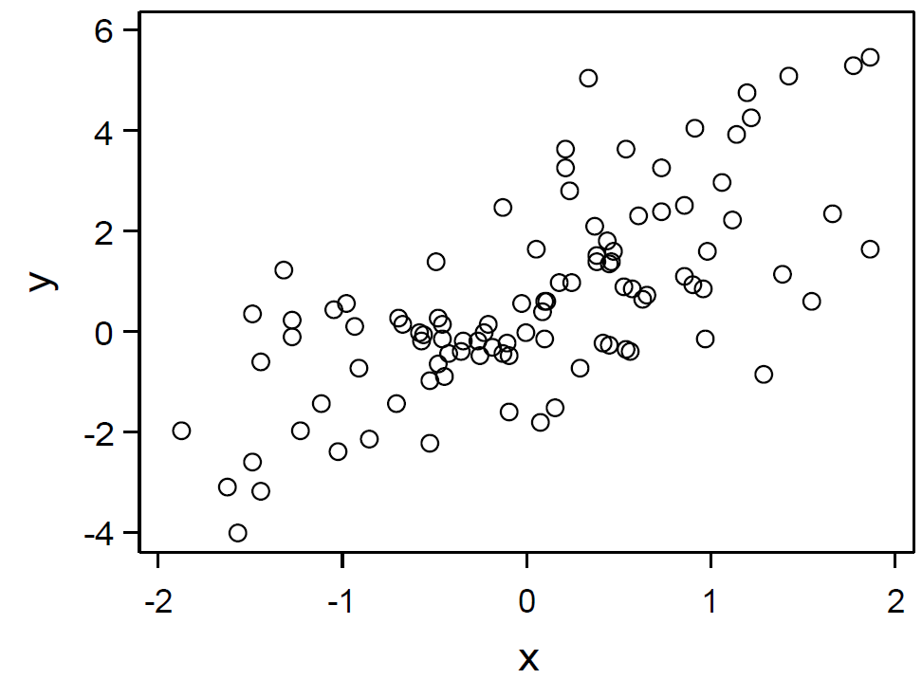
Interpretation exercise 6
Notes:
X and y are some measurement. Both men and women are included in this sample.
Code:
%let slope1 = 1;
%let slope2 = 2;
%let intercept1 = 0;
%let intercept2 = 1;
data a;
do i = 1 to 2;
do j = 1 to 50;
x=rand('NORMAL');
if i = 1 then y=&intercept1 + &slope1*x + rand('NORMAL');
else y=&intercept2 + &slope2*x + rand('NORMAL');
male = (i = 1);
output;
end;
end;
run;
ods graphics/width = 3in; /* 3in for half-width, 6.5 for full-width */
ods pdf file = "c:\users\rreeder\desktop\pic.pdf";
proc template;
define statgraph sgdesign;
dynamic _X _Y _I;
begingraph;
entrytitle halign=center 'Type in your title...';
entryfootnote halign=left 'Type in your footnote...';
layout lattice / rowdatarange=data columndatarange=data rowgutter=10 columngutter=10;
layout overlay;
scatterplot x=_X y=_Y / group=_I name='scatter';
endlayout;
endlayout;
endgraph;
end;
run;
proc sgrender data=WORK.A template=sgdesign;
dynamic _X="X" _Y="Y" _I="I";
run;
ods pdf close;
ods graphics/reset=width;
proc genmod data = a;
model y = x male x*male;
run;

Slide 41
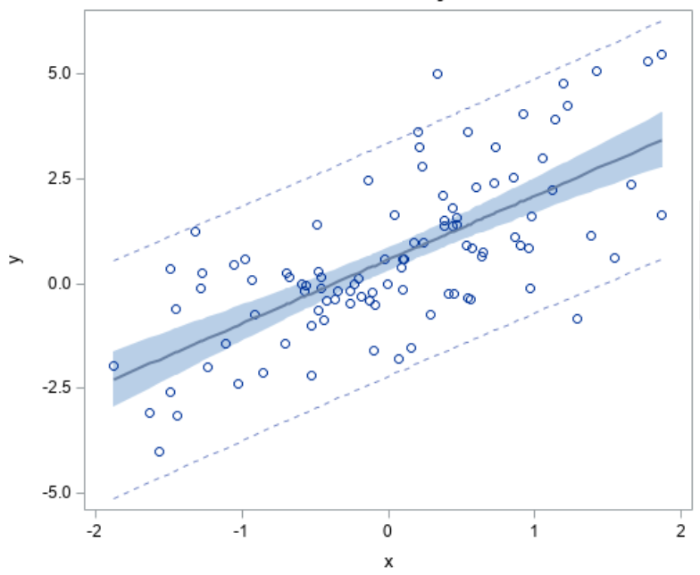
Interpretation exercise 6
Notes:
Residuals look fine.

Slide 42
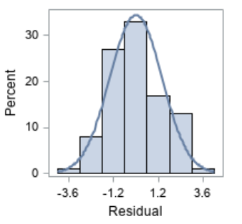
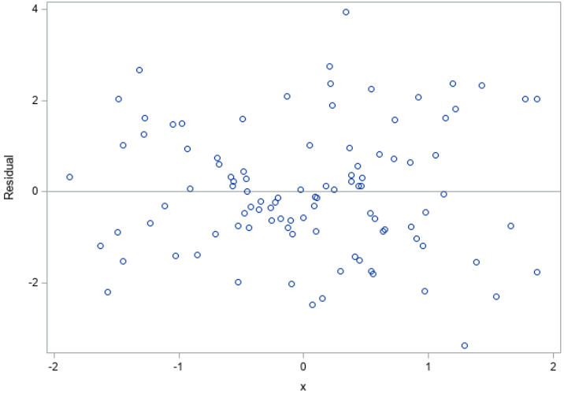
Interpretation exercise 6
Notes:
Residuals look fine.

Slide 43
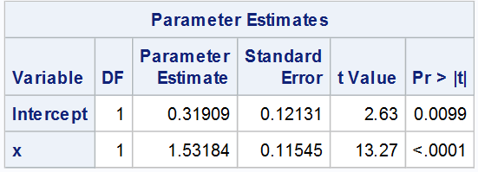
Interpretation exercise 6

Slide 44
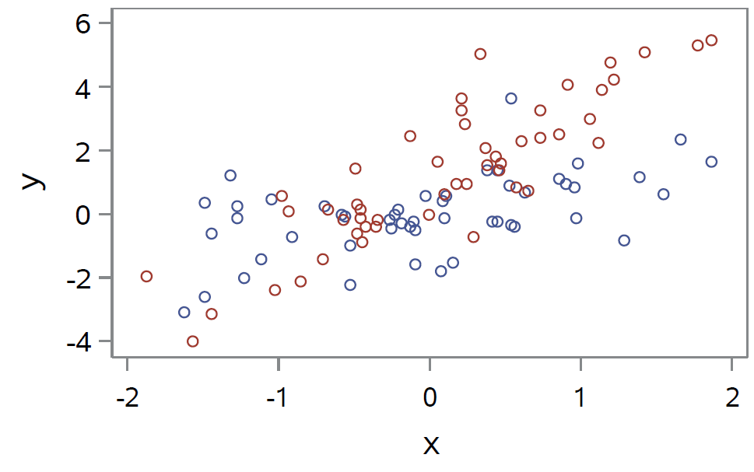
Interpretation exercise 6
Notes:
Red are women and blue are men. Notice that they have different slopes and different intercepts.

Slide 45
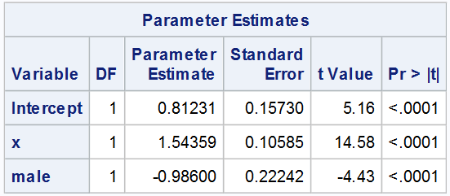
Interpretation exercise 6

Slide 46

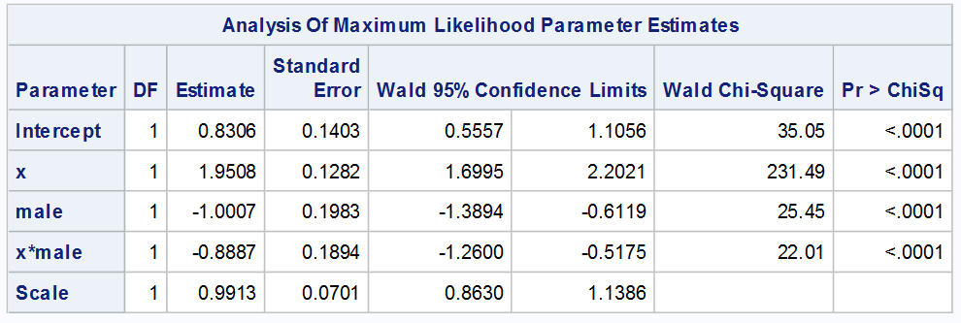
Interpretation exercise 6
Notes:
Write down the expected value of Y. EY = b0 +b1*male + b2*x +b3*(x*male). Write down E(Y|male) and E(Y|female).

Slide 47
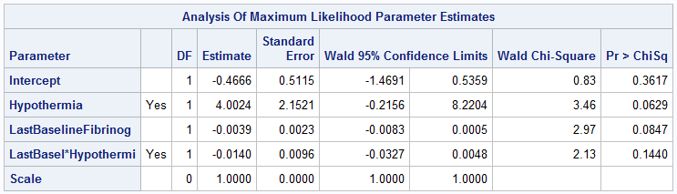
Interpretation exercise 7

Slide 48
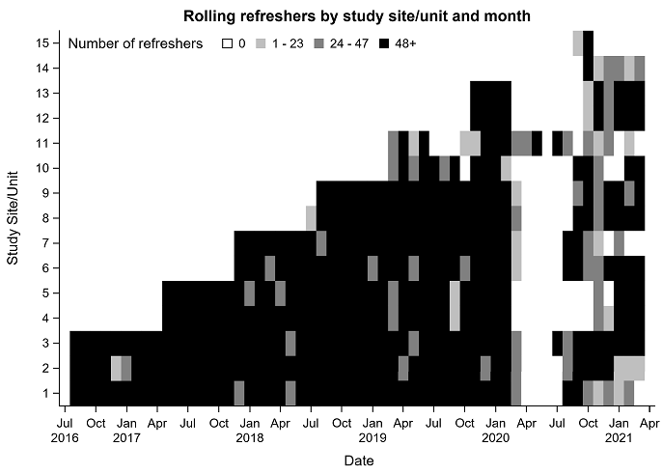

Slide 49
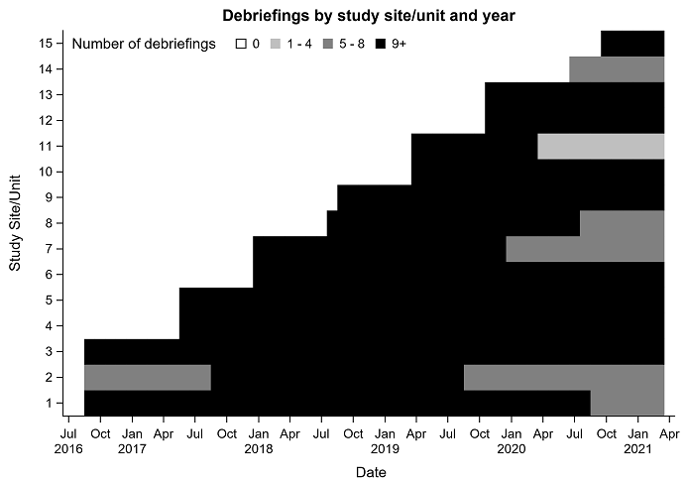

Slide 50
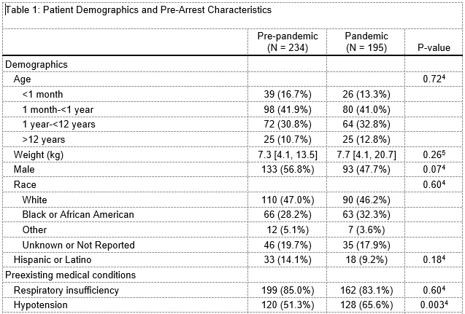
A real example with modeling

Slide 51
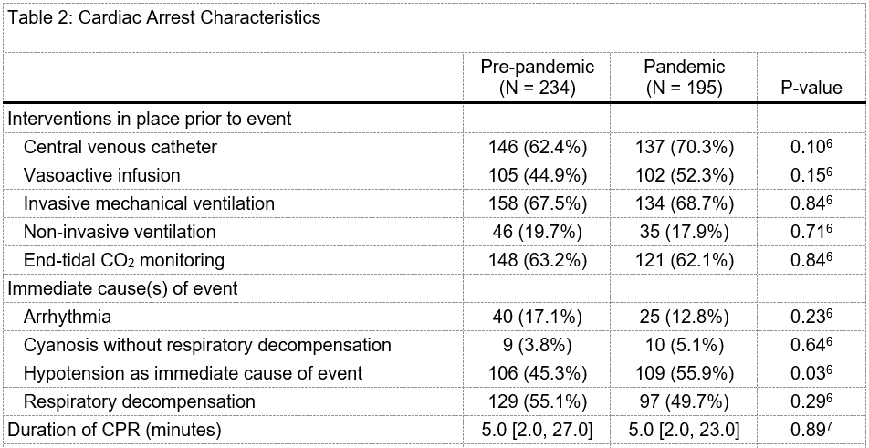

Slide 52
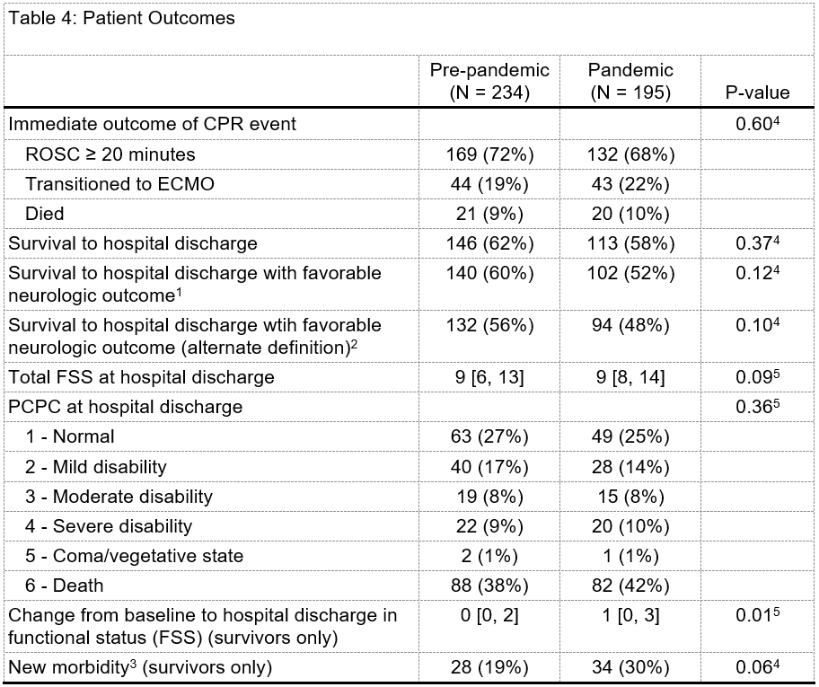

Slide 53
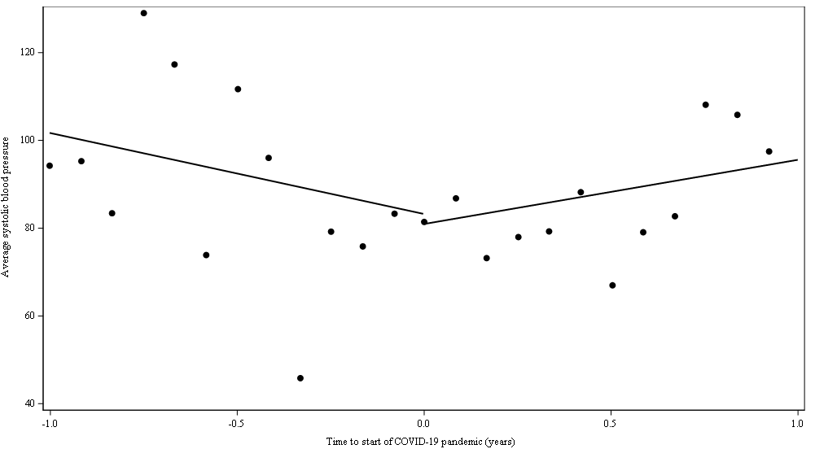

Slide 54
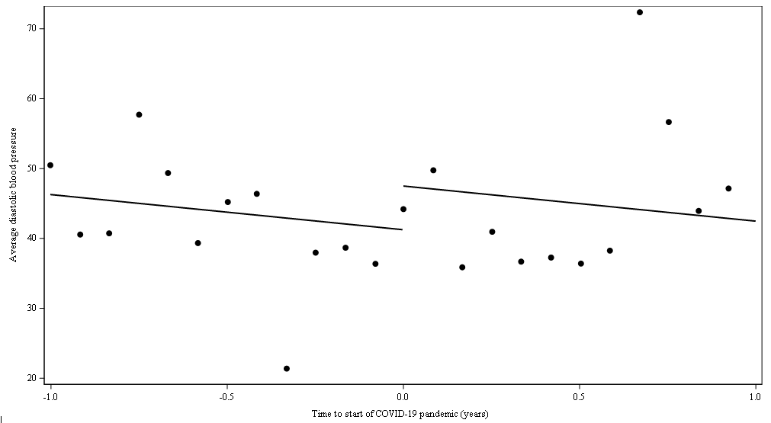

Slide 55
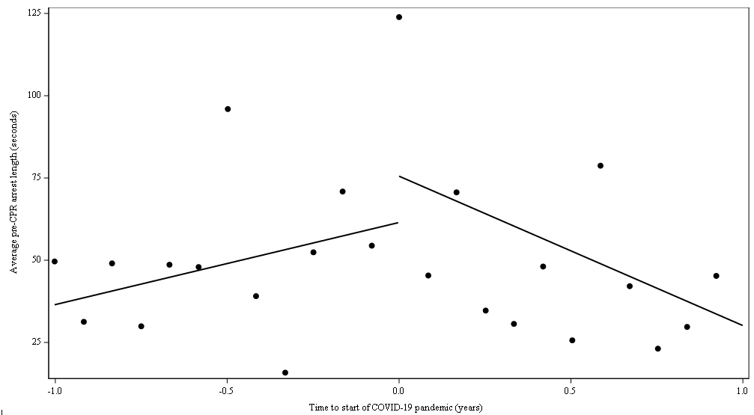

Slide 56
Homework
Write down an appropriate model for the following under 5 different sets of assumptions. Explain the interpretation of each parameter in your model.
  Outcome = average systolic blood pressure during CPR
  Predictor = time since start of COVID
1) Assume that the slope is constant (same before and after COVID) and that there is no jump in average DBP when COVID hits.
2) Assume that the slope is constant but there is a possible jump when COVID hits.
3) Assume the slope is zero but there is a possible jump when COVID hits.
4) Assume that the slope can change when COVID hits, but there is no jump.
5) Assume that the slope can change and a jump may occur when COVID hits.
Repeat the problem above with survival as the outcome.

