Slide 1
Chapter 14
Non-parametric tests

Slide 2
A brief history
We learned what to do when the distribution family is known, e.g. Normal.
We learned to test whether the distribution is from a certain family.
Now, we’ll learn about tests that are completely valid regardless of the population distribution.
These are called ‘non-parametric’ tests.
We’ll also learn some non-parametric methods for deriving confidence intervals.

Slide 3
A caveat or two
Non-parametric tests are less powerful; AND
Non-parametric confidence intervals are wider.

Slide 4
So why use a non-parametric method?
They are valid—regardless of the underlying distribution.
We often have no idea what the underlying distribution is.
They are often insensitive to even the most extreme outliers.
The tests can be nearly as powerful.
The CIs can be nearly as narrow.

Slide 5
Academic (non-faculty) statistician salary in 2018
Notes:
This table is from the 2017-2018 academic, non-faculty statistician salary report by the American Statistical Association.

Slide 6
Academic (faculty) statistician salary in 2018
Notes:
This data is actually for a biostatistics department. A statistics department would pay less than this. A math department would pay less still, and industry would pay more. Essentially, you earn more the more applied the work is.

Slide 7
More salary information for statistics
http://www.amstat.org/ASA/Your-Career/Salary-Information.aspx

Slide 8
Example 14.2.1 – Statistician Salary
Suppose you surveyed 20 young statisticians and these are the reported salaries (in thousands of dollars per year):
60, 86, 87, 92, 93, 94, 97, 99, 99, 101, 107, 109, 113, 116, 117, 122, 136, 136, 139, 142
Test the null hypothesis that the median salary for young statisticians is 100k/year against the alternative that it is higher.
H₀: m = 100k
H₁: m > 100k
Σ 1{X_{i} ≥ 100k} ~ BIN(20,1/2) under the null hypothesis.
Notes:
P-value = 1-pbinom(10, size=20,p=1/2) = 0.412. Notice that 10 is used rather than 11 since we want the probability that the test statistic would be larger than or equal to 11, so we take 1 minus the probability that it would be 10 or less under the null.

Slide 9
Notes:
Poll Title: Would the methodology of the previous example be sound if 90% of new statisticians earn 100k/year? https://www.polleverywhere.com/multiple_choice_polls/LDXRBjT99t5C0YkyQy9qb

Slide 10
Example 14.2.1 – Statistician Salary – Sign test
Suppose you surveyed 2,000,000 (intentionally extreme) young statisticians and these are the reported salaries (in thousands of dollars per year):
60, 100, 100, 100, 100, … , 100, 100, 100, 100, 100, 117, 122, 136, 136, 139, 142
Test the null hypothesis that the median salary for young statisticians is 100k/year against the alternative that it is higher.
H₀: median = 100k
H₁: median > 100k
Σ 1{X_{i} ≥ 100k} ~ BIN(2,000,000; 1/2) under the null hypothesis???
Then p-value = P(BIN(2,000,000; 1/2) ≥ 2x10⁶ – 6) ≈ 0
But, uh, the null hypothesis is obviously true. What went wrong?
Notes:
The problem is we were assuming a continuous distribution or at least that 100 wouldn’t occur with positive probability.

Slide 11
Example 14.2.1 – Statistician Salary
Suppose you surveyed 2,000,000 (intentionally extreme) young statisticians and these are the reported salaries (in thousands of dollars per year):
60, 100, 100, 100, 100, … , 100, 100, 100, 100, 100, 117, 122, 136, 136, 139, 142
Test the null hypothesis that the median salary for young statisticians is 100k/year against the alternative that it is higher.
H₀: P(X>100k) = P(X<100k)
H₁: P(X>100k) > P(X<100k)
Σ 1{X_{i} ≥ 100k} ~ BIN(7; 1/2) under the null hypothesis
Then p-value = P(BIN(7; 1/2) ≥ 6) ≈ 0.06
Notes:
You may reject the null hypothesis or you may not, but the interpretation is quite different.

Slide 12
Example – Statistician Salary
Suppose you surveyed 20 young statisticians and these are the reported salaries (in thousands of dollars per year):
60, 86, 87, 92, 93, 94, 97, 99, 99, 101, 107, 109, 113, 116, 117, 122, 136, 136, 139, 142
Test the null hypothesis that the 80th percentile of salary for young statisticians is 100k/year against the alternative that it is higher.
H₀: x_{0.80} = 100k
H₁: x_{0.80} > 100k
Σ 1{X_{i} > 100k} ~ BIN(20,0.20) under the null hypothesis.
Notes:
P-value = 1-pbinom(10, size=20,p=0.20) = 0.0006.

Slide 13
Example – Statistician Salary
Suppose you surveyed 20 young statisticians and these are the reported salaries (in thousands of dollars per year):
60, 86, 87, 92, 93, 94, 97, 99, 99, 100, 107, 109, 113, 116, 117, 122, 136, 136, 139, 142
The hypotheses
H₀: P(X>100k)/P(X≠100k) = 0.2
H₁: P(X>100k)/P(X≠100k) < 0.2
Σ 1{X_{i} > 100k} ~ BIN(19,0.20) under the null hypothesis.
Notes:
P-value = 1-pbinom(10, size=20,p=0.20) = 0.0006.

Slide 14
[Add example where this test is a good idea even though there are a bunch of ties.]
The example could be two binary classifiers that almost always both get it right. But you want to know if one classifier is better than the other.

Slide 15
Example 14.3.2 – Statistician Salary – CI
Suppose you surveyed 20 young statisticians and these are the reported salaries (in thousands of dollars per year):
60, 86, 87, 92, 93, 94, 97, 99, 99, 100, 107, 109, 113, 116, 117, 122, 136, 136, 139, 142
Find a CI for the median salary of young statisticians.
Begin with a probability statement, e.g. P(X_{5:20} ≤ x_{0.50} ≤ X_{15:20}).
Note that P(X_{5:20} ≤ x_{0.50}) = P[F(X_{5:20}) ≤ F(x_{0.50})] = P[U_{5:20} ≤ 0.50]
F is the cdf of the unknown distribution of young statistician salary,
U represents a UNIF(0,1) distribution,
x_{0.50} is the median of the unknown distribution.

Slide 16
Example 14.3.2 continued
P[U_{5:20} ≤ 0.50] = P(Σ 1{U_{i} ≤ 0.50} ≥ 5) = P[BIN(20,1/2) ≥ 5] = 0.994
P(x_{0.50} ≤ X_{15:20}) = P[F(x_{0.50}) ≤ F(X_{15:20})] = P[0.50 ≤ U_{15:20}]
= P(Σ 1{U_{i} ≥ 0.50} ≥ 6) = P[BIN(20,1/2) ≥ 6] = 0.979
How do we put this together for a single two-sided CI?
Let A = {X_{5:20} ≤ x_{0.50}} and B = {x_{0.50} ≤ X_{15:20}}
P(X_{5:20} ≤ x_{0.50} ≤ X_{15:20}) = P(A∩B)
= 1 – P(A^{c}∪B^{c}) = 1 – P(A^{c}) – P(B^{c}) + P(A^{c}∩B^{c})
= 1 – [1 – P(A)] – [1 – P(B)] = P(A) + P(B) – 1
= .994 + .979 – 1 = 0.973
Notes:
1-pbinom(4,size = 20, p=1/2) = 0.994
1-pbinom(5,size = 20, p=1/2) = 0.979

Slide 17
Example 14.3.2 continued
So what is a 97.3% CI?
Recall the data
60, 86, 87, 92, 93, 94, 97, 99, 99, 100, 107, 109, 113, 116, 117, 122, 136, 136, 139, 142
Recall our work
P(X_{5:20} ≤ x_{0.50} ≤ X_{15:20}) = 0.973
97.3% CI is [93, 117]
Notes:
P-value = 1-pbinom(10, size=20,p=0.20) = 0.0006.

Slide 18
Notes:
Poll Title: Is (93, 117) $k/year a valid 97.3% CI for the median young statistician salary if the distribution is continuous? https://www.polleverywhere.com/multiple_choice_polls/r0MdaEcjK5TNHH5cJD4nJ

Slide 19
Notes:
Poll Title: Is [93, 117] $k/year a valid 97.3% CI for the median young statistician salary if the distribution is not continuous? https://www.polleverywhere.com/multiple_choice_polls/7hk65pXDzhKGN7dpQ6L9L

Slide 20
Homework
Chapter 14
1, 2

Slide 21
Example – Paired sign test
Everyone rate how you feel about Jason Kander 1 = worst, 10 = best.
Write it down.
He’s a politician who was running for some office in Missouri in 2016.

Slide 22
Example – Paired sign test

Slide 23
Example – paired sign test
Everyone rate (again) how you feel about Jason Kander 1 = worst, 10 = best.
Test the null hypothesis that the video does not change public opinion against the alternative that it improves public opinion.
Find the p-value.
Ties should be excluded. Why?

Slide 24
A quick recap of some tests
T-test
One sample t-test
Two independent samples t-test
Paired t-test
Sign test
One sample sign test
Paired sign test

Slide 25
Comparing Power
The comparison
Paired sign test vs. paired t-test.
i.e. sign test vs. t-test applied to differences.
The assumptions
N = 100 pairs of data
Mean/Median difference = 0.3
Standard deviation of differences = 1
Differences are normally distributed.
The plan
Generate outcomes from a random number generator.
Test the hypothesis of zero median difference (or mean difference).
Repeat 1000 times. The proportion with p-value < 0.05 is the power.

Slide 26
Generate the data
%let NumberOfPairs = 100; /* Number of pairs */
%let MeanDifference = 0.3; /* Mean response after - mean response before */
%let StandardDeviation = 1; /* Standard deviation of differences */
%let NumberOfSimulations = 1000; /* Number of times to repeat the experiment*/
data a;
call streaminit(1);
do simulation = 1 to &NumberOfSimulations;
do subject = 1 to &NumberOfPairs;
Difference = &MeanDifference + &StandardDeviation*rand('NORMAL');
output;
end;
end;
run;

Slide 27
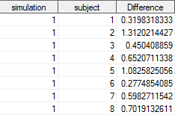
A peek at some of the data

Slide 28
Test the hypothesis
ods select TestsForLocation;
ods output TestsForLocation = TestsForLocationTable
(keep = simulation test pvalue);
proc univariate data=a;
var Difference;
by simulation;
run;

Slide 29
A peek at some of the results

Slide 30
Compute power
proc sql;
select
test
, mean(pvalue < 0.05) as power
from TestsForLocationTable
group by test
;
quit;

Slide 31
Results (Power)

Slide 32
Paired-sample signed-rank test
This test is an attempt to use more and throw away less of the information but still have a non-parametric test.
Steps
Rank the absolute values of the differences, |d_{i}|, where 1 is smallest.
The null hypothesis is that the distribution of differences is symmetric about zero. The two-sided alternative is that the distribution is not symmetric about zero.
i.e. 1{Difference associated with rank i > 0} ~ i.i.d. BER(1/2) under H₀
Test statistic is T = Σ 1{d_{i} > 0} rank(d_{i}), i.e. sum of positive ranks.
Notes:
It is sometimes considered a test of the equality of means (or medians), though it is possible that the p-value would be low even when the means or medians are the same due to other asymmetry in the difference. This test is certainly most powerful for differences in location. It is a test of whether the high values (in absolute value) systematically are negative vs. positive. If so, the null is likely to be rejected.

Slide 33
Paired-sample signed-rank test
Consider, for tractability, an example with 3 pairs
x | y | d | Rank | Sign
1 | 3
5 | 4
3 | 7

Slide 34
Paired-sample signed-rank test
Consider, for tractability, an example with 3 pairs
x | y | d | Rank | Sign
1 | 3 | -2
5 | 4 | 1
3 | 7 | -4

Slide 35
Paired-sample signed-rank test
Consider, for tractability, an example with 3 pairs
x | y | d | Rank | Sign
1 | 3 | -2 | 2
5 | 4 | 1 | 1
3 | 7 | -4 | 3

Slide 36
Paired-sample signed-rank test
Consider, for tractability, an example with 3 pairs
t = 1 (sum of positive ranks)
x | y | d | Rank | Sign
1 | 3 | -2 | 2 | -
5 | 4 | 1 | 1 | +
3 | 7 | -4 | 3 | -

Slide 37
Determining a p-value
Ranks
1 | 2 | 3 | t
+ | + | +
+ | + | -
+ | - | +
+ | - | -
- | + | +
- | + | -
- | - | +
- | - | -
Notes:
Under the null hypothesis every configuration of negative and positive ranks is equally likely.

Slide 38
Determining a p-value
Ranks
1 | 2 | 3 | t
+ | + | + | 6
+ | + | - | 3
+ | - | + | 4
+ | - | - | 1
- | + | + | 5
- | + | - | 2
- | - | + | 3
- | - | - | 0
Notes:
If the alternative is that mean(x) > mean(y), then P-value = P(≥ 1 | null) = 7/8.
If the alternative is that mean(x) ≠ mean(y), then P-value = P(≤ 1 or ≥ 5 | null) = 2/8 + 2/8 = ½.
Note that the null and alternative can only be specified with mean/median if we additionally assume that the differences are symmetric about some point (not necessarily zero). Then we are essentially testing whether the point they are symmetric about is zero or not.

Slide 39
What would you do with ties?
x | y | d | Rank | Sign
1 | 3 | -2
5 | 3 | 2
3 | 7 | -4

Slide 40
Option 1
Average the ranks.
x | y | d | Rank | Sign
1 | 3 | -2 | 1.5
5 | 3 | 2 | 1.5
3 | 7 | -4 | 3

Slide 41
Option 1
t = 1.5 (sum of positive ranks)
x | y | d | Rank | Sign
1 | 3 | -2 | 1.5 | -
5 | 3 | 2 | 1.5 | +
3 | 7 | -4 | 3 | -

Slide 42
Option 1
Ranks
1.5 | 1.5 | 3 | t
+ | + | + | 6
+ | + | - | 3
+ | - | + | 4.5
+ | - | - | 1.5
- | + | + | 4.5
- | + | - | 1.5
- | - | + | 3
- | - | - | 0
Notes:
Under the null hypothesis every configuration of negative and positive ranks is equally likely.

Slide 43
Option 2
Discard ties before starting.
This doesn’t even impact the formulation of the null hypothesis that the distribution of differences is symmetric about zero.
x | y | d | Rank | Sign
3 | 7 | -4 | 1

Slide 44
Determining a p-value
Ranks
1 | 2 | 3 | t
+ | + | + | 6
+ | + | - | 3
+ | - | + | 4
+ | - | - | 1
- | + | + | 5
- | + | - | 2
- | - | + | 3
- | - | - | 0
Notes:
If the alternative is that mean(x) > mean(y), then P-value = P(≥ 1 | null) = 7/8.
If the alternative is that mean(x) ≠ mean(y), then P-value = P(≤ 1 or ≥ 5 | null) = 2/8 + 2/8 = ½.
Note that the null and alternative can only be specified with mean/median if we additionally assume that the differences are symmetric about some point (not necessarily zero). Then we are essentially testing whether the point they are symmetric about is zero or not.

Slide 45
One sided alternatives and more
Two sided
H₀: The differences are symmetric around 0 (or more generally m₀)
H_{a}: The differences are not symmetric around 0
A one-side alternative is a bit harder to formulate elegantly.
H_{a}: P(sum of positive ranks < sum of negative ranks) < ½; OR
H_{a}: P(sum of positive ranks < sum of negative ranks) > ½
The null can be stated as:
P(sum of positive ranks < sum of negative ranks) = ½
Suppose m₀ ≠ 0. How might you state a one-sided alternative?
P(sum of positive ranks < sum of negative ranks) < ½, where ranks are based on the following: D_{i} – m₀
Note this also suggest how to perform the test.

Slide 46
What the signed-rank test is really good at?
It is pretty powerful when there is a location shift.
Violations of symmetry that don’t shift the mean and median are harder to detect.

Slide 47
What if the sample size is large?
[T – E(T)] / sqrt(var(T) converges in distribution to N(0, 1).
E(T) = E[Σ 1{d_{i} > 0} rank(d_{i})] = Σ i/2 = n(n+1)/4
Var(T) = var[Σ 1{d_{i} > 0} rank(d_{i})] = Σ var (i * BER(1/2)_{i})
= Σ i²/4 = n(n+1)(2n+1)/24
Notes:
Note that for the calculation of the expectation, it is important that the two components are independent so that the expected value of the product is the product of the expected value.

Slide 48
Wait, why?
Why use a non-parametric test (e.g. signed-rank test) if you are going to use a normal approximation?
What about power?
Notes:
Even if you use the normal approximation for the signed rank test, it is still less sensitive to outliers.

Slide 49
Homework
Chapter 14
Sign test: 11, 12, 13a
Signed rank test: 13b

Slide 50
Recap – Paired Sign test
Test statistic: T₁ = ∑ 1{D_{i} > 0}
H₀: Differences are equally likely to be positive versus negative.
Or above versus below a different fixed value
Other assumptions
None.

Slide 51
Recap – Paired Signed-rank test
Test statistic: T₂ = ∑ 1{D_{i} > 0} rank (D_{i})
H₀: Differences are symmetric about zero.
Or symmetric about a different fixed value
Other assumptions
None
Notes
This is substantially more powerful than the sign test—nearly as powerful as a paired t-test.

Slide 52
Wait, can’t we do better?
Paired sign test
T₁ = ∑ 1{D_{i} > 0}
Paired signed-rank test
T₂ = ∑ 1{D_{i} > 0} rank (D_{i})
A more powerful test?
T₃ = ∑ 1{D_{i} > 0} D_{i}
Notes:
If summing the positive ranks provides a test statistic that is more powerful that simply counting the number of positive differences, what about summing the positive differences themselves? Yes. However, the impact of outliers is different.

Slide 53
Notes:
Poll Title: For the example with surveys before and after watching a political advertisement, which test would you use? https://www.polleverywhere.com/multiple_choice_polls/EHEQJ3EuTOIg74qQhppQy

Slide 54
P-value for our new test
Consider, for tractability, an example with 3 pairs
t = 1 (sum of positive differences)
x | y | d | |d| | Sign
1 | 3 | -2 | 2 | -
5 | 4 | 1 | 1 | +
3 | 7 | -4 | 4 | -

Slide 55
Determining a p-value
Absolute differences
1 | 2 | 4 | t
+ | + | +
+ | + | -
+ | - | +
+ | - | -
- | + | +
- | + | -
- | - | +
- | - | -
Notes:
Under the null hypothesis every configuration of negative and positive ranks is equally likely.

Slide 56
Determining a p-value
Absolute differences
1 | 2 | 4 | t
+ | + | + | 7
+ | + | - | 3
+ | - | + | 5
+ | - | - | 1
- | + | + | 6
- | + | - | 2
- | - | + | 4
- | - | - | 0
Notes:
Under the null hypothesis every configuration of negative and positive ranks is equally likely.

Slide 57
Another quick recap
We have performed one-sample testing and paired sample testing.
We have not considered two independent samples.
e.g. one group of students are given NZT while the other group get placebo, then both take an IQ test.
X₁, …, X_{n} ~ i.i.d. F_{X} and Y₁, …, Y_{m} ~ i.i.d. F_{Y} with samples independent from one another.
Note that the two samples do not need to be the same size.

Slide 58
The Wilcoxon rank-sum test
Also called:
Rank-sum test
Mann-Whitney test
Wilcoxon-Mann-Whitney test
U test
Mann-Whitney U test
Wilcoxon-Mann-Whitney U test

Slide 59
Homework
Find a simple example for which you get a different p-value from the new test (∑ 1{D_{i} > 0} D_{i} ) versus the signed rank test.

Slide 60
The Wilcoxon rank-sum test
When two samples are independent, this test is used to assess:
H₀: both populations (that the samples came from) have the same distribution
H₁: The distributions are different.
A one sided alternative can be expressed as:
H₁: P(X>Y) > P(X<Y), i.e. X tends to be larger than Y.
This is powerful when there is a shift in location, e.g. median.
It is often erroneously referred to as a test of the medians.
Notes:
But considering that is what it is powerful to detect, how wrong is that really? Why not call it a test of means though? Simply because both are not greatly affected by outliers—that it.

Slide 61
The Wilcoxon rank-sum test
The test statistic (by Wilcoxon)
Pool both samples.
Rank observations (not absolute values) starting with 1 for the smallest.
W_{x} = sum of ranks from sample X, say the first sample.
You could just as easily use W_{y}.
A different test statistic (but an equivalent test; by Mann-Whitney)
U_{x} = W_{x} – n_{x}(n_{x} + 1)/2, where n_{x} is the sample size in sample X.
U_{x} = ∑ ∑ 1{X_{i} > Y_{k}}, with the sum over all n x m possible pairs.
Notes:
Both tests, as you can see from U, are asymptotically normal. The asymptotic mean and variances can be found in the book if needed. You can also see from U why we state a one-sided alternative in the way that we do.
Note the for the U statistic, you should give a half point when X = Y, in order to be consistent with out we describe handling ties next.

Slide 62
Example 14.7.1 (rank-sum test)
We record failure times of air conditioners for two separate airplanes.
W_{x} = 1 + 2 + 3 + 4 + 6.5 + 10 + 11 + 12 + 14 + 18 + 20.5 + 22
= 121
Plane 1 | 7₁ | 14₂ | 21₃ | 23₄ | 47_{6.5} | 62₁₀ | 71₁₁ | 87₁₂ | 120₁₄ | 225₁₈ | 246_{20.5} | 261₂₂
Plane 2 | 33₅ | 47_{6.5} | 55₈ | 56₉ | 104₁₃ | 176₁₅ | 182₁₆ | 220₁₇ | 239₁₉ | 246_{20.5} | 320₂₃

Slide 63
Computing the p-value
Under the null hypothesis, any subset of size n_{x} is equally likely to be the set of observations from Sample X.
P-value = proportion of w_{x} that is as extreme or more extreme
Extreme means unusual under the null or in support of the alternative.
P-value (two-sided alternative) = 0.23
I used a computer… and I feel ashamed.
Notes:
This sample is too large to do reasonably by hand, but you could certainly be asked to compute the outcome of the test statistic
Code to perform test:
data a;
group = 1;
x = 7; output;
x = 14; output;
x = 21; output;
x = 23; output;
x = 47; output;
x = 62; output;
x = 71; output;
x = 87; output;
x = 120; output;
x = 225; output;
x = 246; output;
x = 261; output;
group = 2;
x = 33; output;
x = 47; output;
x = 55; output;
x = 56; output;
x = 104; output;
x = 176; output;
x = 182; output;
x = 220; output;
x = 239; output;
x = 246; output;
x = 320; output;
run;
proc npar1way data = a wilcoxon;
class group;
var x;
run;

Slide 64
Wilcoxon rank-sum test (by hand!)
Airplane 1 | 1₁ | 3₂ | 8₄
Airplane 2 | 7₃ | 9₅
w_{x} = 1 + 2 + 4 = 7

Slide 65
Wilcoxon rank-sum test (by hand!)
1 | 2 | 3 | 4 | 5 | w_{x}
X | X | X |  |  | 6
X | X |  | X |  | 7
X | X |  |  | X | 8
X |  | X | X |  | 8
X |  | X |  | X | 9
X |  |  | X | X | 10
 | X | X | X |  | 9
 | X | X |  | X | 10
 | X |  | X | X | 11
 |  | X | X | X | 12
Notes:
P-value (two-sided) = 0.40
One sided?

Slide 66
Can you do this one by hand?
Airplane 1 | 1 | 5 | 5 | 8 | 12 | 20 | 22 | 23 | 25
Airplane 2 | 30 | 50 | 88
Notes:
P-value (1-sided) = 1/(12 choose 3).
P-value (2-sided) = 2/(12 choose 3).

Slide 68
Homework
Chapter 14
Practice calculating the p-value for the Wilcoxon rank-sum test by hand. You will turn in your solution to one such problem of your choice.

Slide 69
Randomization test
Also called a permutation test.
It is more of a method or principle rather than a specific test.
We’ll look at a simple (fake) example, and then we’ll look at a real (and very awesome) example.

Slide 70
Example: Randomization test Choose a test statistic
Subject | Treatment | IQ score
1 | Placebo | 96
2 | Placebo | 102
3 | NZT | 118
4 | NZT | 112
Notes:
Difference in averages (NZT – Placebo)= 115 – 99 = 16.

Slide 71
Example: Permutation test
Write down every permutation of the treatments (explanatory variable).
How many permutations are there?
Compute the test statistic for each permutation.
For a one-sided alternative (NZT improves IQ), compute the p-value.
Notes:
How many are there? Well, 12, but they come in pairs. For every permutation, there’s another permutation with the exact same arrangement of placebo and NZT. So you could look just at 6.
Note that under the null hypothesis, every permutation and therefore every test statistic is equally likely.
Consider adding an additional slide with the details worked out (a table for each permutation).

Slide 72
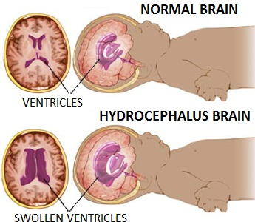
Hydrocephalus
“Water on the brain”
Too much cerebrospinal fluid (CSF) in the ventricles of the brain → increase in intracranial pressure

Slide 73
Hydrocephalus
Current methods of treatment
Temporary devices
Shunt
Endoscopic Third Ventriculostomy (ETV)
With and without Choroid Plexus Cauterization (CPC)

Slide 74
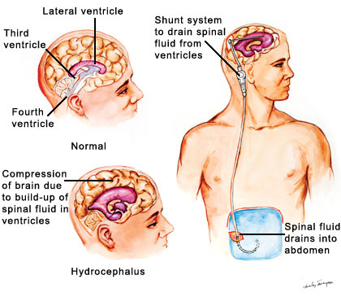
Shunt
A tube that drains CSF from the ventricles to another part of the body for absorption
http://hydrocephalus.yolasite.com/hydrocephalus.php

Slide 75
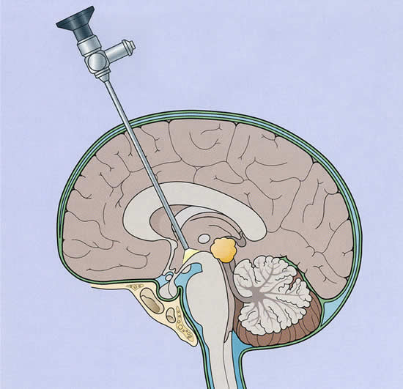
Endoscopic Third Ventriculostomy (ETV)
A small hole at the floor of the third ventricle to allow for alternative flow and absorption of CSF
seattlechildrens.org

Slide 76
VINOH study
Objective: Evaluate the association between ventricle size and cognitive functioning 6 months after treatment for hydrocephalus.

Slide 77
Study Cohort
Eligibility Criteria
5 – 17 years old
Getting a shunt or ETV
Etc.
Notes:
Dilated ventricles – Wikipedia
Atrial – to the atrium of the heart
Pleural – to the pleural space (surrounding the lungs)

Slide 78
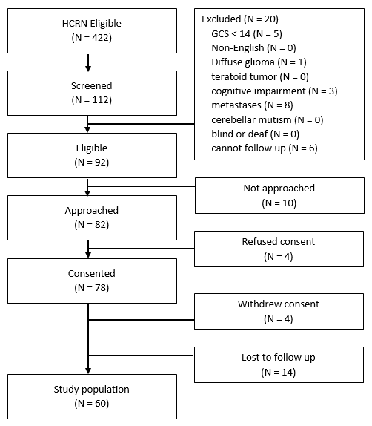

Slide 79
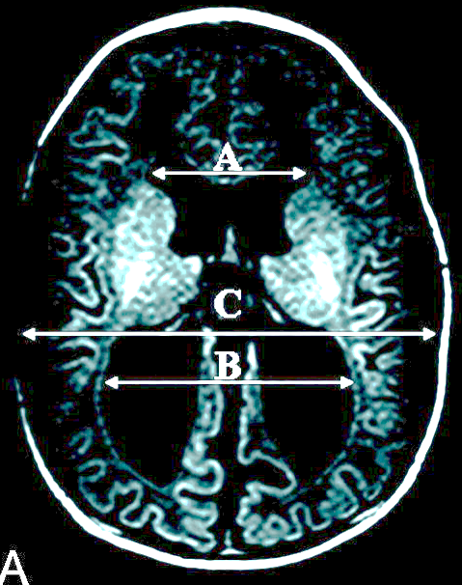
The primary predictor: FOR
Measurement of ventricle size – frontal-occipital horn ratio (FOR) at 6 months post-op
“Average of the frontal and occipital horn width divided by the interparietal distance”²
(A+B)/(2C)
http://www.ajnr.org/content/30/9/1792 - Anisotropic Diffusion Properties in Infants with Hydrocephalus: A Diffusion Tensor Imaging Study, Yuan et al, 2009

Slide 80
The outcomes: 36 different measures of cognitive functioning
Parent estimated GPA – overall, language arts, math, science, and social studies
HOQ – overall, physical, social-emotional, and cognitive
Behavior Rating Inventory of Executive Function (BRIEF)
Weschler Abbreviated Scale of Intelligence (WASI)
Weschler Individual Achievement Test, Second Edition Abbreviated (WIAT-II)
Beery-Buktenica Development Test of Visual Motor Integration, Fifth Edition (VMI-5)
NEPSY-II Word Generation subtest
Peabody Picture Vocabulary Test, Fourth Edition (PPVT-IV)
Story Memory, Design Memory, Verbal Learning, Picture Memory, Story Memory Delay, Finger Windows subtests from Wide Range Assessment of Memory and Learning, Second Edition (WRAML-2)
Digit span subtest from Weschler Intelligence Scale for Children, Fourth Edition (WISC-IV)
Coding Subtest from Weschler Primary and Preschool Scales of Intelligence, Third Edition (WPPSI-III) or Weschler Intelligence Scale for Children, Fourth Edition (WISC-IV)
Delayed Recall Verbal Learning subtest from Wide Range Assessment of Memory and Learning, Second Edition (WRAML-2)
Benton Judgment of Line Orientation (JLO)
Pragmatic Judgment subtests from Comprehensive Assessment of Spoken Language (CASL)
Etc.

Slide 81
Goal
Determine if ventricle size (FOR) is associated with cognitive functioning?
Test each of 36 outcomes separately?

Slide 83
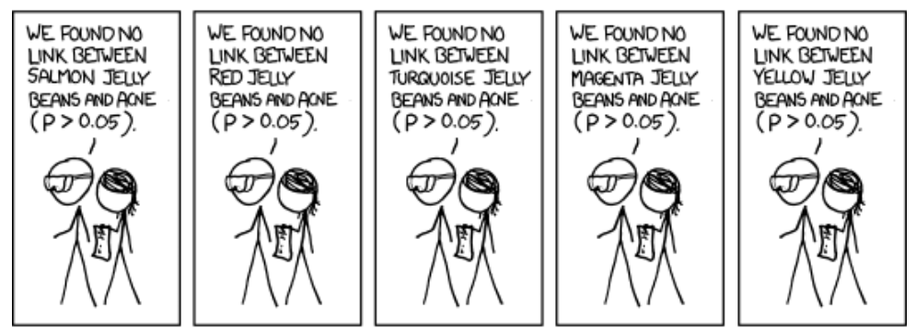

Slide 88
The problem
Jay performs 100 tests.
If no effect:
Expect about 5 false positives (α = 0.05).
Notes:
The problem of testing many hypotheses is familiar, but let me lay it out. Jay is interested in knowing if ventricle size is associated with poor neurologic functioning. He has many different ways of measuring neurologic function. For this example, let’s assume he has 100 different ways of measuring the outcome so he performs 100 statistical tests. If there is no association between ventricle size and any of these outcomes, we would expect about 5% of these tests to have p-values less than 0.05. So we would expect about 5 false positives.

Slide 89
Now comes the permutation test
Step 1: Choose a test statistic
The average of the correlations between FOR and each of the 36 different cognitive outcomes.
The sum of the correlations between FOR and each of the 36 different cognitive outcomes.
The number of correlations that are negative.
Notes:
A test statistic should be chosen that can discriminate well.

Slide 90
Our chosen test statistic
The sum of the correlations between FOR and each of the 36 different cognitive outcomes.
Observed outcome of test statistic = -5.8
Notes:
A test statistic should be chosen that can discriminate well.

Slide 91
Calculating the p-value
We need to know the distribution of the test statistic under the null hypothesis.
If FOR was independent of the 36 outcomes, any permutation of the FORs would be equally likely to pair with the set of outcomes.
Each permutation has a different outcome of the test statistic.
The distribution of these is the distribution of the test statistic under the null.

Slide 92
Every possible permutation?
The VINOH study enrolled 60 subjects.
60! different permutations
Assuming that you can compute the test statistic for 100 permutations in 1 second, this would take 2.6 x 10⁷² years.

Slide 93
Alternative
Sample your permutations with or without replacement a large number of times based on the precision you desire.
$sⅆ\left(\hat{p}\right)=\sqrt{\frac{p\left(1−p\right)}{n}}$ < 0.001
Choose n to make the inequality true.
But I don’t know p…

Slide 94
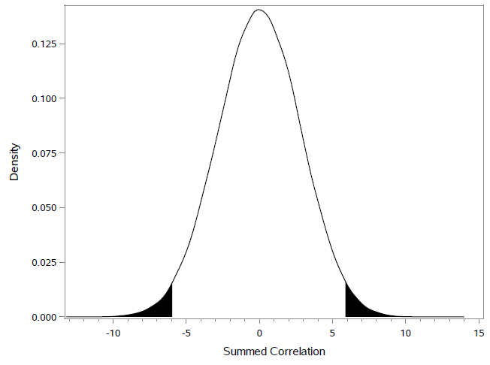
Results
P-value: 0.038
FOR is associated with poorer cognitive functioning.

Slide 95
Another simple example
Compare a permutation test to the rank-sum test (2-sided p-value)
NZT | 118 | 107
Placebo | 108 | 105 | 89

Slide 96
Homework
Find or create some examples and perform a permutation test. Turn in one such example.

Slide 97
False Discovery Rate (FDR)
A moderate approach to multiple comparisons

Slide 98
Outline
The problem
Traditional approaches
False Discovery Rate (FDR)
Vinoh
Notes:
In this brief presentation, I will show the problem of testing many hypotheses. I’ll describe some traditional approaches to overcome the problem, and I’ll introduce a new strategy called the ‘false discovery rate.’ The concept of false discovery rate is relatively new; it was first described in 1995, and in 2005, the original paper was in the top 25 sited statistics papers.

Slide 99
The problem
Jay performs 100 tests.
If no effect:
Expect about 5 false positives (α = 0.05).
Notes:
The problem of testing many hypotheses is familiar, but let me lay it out. Jay is interested in knowing if ventricle size is associated with poor neurologic functioning. He has many different ways of measuring neurologic function. For this example, let’s assume he has 100 different ways of measuring the outcome so he performs 100 statistical tests. If there is no association between ventricle size and any of these outcomes, we would expect about 5% of these tests to have p-values less than 0.05. So we would expect about 5 false positives.

Slide 100
Traditional approaches: Bonferroni
Bonferroni suggests using α = 0.05/100 = 0.0005.
Probability of a false positive will be no higher than 100 α = 0.05.
Show why this works with 2 tests.
Notes:
A common way to overcome this problem is the Bonferroni method, in which you divide alpha by the number of tests that are performed.
For STATS: This controls the family wise error rate in the strong sense, meaning that no matter whether the hypotheses are true or false, the probability of erroneously rejecting one is no more than 5%. In other words, you are really performing a single hypothesis test to determine if there are any associations from any of the sub-tests. If that is really your goal, this would typically not be the most powerful approach. If we contemplate this long, I think we may realize that it isn’t what we actually want at all.

Slide 101
What’s wrong with tradition?
A researcher performs 20 tests.
P-values are all 0.001, below the threshold of 0.05/20 = .0025
We conclude that ventricle size is associated with all 20 outcomes. =)
Notes:
Here’s an example that illustrates a problem with the traditional logic. [Describe slide]
For Stats: Technically, we only conclude that ventricle size is associated with at least one of these outcomes, since we are really only doing a single, global hypothesis test.

Slide 102
What’s wrong with tradition?
Researcher performs the same 20 tests but adds 80 more outcomes of interest (100 total tests) with the SAME DATA.
P-values are still 0.001 for the original 20 tests, but now they are above the threshold of .05/100 = .0005
We conclude that ventricle size may not be associated with any of the original 20 outcomes. =(
Notes:
[Describe slide]
So what we are seeing is that as the number of tests increases, the power of each tests to identify a relationship decreases. It seems paradoxical that the same 20 tests with the same data will have a different conclusion simply because we decided to perform some additional tests.
For Stats: This is not a paradox, because we are performing A SINGLE GLOBAL hypothesis test.

Slide 103
A ‘discovery’
If a researcher things that a treatment might have an effect on, say, IQ, then we test:
H₀: no effect
H_{a}: an effect
If we reject the null hypothesis, we will call it a ‘discovery.’

Slide 104
Another issue
Deliberate David (DD) studies hypotheses that are motivated by science and reason; 80% of these have a true effect.
Careless Carl (CC) chooses hypotheses less carefully, and there is a true effect in only 13% of tests.
When a result is ‘significant,’ the probability that it is a true effect is 98%* for DD and 71%* for CC.
* Calculated with Bayes Theorem assuming α = 0.05 and power = 0.80.
Notes:
[Describe slide]
If we knew that we were reviewing a manuscript from Deliberate David, we could be confident in his results, even if he didn’t adjust for multiplicity. The problem is, nobody knows if you are a Deliberate David or a Carless Carl, and there is a good chance that any effects shown by Careless Carl are erroneous.

Slide 105
False Discovery Rate (FDR)
FDR is the estimated fraction of discoveries (significant results) that are spurious.
FDR (DD) = 2%
FDR (CC) = 29%
From an FDR perspective, DD’s results are trustworthy and do not need adjustment for multiplicity.
Notes:
If you are doing an exploratory investigation but you have many tests, a more modern and moderate approach might allow you to adjust for multiplicity without destroying your power. The concept of FDR was first described in 1995 by Benjamini and Hochberg.
[Describe slide]
The question then, is how can we know if results come from Deliberate David or Careless Carl.

Slide 106
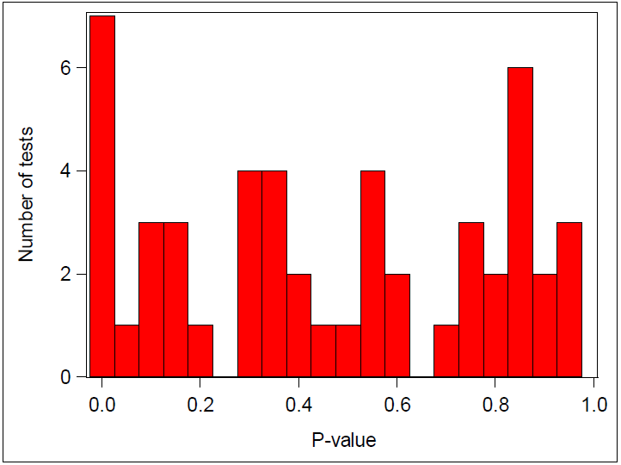
Careless Carl
Notes:
So the question is: How do you know if a researcher is a DD or a CC. When there is no effect at all, p-values are spread fairly evenly from 0 to 1, which is what we see in this example. CC’s FDR is estimated to be about 30%, meaning that of his ‘discoveries’ with p-values less than 0.05, 30% of them are spurious. So we can’t be too confident in his results, and we may need to consider a lower threshold. Perhaps we should only call his results ‘significant’ if they have p-values less that 2.5%.

Slide 107
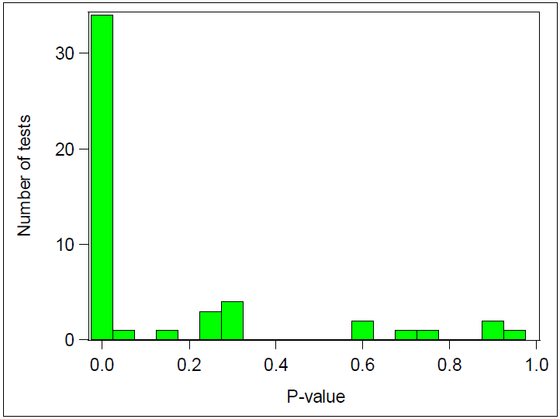
Deliberate David
Notes:
On the other hand, when there are true effects, many of the p-values will be quite small, leading to a very skewed distribution. The false discovery rate here is estimated to be less than 2%. So, more than 98% of the ‘discoveries’ with p-values less than 0.05 are true effects. We can be confident in his claims.

Slide 108
Deliberate David vs. Careless Carl
Raw p-value | Bonferroni adjusted p-value | FDR adjusted p-value (q-value)
0.000 | 0.000 | 0.000
0.001 | 0.029 | 0.009
0.001 | 0.029 | 0.009
0.001 | 0.035 | 0.009
0.001 | 0.047 | 0.009
0.002 | 0.080 | 0.013
0.002 | 0.095 | 0.013
0.002 | 0.100 | 0.013
0.003 | 0.133 | 0.015
0.003 | 0.157 | 0.016
0.003 | 0.173 | 0.016
0.004 | 0.197 | 0.016
0.005 | 0.231 | 0.017
0.005 | 0.266 | 0.017
0.006 | 0.280 | 0.017
0.006 | 0.303 | 0.017
0.006 | 0.319 | 0.017
0.007 | 0.327 | 0.017
0.007 | 0.344 | 0.017
0.007 | 0.367 | 0.017
Raw p-value | Bonferroni adjusted p-value | FDR adjusted p-value (q-value)
0.002 | 0.085 | 0.078
0.005 | 0.246 | 0.078
0.006 | 0.309 | 0.078
0.007 | 0.367 | 0.078
0.011 | 0.529 | 0.078
0.011 | 0.532 | 0.078
0.011 | 0.543 | 0.078
0.046 | 1.000 | 0.288
0.098 | 1.000 | 0.526
0.105 | 1.000 | 0.526
0.122 | 1.000 | 0.554
0.148 | 1.000 | 0.578
0.150 | 1.000 | 0.578
0.170 | 1.000 | 0.599
0.180 | 1.000 | 0.599
0.276 | 1.000 | 0.777
0.280 | 1.000 | 0.777
0.294 | 1.000 | 0.777
0.296 | 1.000 | 0.777
0.331 | 1.000 | 0.777
Notes:
Let’s take a closer look at the individual p-values from DD and CC. The left panel is from DD, and you can see the first column shows the raw p-value. The second column shows the Bonferroni-adjusted p-values. This adjustment is very conservative and results in a major loss of power so that only 5 results are deemed ‘significant’ at the 0.05 level. The FDR-adjusted p-values in the third column use a more moderate adjustment. Based on this adjustment all 20 of the results shown are considered ‘significant.’
The panel on the right shows CC’s p-values and adjusted p-values. After adjustment with either strategy, no results are considered ‘significant’ at the 0.05 level.
This is exactly what you want to see. You want power to detect effects when they are real without accidentally finding a lot of spurious effects.

Slide 109
Vinoh
Notes:
This is a histogram of the 36 p-value from Vinoh. So, is Jay a DD or a CC? It looks to me like he’s somewhere in the middle, but closer to DD.

Slide 110
Vinoh
Raw P-value | Bonferroni adjusted p-value | FDR adjusted p-value (q-value)
0.006 | 0.212 | 0.115
0.006 | 0.230 | 0.115
0.013 | 0.461 | 0.128
0.019 | 0.673 | 0.128
0.019 | 0.688 | 0.128
0.021 | 0.770 | 0.128
0.029 | 1.000 | 0.135
0.030 | 1.000 | 0.135
0.037 | 1.000 | 0.148
0.051 | 1.000 | 0.168
0.051 | 1.000 | 0.168
0.058 | 1.000 | 0.172
0.062 | 1.000 | 0.172
0.082 | 1.000 | 0.182
0.084 | 1.000 | 0.182
0.088 | 1.000 | 0.182
0.089 | 1.000 | 0.182
0.091 | 1.000 | 0.182
0.101 | 1.000 | 0.192
0.117 | 1.000 | 0.205
Notes:
These are the lowest 20 p-values from Vinoh. With the ultra conservative Bonferroni adjustment, no effects are ‘significant,’ but with the FDR adjustment 9 effects are significant at the 0.15 level. We usually use 0.05 for the significance level, so why would I use 15% here? With FDR, the interpretation is quite different than a traditional p-value. It is useful to refer to these as q-values rather than as p-values to emphasize the different meaning. If we accept a q-value of < 15% as significant, then roughly 15% of our ‘significant’ results will be spurious. But that means that roughly 7 or 8 of the 9 are real. A false discovery rate of 15% seems acceptable to me. I would conclude that these 9 effects are significant, but, when considered with the associated scatter plots, perhaps the effects are not particularly strong.

Slide 111
Homework
Prepare for a quiz about FDR concepts and/or the Bonferroni correction.

