Slide 1
Chapter 10
Chapter 6 – Functions of random variables
Chapter 7 – Limiting distributions
Chapter 8 – Statistics
Chapter 9 – Point estimation
Chapter 10 – Sufficiency and completeness

Slide 2
Sufficient
A statistic, S, is sufficient for θ if f_{X|S}(x|s) does not depend on θ.
In other words, a sufficient statistic contains all the information from the sample about θ. Thus, knowing the outcome of S, there is no additional information to be gained from the sample.
If the conditional density function depended on θ, then the outcomes of the random sample are related to θ and therefore could tell you something about theta.

Slide 3
Jointly sufficient
If S in the previous definition is vector valued, then we say the components of S are ‘jointly sufficient.’

Slide 4
Example
Given a random sample from any distribution
S = (X₁, …, X_{n}) is sufficient for the parameter(s).
S = (X_{1:n}, …, X_{n:n}) is sufficient for the parameter(s).
Which contains more information?

Slide 5
Minimal sufficient statistic
A statistic, S, that is sufficient for θ is ‘minimal sufficient’ if it is a function of every other sufficient statistic.
In other words, S is minimal sufficient, if knowing the outcome of any sufficient statistic determines the outcome of S.
Example:
We saw that (X₁, …, X_{n}) is sufficient but it is not minimal because (X_{1:n}, …, X_{n:n}) is also sufficient. Knowing the outcome of (X_{1:n}, …, X_{n:n}) we still do not know the outcome of (X₁, …, X_{n}).
Suppose the sample mean is sufficient (and so is the whole sample). The whole sample is clearly not minimal… what about the sample mean?

Slide 6
Example 10.1.1
A coin is tossed n times. X_{i} = 1{i^{th} toss is heads}.
Show that ΣX_{i} is sufficient for p.

Slide 7
Theorem 10.2.1 (The Factorization Criterion)
S is sufficient for θ if and only if
f_{X}(x;θ) = g(s;θ)h(x)
For some functions g and h.

Slide 8
Example 10.1.1 (the easy way)
A coin is tossed n times. X_{i} = 1{i^{th} toss is heads}.
Factorization criterion: f_{X}(x;θ) = g(s;θ)h(x)

Slide 9
Example 10.2.3
Find minimally sufficient statistics for θ from a random sample of UNIF(0,θ).

Slide 10
Example 10.2.4
Find minimally sufficient statistics for μ and σ² from a random sample of N(μ,σ²).
Note that knowing the outcome of these would determine the outcome of the MLEs (and vice versa).
Theorem 10.3.1
If S is sufficient for θ and the MLE for θ is unique, then the MLE is a function of S.

Slide 11
End of Day 19
Homework
10.1
10.2
10.3
10.4
10.5
10.6
10.7
10.8
10.10
10.11
10.12

Slide 12
Example 10.2.5
Suppose you have a random sample from UNIF(θ,θ+1).
Find minimally sufficient statistics for θ.

Slide 13
Theorem 10.3.4
Notes:
Takeaway message: The unbiased estimator with the smallest variance is a function of a sufficient statistic. Of all sufficient statistics, actually, and therefore of a minimal sufficient statistic.
If we’re looking for a UMVUE, we only need to consider functions of the minimal sufficient statistic.

Slide 14
Completeness
Suppose X has distribution f(x; θ).
Note that f(x, θ) represents a family of distributions.
If E[u(X)] = 0 for all θ ∈ Ω implies that
u(X) = 0 with probability 1 for all θ.
Then we say that the family, f(x; θ) is complete.
Notes:
Basically, if the only way that the expected value of u(X) is zero for all parameters is for the function u to be the zero function, then we say the family is complete.

Slide 15
Completeness (less technical)
If the only way for E(u(X)) to be zero for all θ is for u(.) to be the zero function, then the family, f(x, θ) is complete.

Slide 16
Example 10.4.1
Use the definition to show that POI(λ) is complete.
Note that by POI(λ), we mean the entire set of distributions POI(λ), where λ>0.

Slide 17
Example: An incomplete family
Consider the family, {POI(λ) | λ ∈ {1, 2, 3}}.
Note that this is a smaller family than {POI(λ) | λ>0}.
Let’s go even smaller for this example.
Consider the family {POI(λ) | λ = 1}.

Slide 18
Some complete families
BIN(p)
POI(λ)
EXP(λ)
GAM(θ, κ)
N(μ, σ²)

Slide 19
Complete statistic
A statistic, T, is complete if its density function could be any member of a complete family.
Thinking about what this means:
T is a statistic, a function of a random sample.
The random sample is from a population.
The population has a distribution that could be an member of a family, f(x, θ).
The statistic T has distribution that could be any member of a (possibly) different family, g(x, θ).
If the family g(x, θ) is complete, then we say that T is complete.

Slide 20
Example
Is the sample mean from a N(μ, σ²) population complete?

Slide 21
Theorem 10.4.1
If
You have a random sample;
S is a sufficient and complete statistic;
T is a function of S and unbiased for τ(θ);
Then
T is a UMVUE for τ(θ).
We gotta prove this. It will blow your mind!
Proof to come next class.

Slide 22
End of Day 20
Homework
10.17
10.18

Slide 23
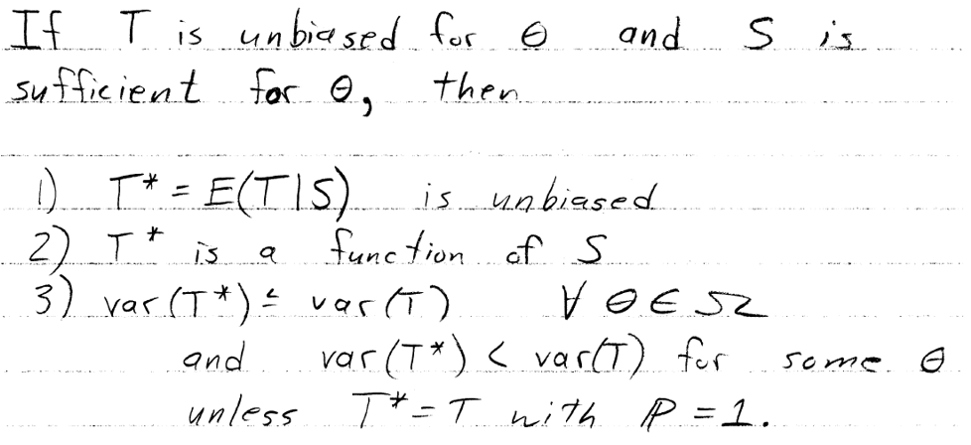
Proof of Theorem 10.4.1
If
You have a random sample;
S is a sufficient and complete statistic;
T is a function of S and unbiased for τ(θ);
Then
T is a UMVUE for τ(θ).
Recall that the unbiased estimator with the lowest variance is a function of S, a sufficient statistic. So we need only consider functions of S.
Now, suppose you have an estimator T₁ that satisfies the conditions of the theorem.
Let T₂ be another such estimator.
E(T₂ – T₁) = 0 (both unbiased).
T₂ – T₁ is a function of S (since T₁,T₂ are).
Thus T₂ – T₁ = 0 (since S is complete) and T₁ = T₂.
Notes:
Any two estimators satisfying the theorem are actually the same estimator. There can be only one unbiased function of a sufficient statistic. And since only such estimators need be considered, we know we have the best one.

Slide 24
Example 10.4.1
Suppose you have a random sample from POI(λ)
Recall that ∑X_{i} is sufficient.
Note that ∑X_{i} ~ POI(nλ)
Can be proven with moment generating functions.
{POI(nλ), λ>0} = {POI(λ), λ>0}, a complete family.
Thus S = ∑X_{i} is sufficient and complete.
∑X_{i}/n is a function of S that is unbiased for λ.
Therefore ∑X_{i}/n is a the UMVUE.

Slide 25
Example 10.4.1 continued
One could verify that ∑X_{i}/n is a UMVUE for λ with the CRLB.
But recall that λ² couldn’t possible have an unbiased estimator with variance equal to its CRLB.
Can you find a UMVUE?
Note that

Slide 26
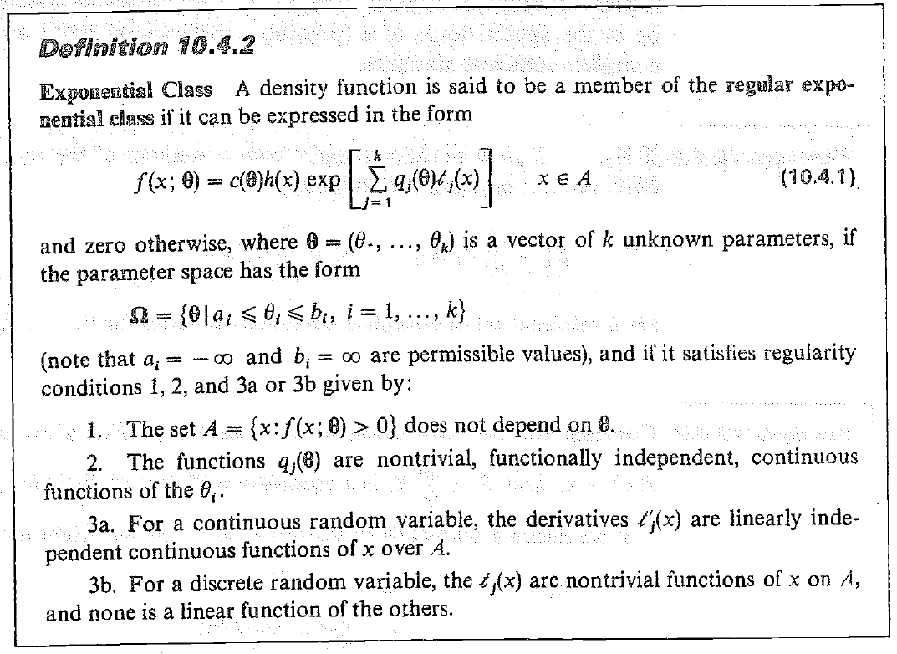
The regular exponential class

Slide 27
Example 10.4.4
The next slides will walk us through the process of demonstrating that the normal family is a member of the regular exponential class.
Step 1: Show that the density function can be expressed as

Slide 28
Step 2
Show that the parameter space is an interval, rectangle, cube, or hypercube:
Note than b_{i} must be strictly greater than a_{i}
Infinity and non-strict inequalities are okay

Slide 29
Step 3
Show that the support of the density function does not depend on the unknown parameter(s).

Slide 30
Step 4
Show that the functions q_{j}(θ) are
Nontrivial functions of θ;
Functionally independent; and
Continuous.

Slide 31
Step 4
Show that the functions d/dx t_{i}(x) are
Linearly independent
Continuous on the support of the density function
That’s it. The normal family is thus shown to be a member of the regular exponential class.

Slide 32
End of Day 21
Homework
10.20
10.21
10.22
10.25
10.30
10.31

Slide 33
Homework exercise 10.21
Find the UMVUE for p from a BER(p) population.
Show that the family is a member of the REC
Following slides walk us through it.
Find a sufficient statistic.
Argue that the sufficient statistic is complete.
Find a function of S that is unbiased for p.
Argue that the function of S is the UMVUE for p.
Find a UMVUE for p²

Slide 34
Step 1
Show that the density function can be expressed as

Slide 35
Step 2
Show that the parameter space is an interval, rectangle, cube, or hypercube:
Note than b_{i} must be strictly greater than a_{i}

Slide 36
Step 3
Show that the support of the density function does not depend on the unknown parameter(s).

Slide 37
Step 4
Show that the functions q_{j}(θ) are
Nontrivial functions of θ;
Functionally independent; and
Continuous.

Slide 38
Step 4 (different for discrete families)
Show that the functions t_{i}(x) are
Non-trivial functions of x
Linearly independent

Slide 39
Homework exercise 10.21 continued.
Find the UMVUE for p from a BER(p) population.
Show that the family is a member of the REC
Find a sufficient statistic.
Argue that the sufficient statistic is complete.
Find a function of S that is unbiased for p.
Argue that the function of S is the UMVUE for p.
Find a UMVUE for p²

Slide 40
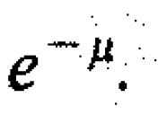
Homework exercise 10.22
Find a UMVUE for e^{-μ} for POI(μ)
Note that

Slide 41
Homework exercise 10.23a

