Slide 1
The regular exponential class

Slide 2
Why REC is AWESOME
If a random sample is drawn from a population that is REC,
Then any sufficient statistic is complete!

Slide 3
Is the normal family REC?

Slide 4
Example 10.4.4
The next slides will walk us through the process of demonstrating that the normal family is a member of the regular exponential class.
Step 1: Show that the density function can be expressed as

Slide 5
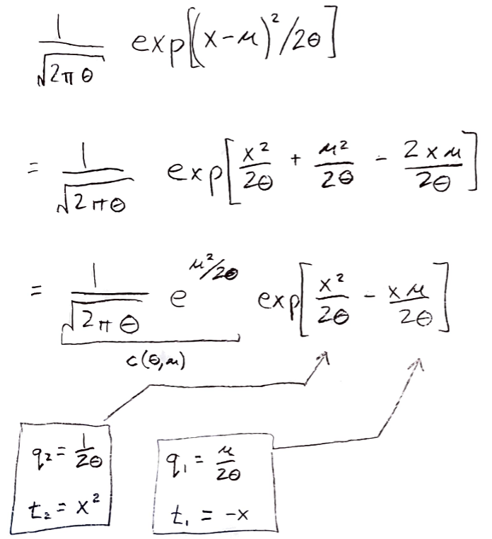

Slide 6
Step 2
Show that the parameter space is an interval, rectangle, cube, or hypercube:
Note than b_{i} must be strictly greater than a_{i}

Slide 7
Step 3
Show that the support of the density function does not depend on the unknown parameter(s).

Slide 8
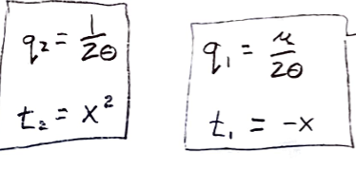
Step 4
Show that the functions q_{j}(θ) are
Nontrivial functions of θ;
Functionally independent; and
Continuous.

Slide 9
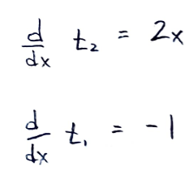
Step 4
Show that the functions d/dx t_{i}(x) are
Linearly independent
Continuous on the support of the density function
That’s it. The normal family is thus shown to be a member of the regular exponential class.

