Slide 1
Chapter 10
Chapter 6 – Functions of random variables
Chapter 7 – Limiting distributions
Chapter 8 – Statistics
Chapter 9 – Point estimation
Chapter 10 – Sufficiency and completeness

Slide 2
Sufficient
A statistic, S, is sufficient for θ if f_{X|S}(x|s) does not depend on θ.
In other words, a sufficient statistic contains all the information from the sample about θ. Thus, knowing the outcome of S, there is no additional information to be gained from the sample.
If the conditional density function depended on θ, then the outcomes of the random sample are related to θ and therefore could tell you something about theta.

Slide 3
Jointly sufficient
If S in the previous definition is vector valued, then we say the components of S are ‘jointly sufficient.’

Slide 4
Example
Given a random sample from any distribution
S = (X₁, …, X_{n}) is sufficient for the parameter(s).
S = (X_{1:n}, …, X_{n:n}) is sufficient for the parameter(s).
Which contains more information?

Slide 5
Minimal sufficient statistic
A statistic, S, that is sufficient for θ is ‘minimal sufficient’ if it is a function of every other sufficient statistic.
In other words, S is minimal sufficient, if knowing the outcome of any sufficient statistic determines the outcome of S.
Example:
We saw that (X₁, …, X_{n}) is sufficient but it is not minimal because (X_{1:n}, …, X_{n:n}) is also sufficient. Knowing the outcome of (X_{1:n}, …, X_{n:n}) one cannot know the outcome of (X₁, …, X_{n}).
Suppose the sample mean is sufficient (and so is the whole sample). The whole sample is clearly not minimal… what about the sample mean?

Slide 6
Example 10.1.1
A coin is tossed n times. X_{i} = 1{i^{th} toss is heads}.
Show that ΣX_{i} is sufficient for p.

Slide 7
Theorem 10.2.1 (The Factorization Criterion)
S is sufficient for θ if and only if
f_{X}(x;θ) = g(s;θ)h(x)
For some functions g and h.

Slide 8
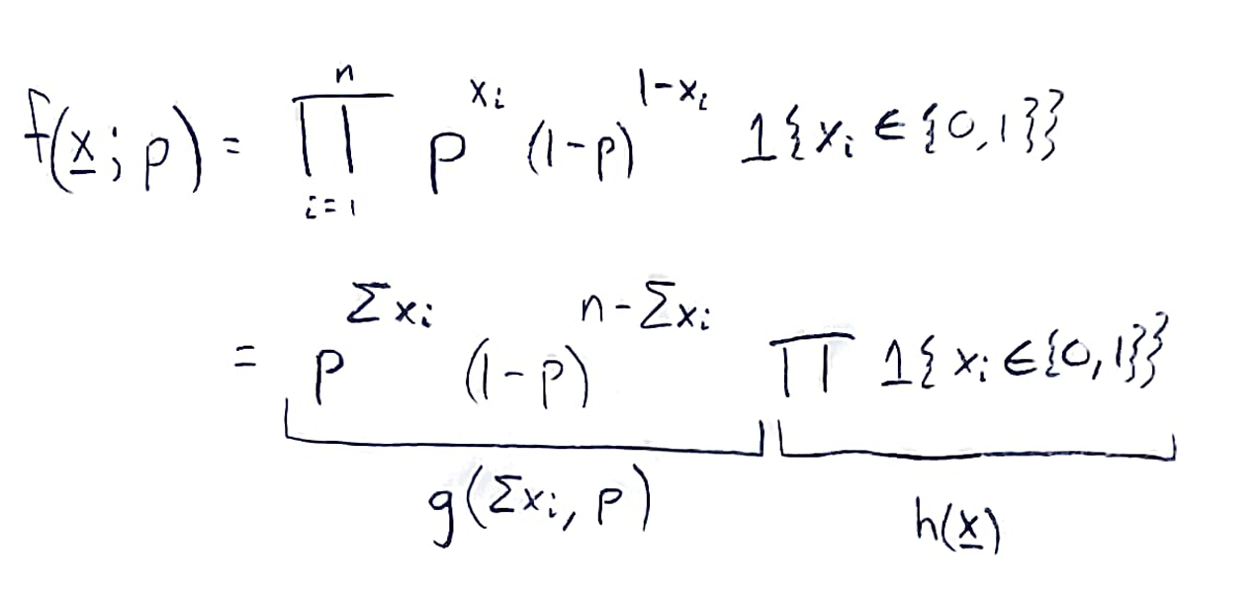
Example 10.1.1 (the easy way)
A coin is tossed n times. X_{i} = 1{i^{th} toss is heads}.
Factorization criterion: f_{X}(x;θ) = g(s;θ)h(x)

Slide 9
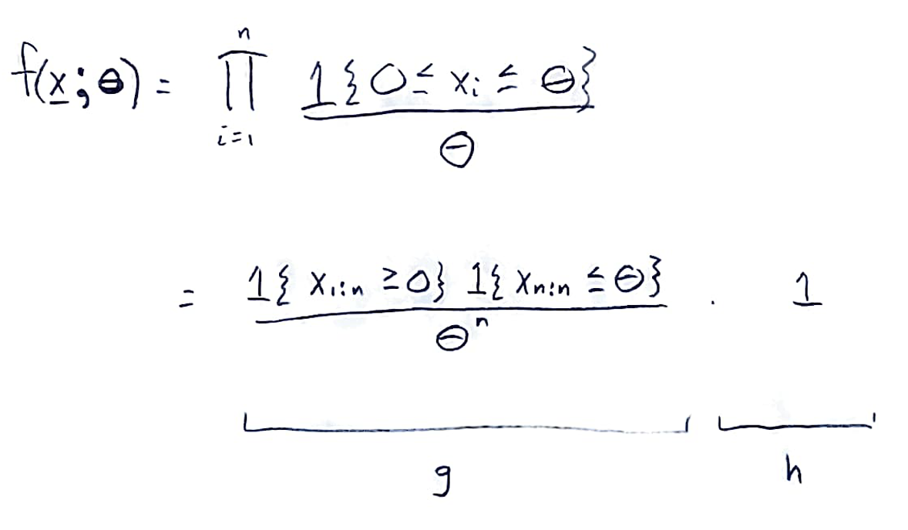
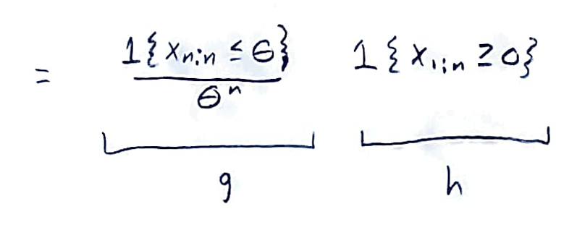
Example 10.2.3
Find minimally sufficient statistics for θ from a random sample of UNIF(0,θ).

Slide 10
Theorem 10.3.1
If S is sufficient for θ and the MLE for θ is unique, then the MLE is a function of S.

Slide 11
Example 10.2.4
Find minimally sufficient statistics for μ and σ² from a random sample of N(μ,σ²).

Slide 12
End of Day 19
Homework
10.1
10.2
10.3
10.4
10.5
10.6
10.7
10.8
10.10
10.11
10.12

