Slide 1
Chapter 9
Chapter 6 – Functions of random variables
Chapter 7 – Limiting distributions
Chapter 8 – Statistics
Chapter 9 – Point estimation
Chapter 10 – Sufficiency and completeness

Slide 2
A parameter of a distribution
A parameter is any characteristic of a distribution
Examples
BIN(n, p)
N(μ, σ²)
BER(p)
POI(λ)
This is what a ‘family’ (of distributions) looks like:
Ω is the ‘parameter space.’

Slide 3
The knowledge boundary
Scenario 1
We know the population distribution belongs to a certain family, e.g. normal.
We don’t know which member of the family, i.e. we don’t know the parameters μ, σ².
Scenario 2
We know nothing.
There are still parameters that we might be interested in, e.g. the mean.

Slide 4
Examples
Example 1
Three sisters are pregnant, and the number of girls joining the family is of interest.
What is the distribution of the number of baby girls?
Example 2
The length (at birth) of the babies is of interest.
What is the distribution of lengths?

Slide 5
Estimators (review)
A statistic that is used to estimate the value of a parameter is called an estimator.
The outcome of the estimator is called an estimate.

Slide 6
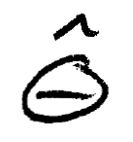
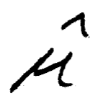
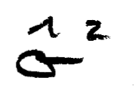
Notation

Slide 7
Methods for creating an estimator
Method of moments
Set population and sample moment equal and solve for the parameter.
Maximum likelihood method
Find the value of the parameter that maximizes the likelihood of the observed data.

Slide 8
Example 9.2.1
Find a MME for μ.
Find a MME estimator for σ².
Note, via some algebra, the similarity to the sample variance.
Note that these are valid for any population distribution.

Slide 9
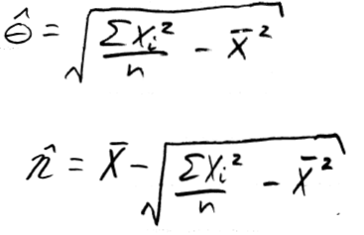
Example 9.2.2
Find an MME for θ and η.

Slide 10
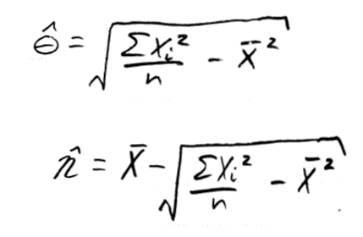
Why θ and η?
We can estimate any parameter we’d like.
Find an MME for P(X>0).

Slide 11
Uniqueness
Have a different MME than your neighbor?
Based on the same sample from the same population.

Slide 12
End of Day 14
Homework
9.1
9.2

Slide 13
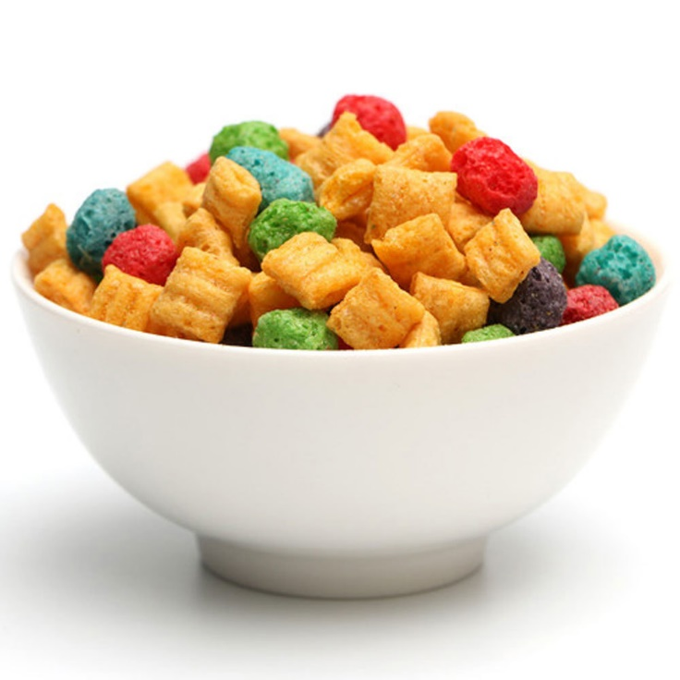
Example 9.2.5 (Oops)
Consider a random sample of size N = 2 from a BER(p) distribution.
Suppose you know that p ∈ {0.2, 0.3, 0.8}.
Think about a box of captain crunch as the population.
The box comes from one of three factories.
Each factory uses a different proportion of crunchberries (0.2, 0.3, or 0.8).
Find a MME for p—something is wrong…
Notes:
Note what is wrong.

Slide 14
Example 9.2.5 (Another approach)
Consider the joint mass function for X₁ and X₂.
It’s the product of two Bernoulli mass functions.

Slide 15
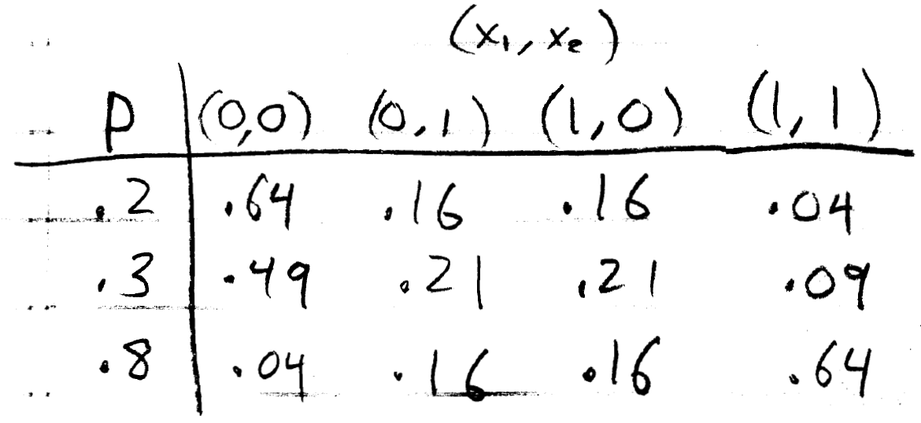
Example 9.2.5 (Another approach)
Consider a table showing the probabilities of each set of outcomes for each possible value of p.

Slide 16
Example 9.2.5 (Another approach)
If p = 0.8, which outcome has the highest probability?
Which p makes an outcome of (0,0) most probable?
Notes:
It’s the second question which is at the heart of maximum likelihood estimation.

Slide 17
Example 9.2.5 (Another approach)
Here’s the estimator we just described:

Slide 18
A major limitation?
Why will this not work with continuous distributions?
Which p makes an outcome of (0,0) most probable?
Which p makes an outcome of (0,0) most likely?
Answer: it works just fine if we replace ‘probability’ with ‘likelihood,’ defined from the density function instead of the mass function.

Slide 19
Maximum Likelihood Method
To estimate a parameter, choose the value of the parameter that maximizes the likelihood function.
Estimators are called Maximum Likelihood Estimators (MLEs).
Whereas estimators based on the method of moments are called Method of Moment Estimators (MMEs).

Slide 20
The likelihood function
The ‘likelihood function’ is just the joint density (or mass) function with a caveat.
Here’s the likelihood function from the Captain Crunch problem.
What do you notice?
It’s a function of p—not x₁, x₂.
Notes:
No need to specify values for x, but very important to do so for the parameter.

Slide 21
Example 9.2.6
Suppose X₁, …, X_{n} ~ i.i.d. POI(λ).
Find the likelihood function.
Find the MLE for λ.

Slide 22
Theorem 9.2.1 (Invariance Property)

Slide 23
Example 9.2.7
Suppose you have a random sample from EXP(λ).
Find the MLE for λ.
Find the MLE for

Slide 24
Example 9.2.10
Suppose you have a random sample from a normal population.
Find MLEs for μ and σ².
Compare them to the MMEs.

Slide 25
The bivariate second derivative test

Slide 26
End of Day 15
Homework
9.3

Slide 27
Example 9.2.11
Suppose you have a random sample from EXP(θ, η).
Find MLEs for θ and η.
Compare them to the MMEs (Previously computed in Example 9.2.2).
MMEs:

Slide 28
So, which is better?
We’ll get to that, but first let’s revisit the idea of bias in the next example.

Slide 29
Example 9.3.2
Suppose you have a random sample from EXP(θ).
The MLE for θ is the sample mean.
What is the MLE for 1/θ?
1/(sample mean).
However, it can be shown that the expectation of 1/(sample mean) is n/[(n-1)θ]. Is it unbiased?
What is the bias?
Expected value of estimator minus the thing you’re estimating.
Notice that the bias is small for large n.
Can you create an unbiased estimator for 1/θ?

Slide 30
Example 9.3.3
Suppose you have a random sample from EXP(θ).
We already know one unbiased estimator for θ. What?
Find the distribution of the first order statistic.
Use that to find another unbiased estimator for θ.
If they are both unbiased, how might I decide which is best?
What is the variance of these estimators?

Slide 31
End of Day 16
Homework:
9.5
9.6
9.7
9.8
9.9
9.10
9.13 (assuming variances are known, find MLEs for means)

Slide 32
Uniformly minimum variance unbiased estimator (UMVUE)
An unbiased estimator for a given parameter is a UMVUE if there is no other unbiased estimator with a lower variance.
Caveat 1: We need to clarify in our definition of an unbiased estimator, that it must be unbiased for all θ ∈ Ω
Bad example: suppose the expectation of an estimator was 5, regardless of what the true value of the parameter is. If the true value of the parameter is 5, you might call this unbiased… but we will not call it an unbiased estimator.
Caveat 2: We need to clarify that no other unbiased estimator has a lower variance, for any value of θ ∈ Ω.
Bad example: If the variance of two unbiased estimators are θ/n and 5/n, and θ can be any positive number, Is one of them a UMVUE?

Slide 33
Uniformly minimum variance unbiased estimator (UMVUE)
E(T) = θ for all θ ∈ Ω (unbiased)
Var(T) ≤ var(T*) for all θ ∈ Ω (minimum variance)
For all T* satisfying E(T*) = θ for all θ ∈ Ω

Slide 34
How do I know if I have a UMVUE?
Cramer-Rao Lower Bound (CRLB)
The CRLB, if it exists, is a lower bound on the variance of an unbiased estimator for a particular parameter and family of distributions.

Slide 35
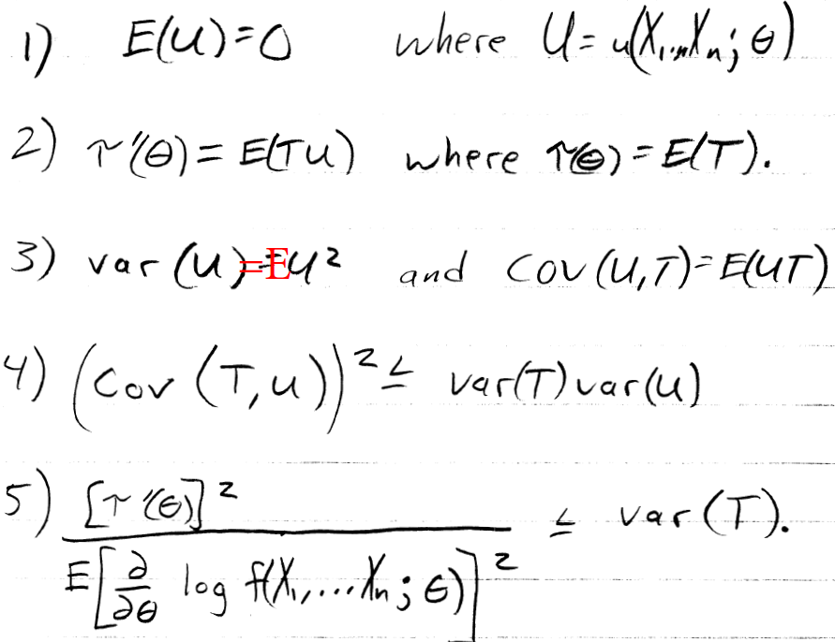
Deriving the CRLB

Slide 36
One more step…

Slide 37
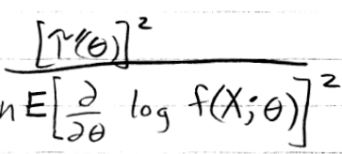
Example 9.3.4
Find the CRLB for θ.
For θ²?
UMVUE for θ?
Notes:
We already saw that X bar was unbiased and had variance that we now see is the CRLB.

Slide 38
So, how do you find a UMVUE?
Or at least know if you have one?

Slide 39
Theorem 9.3.1
If T is an unbiased estimator of τ(θ) with var(T) = CRLB for τ(θ),
Then
T is a UMVUE of τ(θ) (okay, we knew that already); and
Only a linear function of τ(θ), i.e. aτ(θ) + b, will admit a CRLB estimator.
Example: There is a CRLB estimator for the mean of an exponential population, θ.
Is there a CRLB estimator for e^{θ}?
Is there a CRLB estimator for θ²?
Is there a CRLB estimator for 3θ?
Is there a CRLB estimator for 3θ+7?

Slide 40
Relative efficiency of unbiased estimators
The relative efficiency of T₁ compared to T₂, RE(T₁, T₂) is

Slide 41
Efficient estimators
If
T₂ is unbiased for τ(θ)
RE(T₁, T₂) ≤ 1 for all θ ∈ Ω for all unbiased T₁.
Then T₂ is ‘efficient.’

Slide 42
Efficiency of an unbiased estimator
The efficiency of an estimator is the relative efficiency compared to an efficient estimator.
If T₂ is efficient, then the efficiency of T₁ is RE(T₁, T₂) =

Slide 43
Asymptotic properties
Asymptotically unbiased?
Asymptotic relative efficiency?
Asymptotically efficient?
Asymptotic efficiency?

Slide 44
End of Day 17
Homework:
9.15
9.17
9.19
9.21
9.22
9.23

Slide 45
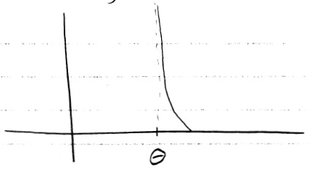
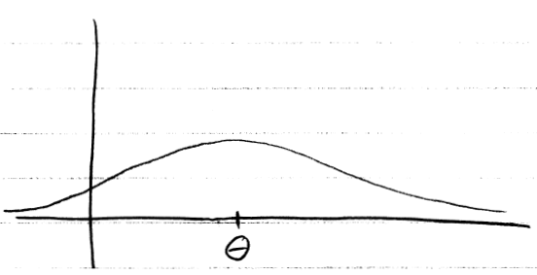
But… unbiasedness isn’t everything.

Slide 46
One way to balance variance with bias
The ‘mean square error’ (MSE) of an estimator is

Slide 47
Theorem 9.3.2
MSE = var(T) + [bias(T)]²
Prove it.
Provide an example of how this works in every case. =)

Slide 48
Uniformly minimum MSE?
Is it possible to find an estimator that has a uniformly minimum MSE, i.e. smallest MSE for any θ ∈ Ω?
Notes:
No, if my estimator is defined as always 5, and theta is 5, then I’ve got the lowest MSE. However, this doesn’t hold if theta is changed. The concept simply doesn’t makes sense.

Slide 49
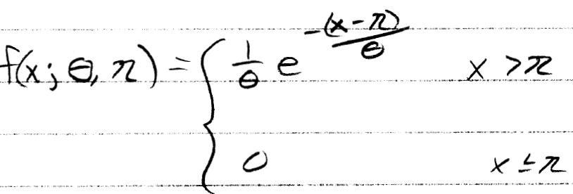
Example 9.3.9
Suppose you have a random sample from a two-parameter exponential, with θ = 1.
Compare the MSE of the MLE and MME for η.

Slide 51
Definition: Consistent

Slide 52
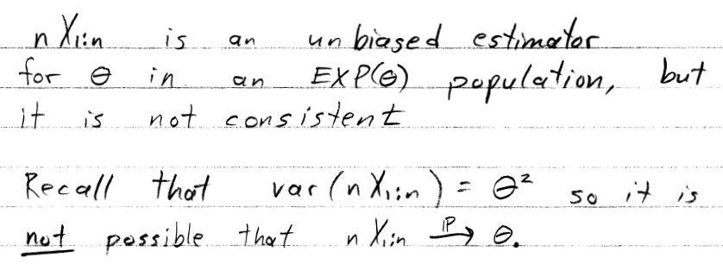
An inconsistent estimator
Recall the following example:

Slide 53
Asymptotic properties of an MLE (under certain conditions)
If
exists;
doesn’t depend on θ;
And some derivatives (that we won’t discuss) exist;
Then

Slide 54
End of Day 18
Homework:
9.24
9.26
9.28a-d
9.32
9.33
9.34a-f
9.35
9.36
9.38
9.39

