Slide 1
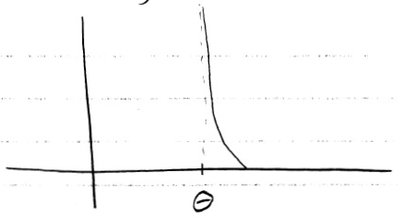
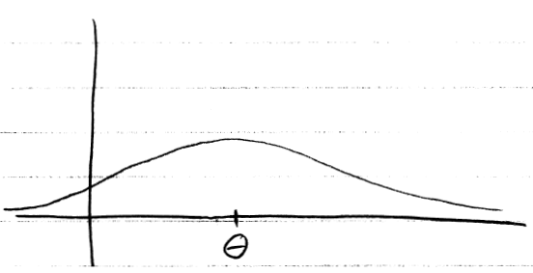
But… unbiasedness isn’t everything.

Slide 2
One way to balance variance with bias
The ‘mean square error’ (MSE) of an estimator is

Slide 3
Theorem 9.3.2
MSE = var(T) + [bias(T)]²
Recall that bias(T) = E(T) - τ(θ)

Slide 4
Uniformly minimum MSE?
Is it possible to find an estimator that has a uniformly minimum MSE, i.e. smallest MSE for any θ ∈ Ω?
No.
Example. Consider the estimator, T=5.
When θ = 5, then MSE(T) = E[(T-θ)²] = 0.
Notes:
No, if my estimator is defined as always 5, and theta is 5, then I’ve got the lowest MSE. However, this doesn’t hold if theta is changed. The concept simply doesn’t makes sense.

Slide 5
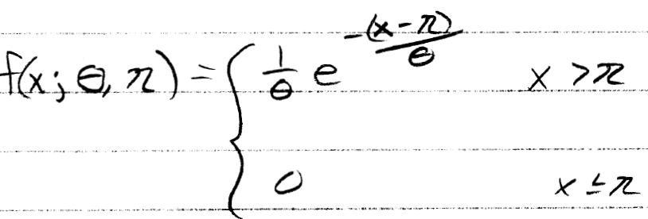
Example 9.3.9
Suppose you have a random sample from a two-parameter exponential, with θ = 1.
Compare the MSE of the MLE and MME for η.

Slide 6
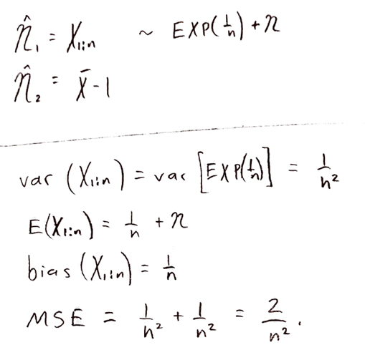

Slide 7
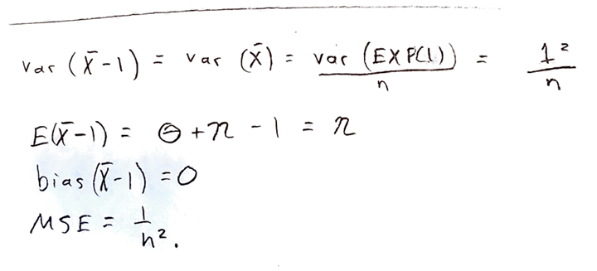

Slide 8
Definition: Consistent

Slide 9
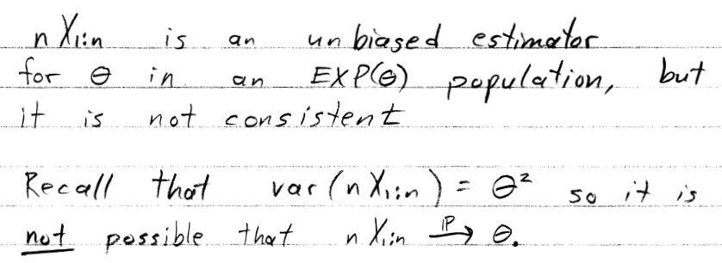
An inconsistent estimator
Recall the following example:

Slide 10
Asymptotic properties of an MLE (under certain conditions)
If
exists;
{x | f(x;θ) = 0} doesn’t depend on θ;
And some derivatives (that we won’t discuss) exist;
Then

Slide 11
End of Day 18
Homework:
9.24
9.26
9.28a-d
9.32
9.33
9.34a-f
9.35
9.36
9.38
9.39

