Slide 1
Uniformly minimum variance unbiased estimator (UMVUE)
An unbiased estimator for a given parameter is a UMVUE if there is no other unbiased estimator with a lower variance.
Caveat 1: We need to clarify in our definition of an unbiased estimator, that it must be unbiased for all θ ∈ Ω
Bad example: suppose the expectation of an estimator was 5, regardless of what the true value of the parameter is. If the true value of the parameter is 5, you might call this unbiased… but we will not call it an unbiased estimator.
Caveat 2: We need to clarify that no other unbiased estimator has a lower variance, for any value of θ ∈ Ω.
Bad example: If the variance of two unbiased estimators are θ/n and 5/n, and θ can be any positive number, Is one of them a UMVUE?

Slide 2
Uniformly minimum variance unbiased estimator (UMVUE)
E(T) = θ for all θ ∈ Ω (unbiased)
Var(T) ≤ var(T*) for all θ ∈ Ω (minimum variance)
For all T* satisfying E(T*) = θ for all θ ∈ Ω

Slide 3
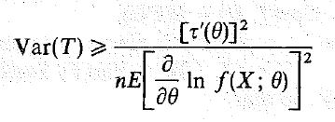
How do I know if I have a UMVUE?
Cramer-Rao Lower Bound (CRLB)
The CRLB, if it exists, is a lower bound on the variance of an unbiased estimator for a particular parameter and family of distributions.

Slide 4
Example 9.3.4
Find the CRLB for θ.
For θ²?
UMVUE for θ?
Notes:
We already saw that X bar was unbiased and had variance that we now see is the CRLB.

Slide 5
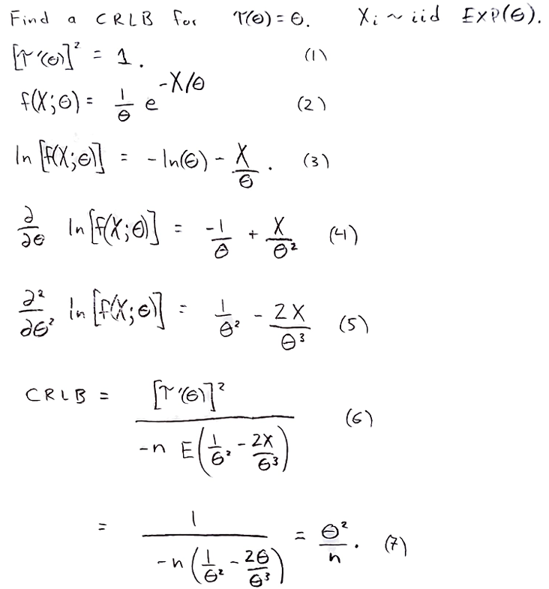
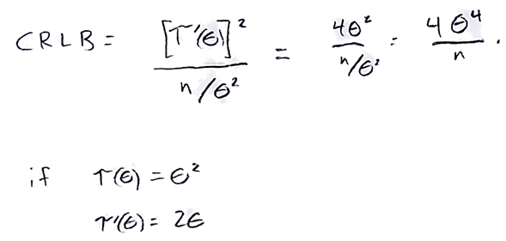
For θ²:

Slide 6
So, how do you find a UMVUE?
Or at least know if you have one?

Slide 7
Theorem 9.3.1
If T is an unbiased estimator of τ(θ) with var(T) = CRLB for τ(θ),
Then
T is a UMVUE of τ(θ) (okay, we knew that already); and
Only a linear function of τ(θ), i.e. aτ(θ) + b, will admit a CRLB estimator.
Example: There is a CRLB estimator for the mean of an exponential population, θ.
Is there a CRLB estimator for e^{θ}?
Is there a CRLB estimator for θ²?
Is there a CRLB estimator for 3θ?
Is there a CRLB estimator for 3θ+7?

Slide 8
Relative efficiency of unbiased estimators
The relative efficiency of T₁ compared to T₂, RE(T₁, T₂) is

Slide 9
Efficient estimators
If
T₂ is unbiased for τ(θ)
RE(T₁, T₂) ≤ 1 for all θ ∈ Ω for all unbiased T₁.
Then T₂ is ‘efficient.’

Slide 10
Efficiency of an unbiased estimator
The efficiency of an estimator is the relative efficiency compared to an efficient estimator.
If T₂ is efficient, then the efficiency of T₁ is RE(T₁, T₂) =

Slide 11
Asymptotic properties
Asymptotically unbiased?
Asymptotic relative efficiency?
Asymptotically efficient?
Asymptotic efficiency?

Slide 12
Relative efficiency of unbiased estimators
The relative efficiency of T₁ compared to T₂, RE(T₁, T₂) is

Slide 13
End of Day 17
Homework:
9.15
9.17
9.19
9.21
9.22
9.23

