Slide 1
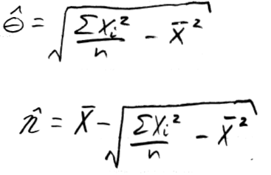
Example 9.2.11
Suppose you have a random sample from EXP(θ, η).
Find MLEs for θ and η.
Compare them to the MMEs (Previously computed in Example 9.2.2).
MMEs:

Slide 2
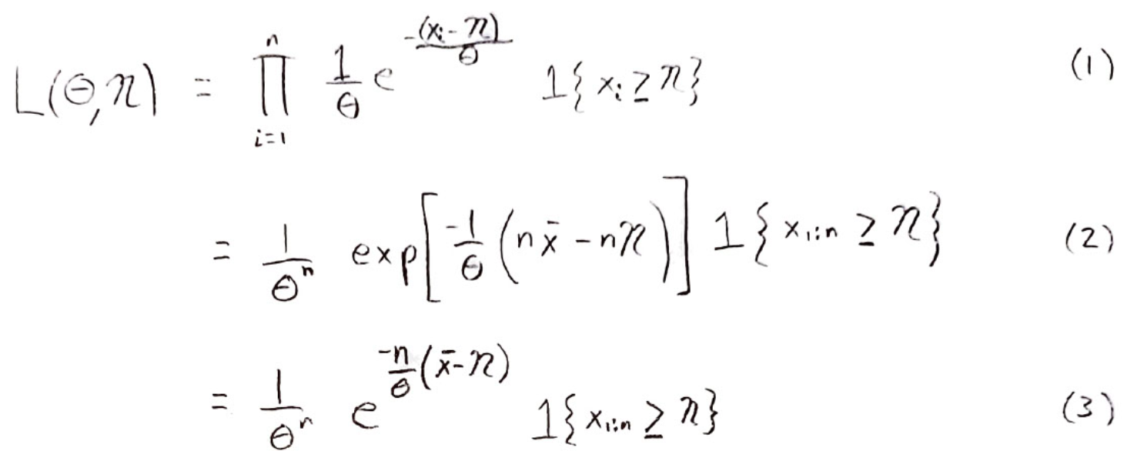

Slide 3
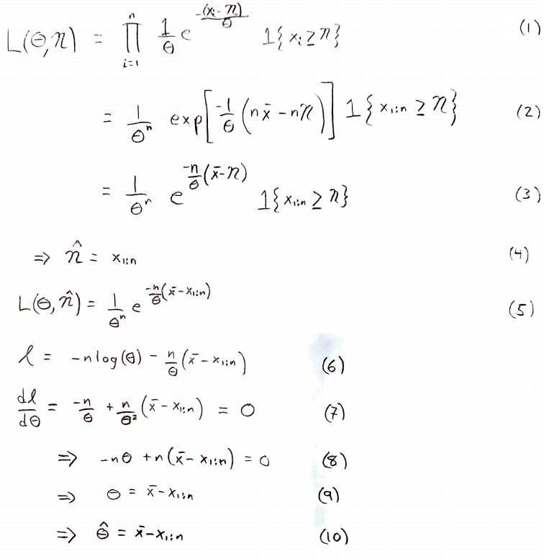

Slide 4
So, which is better?
We’ll get to that, but first let’s revisit the idea of bias in the next example.

Slide 5
Example 9.3.2
Suppose you have a random sample from EXP(θ).
The MLE for θ is the sample mean.
What is the MLE for 1/θ?
1/(sample mean).
However, it can be shown that the expectation of 1/(sample mean) is n/[(n-1)θ].

Slide 6
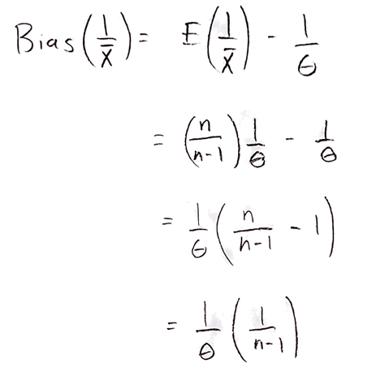

Slide 8
Example 9.3.3
Suppose you have a random sample from EXP(θ).
We already know one unbiased estimator for θ. The sample mean.

Slide 11
End of Day 16
Homework:
9.5
9.6
9.7
9.8
9.9
9.10
9.13 (assuming variances are known, find MLEs for means)

