Slide 1
Chapter 8
Chapter 6 – Functions of random variables
Chapter 7 – Limiting distributions
Chapter 8 – Statistics
Chapter 9 – Point estimation
Chapter 10 – Sufficiency and completeness

Slide 2
What is a statistic?

Slide 3
Definition of a statistic
A statistic is a function of a random sample
In other words, it is a random variable whose outcome is completely determined by the outcome of the random sample.

Slide 4
So what is statistical inference?
Seems like we should know since it’s the title of this class.

Slide 5
Examples of statistics
Sample mean
Sample variance
Sample standard deviation
Sample median
Order statistics

Slide 6
Theorem 8.2.1
The expected value of the sample mean is the population mean.
The variance of the sample mean is σ²/n.
Prove these statements.

Slide 7
Unbiased statistics
A statistic, T, is unbiased for a parameter, θ, if E(T) = θ.
Apply this terminology to the previous theorem.
The expected value of the sample mean is the population mean.

Slide 8
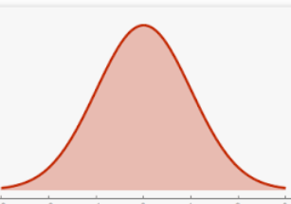
Some intuition about unbiased statistics
The distribution of the statistic is centered around the parameter.
T
θ
Notes:
Outcome of T, on average, are about theta. Individual outcome, however, may be far from theta.

Slide 9
Estimators
A statistic that is used to estimate the value of a parameter is called an estimator.
The outcome of the estimator is called an estimate.

Slide 10
Which is the better estimator?
θ

Slide 11
Example 8.2.2
Let X₁, X₂, …, X_{n} ~ i.i.d. BER(p).
Find an estimator for p and check if it is unbiased.
What happens to the variance of the estimator as n increases?

Slide 12
Theorem 8.2.2
If
The population has finite mean and variance,
Then
The sample variance is unbiased for the population variance.
Prove it.

Slide 13
Sampling distribution
This is just a fancy name for the distribution of a statistic.

Slide 14
Example
Find the sampling distribution of the sample mean from a normally distributed population.
Hint:
Notes:
Hint: use the MGF approach.

Slide 15
Example 8.3.1

Slide 16
End of Day 10
Homework:
8.1
8.2
8.3
8.4

Slide 17
Gamma distribution
Notes:
Notice when K = 1, it looks like the exponential distribution—it is!
Note that a gamma random variable is always positive.

Slide 18
Chi-squared distribution
Notes:
This is another special case of a gamma distribution (when theta is 2).
Notice that when k is 2, it looks exponential—it is!

Slide 19
Theorem 8.3.3
Prove it using the moment generating function for a GAM(θ, k) distribution, (1-θt)^{-k}
Note that the MGF for a χ²(n) is (1-2t)^{-0.5n}

Slide 20
Example 8.3.3

Slide 21
Theorem 8.3.4
The sum of independent χ² random variables is χ².
Prove it!
Note that the MGF for a χ²(n) is (1-2t)^{-0.5n}

Slide 22
Theorem 8.3.5
Prove this by finding the MGF for Z²; it’s the MGF of a χ²(1).
Note that the MGF for a normal r.v. is
Note that the MGF for a χ²(n) is (1-2t)^{-0.5n}

Slide 23
Notes:
Poll Title: If X ~ χ2(2) and Y ~ χ2(5), then Y-X ~ χ2(3)? https://www.polleverywhere.com/multiple_choice_polls/ql4lsuWhlMxzyPKvXlUpo

Slide 24
Notes:
Poll Title: If X ~ χ2(2) and Y ~ χ2(5), AND X and Y are INDEPENDENT, then Y-X ~ χ2(3)? https://www.polleverywhere.com/multiple_choice_polls/Bz7VLl80R4bcUKLix0p8d

Slide 25
End of Day 11
Homework:
8.5
8.8
8.9
8.10
8.12

Slide 26
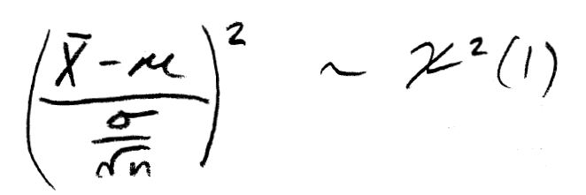
Corollary 8.3.2
Recall that the square of a standard normal is χ²(1).
It follows that
and

Slide 27
What distribution does the sample variance have?
Can the previous corollary be used?
Notes:
One could scale properly so that each term in the sum is chi-squared, but the terms are dependent so that their sum is not quite chi-squared.

Slide 28
Theorem 8.3.6
Notes:
To prove this (if you wanted to):
Find the joint distribution of x bar and X1 – xbar. You’ll see it is separable and therefore the product of two marginals. Alternatively, if you know that tow normals are independent iff they are uncorrelated, you can simply check that the covariance is zero.
Follows from 1.
Uses some algebra and moment generating functions (next slide)

Slide 30
Example: hypothesis testing
Claim: population ~ N(60, 36).
Suppose that we will get a sample of size 25.
We will consider the claim valid, unless that outcome of the sample variance is more than 54.6.
If the claim really is valid, what is the probability that we will falsely conclude that we have been lied to?

Slide 31
Making inferences about μ
The sample mean is an estimator for μ
But, since we don’t know σ², we don’t know the distribution of the sample mean.
This will prevent us from making inferences about μ.

Slide 32
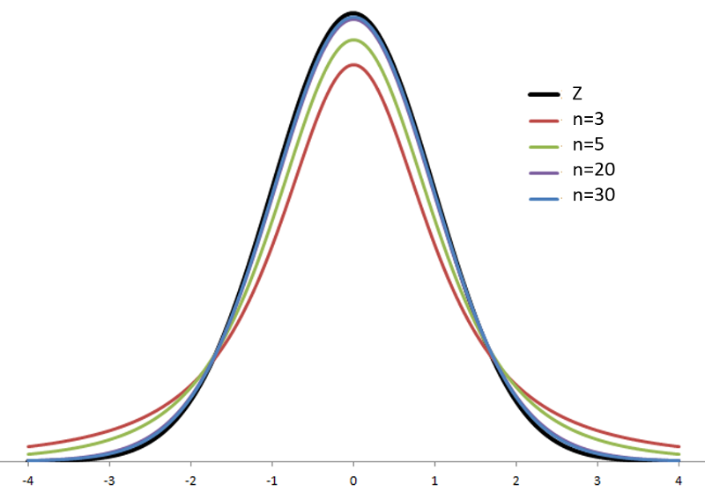
T distribution
Notes:
What is the mean of a t-distribution?

Slide 33
Theorem 8.4.3

Slide 34
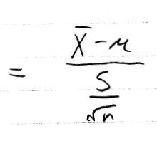
Proof
Notes:
Note that xbar and the sample variance are independent.

Slide 35
End of Day 12
Homework:
8.13

Slide 36
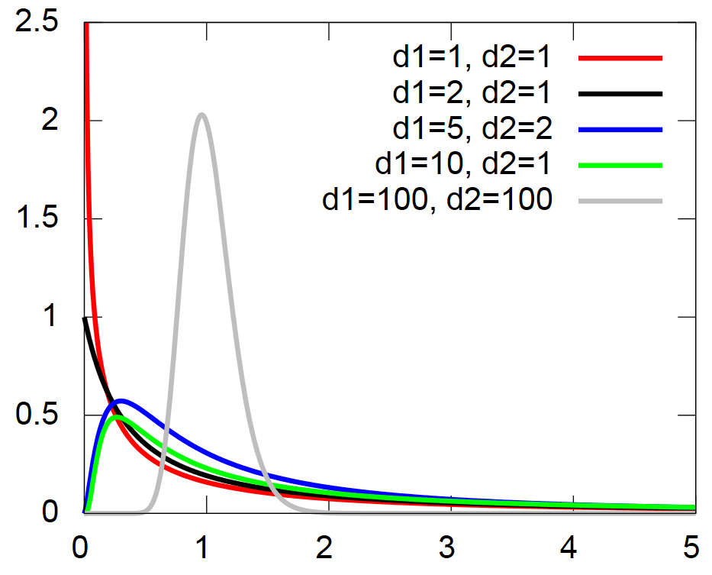

Slide 37
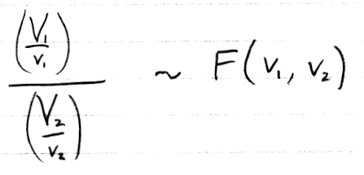
Example
If X ~ F(3,5)
Then what is the distribution of 1/X?

Slide 38
Example
What is the relationship between the 5th percentile of F(3,7) and the 95th percentile of F(7,3)?
1/f_{0.05}(3,7) = f_{0.95}(7,3)

Slide 39
What are the plausible values of σ₂²/σ₁²?
X₁, X₂, …, X₁₆ ~ i.i.d. N(μ₁, σ₁²)
Y₁, Y₂, …, Y₂₁ ~ i.i.d. N(μ₂, σ₂²)
Assume samples are independent.
Suppose we want to estimate σ₂²/σ₁².
Note that f_{0.05}(15,20) = 0.43 and f_{0.95}(15,20) = 2.2.
Suppose s₁² = 2 and s₂² = 4.
Notes:
(0.86, 4.40)

Slide 40
Is σ₂²/σ₁² =1, i.e. equal variances?
X₁, X₂, …, X₁₆ ~ i.i.d. N(μ₁, σ₁²)
Y₁, Y₂, …, Y₂₁ ~ i.i.d. N(μ₂, σ₂²)
Assume samples are independent.
Suppose we want to estimate σ₂²/σ₁².
Note that f_{0.05}(15,20) = 0.43 and f_{0.95}(15,20) = 2.2.
Suppose s₁² = 2 and s₂² = 4.

Slide 41
End of Day 13 (look at #15 on next slide)
Homework:
8.15 This is one of my favorites!
8.16
8.17
8.18
8.24
8.26

Slide 42
Notes:
Try a few.

