Slide 1
Chapter 7
Chapter 6 – Functions of random variables
Chapter 7 – Limiting distributions
Chapter 8 – Statistics
Chapter 9 – Point estimation
Chapter 10 – Sufficiency and completeness

Slide 2
Convergence in distribution
A sequence of random variables, X_{n}, ‘converges in distribution’ to Y if
Lim F_{Xn}(x) = F_{Y}(x), for all x where F_{Y}(x) is continuous.
In other words, the distributions (cdfs) get close together as n increases.

Slide 3
Example 7.2.1
Let X₁, X₂, …, X_{n} ~ i.i.d. UNIF(0,1).
Find the cdf of X_{n:n}.
Show that X_{n:n} converges to 1.

Slide 4
Example 7.2.2
Let X₁, X₂, …, X_{n} ~ i.i.d. UNIF(0,1).
Find the cdf of X_{1:n}.
What does X_{1:n} converge to?
The limit of the cdfs is not right continuous and therefore not a cdf.
What does that mean? Does X_{1:n} converge?

Slide 5
A student’s question (previous semester)
Why are cdfs right continuous?
Notes:
They are continuous except at points of positive probability. Then, note that the cdf is defined as the probability that the r.v. is less than **or equal to** an argument. Thus at the point of positive probability, the cdf has already jumped up. Thus it is right continuous.

Slide 6
Example 7.2.3
Let X₁, X₂, …, X_{n} ~ PAR(1,1)
F(x) = [1 – 1/(1+x)] 1{x>0}
Find the limiting distribution of nX_{1:n}.

Slide 7
End of Day 6
Homework:
6.29
6.31

Slide 8
Example 7.2.4
Let X₁, X₂, …, X_{n} ~ PAR(1,1)
F(x) = [1 – 1/(1+x)] 1{x>0}
Find the limiting distribution of X_{n:n}.
Again the limit of cdfs is not a cdf.
What does it mean?

Slide 9
Example 7.2.5
Let X₁, X₂, …, X_{n} ~ PAR(1,1)
F(x) = [1 – 1/(1+x)] 1{x>0}
Find the limiting distribution of X_{n:n}/n.

Slide 10
Example 7.2.7 (Law of Large Numbers)
Let X₁, X₂, …, X_{n} ~ N(μ, σ²).
Find the limiting distribution of the sample mean.
Limit of cdfs is not a cdf. What does it mean?

Slide 11
Theorem 7.3.1
If
M_{Xn}(t) → M_{X}(t), in a neighborhood of 0,
Then
X_{n} → (in distribution) X.

Slide 12
Example 7.3.1
Let Y_{n} ~ BIN(n, μ/n).
Find the limiting distribution.
Do you recognize the distribution?
Applications.

Slide 13
Example 7.3.2 (Bernoulli LLN)
Find the limiting distribution of the sample mean from a BER(p) population.

Slide 14
End of Day 7
Homework:
7.1
7.2
7.3
7.5

Slide 15
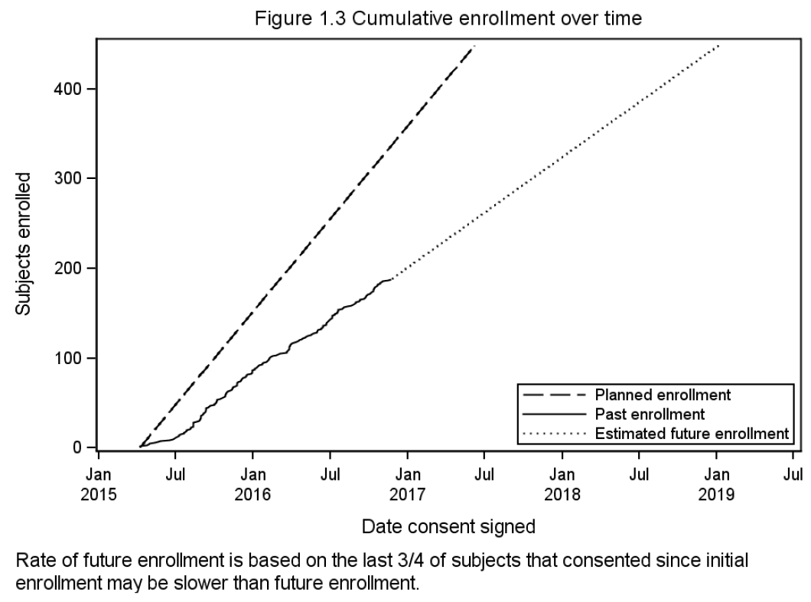

Slide 16
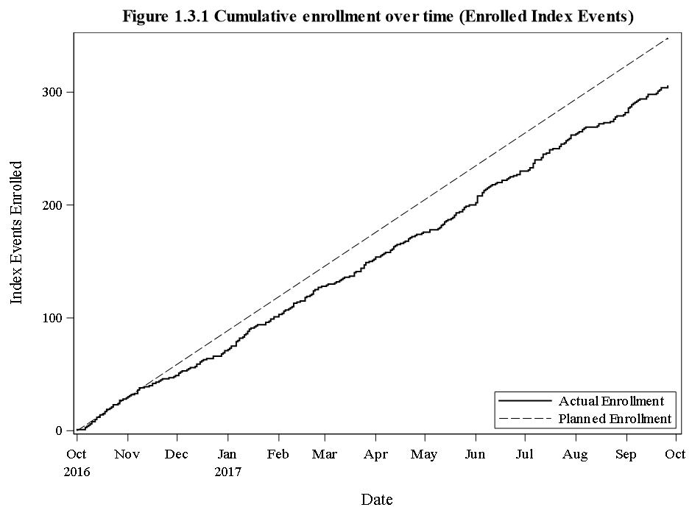

Slide 17
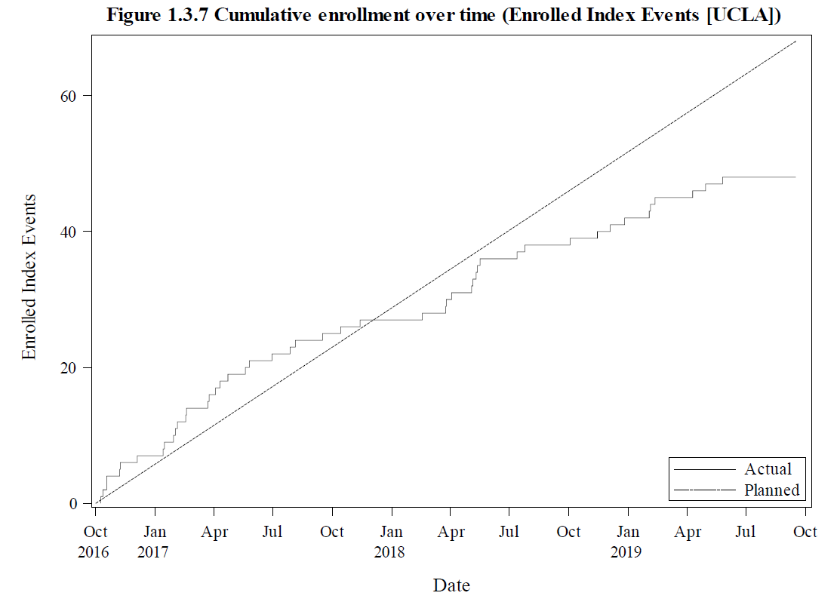

Slide 18
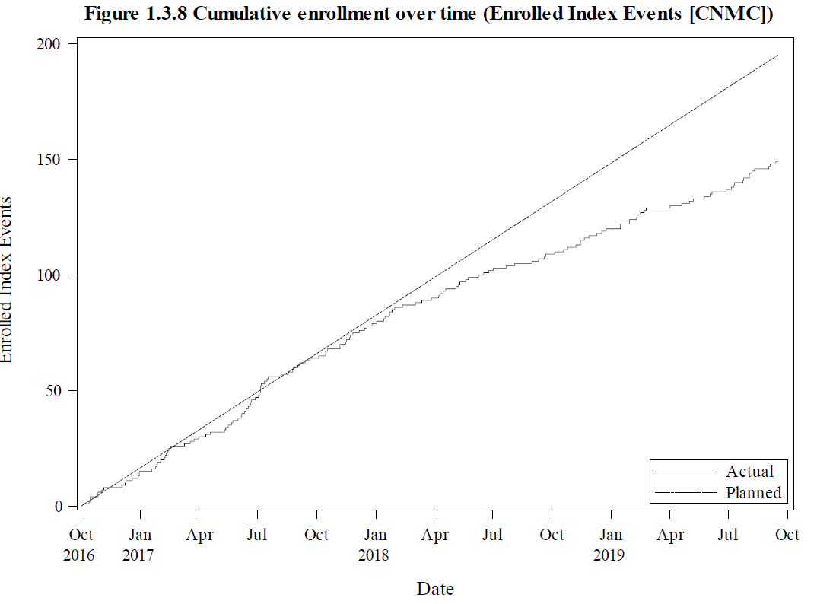

Slide 19
Enrollment in a hypothetical clinical trial
Monthly enrollment is BIN(n,p)
p is small and n is huge.
Neither parameter is known.
10 hospitals are enrolling.
Primary Children’s hospital enrolled 1200 in 2019, but only 86 in Jan 2020.
Is there a problem with enrollment?
Notes:
First, use Poisson approximation. Enrollment is approx. POI(100) each month. Since POI is approx normal for large means, about 2/3 of the distribution is between -1 and +1 standard deviation. For a Poisson, that’s +-sqrt(mean). So 2/3 of the time, we expect monthly enrollment at this site to be between 90 and 110. It’s not terribly unusually for it to be out of this range for 1 month. But if it is for multiple months…

Slide 20
Notes:
Poll Title: Enrollment for 2019 was 1200 subjects. Enrollment in January 2020 was 79. Is there a problem? https://www.polleverywhere.com/multiple_choice_polls/OYyfJO5Wz7zISqg6JEQXP

Slide 21
Notes:
Poll Title: Enrollment for 2019 was 1200 subjects. Enrollment in January 2020 was 79. If enrollment in February 2020 is also less than 80, is there a problem? https://www.polleverywhere.com/multiple_choice_polls/c7LNQB6R4EAwDubWA7YpS

Slide 22
Theorem 7.3.2 (Central Limit Theorem)
If
Mean and variance of a population exist
Then
The sample mean of a random sample, when standardized to zero mean and unit variance, converges in distribution to a standard normal.
The proof is actually really fun and involves moment generating functions and a theorem about the remained of a Taylor expansion, but…

Slide 23
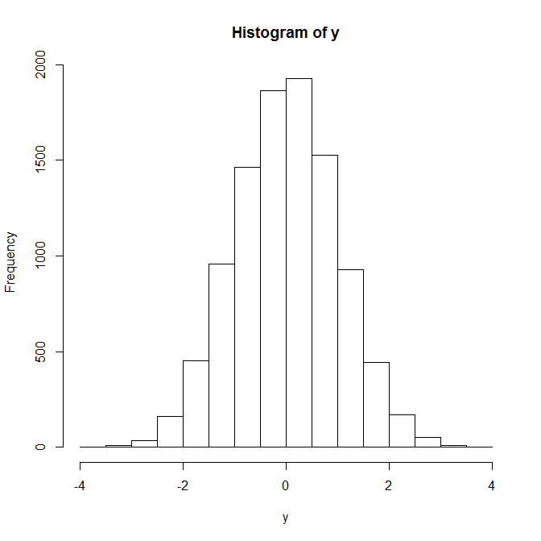
Histogram
Notes:
This shows how close to normally distributed this is, even with a sum of only 12.
y=-6
for (index in 1:12)
{
y = y + runif(10000)
}
hist(y)

Slide 24
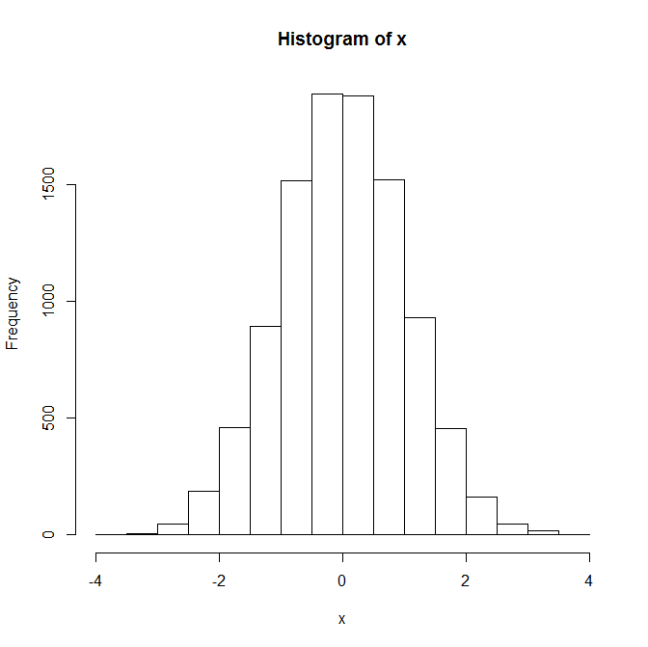
Histogram
N(0,1)
Notes:
x=rnorm(10000)
hist(x)

Slide 25
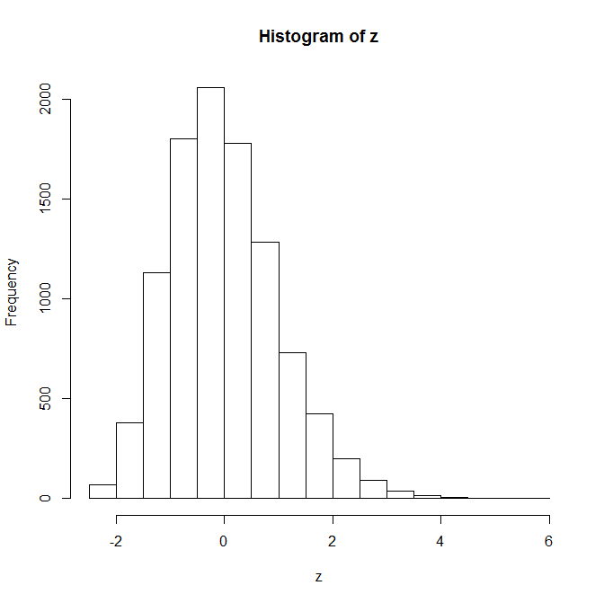
Histogram
Using a random sample
of size 12 from EXP(1)
Notes:
z=-sqrt(12)
for (index in 1:12)
{
z = z + rexp(10000)/sqrt(12)
}
hist(z)

Slide 26
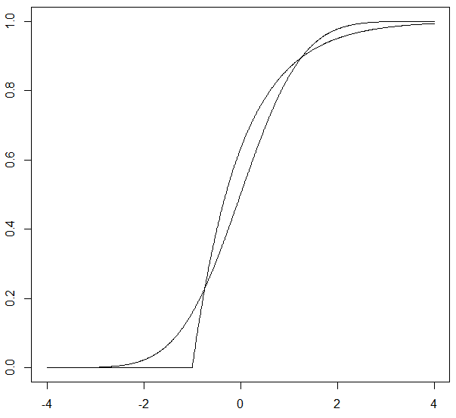
Why…
Normal vs. Uniform Normal vs. exponential
Notes:
This is a comparison of distributions, all shifted and scaled to be standardized. The uniform is closer to normal than the exponential.
x=seq(from= -4, to=4, by = 0.01)
plot(x,punif(x, min=-sqrt(12)/2, max=sqrt(12)/2), type = 'l')
lines(x, pnorm(x))
plot(x, pnorm(x), type = 'l')
lines(x, pexp(x+1))

Slide 27
Does it matter on what interval the uniform distribution is?
Notes:
Nope.

Slide 28
Example 7.4.1
If your friend can make each free throw with p = 0.50,
Estimate the probability he/she makes 9 or more out of 20.
Y ~ BIN(20,1/2)
P(Y ≥ 9) = 0.7483 (using actual probabilities based on BIN(20,1/2))
P(Y ≥ 8.5) = 0.7483
P(Y > 8) = 0.7483
P(Y ≥ 9) ≈ 0.6726 (using the central limit theorem)
P(Y ≥ 8.5) ≈ 0.7486 (using the central limit theorem and continuity correction)

Slide 29
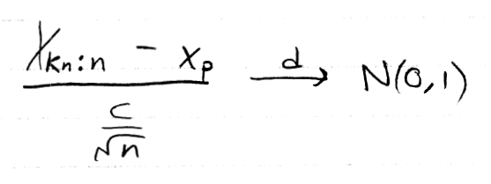
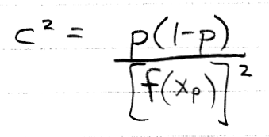
Theorem 7.5.1
If
X₁, X₂, …, X_{n} is a random sample from a continuous distribution
f(x_{p}) ≠ 0, where x_{p} is the p^{th} percentile
k_{n}/n → p
k_{n} - np is bounded
Then
Notes:
So, the sample median is also asymptotically normal. =)
It is interesting to consider that the variance of the estimator is large if f is small at the pth percentile.

Slide 30
Example 7.5.2
Notes:
Check conditions and apply the previous theorem.

Slide 31
Convergence in probability

Slide 32
Notes:
Poll Title: I understand the conceptual difference between convergence in distribution and probability. https://www.polleverywhere.com/multiple_choice_polls/YRFp1tCCuTNWB6bwiDWXL

Slide 33
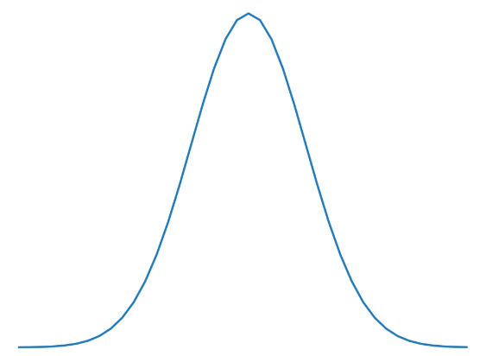
Convergence in distribution vs. probability
X_{n}
X

Slide 34
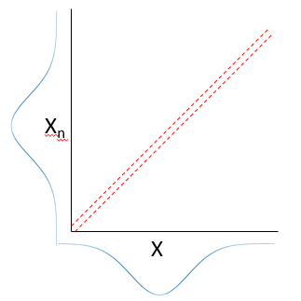
Theorem

Slide 35
Theorem
Notes:
Note that together these theorems show that convergence in distribution and probability are exactly the same when converging to a constant.

Slide 36
Notes:
Poll Title: I understand the conceptual difference between convergence in distribution and probability. https://www.polleverywhere.com/multiple_choice_polls/CGZGcEFA0LQ1ripi4MTTO

Slide 37
End of Day 8
Homework:
7.7
7.9
7.10
7.11
7.12
7.13

Slide 38
Law of large numbers
Notes:
As an example of a density function that doesn’t have a mean, consider the density function that is 1/x² 1{x>1}.

Slide 39
Chebyshev inequality
Use this to prove the law of large numbers.
Notes:
Let K = epsilon times sqrt(n) / sigma. Also note that sigma in the inequality should be replaced with sigma / root(n) when the random variable is the sample mean.

Slide 40
Theorem 7.6.3
Previous theorem (assumptions apply)
Notes:
We previously saw that, under certain conditions, order statistics are asymptotically normal. Together with this theorem, we see that order statistics, under those conditions, converge in probability to the percentiles that they are estimating.

Slide 41
Theorem 7.7.2
Prove this using the delta-epsilon definition of continuity. =)
Notes:
Note that this prove is equally valid for multivariate functions.

Slide 42
Theorem 7.7.3
Proof is trivial… No, really!
Notes:
Just use the last theorem by noting that these are continuous functions.

Slide 43
Slutsky’s theorem (7.7.4)
Notes:
Seems like I could prove this with the cdf technique… but let’s not try.

Slide 44
Example 7.7.2
Prove the following:
Notes:
You will need the central limit theorem, that theorem (7.7.2) about continuous functions, and Slutsky.

Slide 45
Theorem 7.7.6
Notes:
Note that the text uses the absolute value of g prime. Is that necessary? No, because the standard normal is symmetric around zero.
It seems impossible that this would be true because squaring a normal random variable you don’t get normal. Yet in the limit you do here? This works because of the convergence. Yn is really close to m. and a differentiable function is basically locally linear if you zoom in far enough. That’s what we’re doing.

Slide 46
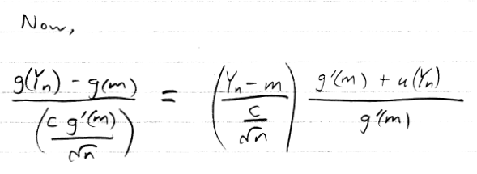
Proof of Theorem 7.7.6
Notes:
Depending on time, this proof could reasonably be skipped. The only reason to do it is because it demonstrates the application of Slutsky, but another example of this is probably not needed.
The text uses an absolute value in the denominator. Is it needed? No, because N(0,1) is symmetric about zero.

Slide 47
End of Day 9
Homework:
7.15
7.16
7.17
7.18
7.19
7.20
7.22

