Slide 1
Fractals:
A Visual Display of Mathematics
Laura, Molly, Montana

Slide 2
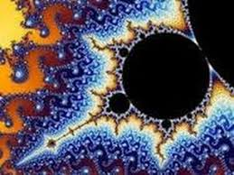
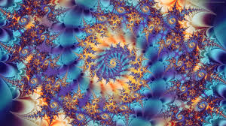
Intro:
Fractals are infinite patterns that look similar at all levels of magnification and exist between the normal dimensions.

Slide 3
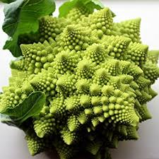
Topics:
A Brief History
How Fractals Work with Linear Algebra
Types of Fractal Sets
Fractals in Nature

Slide 4
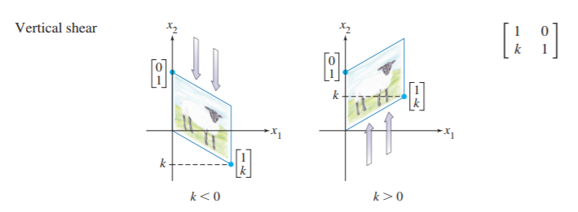
Relationship of Fractals and Linear Algebra
Fractals can be created by using affine transformations
An affine transformation is comprised of a linear mapping/transformation and a translation
Affine transformations
  Are a function between affine spaces which preserves points, straight lines, and planes
  Allow parallel lines to remain parallel
  Do not need to map origin to origin
  Examples: translation, reflection, shear mapping, rotation

Slide 5
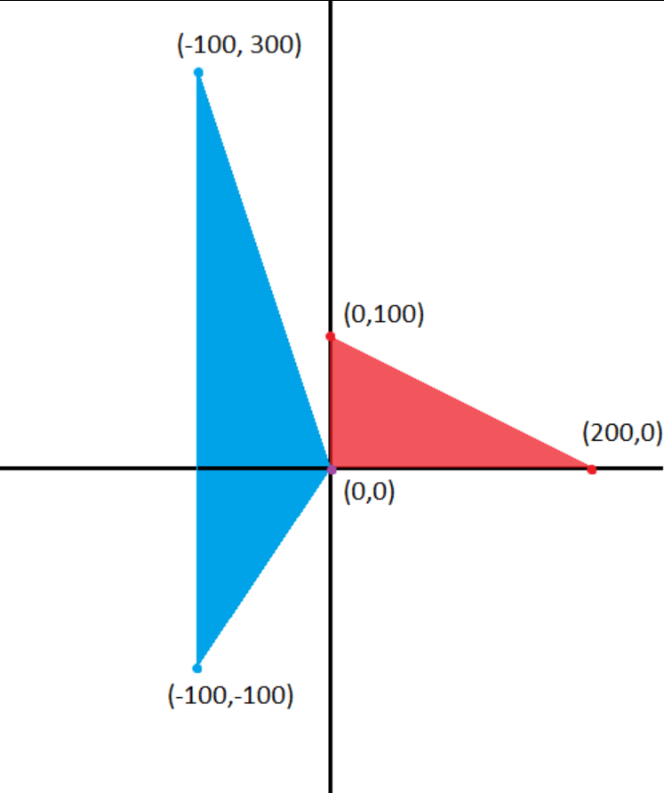

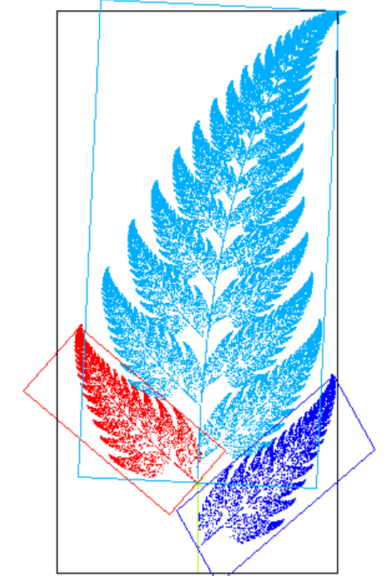
Affine Transformation Example
In R², the transformation from the red triangle to the blue is given by this matrix

Slide 6
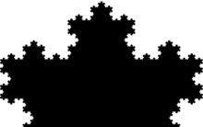
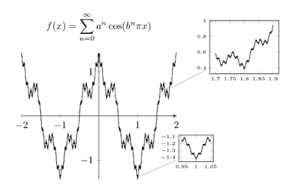
History
Self-similarity: the property of having a substructure analagous or identical to an overall structure.
  Liebniz 17th century
  Weierstrauss 19th century
  Sierpinski 19th century
  Koch 19th century

Slide 7
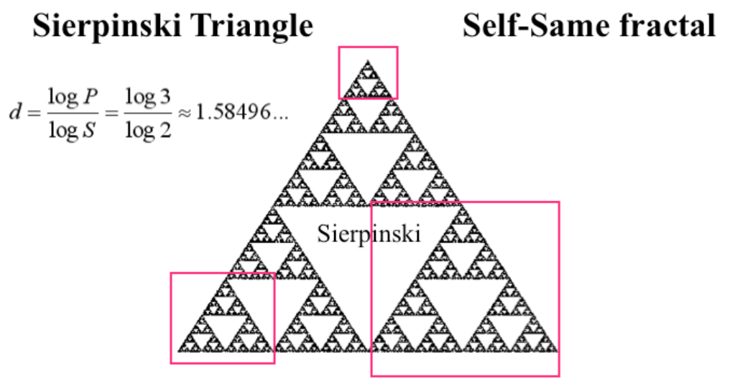
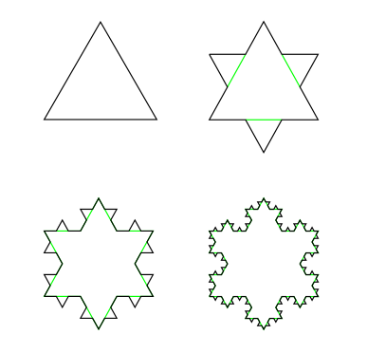
Hausdorff Dimension
Measures roughness
Integer dimensions
  Single point = 0
  Line = 1
  Square = 2
  Cube = 3
Non-Integer Dimensions
  Sierpinski Triangle = 1.58
  Koch Curve = 1.26
Dimension = log (number of self-similar pieces)
log (magnification factor)

Slide 8
Benoit Mandelbrot
Heinz-Otto Peitgen
Loren Carpenter
coined and defined the term fractal which stems from the Latin word “fractus” and means “to break” and “irregular”
defined fractals to be a set for which the Hausdorff dimension strictly exceeds the topological dimension
D > D_{T}
Cantor set: D = log(2)/log(3) ~ 0.6309 > 0 = D_{T}
Koch curve: D = log(4)/log(3) ~ 1.2618 > 1 = D_{T}
Worked to visualize fractals using computers
University of Utah computer science equipment 1980s
Mandelbrot book inspired the idea to use fractals to create computer-generated landscapes

Slide 9
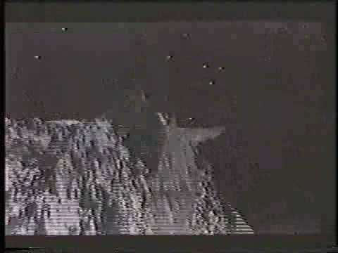
Wrath of Khan - Genesis Effect

Slide 10
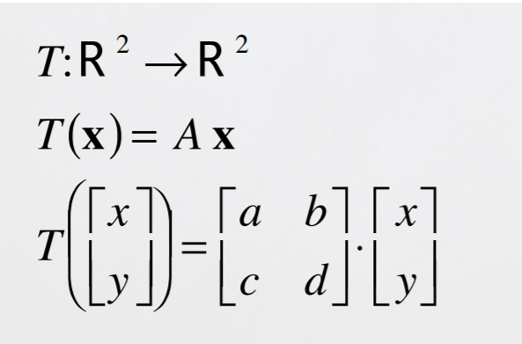
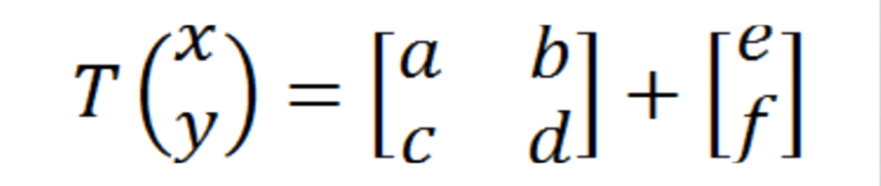
How they work
Self-similarity as a result of affine transformations
Recursion to compute these transformations

Slide 11
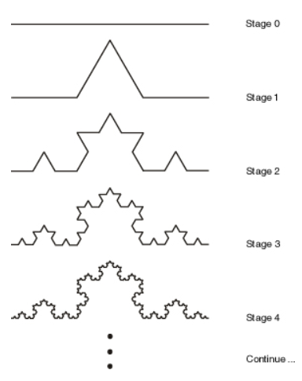
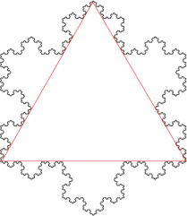
Koch Curve
Curve gets longer and each section more complex and jagged
Bounded curve of infinite length
  Only possible with fractals

Slide 12

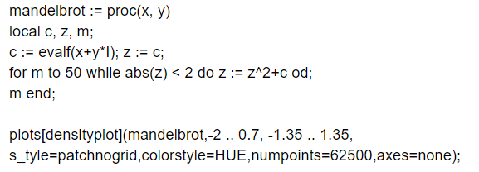
Mandelbrot Set
Computed in the complex plane (utilizing imaginary numbers)
  C = a +bi
Just a few simple lines of recursive code
Notes:
Mandelbrot set demo

Slide 13
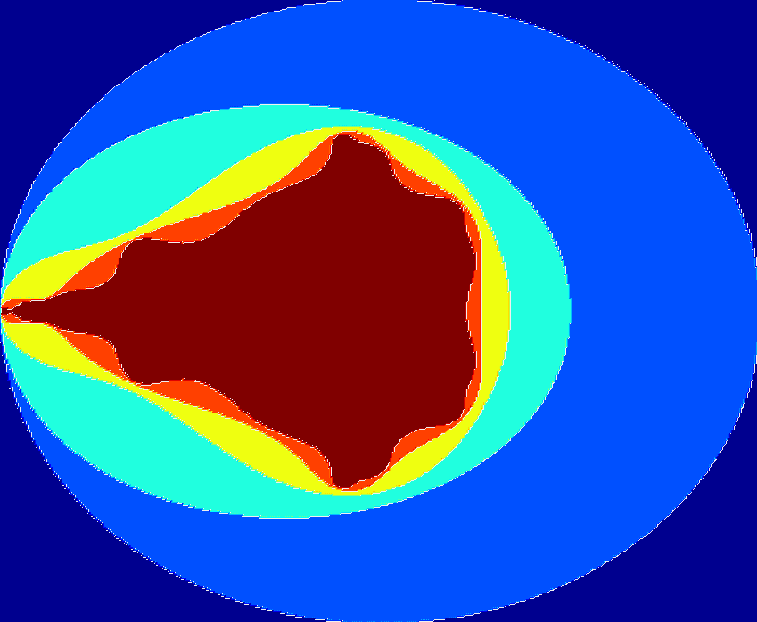
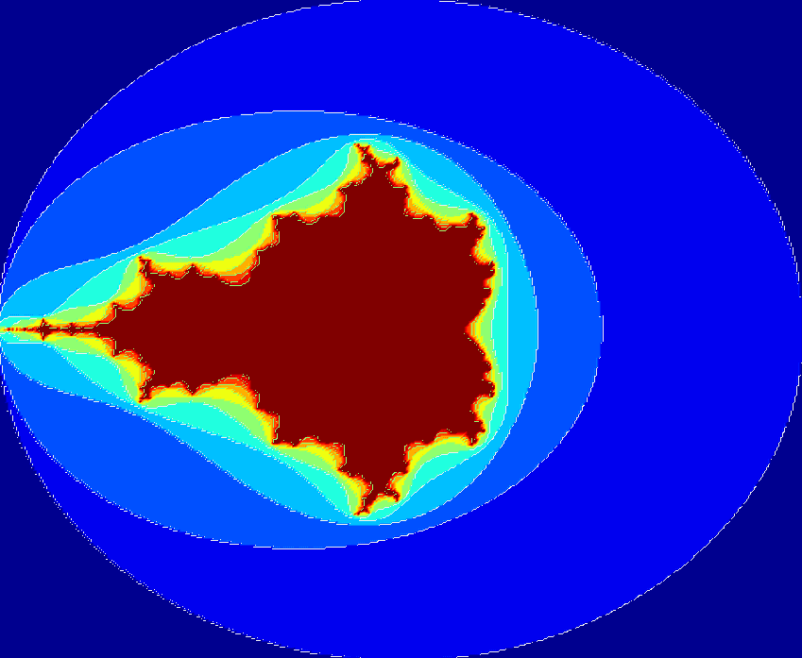
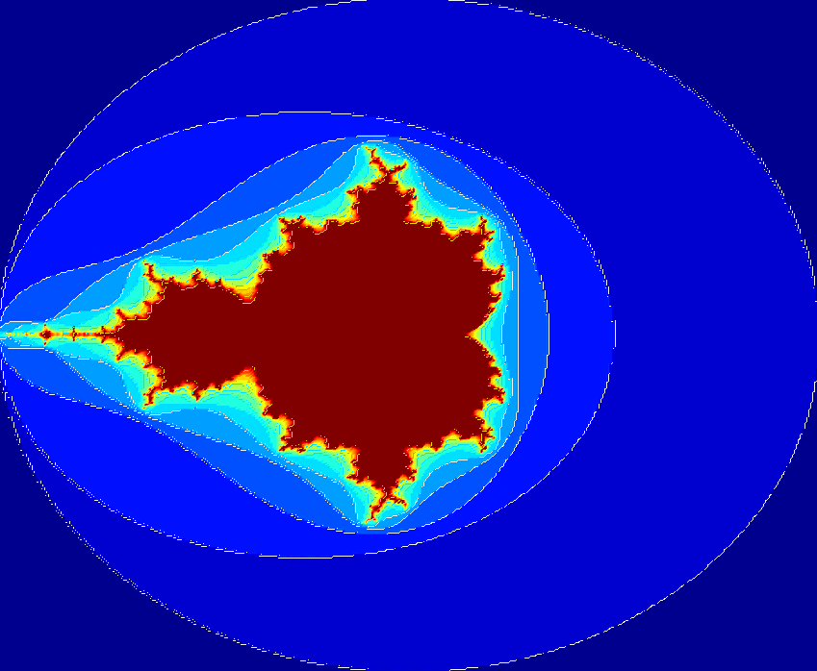
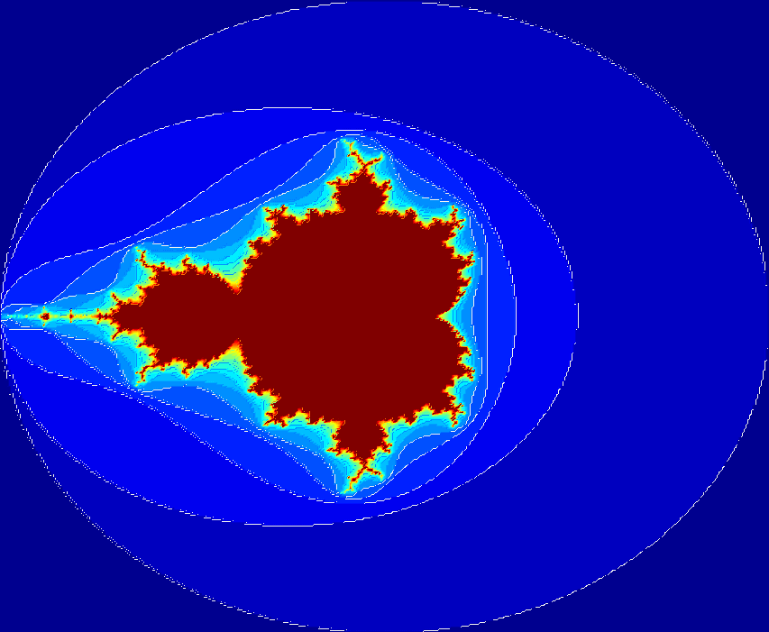
Iteration: 5
Iteration: 10
Iteration: 15
Iteration: 20

Slide 14
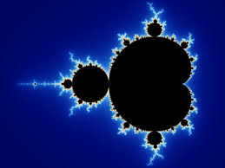
Mandelbrot set
The Mandelbrot set is the black section in the center of the picture. The color of the pixels outside indicate how many iterations it took for each of those pixels until the distance between that point and the origin exceed the square root of 5, and it is considered outside of the set.

Slide 15
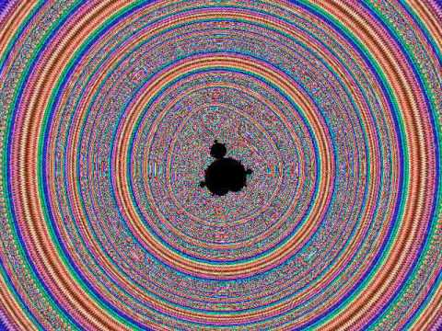

Slide 16
Types of Fractals
Sierpinski Triangle
Koch
Galaxies

Slide 17
Sierpinski Triangle
Sierpinski Triangle was named after Waclaw Sierpinski, who is a famous mathematician based in Poland. The basic idea of creating this type of triangle is through the use of recursion. The process is recursively dividing a triangle into smaller divisions of triangles creating an image composed of triangles within each other and layered next to each other.
However, an important idea of this fractal is the main and largest triangle is upward and the rest of the triangles within the largest triangle are upside down. All of the triangles drawn within the largest one must have corners touching the midpoint of the triangles surrounding them.

Slide 18
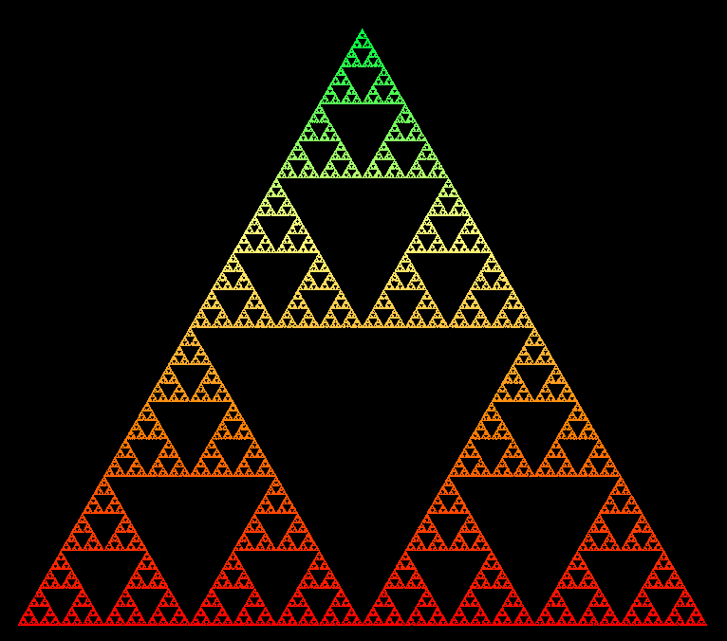
http://ecademy.agnesscott.edu/~lriddle/ifs/siertri/siertri.htm

Slide 19
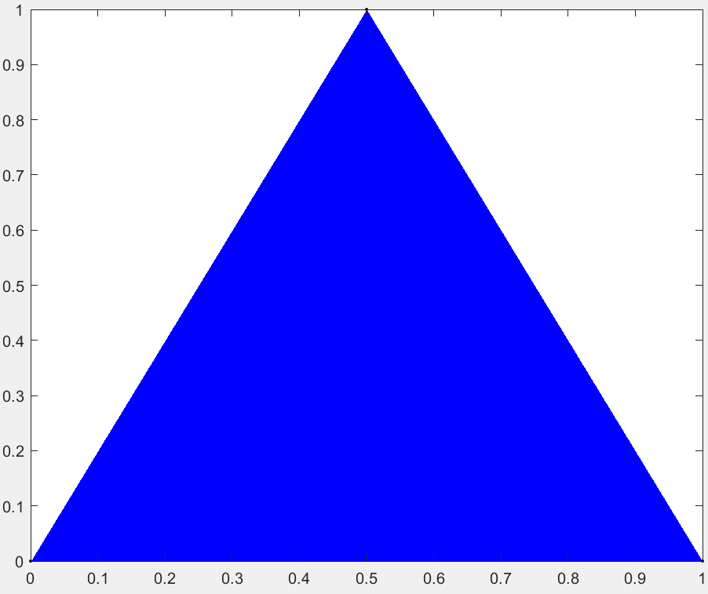
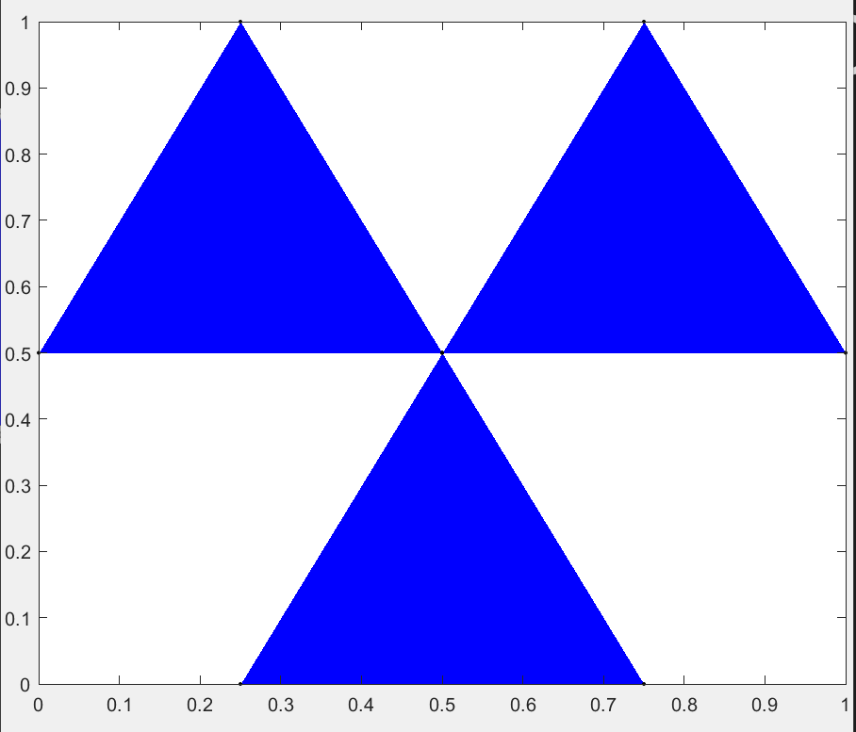
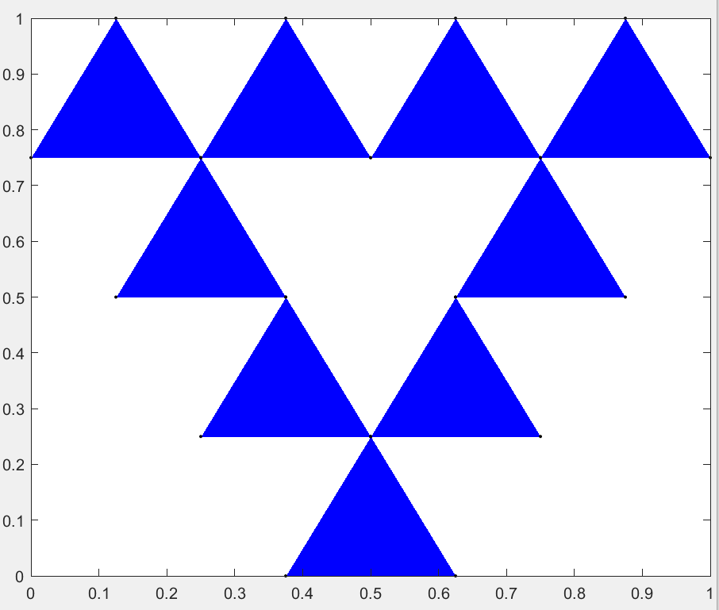
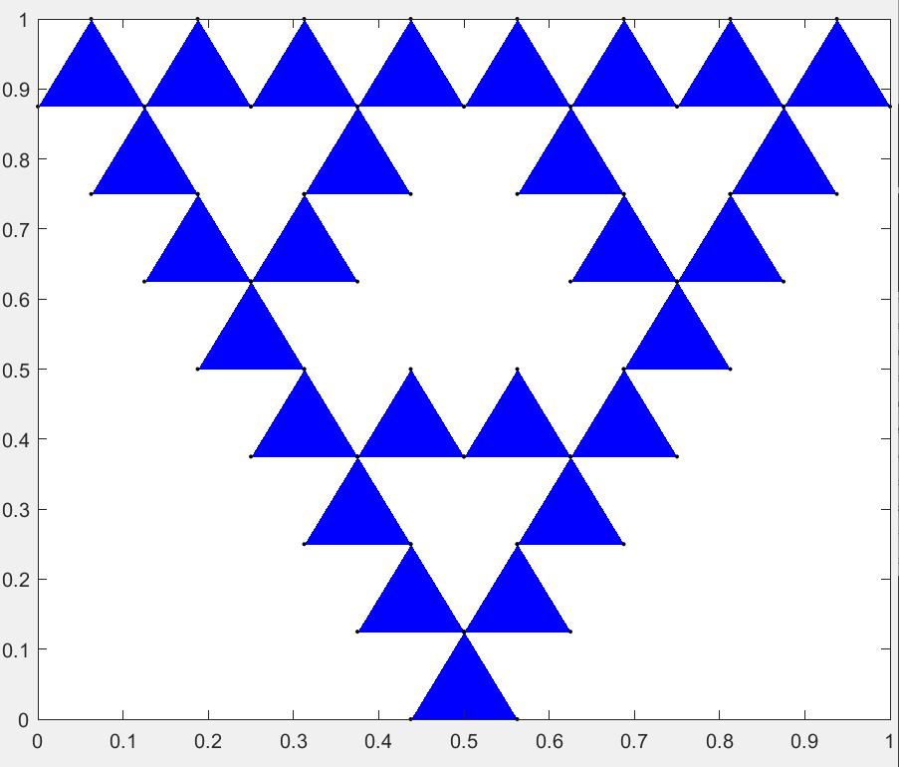
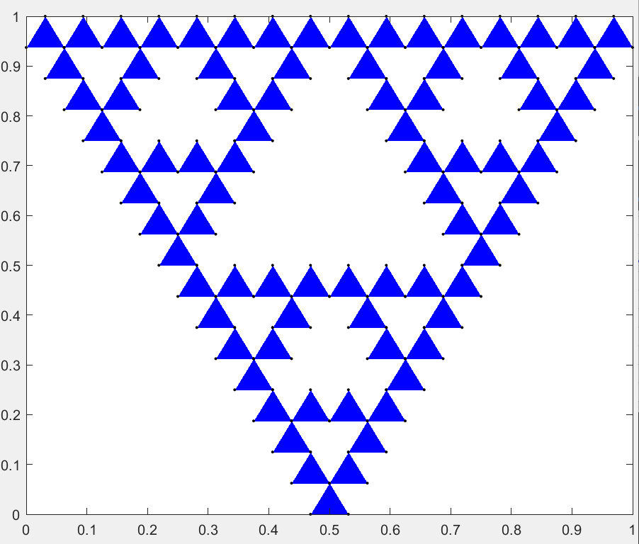
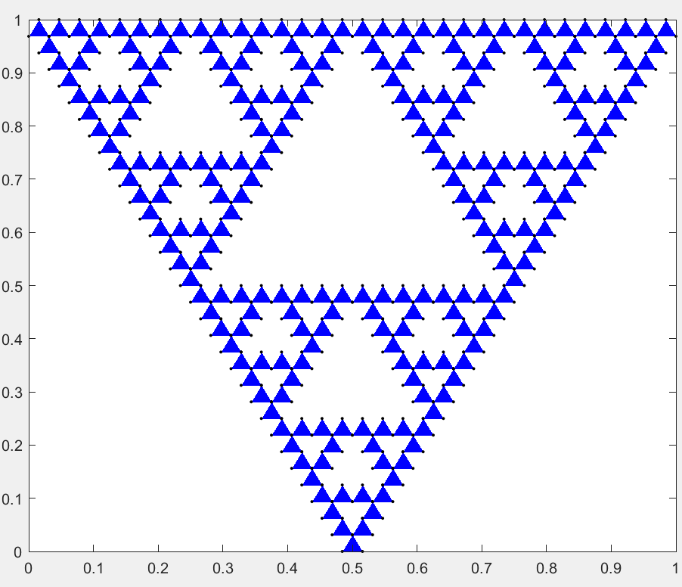
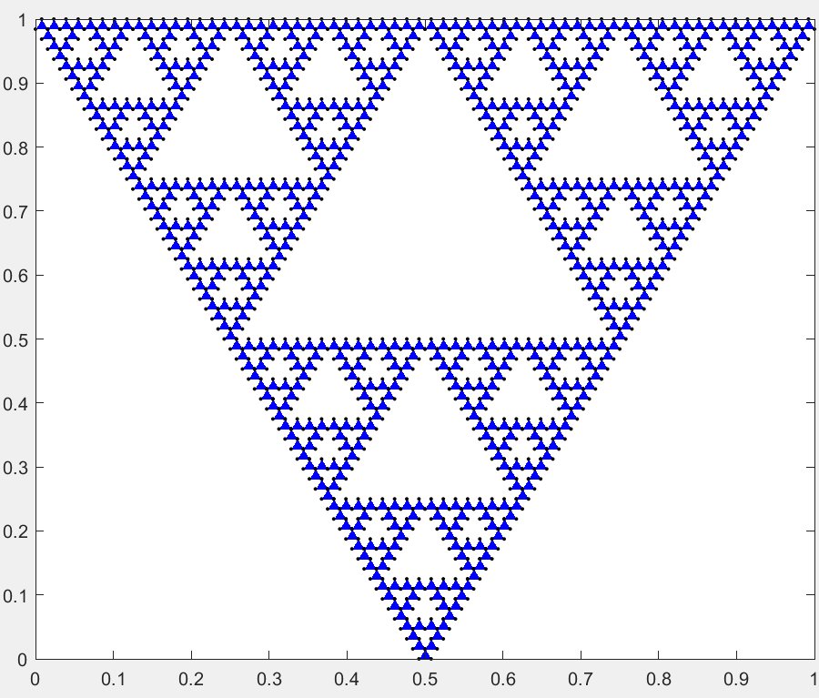
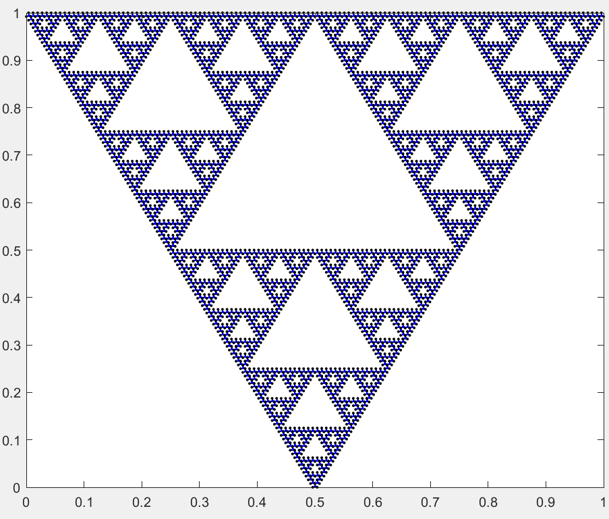
SIERPINSKI TRIANGLE
Iteration: 0
Iteration: 1
Iteration: 2
Iteration: 3
. . . . .
Iteration: 7
Iteration: 4
Iteration: 5
Iteration: 6

Slide 20
Koch
Koch was originally visualized by Helge von Koch. Recursion curve with triangle like formations branching off from one another. The inside of the shapes tend to stay hollow with only the outer layer showing. There is a specific formation pattern for this fractal. In order to create this fractal, an equilateral triangle must become the starting point. Every side of the triangle is split into thirds, and the middle third is replaced with another equilateral triangle. The splitting and replacing becomes recursive. Every equilateral triangle will go through this effect until the recursion loop stops.

Slide 21
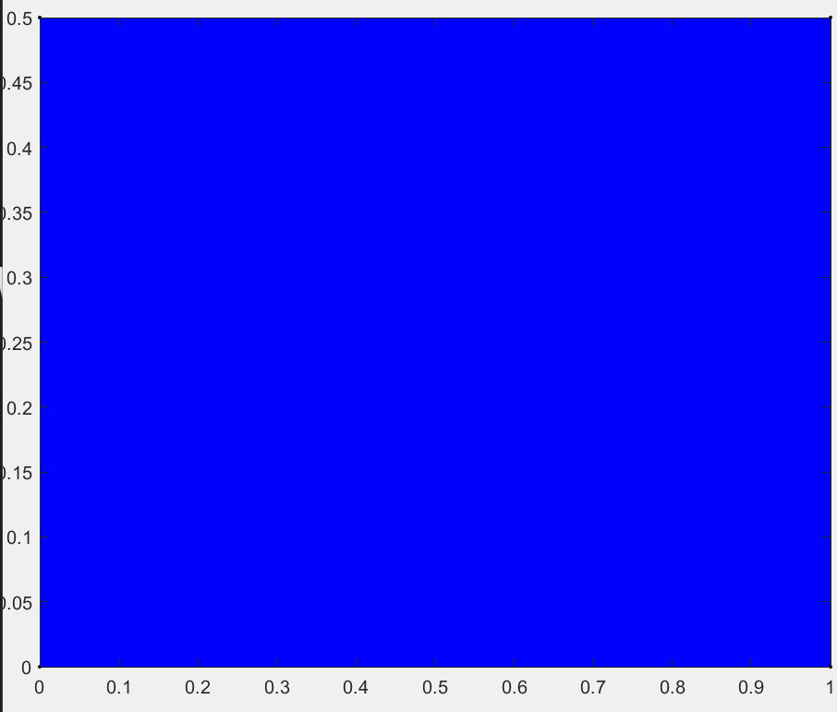
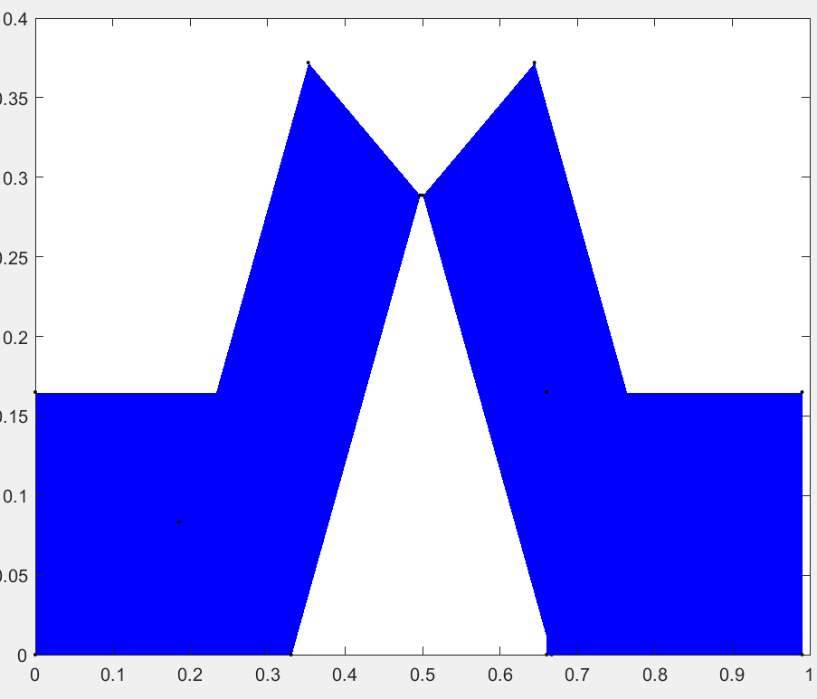
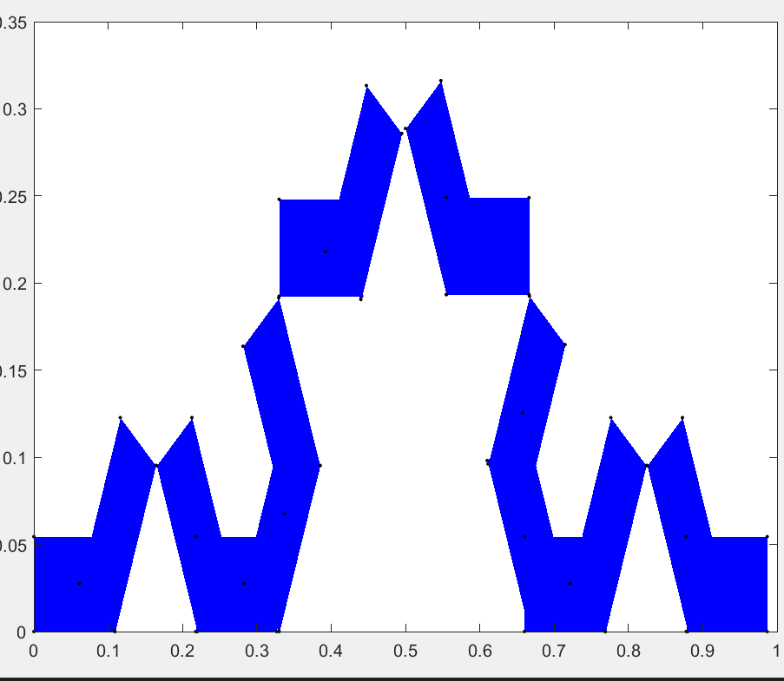
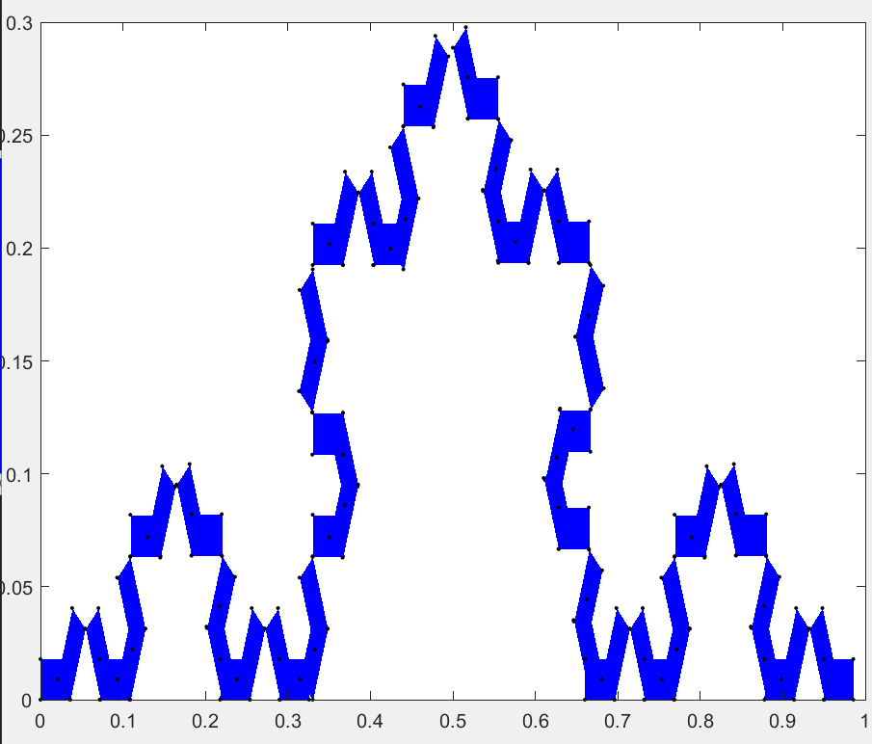
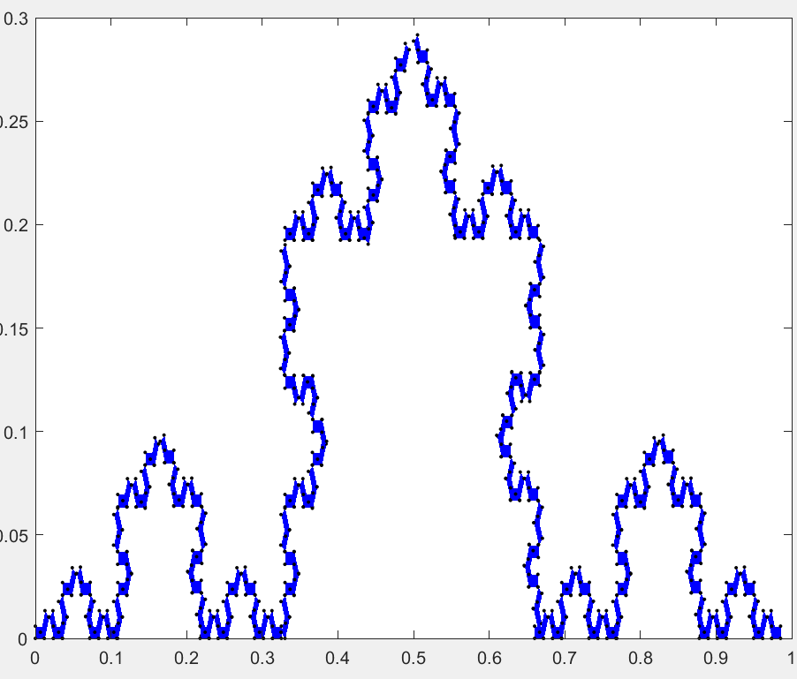
THE KOCH TRIANGLE
Iteration: 0
Iteration: 1
Iteration: 2
Iteration: 3
Iteration: 4

Slide 22
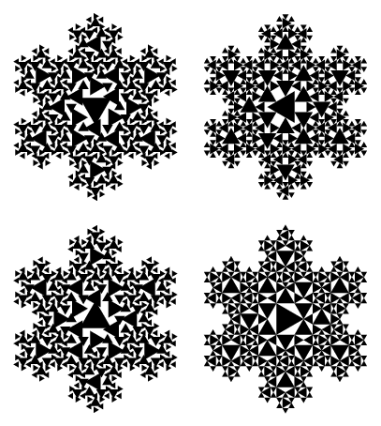
The example specifically involves the shape of a snowflake koch found on the website: http://mathworld.wolfram.com/KochSnowflake.html. The snowflake pattern involves using triangles in a different pattern described above but the same recursive method and use of triangles.

Slide 23
Galaxies
Galaxies are widely speculated to be a fractal like pattern. There is no factual evidence that proves this theory, but observations and education hypothesis create very convincing arguments supporting this theory. The clusters within the sky from stars, meteorites, and the mysteries of space bring a fractal like formation to the galaxy. Our specific galaxy has the sun and planets revolving around it. There are galaxies similar to our galaxy out there in the universe. The similarities in the galaxies is evidence of the fractal patterns.

Slide 24
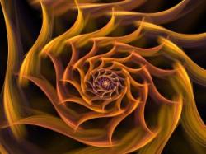
https://www.newscientist.com/article/dn14200-galaxy-map-hints-at-fractal-universe/

Slide 25
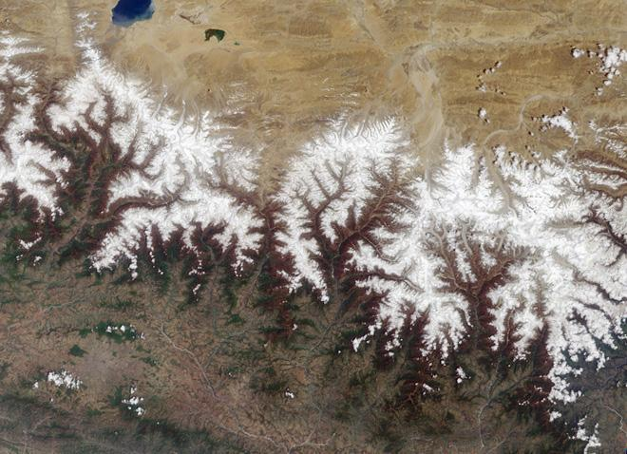
Fractals in Nature
Many geographic features are the result of fractal patterns—mountains, coastlines, rivers, canyons, etc.
To the right is an aerial view of the Himalayas. The movement of the tectonic plates forms the mountains with fractal trends.

Slide 26
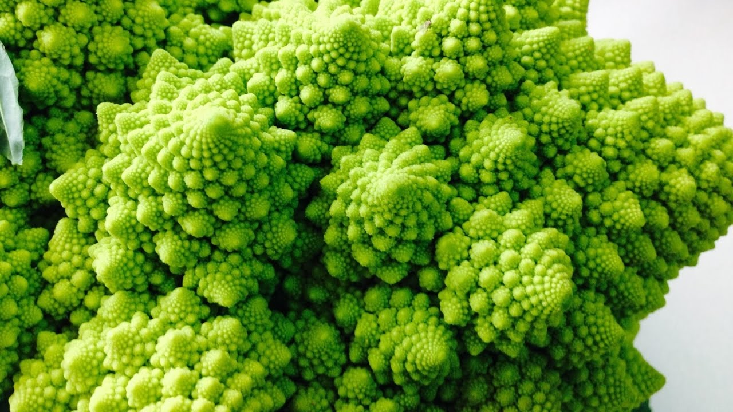
Fractals in Nature
Romanesco, the cousin of broccoli, is a great example of fractal patterns in nature. It is a natural representation of the Fibonacci or golden spiral, a logarithmic spiral where every quarter turn is farther from the origin by a factor of phi, the golden ratio

Slide 27
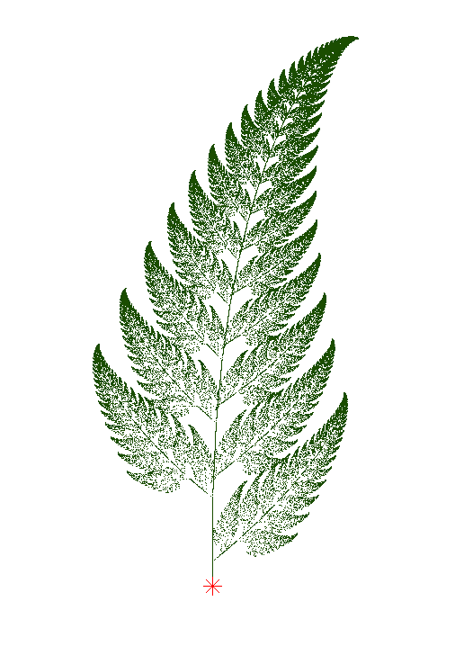
SHOW THE TREE
CODING DEMO

Slide 28
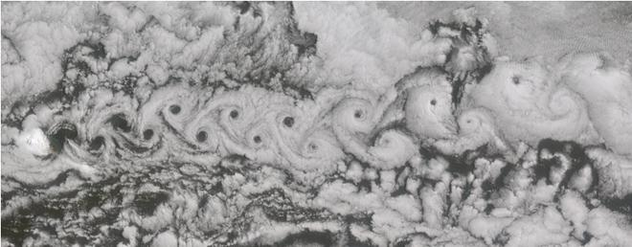
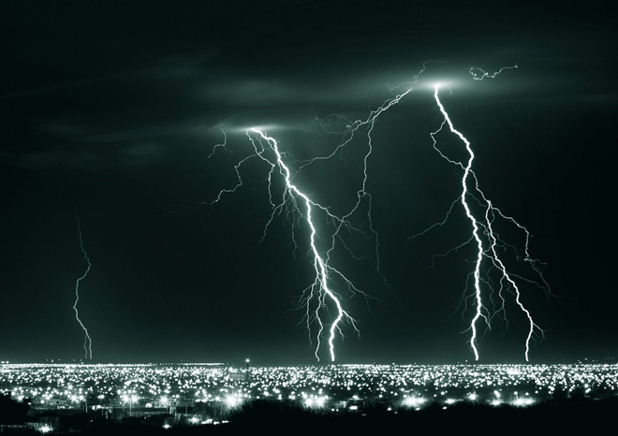
Fractals in Nature
The weather puts on fantastic displays of fractals in cloud, lightning, hurricanes, and more.

Slide 29
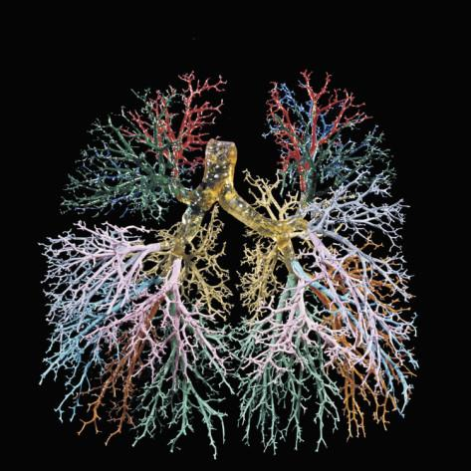
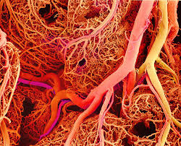
Fractals in Nature
The study of fractals opened up a whole new world in regard to the study of the human body. Fractals are everywhere inside of us. Kidneys, blood vessels,
lungs, even our brain exhibit fractal formations.

