Slide 1
Image manipulation via matrices
Stephanie Orgill

Slide 2
Linear Transformations
Ax = b is at the center of matrix transformations
Think of matrix A as an object that is acting on vector x by multiplication, which produces a new vector Ax.
The transformation from x⟶Ax follows a set of rules which preserve the operations of vector addition and scalar multiplication:
  A(u + v) = Au + Av
  A(cu) = cAu
We can use these rules with transformation matrices to translate, shear, scale, rotate, and reflect images in 2-D space

Slide 3

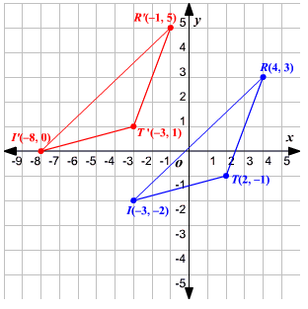
Translating
A vector X is translated by a vector V to X+V. Translation is with vector addition.
Say we wish to translate a triangle with vertices at (2, -1), (4, 3), and (-3, -2) 5 units left and 2 units up. To do this, we would take the triangle’s matrix A and add to it the transformation matrix that subtracts 5 from the x values and adds 2 to the y values:
Thus the triangle’s location matrix A, composed of vertices x_{1,} x₂, x₃ are translated by vectors v_{1,} v₂, v₃ to produce the translation matrix.

Slide 4


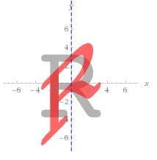
Shearing
A shear transformation is defined by T(x) = Ax.
Shearing a matrix causes each point, or each m_{ij} , to be displaced in a fixed direction by an amount proportional to its distance from a line parallel to that direction.
Shearing can occur along the vertical or horizontal axes by a scalar k:
As an example, let’s vertically shear the following matrix:
This has the effect of transforming the grey R into the lopsided red R seen to the right:

Slide 5

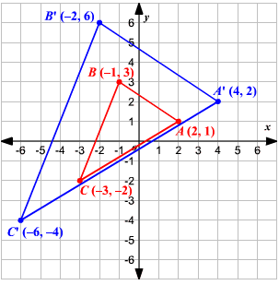
Scaling
There are two types of scaling: contraction and dilation
Contraction occurs when a matrix T is multiplied by a scalar k such that T(x) = kx when 0 ≤ k ≤ 1
Dilation occurs when matrix T is multiplied by k such that T(x) = kx when k > 1
Scaling means that the matrix and the image it represents either grows or shrinks.
Scaling is uniform when the x and y values are both scaled by the same k.
Take a simple 2x3 matrix and uniformly contract it by multiplying it by k = ½:

Slide 6

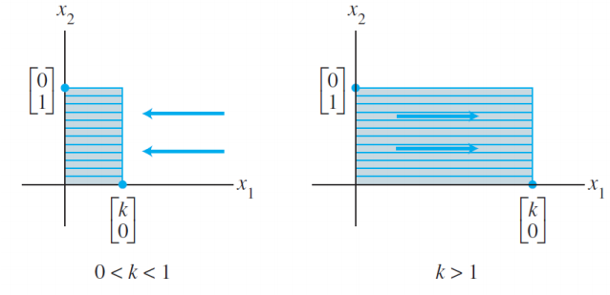
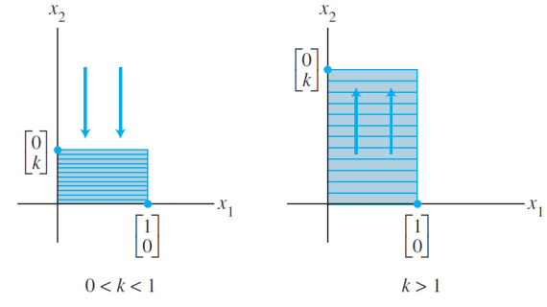
Scaling cont’d
Scaling does not have to be uniform. Scaling can occur along any axis by applying the correct scaling matrix:

Slide 7

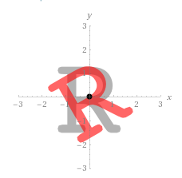


Rotating
Images can be rotated counterclockwise around a central point (like the origin) through an angle θ.
For example, let’s rotate some (x, y) values by 30 degrees.
Remember that $\cos{(30})= \frac{\sqrt{3}}{2}$ and $\sin\left(30\right)= \frac{1}{2}$.
This results in the grey R to the right being twisted about the origin by 30 degrees clockwise (represented by the red R):

Slide 8
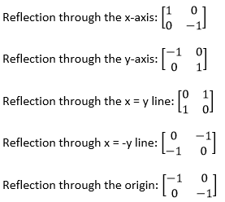

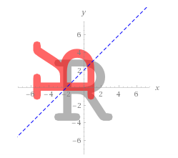
Reflecting
Reflection is the act of flipping the image across a designated line, such that it is a mirror image of the original.
Common types of reflections with their respective matrices are listed below:
As an example, let’s flip an arbitrary (x,y) value across x = y and translate it 2 units in each direction to center it:

Slide 9
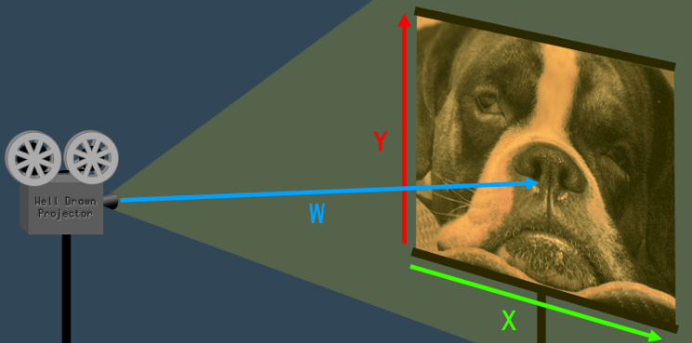
Transformations in 3-D space
Transformations in 3-D space follow the same rules as those in 2-D space, but with slightly more complicated matrices.
3-D transformations require the use of 4x4 matrices, which may seem odd – what’s the fourth dimension?
4-D vectors define space along the x, y, and z axes as well as a fourth dimension w. This dimension is the projective space.
To better understand projective space, imagine it as a video projector that is showing a 2-D image; w is the distance from the projector to the screen and it affects the image size/scale.
Some 3-D transformations (like translations) require the use of w, while others do not (like rotation). Remember that the rules of matrix multiplication dictate that a 4x4 matrix cannot be multiplied against a 3x3 matrix, so all 3-D transformations must use 4x4 matrices.

Slide 10




3-D Transformation Matrices
The below matrices are examples of some 3-D transformation matrices.

Slide 11

3-D transformation Example:
Let’s say an object is located along the vector x = [4 3 2 1] and we want to:
  translate it by -2 in the x direction, 3 in the y direction, and 1 in the z direction
  rotate it by 45 degrees along the z axis and 30 degrees along the y axis
  shear it in the x-direction by 45 degrees
The combined transformation matrix (T) is as follows, in order of translation, z rotation, y rotation, and shear:

Slide 12
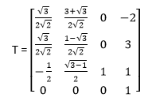
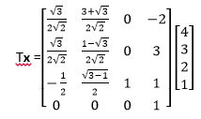
Example cont’d & Conclusion:
Multiplying the location vector x by T will result in x being rotated, translated, and sheared as indicated in the previous slide.
In conclusion, matrix transformations are an essential part to many fields like computer science, robotics, and mechatronics. The process for transforming matrices is simple and follows a very clear and consistent set of rules.

