Slide 1
Math 5750 / 6880
Mathematics and Climate
Kenneth M. Golden

Slide 2
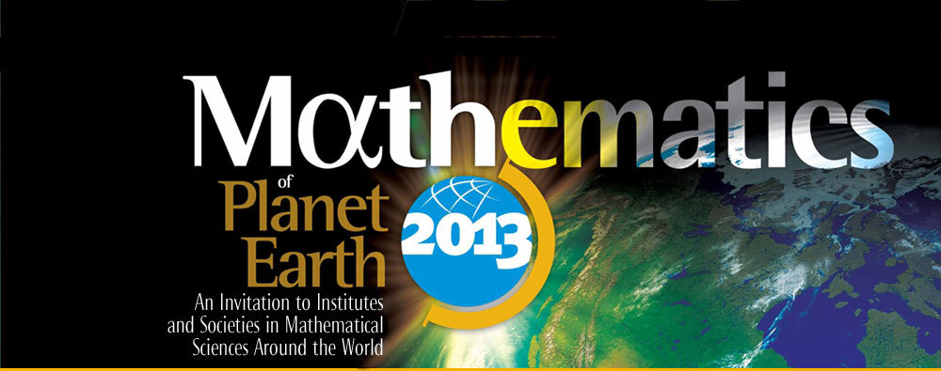
Mathematics of Planet Earth 2013
A Worldwide initiative, involving:
North America: US and Canadian Math Institutes, Societies, etc.
Partners worldwide: Europe, Africa, India…

Slide 3
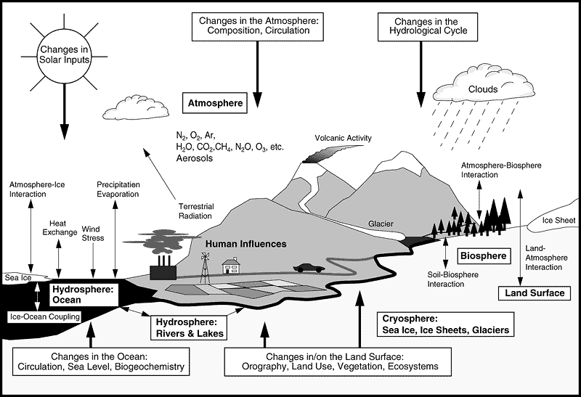
Schematic view of Earth’s climate system (IPCC).
Snow
permafrost

Slide 4
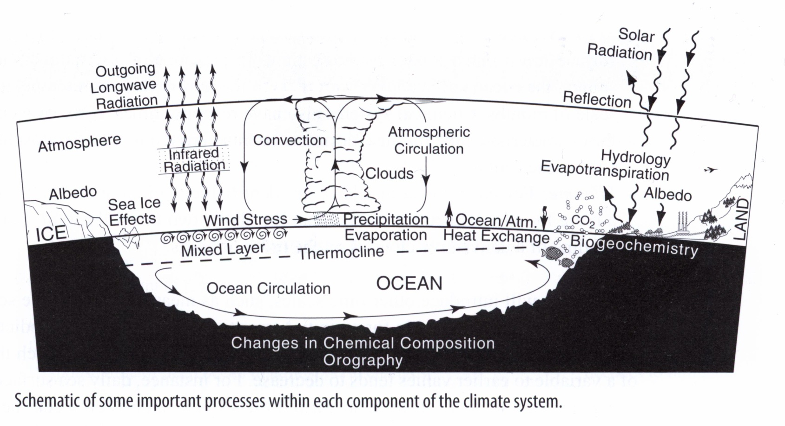
Basics of global climate
Basic components: cryosphere – land ice, snow, sea ice, permafrost
biosphere – sum total of all living things
lithosphere – solid Earth – ocean basins, mountain ranges
atmosphere, hydrosphere (oceans, seas, rivers, …)

Slide 5
Evidence of a Changing Climate
Intergovernmental Panel on Climate Change (IPCC):
Warming is “unequivocal”
Dots: yearly average
Curve: decadal average
Blue: uncertainty interval
Notes:
We’re going to focus on global mean temperature
(mean over planet and over a year)

Slide 6
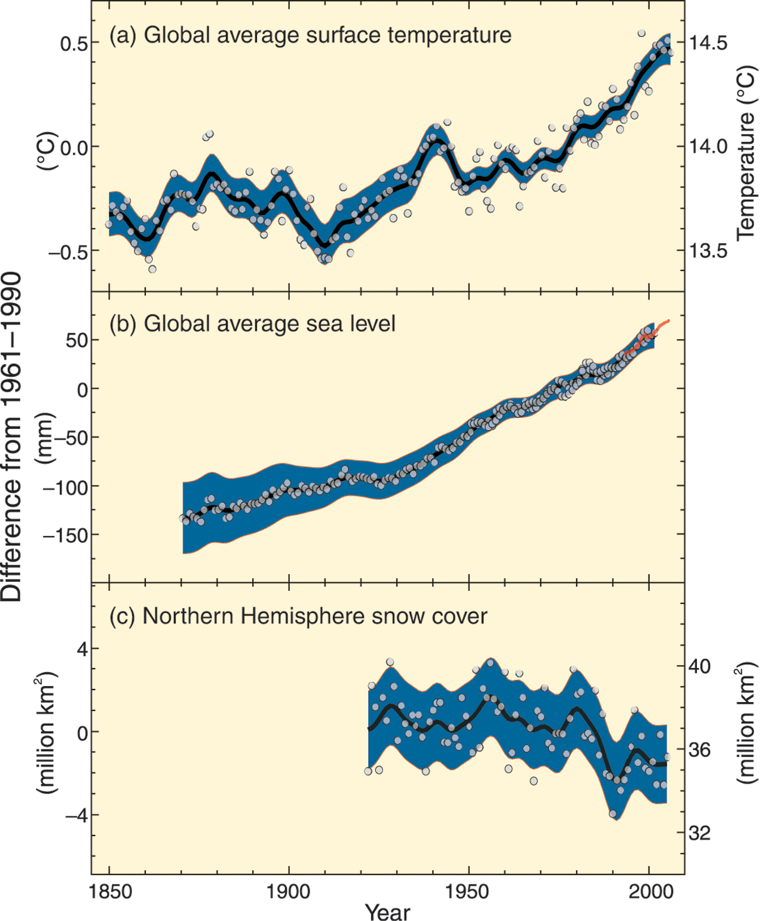
IPCC: Warming is “unequivocal”
Global mean surface temp
Global mean sea level
Northern Hemisphere snow cover (March-April)
Dots: yearly average
Curve: decadal average
Blue: uncertainty interval
1850
2000

Slide 7
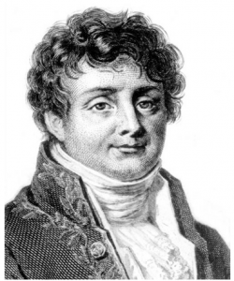
Basics of global warming date back to the 1800’s
Jean Baptiste Joseph Fourier (1768-1830), French mathematician and natural philosopher, did groundbreaking work in mathematics and the theory of heat. He was the first to propose that the Earth's atmosphere acts to raise the planet's temperature.
“As a dam built across a river causes a local deepening of the stream, so our atmosphere, thrown as a barrier across the terrestrial rays, produces a local heightening of the temperature at the Earth’s surface.”
Thus in 1862 John Tyndall described the key to climate change. He had discovered in his laboratory that certain gases, including water vapor and carbon dioxide ( CO2 ) are opaque to heat rays. He understood that such gases high in the air help keep our planet warm by interfering with escaping radiation.

Slide 8
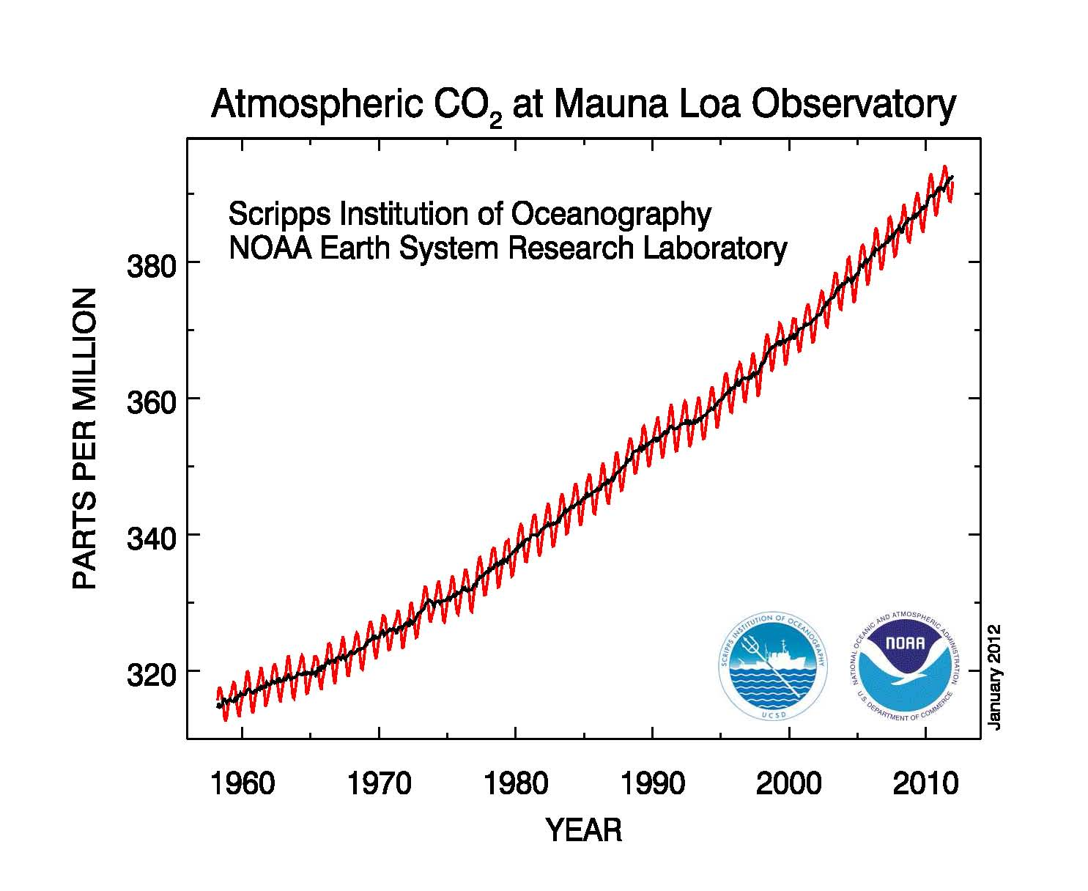
Monthly average carbon dioxide concentration. Seasonal cycle is thought to be driven by the terrestrial biosphere; net consumption of carbon dioxide by biomass in the summer (abundance of light and heat) and net respiration in winter.

Slide 9
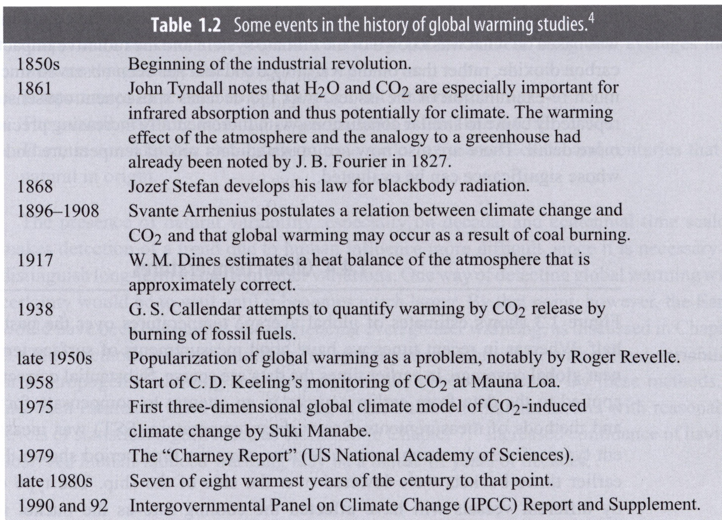

Slide 10
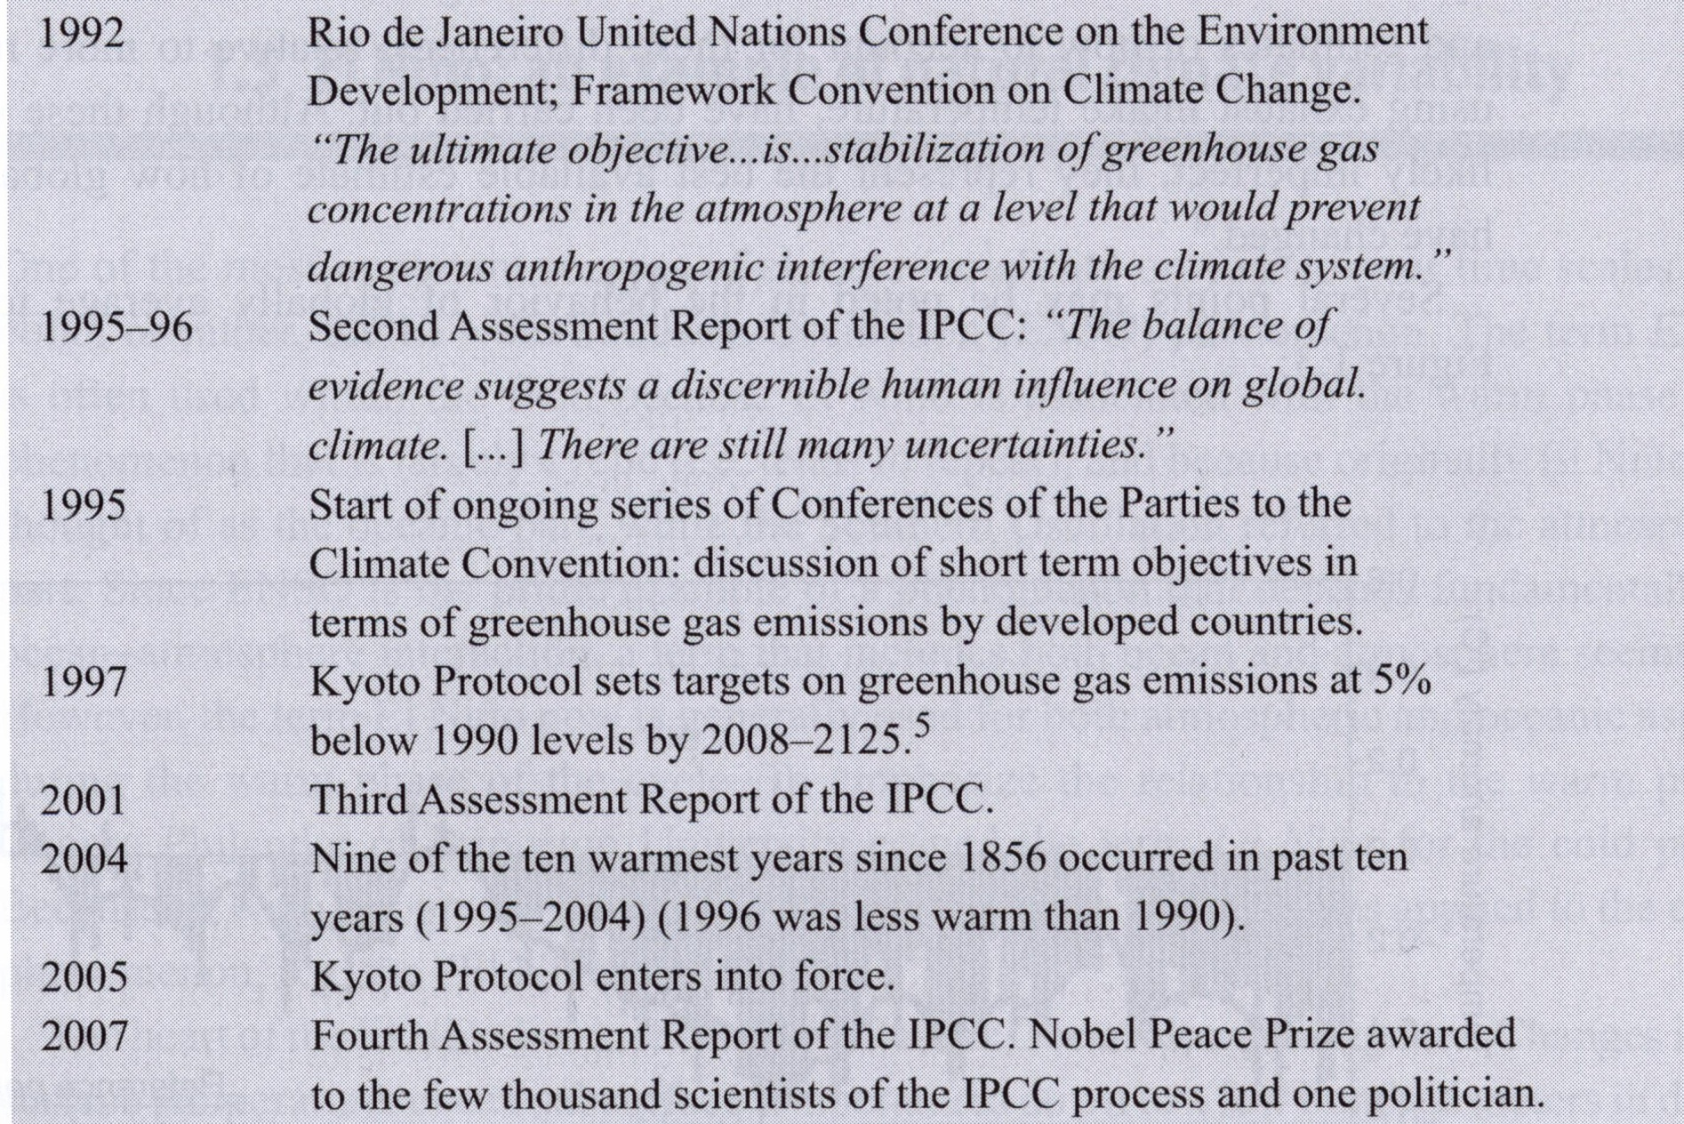

Slide 11
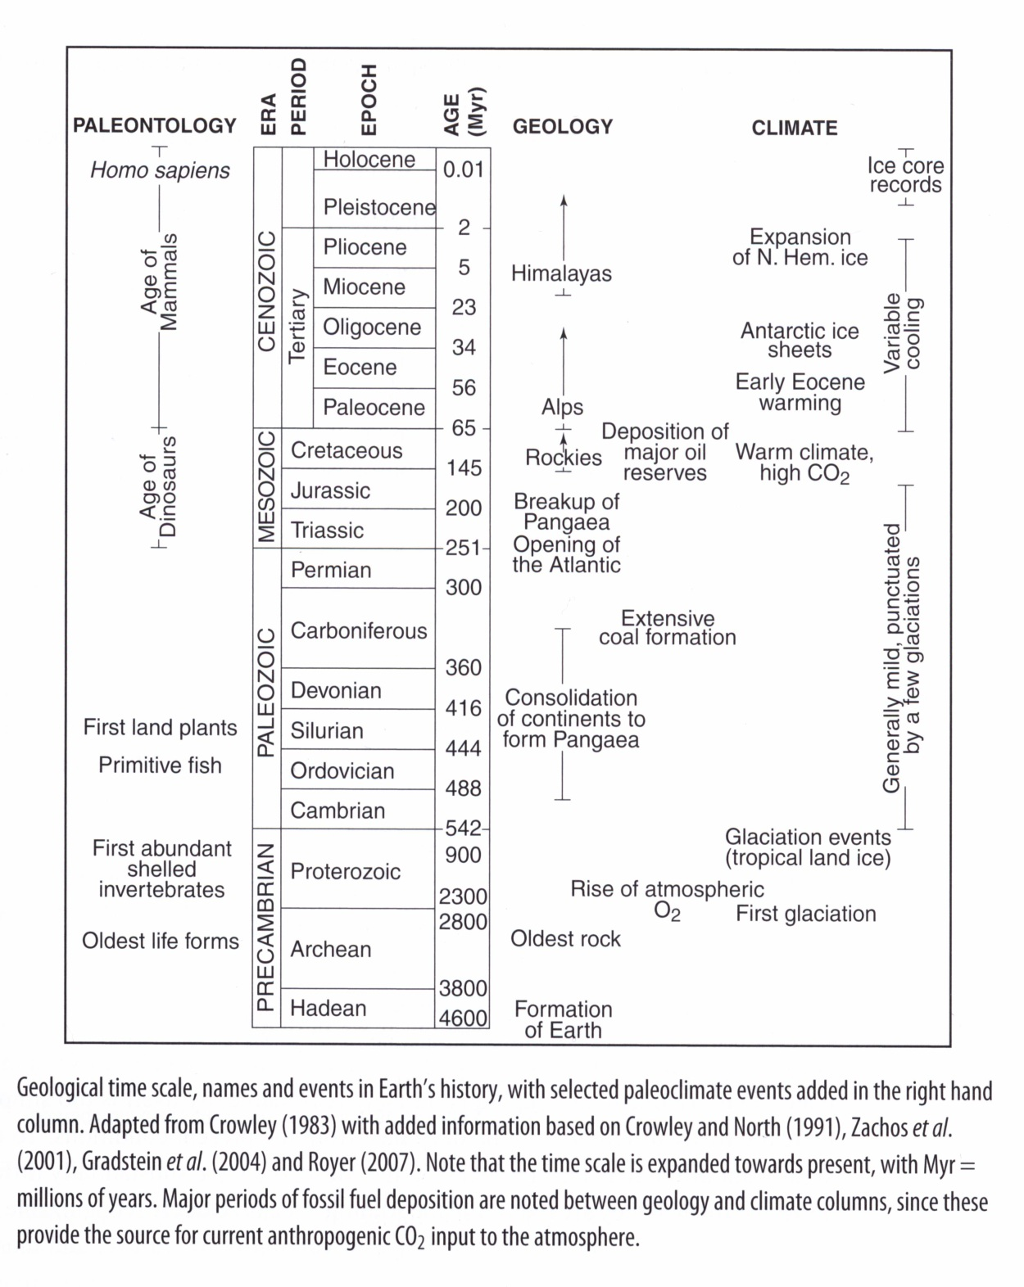

Slide 12
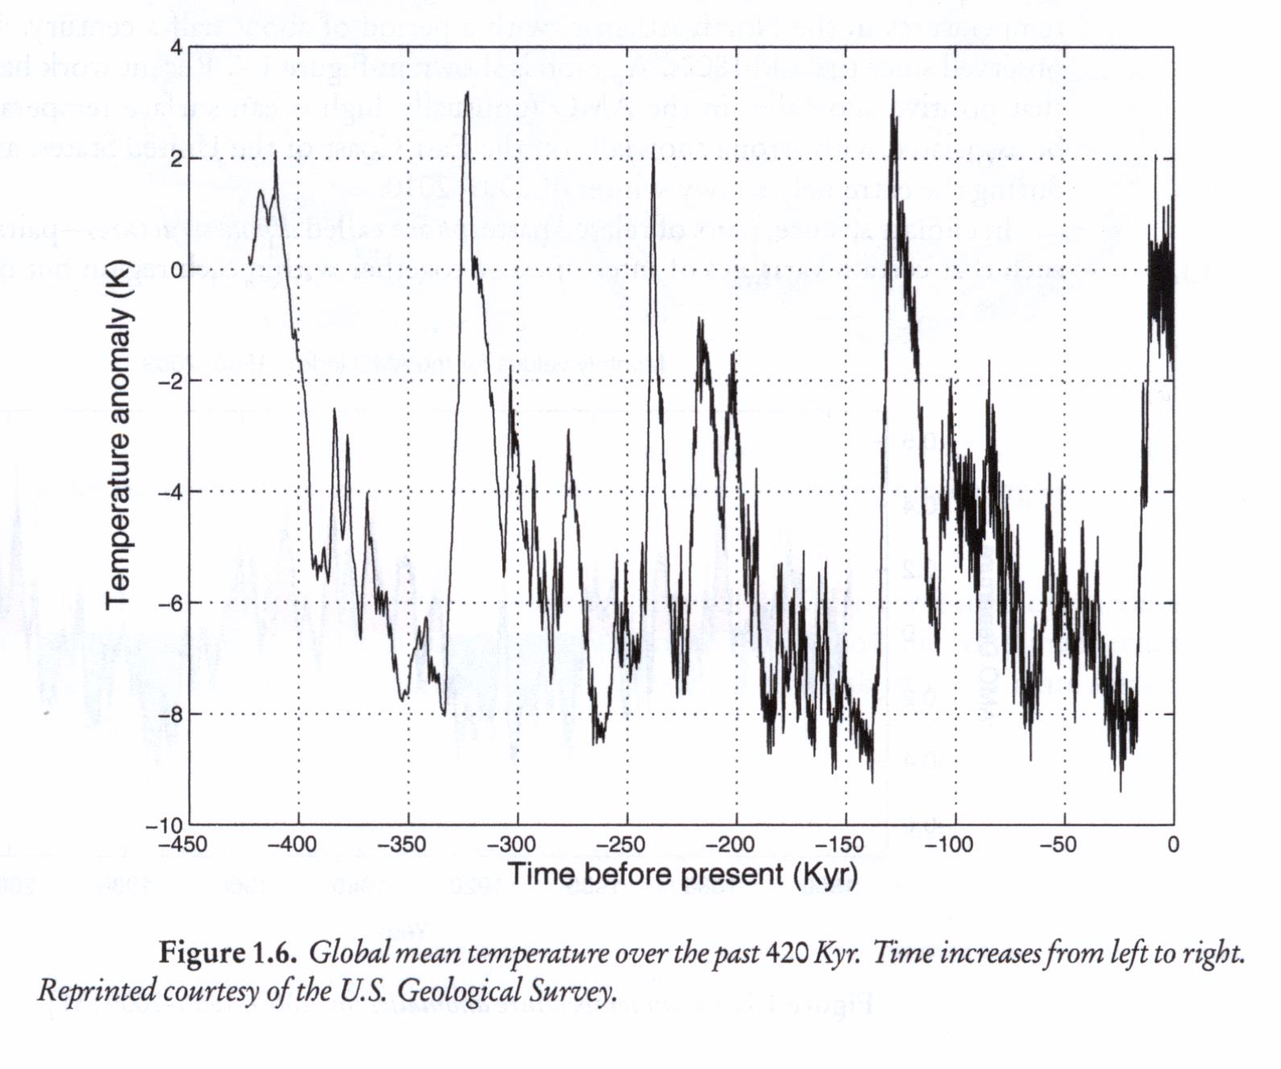
climate variability vs. climate change

Slide 13
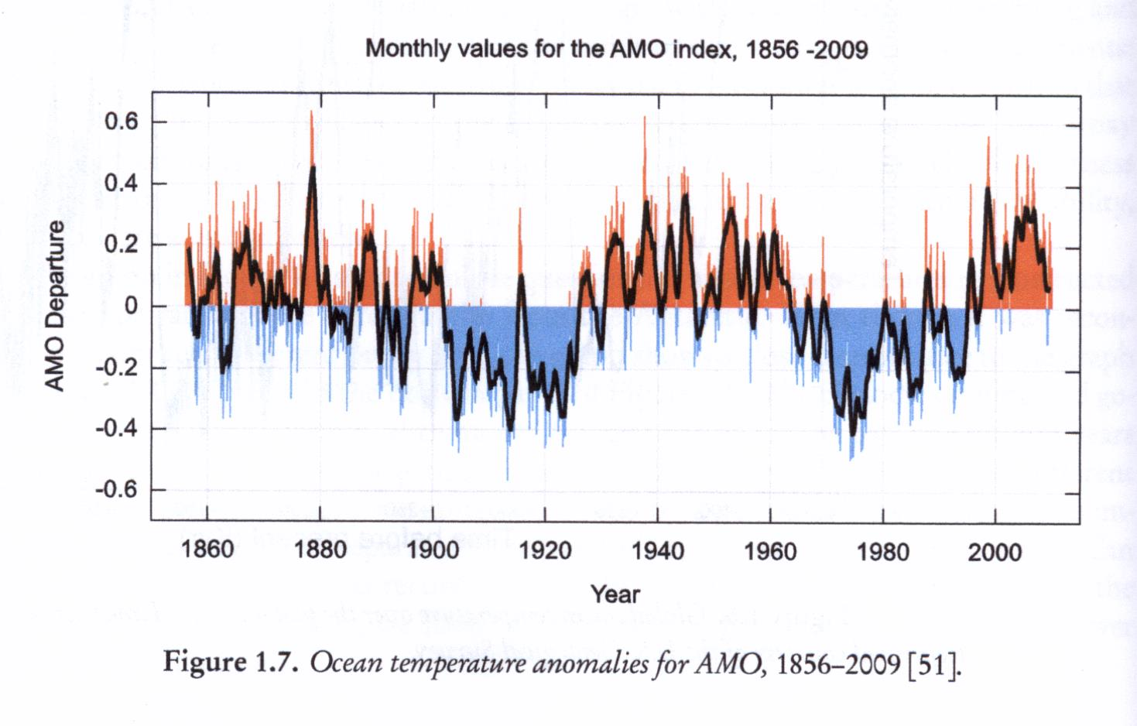
Sir Gilbert Walker (1868-1958) -- observed years of reduced rainfall over Australia and Indonesia (high air pressure over western Pacific) correlated with low pressure over central and eastern Pacific – SOUTHERN OSCILLATION
His observations vindicated when connected to ocean temperature oscillations observed by fishermen off the coast of South America around Christmas – called “El Nino”
ENSO – El Nino Southern Oscillation
NAO – North Atlantic Oscillation – pressure difference – Icelandic low, Azores high
AMO – Atlantic Multidecadal Oscillation (~ 50 yrs) – sea surface temps in North Atlantic
positive anomalies – high ocean surface temps – associated with strong snowfall
in East Coast, as in 2009-2010.

Slide 14
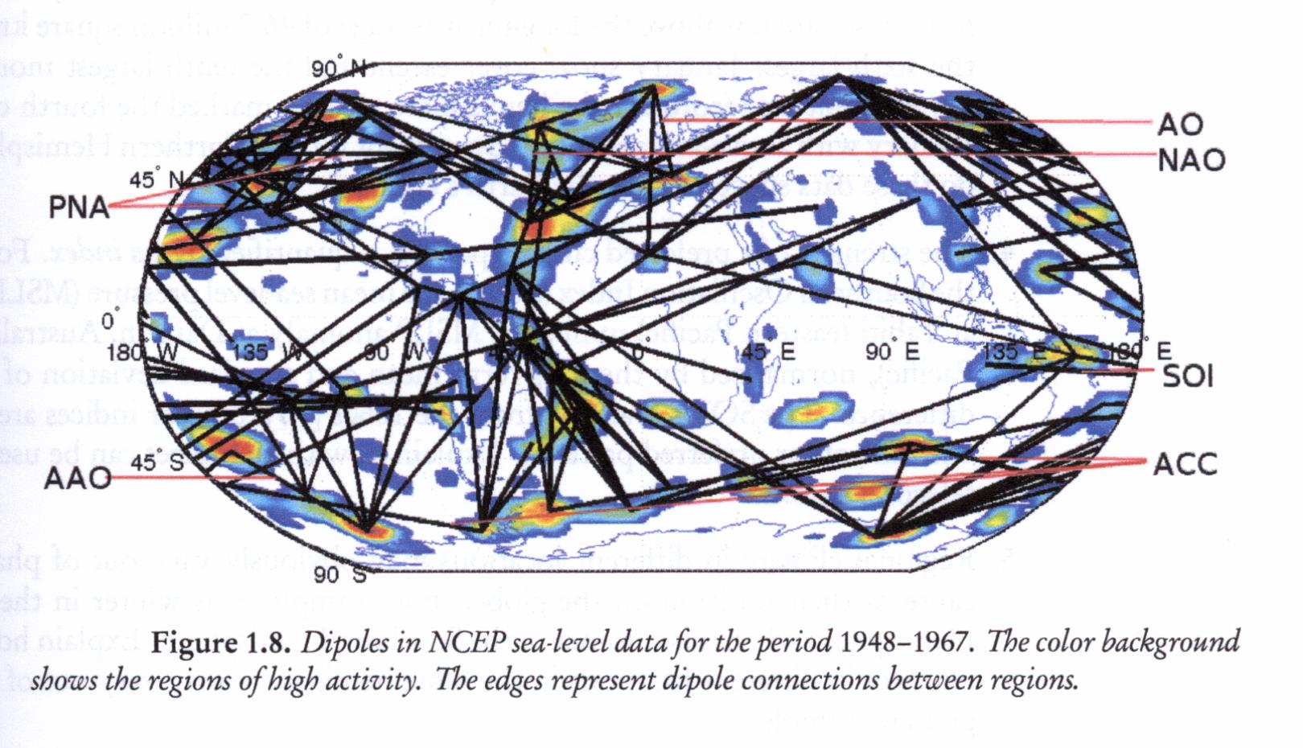
DIPOLE Teleconnections

Slide 15
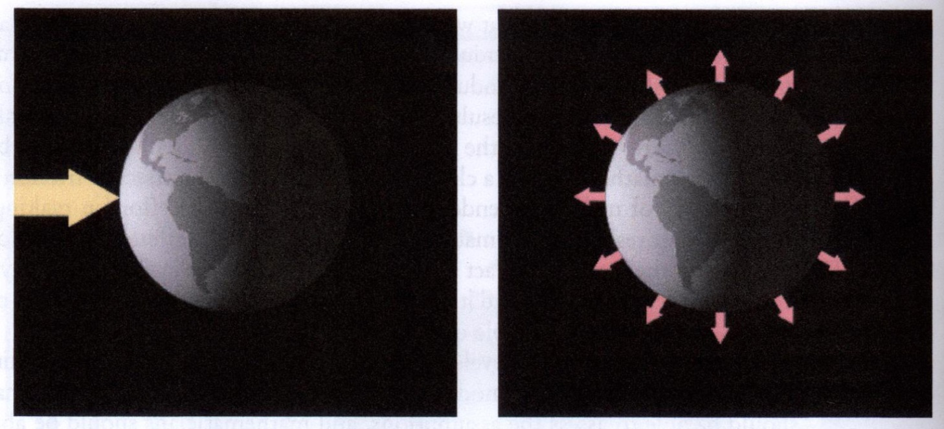
Most basic model of Earth’s climate: balancing incoming energy from sunlight (shortwave radiation) with outgoing energy from escape of heat (longwave radiation).

Slide 16
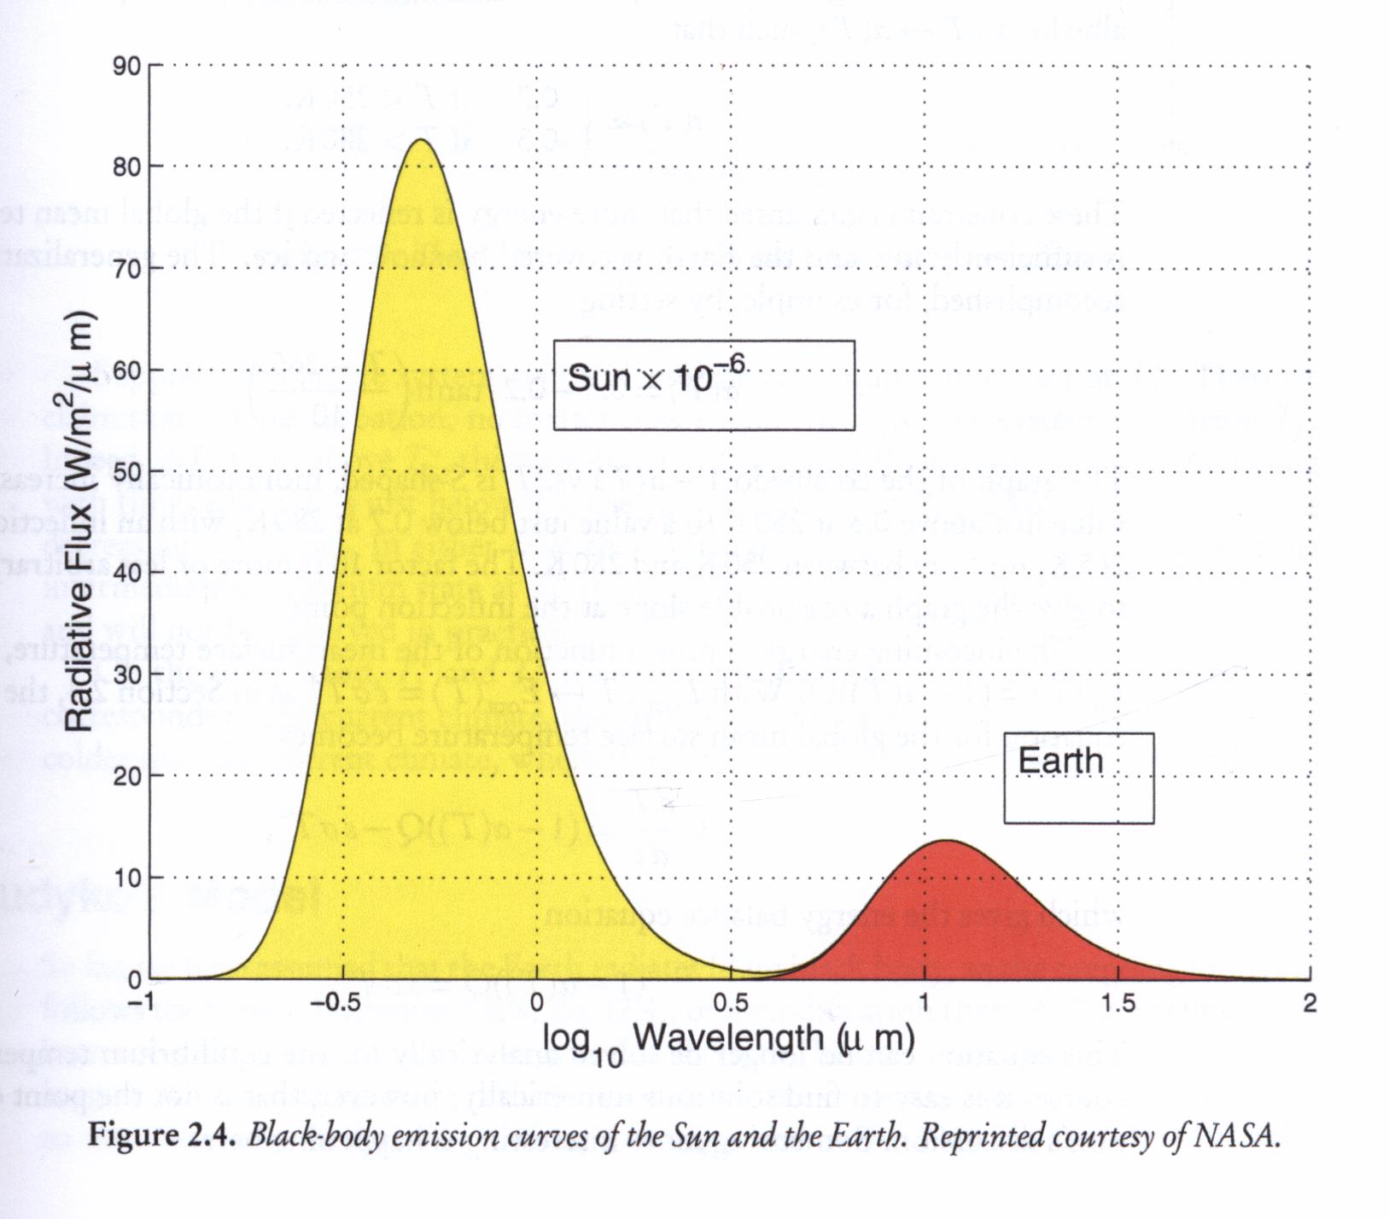
Blackbody emission curves for Sun and Earth.
A perfect blackbody is one that absorbs all incoming light and does not reflect any; it emits electromagnetic radiation (thermal radiative energy) with spectrum that depends on temperature T according to Plank’s law.

Slide 17
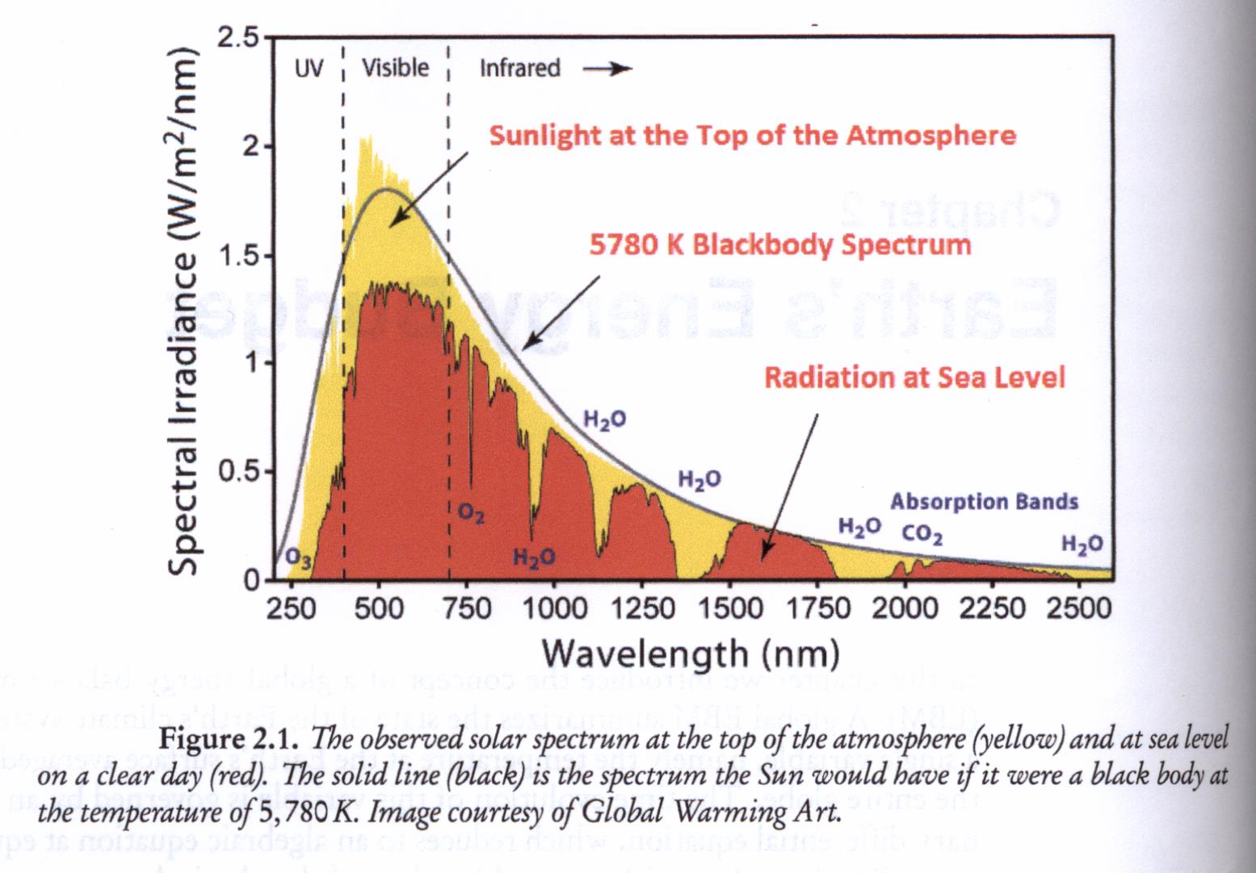
Observed solar spectrum at top of atmosphere and at sea level

Slide 18
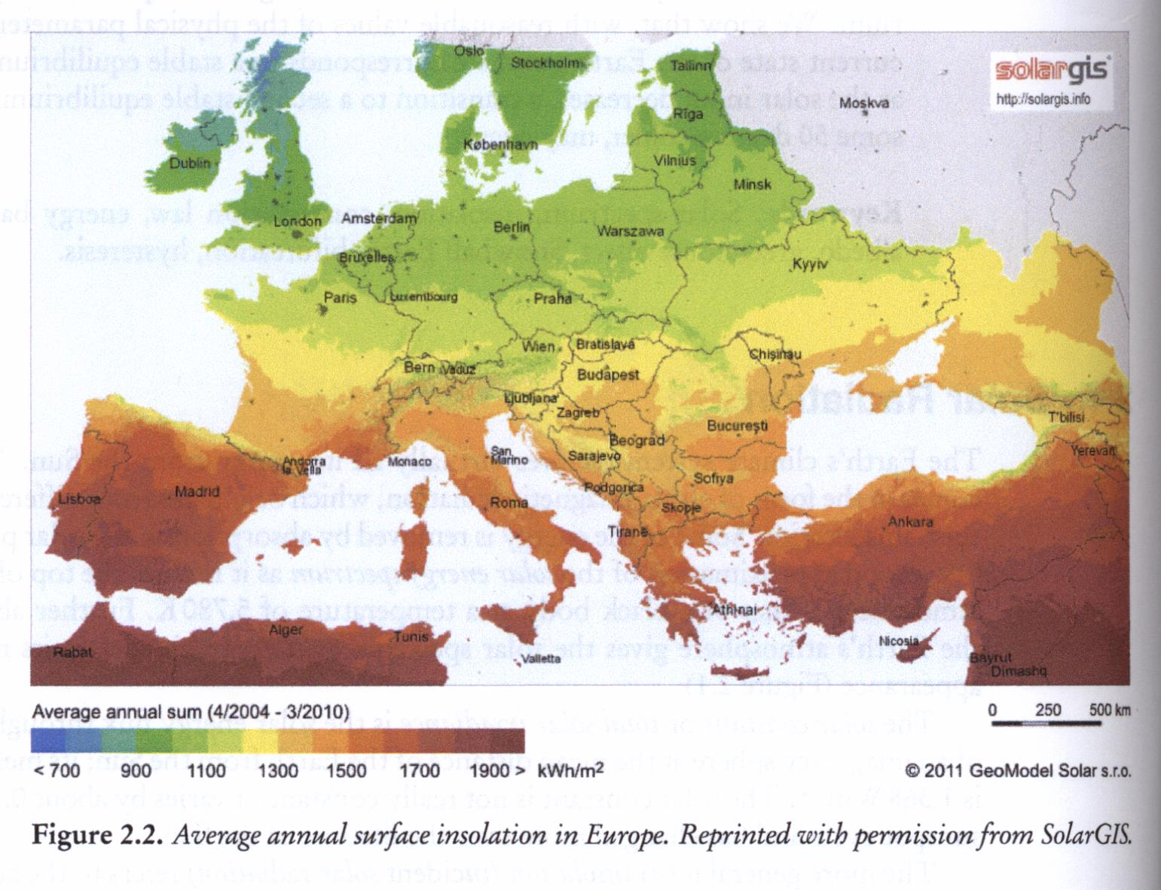
Surface insolation in Europe.

Slide 19
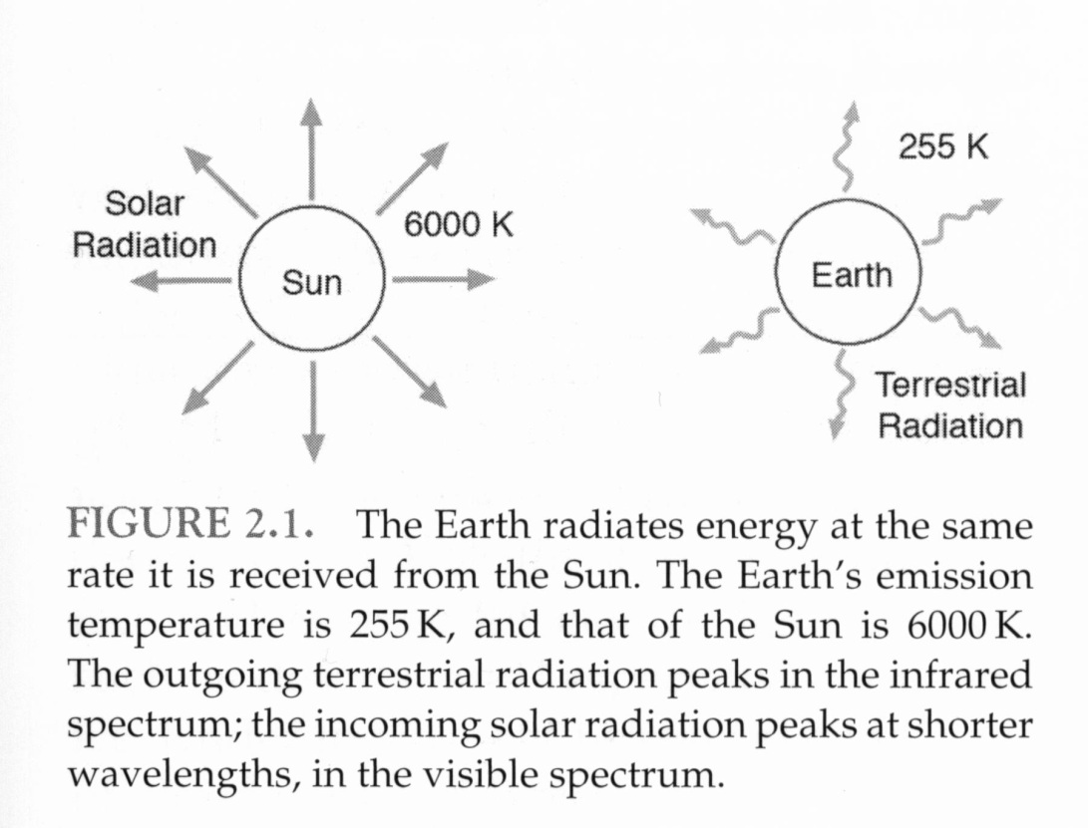
The global energy balance
Consider the radiative equilibrium temperature of Earth. To maintain equilibrium, it warms up (absorbs solar energy) and radiates energy away at same rate it is received. We’ll see the emission temperature is 255 K and a body at this temperature radiates primarily in infrared. But atmosphere is strongly absorbing at these wavelengths (H2O and CO2) thus raising surface temperature above emission temperature – GREENHOUSE EFFECT.

Slide 20
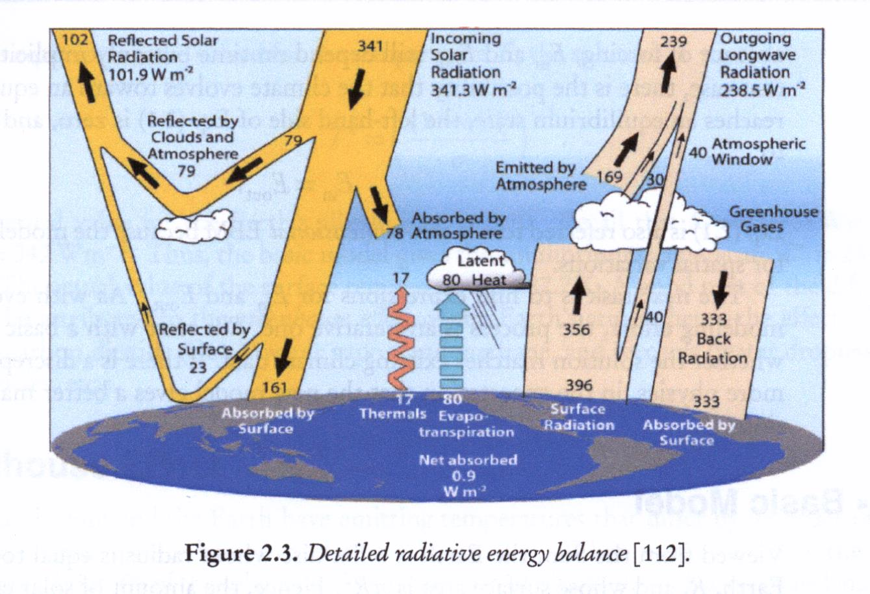
radiative energy balance

Slide 21
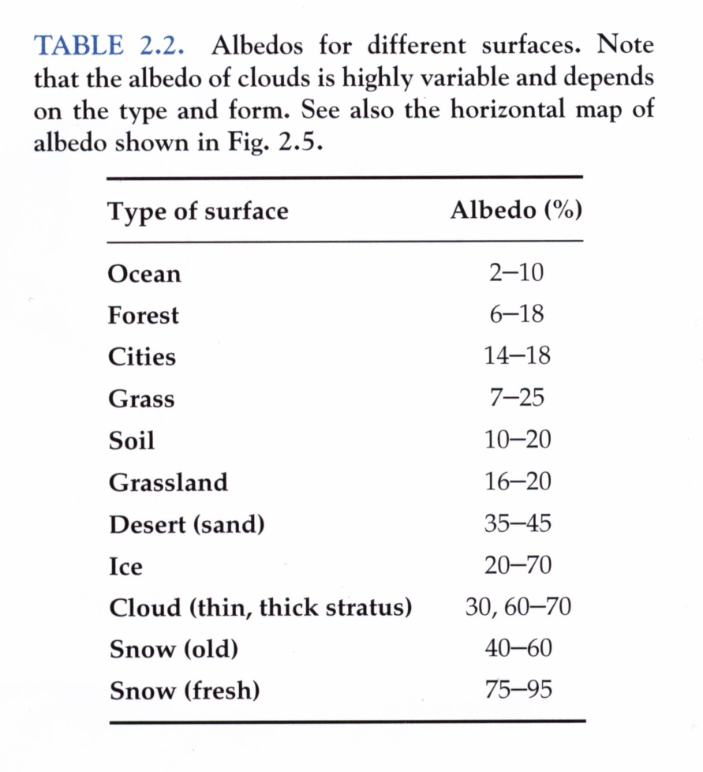
Not all radiation absorbed, some reflected
ratio of reflected to
incident solar energy
= albedo = α

Slide 22
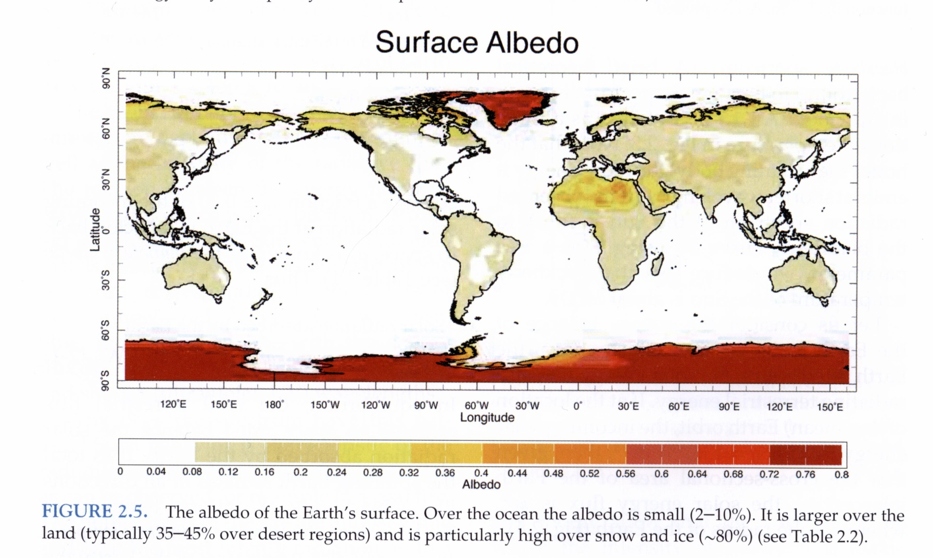
Albedo depends on the nature of the reflecting surface, large for clouds, light surfaces like deserts, and especially snow and ice.
Under present terrestrial conditions of cloudiness and snow and ice cover, on average a fraction α ∼ 0.3 of incoming

Slide 23
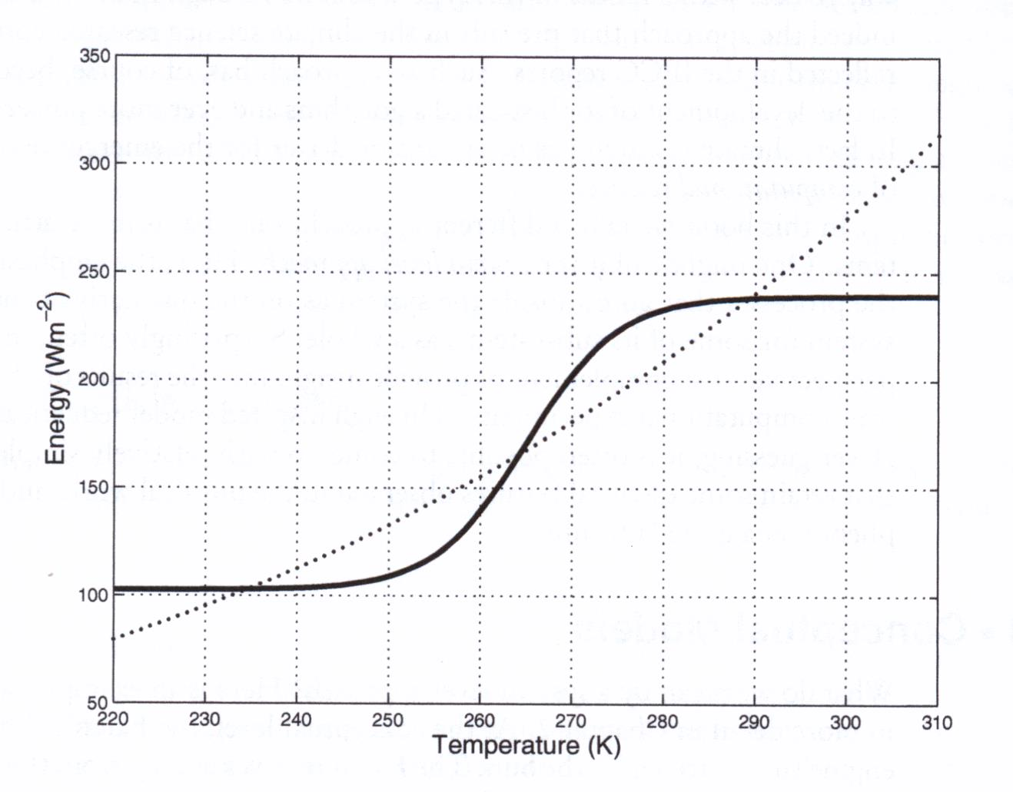
Energy balance model with multiple equilibria for Earth’s climate.
outgoing energy
incoming energy
Outgoing : increasing – a warmer planet radiates more energy.
Incoming : S – shaped from albedo of ice/snow vs. land/ocean.

Slide 24
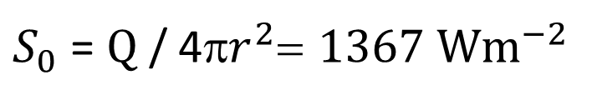

solar “constant”
Sun emits energy at rate Q = 3.87 x ${10}^{26}$ W
Flux of solar energy at Earth is called solar constant
$S_{0}$ = Q / 4π$r^{2}$= 1367 W$m^{−2}$
r = distance from Sun to Earth

Slide 25
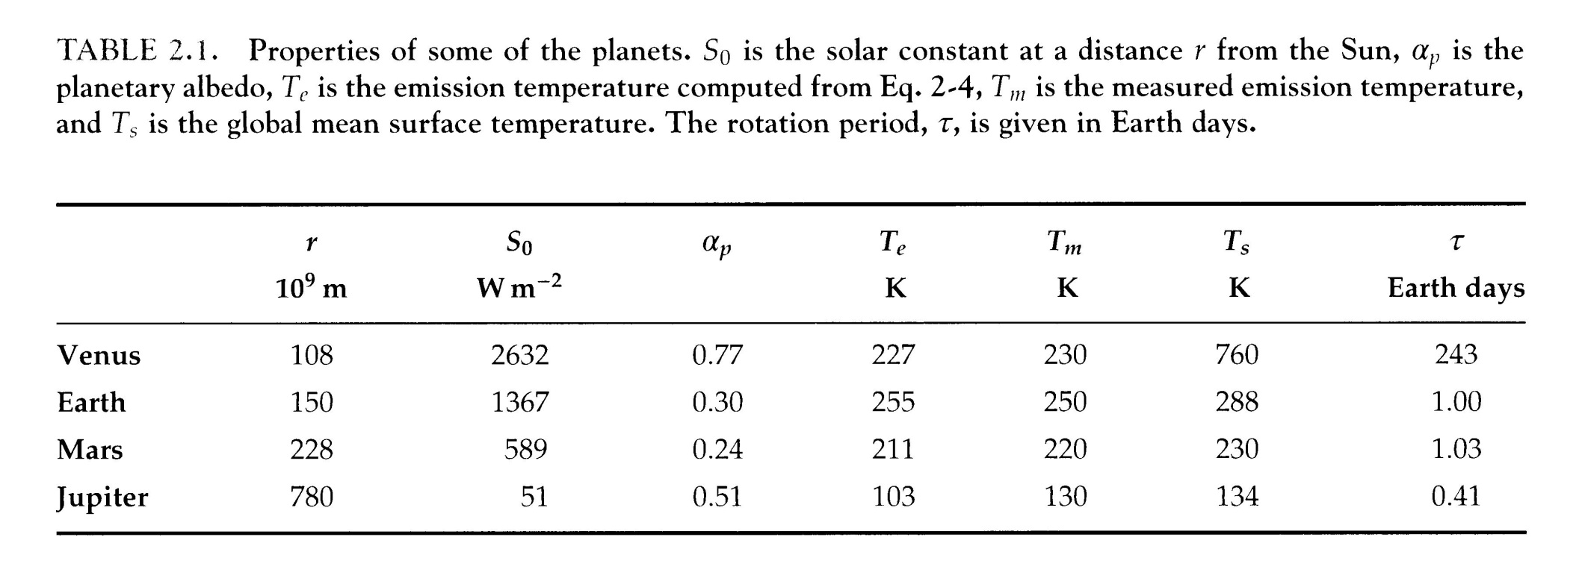
Planetary properties

Slide 26
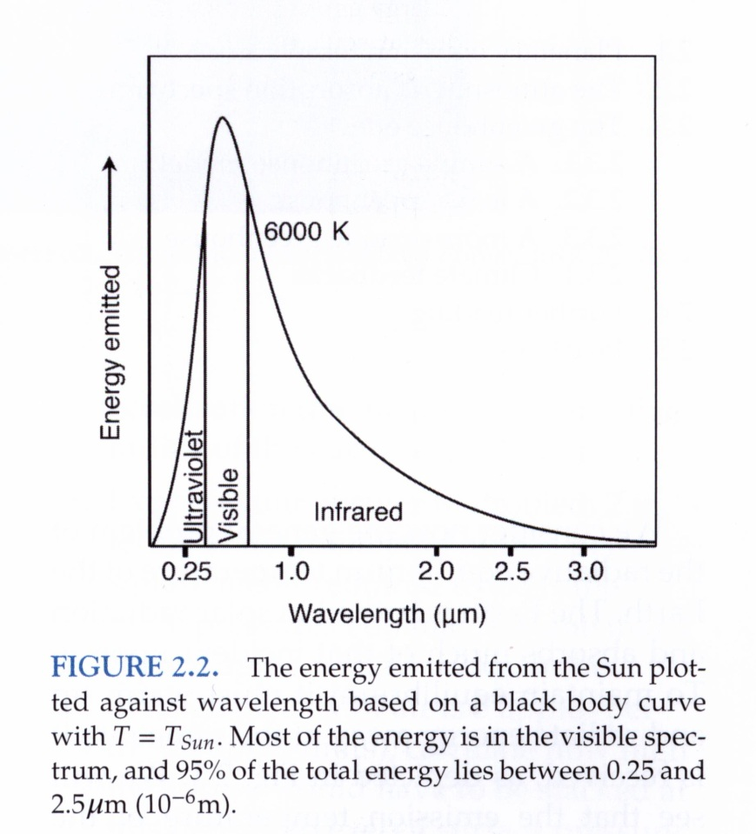
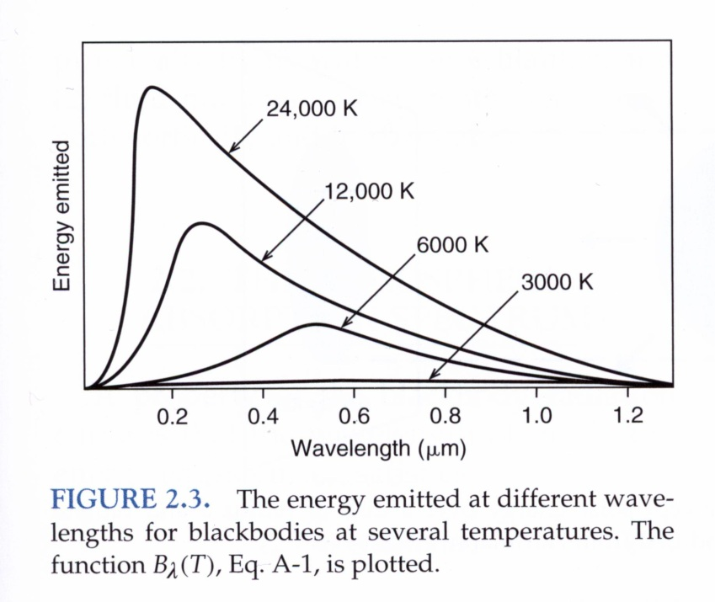
Radiation emitted by an incandescent material.
Incandescence is the emission of light (visible electromagnetic radiation) from a hot body as a result of its temperature.
Planck or blackbody spectrum: wavelength at which the intensity of radiation is a max, and the flux of emitted radiation, depend only on the temperature of the body. The hotter the radiating body, the more energy it emits at shorter wavelengths. If the observed radiation spectrum is fitted to the blackbody curve using T as a free parameter, then the blackbody temp of the sun is 6000 K.

Slide 27
Planck’s radiation curve – the Planck function
A blackbody absorbs 100% of incident radiation.
It therefore reflects no radiation and appears perfectly black.
Planck showed the power emitted by a blackbody per unit area, per unit solid angle, per unit wavelength, is given by
Figures 2.2 and 2.3 are plots of vs. wavelength for various
h is Planck’s constant, c is the speed of light, k is Boltzmann’s constant

Slide 28
Integrate over all wavelengths, obtain blackbody radiance
Stefan-Boltzmann constant

Slide 29
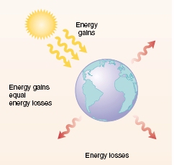
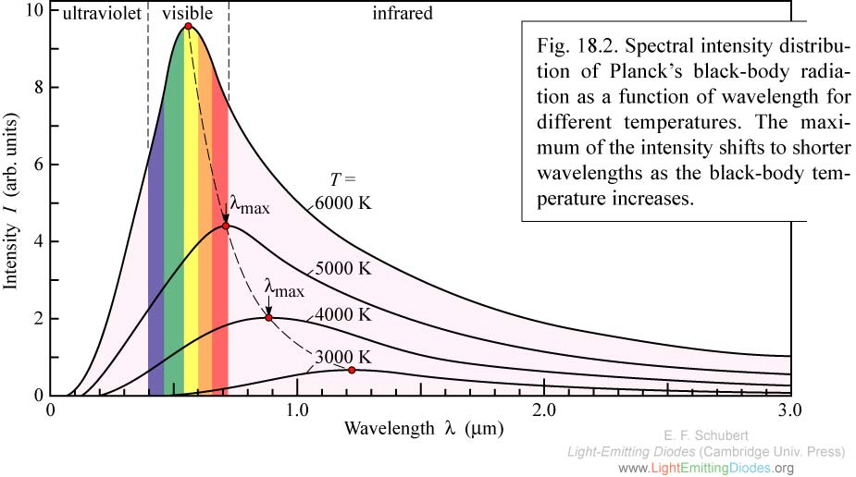
Black Body Radiation - Planck
Energy gains
Spectral Intensity
vs
Wavelength
For black bodies at different temperatures (0°C=273K)
Energy gains
equal
Energy losses
Intensity (arb. units)
Energy losses
Wavelength (μm)
Sun: ~6000K, emits mainly in visible spectrum (shortwave)
Earth: ~300K, emits mainly in IR (longwave)
Integrate over wavelength for temp T to get total emission flux σT⁴ -- Stefan-Boltzmann
Notes:
Two black bodies, each radiating energy according to their temperature
Degrees K and C are the same size
Not a coincidence that sun emits in visible spectrum.
Doubtless a consequence of evolution that vision has evolved to optimize use of available spectrum ☺
.

Slide 30
Blackbody emission curves for Sun and Earth.

Slide 31
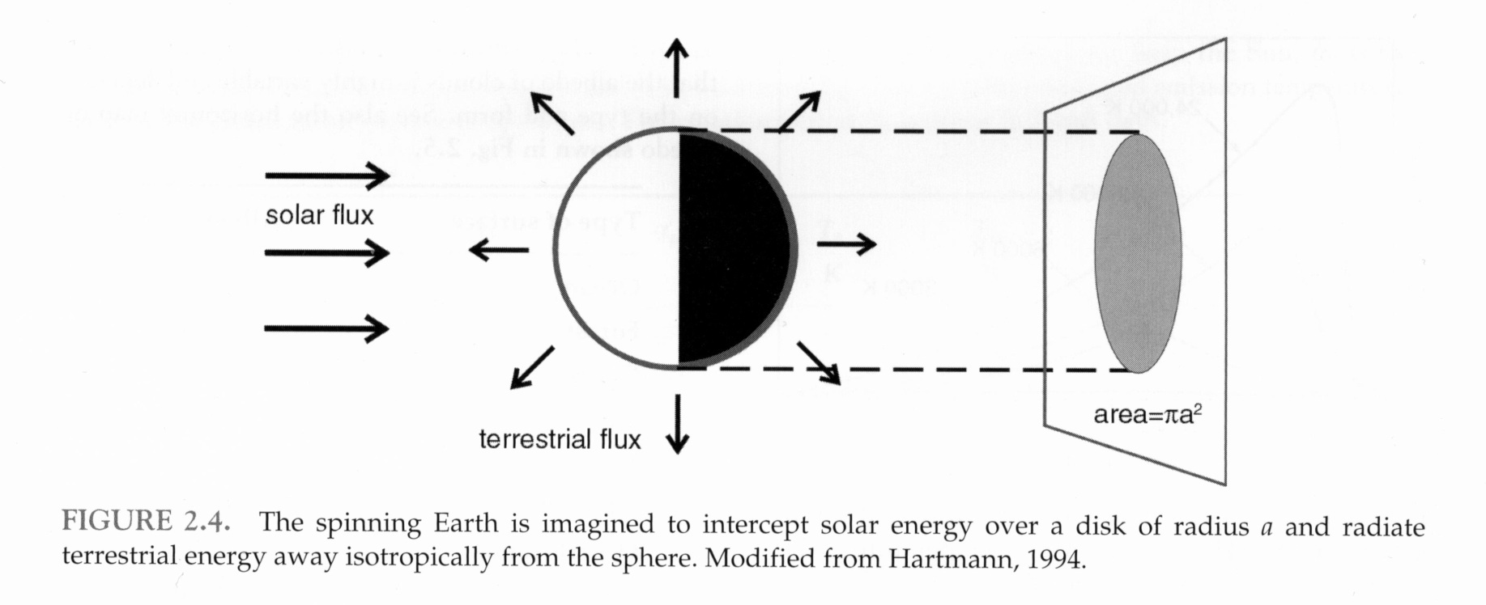
solar power incident on Earth

Slide 32
Not all radiation absorbed, some reflected
ratio of reflected to
incident solar energy
= albedo = α

Slide 33
Albedo depends on the nature of the reflecting surface, large for clouds, light surfaces like deserts, and especially snow and ice.
Under present terrestrial conditions of cloudiness and snow and ice cover, on average a fraction α ∼ 0.3 of incoming

Slide 34
Planetary albedo
Albedo depends on the nature of the reflecting surface, and is large for clouds, light surfaces like deserts, and especially snow and ice.
Under present terrestrial conditions of cloudiness and snow and ice cover, on average a fraction
α_{p} ∼ 0.3
of incoming solar radiation is reflected back to space.
α_{p} is known as the planetary albedo

Slide 35
Solar radiation absorbed by Earth =
( 1 – α_{p}) S₀ π a² = 1.22 x 10¹⁷ W
In equilibrium, the total terrestrial flux radiated to space must balance the solar radiation absorbed by Earth
If the spinning Earth radiates in all directions like a black body of uniform temperature
T_{e} known as the effective planetary temperature
or the emission temperature of the Earth
The Stefan-Boltzman law gives
emitted radiation per unit area =

