Slide 1
MATH 5740/MATH 6870 001 MATH MODELING 2010 09:40 AM-10:30 AM JWB 208
Introduction

Slide 2
Models and reality
Theory attracts practice as the magnet attracts iron. Gauss
We live in the world of models:
Great models: Universe, Evolution, Social organization – determine our life forcing our judgment, decisions, and feelings
Paradigms arrive in the form of new models: Examples: Neo-Darwinism, fractals, democracy, solitons.
Models as reference points
show fractal website

Slide 3
Galilei, Galileo (1564 - 1642): [The universe] cannot be read until we have learnt the language and become familiar with the characters in which it is written. It is written in mathematical language, and the letters are triangles, circles and other geometrical figures, without which means it is humanly impossible to comprehend a single word. Opere Il Saggiatore p. 171.

Slide 4
Definition from Wiki
A mathematical model uses mathematical language to describe a system.
Mathematical models are used in the natural sciences and engineering disciplines (such as physics, biology, earth science, meteorology, and engineering) and in the social sciences (such as economics, psychology, sociology and political science)..
The process of developing a mathematical model is termed 'mathematical modelling' (also modeling).

Slide 5
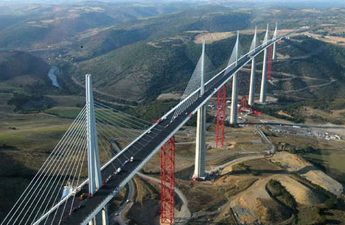
Model is an intentionally distorted system description that emphasizes desirable features
Everything should be made as simple as possible, but not simpler. A. Einstein
Model is not unique
Bridge: for traffic model – a piece of road
For flight navigation model – an obstacle
For vibration model – an unbreakable elastic structure
For strength model – an elastic-plastic structure
For bungle jumping -- a base.
For an artist – a shape.
The Millau Viaduct

Slide 6
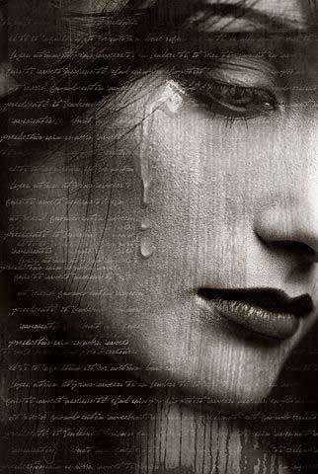
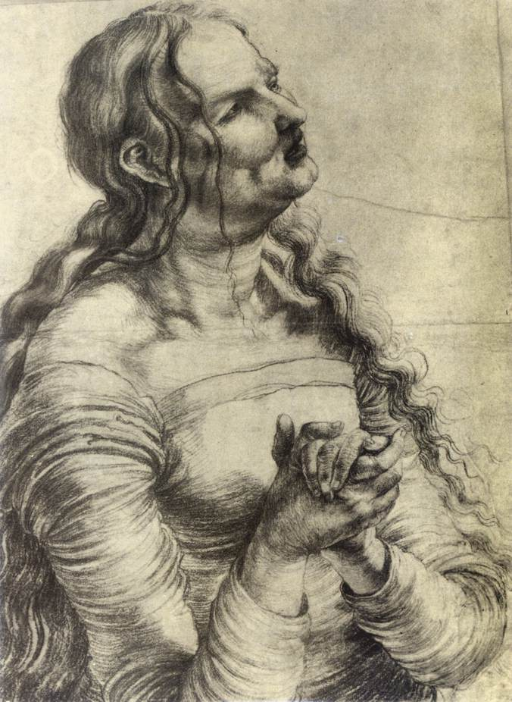
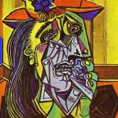
Three visual models of the same emotion

Slide 7
The use of math models
Goals: descriptive or design/optimization (natural or engineering model).
Range of applicability Ideal gas, Black matter, optimization
Validation: Mental experiment vs. real experiment. Galileo.
Results: Numerical or analytic. Simulation models.

Slide 8
Types of math models, by math methods
Curve fitting vs. equation solving
(based on a priori principles or empirical)
Static vs. dynamic
Continuum vs. discrete
Deterministic vs. stochastic
Game theoretical vs. probabilistic

Slide 9
Types of models, by the level of abstraction
geometric model – from Plato bodies to fractals
curve fitting, statistics
differential equations
variational principles
example:
Copernicus, Tycho Brahe, Kepler, Newton, Lagrange

Slide 10
Ingredients:
Modeling involves natural/social sciences (physics-biology-geology- sociology-etc), engineering, and mathematical techniques
Mathematical tools
Geometry, Equation solving, ODE, PDE, numerics, game theory, probability, statistics, optimization and control theory,
Creativity

Slide 11
Modeling of the Universe (Problem 1)
Write a short essay (< 2 pages) about development of the model of Universe by
Ptolemy (Klaúdios Ptolemaîos),
Nicolaus Copernicus
Tycho Brahe,
Johannes Kepler,
Isaac Newton,
Albert Einstein.
Characterize the models as empirical, or data fitting, or equation solving, or a general-principle-based, and comment on complexity of the models and motivation for the improvement/development.
Use Internet, Wiki, or any other available sources
http://astro.unl.edu/naap/ssm/animations/ptolemaic.swf

Slide 12
Class Outline (wish list)
Introduction. Types of Models.
Great Models: Copernicus, Newton, Einstein. Black holes. Fractals.
Population dynamics. Simple models and their combinations
Epidemics: disease spread
Dimensionality analysis (Parachute problem).
Discrete and continuum waves: domino train and traffic wave
Model of diffusion. ????
Optimal design -- a friction stopper
Thresholds: model of damage propagation
Stochastic Modeling for uncertainties
Game theory: Modeling for the worse case scenario
Suggestions are welcome!

Slide 13
Organization of the class work
For the project work the class will be divided into groups of tree
A presenter will orally present the group’s work, the report will be written. The group get a grade for the project.
The groups will be formed for each project, the roles will be reassigned so that each student will be researcher and presenter.
Problem 2. (one week)
Write an algorithm for dividing the class into groups of three for each project. Next time, bring in your ideas.

