Slide 1
Modeling the Universe

Slide 2
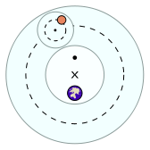
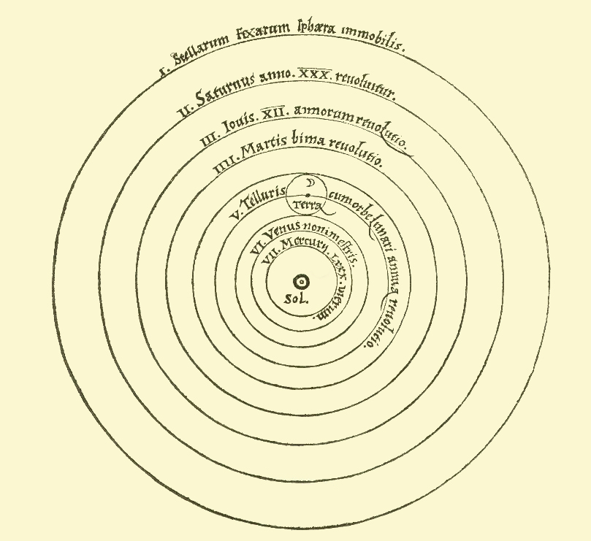
Models of the Universe
Turtles all the way down.
Ptolemy: Earth in the center, planets move with constant speed, circular orbits, and epicycles: http://www.pbs.org/wgbh/nova/ancient/ancient-computer.html
Copernicus 1473-1543: Sun in the center, planets move with constant speed, circular orbits, and epicycles.
http://en.wikipedia.org/wiki/Turtles_all_the_way_down
http://en.wikipedia.org/wiki/Geocentric_model
http://en.wikipedia.org/wiki/Copernican_heliocentrism

Slide 3
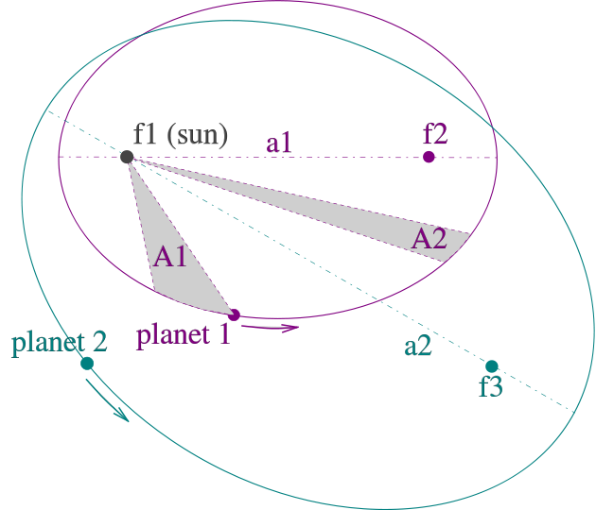
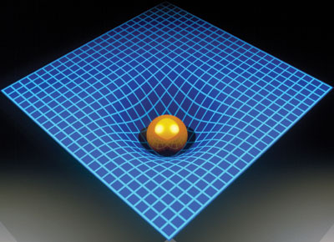
Kepler’s model, Newton’ law
Johannes Kepler published his
first two laws in 1609, the third –in 1619
The orbits are ellipses, with focal points ƒ1 and ƒ2 for the first planet and ƒ1 and ƒ3 for the second planet. The Sun is placed in focal point ƒ1.
(2) The two shaded sectors A1 and A2 have the same surface area and the time for planet 1 to cover segment A1 is equal to the time to cover segment A2.
(3) The total orbit times for planet 1 and planet 2 have a ratio a1^3/2 : a2^3/2.
Newton gravity law explained all three Kepler’s laws
but left open the question of how the gravity force acts.
Einstein’s general relativity explains the nature of the gravity force

Slide 4
History of modeling of the Universe (HW 1)
Write a short essay (< 3 pages) about models of Universe:
Turtles all the way down
Ptolemy (Klaúdios Ptolemaîos),
Nicolaus Copernicus
Tycho Brahe and Johannes Kepler,
Isaac Newton (gravity law)
Albert Einstein (general relativity)
Big Bang theory
Characterize the models as
empirical,
data fitting,
equation solving,
general-principle-based
and comment on motivation for the improvement/development. thought and physical experiments. What question were asked?
Use Internet, Wiki, or any other available sources
http://astro.unl.edu/naap/ssm/animations/ptolemaic.swf

