Slide 1
MATH 5740/MATH 6870 001 MATH MODELING 2013 09:40 AM-10:30 AM JWB 208 Andrej Cherkaev
Introduction

Slide 2
Components of applied math
Differential equations
Math Modeling
Numerical Methods
Applied math
Data: Statistics
approx
Optimization
Physics, or biologogy, or chemisty, or ..

Slide 3
Modeling is naming and understanding of the world phenomena
The term "fractal" was first used by Polish-French-American mathematician Benoit Mandelbrot in 1975.

Slide 4
Models and reality
Theory attracts practice as the magnet attracts iron.
Gauss
The applied math studies problems that are inspired by a nature phenomenon or a social need.
We live in the world of models:
Great models: Universe, Nuclear Physics, Evolution, Social organization – determine our life forcing our judgment, decisions, and feelings
Paradigms arrive in the form of new models: atoms, Neo-Darwinism, fractals, democracy.
Models are reference points: New ideas are placed in the framework of exiting models

Slide 5
Definition from Wiki
A mathematical model uses mathematical language to describe a system.
Mathematical models are used in the natural sciences and engineering disciplines (such as physics, biology, earth science, meteorology, and engineering) and in the social sciences (such as economics, psychology, sociology and political science)..
The process of developing a mathematical model is termed 'mathematical modelling' (also modeling).

Slide 6
Galilei, Galileo (1564 - 1642): [The universe] cannot be read until we have learnt the language and become familiar with the characters in which it is written. It is written in mathematical language, and the letters are triangles, circles and other geometrical figures, without which means it is humanly impossible to comprehend a single word. Opere Il Saggiatore p. 171. Thought_experiment http://en.wikipedia.org/wiki/Thought_experiment

Slide 7
Features of math models
Goals: descriptive or design/optimization (natural or engineering model).
Range of applicability (Ideal gas, Black matter, optimization)
Validation: Mental experiment vs. real experiment. Galileo.
Results: Numerical or analytic. Simulation models.
Predictability: Curve fitting vs. equation solving.
(based on a priori principles or empirical). The “good” model should to a degree predict the behavior of a system in a new environment.
Mathematical tools
Geometry, Equation solving, ODE, PDE, calculis of variations, numerical methods, game theory, probability, statistics, optimization and control theory, etc.
Creativity
Mathematics is made of 50% formulas, 50% proofs, and 50% imagination.

Slide 8
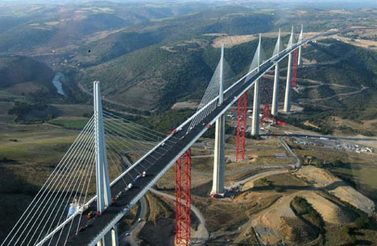
Model is an intentionally distorted system description that emphasizes desirable features
Everything should be made as simple as possible, but not simpler. A. Einstein
Model is not unique
Bridge: for traffic model – a piece of road
For flight navigation model – an obstacle
For vibration model – an unbreakable elastic structure
For strength model – an elastic-plastic structure
For bungle jumping -- a base.
For an artist – a shape.
The Millau Viaduct

Slide 9
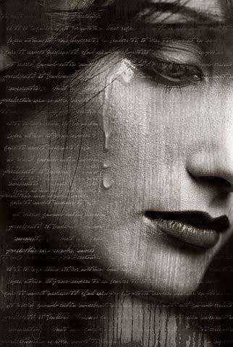
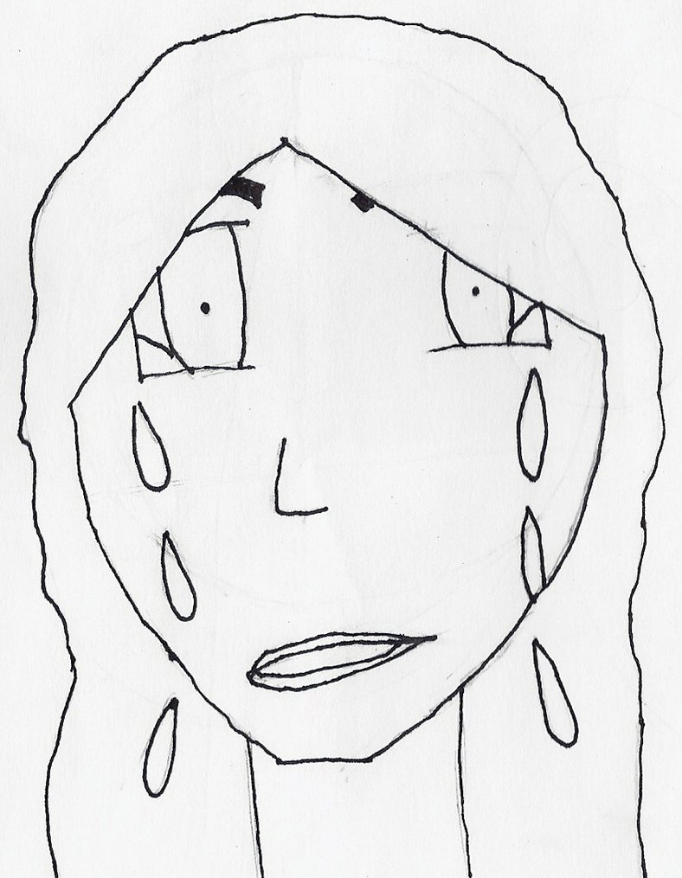
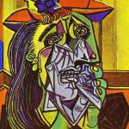
Models intentionally distort reality
No one needs a geographical map in the scale 1:1

Slide 10
Syllabus (Wish list)
Introduction. Principles of modeling. Great Model of the Universe. From observations and assumptions to equations.
How to split the class in several working groups
Growth and interaction of species. Population dynamics. Epidemic spread. Model of population dynamics. Model of epidemic disease and vaccination. PDE Model of population dynamics.
Wave models. Traffic: shock waves, stabilization factors. Simulation of a traffic jam. Domino, slinky, and similar “discrete waves”
Modeling of conflicts: Games- Best strategy, minimax. Cooperative game - How to share fairly. Evolutionary games - Models of social behavior.
Models with graphs
Models with shapes.
Lattice models of complicated structures. Metamaterials

Slide 11
Principles of modeling in the syllabus
Simplification. To what extend?
Combination of discrete and continuum descriptions. Examples of continuum models: Population dynamics, Traffic waves. Examples of discrete description: Domino train, breakable chains, division of the class.
Waves and repeated sequences of events. -Wave of damage, traffic waves, evolution dynamics.
Stability and catastrophes -- Domino, multiple equilibria system, breakable chains.
Multiscale approach, models for different scales: Evolution dynamics, decease spread.
Descriptive modeling vs Design and Optimization.
Formalization of ``humanitarian'' concepts.

Slide 12
Organization of the class work
For the project work the class will be divided into groups of tree
A presenter will orally present the group’s work, the report will be written. The group get a grade for the project.
The groups will be formed for each project, the roles will be reassigned so that each student will be researcher and presenter.
Problem: (one week)
Write an algorithm for dividing the class into groups of three for each project. During the semester, each student should work with all class mates.
Next time, bring in your ideas.

Slide 13
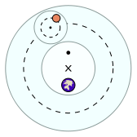
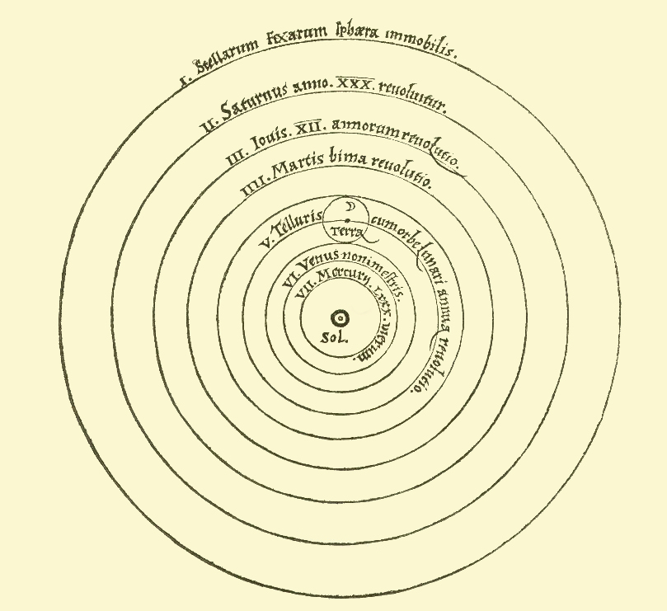
Models of the Universe
Turtles all the way down.
Ptolemy: Earth in the center, planets move with constant speed, circular orbits, and epicycles: http://www.pbs.org/wgbh/nova/ancient/ancient-computer.html
Copernicus 1473-1543: Sun in the center, planets move with constant speed, circular orbits, and epicycles.
http://en.wikipedia.org/wiki/Turtles_all_the_way_down
http://en.wikipedia.org/wiki/Geocentric_model
http://en.wikipedia.org/wiki/Copernican_heliocentrism

Slide 14
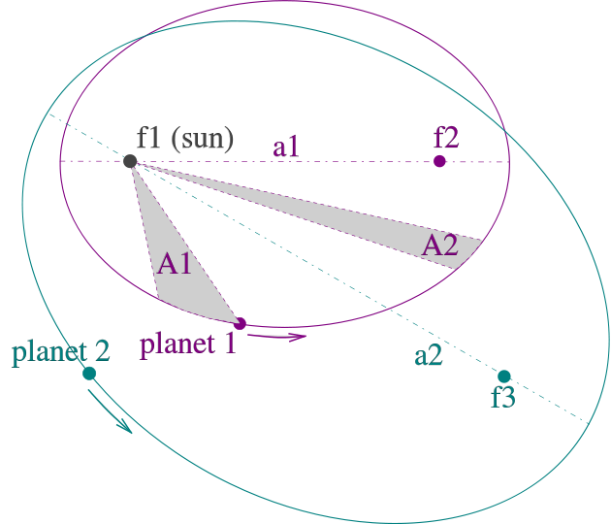
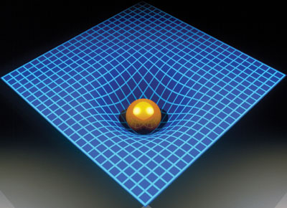
Kepler’s model, Newton’ law
Johannes Kepler published his
first two laws in 1609, the third –in 1619
The orbits are ellipses, with focal points ƒ1 and ƒ2 for the first planet and ƒ1 and ƒ3 for the second planet. The Sun is placed in focal point ƒ1.
(2) The two shaded sectors A1 and A2 have the same surface area and the time for planet 1 to cover segment A1 is equal to the time to cover segment A2.
(3) The total orbit times for planet 1 and planet 2 have a ratio a1^3/2 : a2^3/2.
Newton gravity law explained all three Kepler’s laws
but left open the question of how the gravity force acts.
Einstein’s general relativity explains the nature of the gravity force

Slide 15
History of modeling of the Universe (HW 1)
Write a short essay (< 3 pages) about models of Universe:
Turtles all the way down
Ptolemy (Klaúdios Ptolemaîos),
Nicolaus Copernicus
Tycho Brahe and Johannes Kepler,
Isaac Newton (gravity law)
Albert Einstein (general relativity)
Big Bang theory
Characterize the models as
empirical,
data fitting,
equation solving,
general-principle-based
and comment on motivation for the improvement/development. thought and physical experiments. What question were asked?
Use Internet, Wiki, or any other available sources
http://astro.unl.edu/naap/ssm/animations/ptolemaic.swf

