Slide 1
MATH 5740/MATH 6870 001 MATH MODELING 2012 09:40 AM-10:30 AM JWB 208
Introduction

Slide 2
Models and reality
Theory attracts practice as the magnet attracts iron. Gauss
We live in the world of models:
Great models: Universe, Physics, Evolution, Social organization – determine our life forcing our judgment, decisions, and feelings
Paradigms arrive in the form of new models: atoms, Neo-Darwinism, fractals, democracy.
Models as reference points

Slide 3
Galilei, Galileo (1564 - 1642): [The universe] cannot be read until we have learnt the language and become familiar with the characters in which it is written. It is written in mathematical language, and the letters are triangles, circles and other geometrical figures, without which means it is humanly impossible to comprehend a single word. Opere Il Saggiatore p. 171. Thought_experiment http://en.wikipedia.org/wiki/Thought_experiment

Slide 4
Definition from Wiki
A mathematical model uses mathematical language to describe a system.
Mathematical models are used in the natural sciences and engineering disciplines (such as physics, biology, earth science, meteorology, and engineering) and in the social sciences (such as economics, psychology, sociology and political science)..
The process of developing a mathematical model is termed 'mathematical modelling' (also modeling).

Slide 5
Syllabus (Wish list)
Introduction. Principles of modeling. Great Model of the Universe. {\bf Paper}. From observations and assumptions to equations. {\bf Project }. How to split the class in several working groups
Growth and interaction of species. Population dynamics. Epidemic spread. {\bf Project a}. Model of population dynamics after Marsian invasion. {\bf Project b}. Model of epidemic disease and vaccination. {\bf Project c}. PDE Model of population dynamics.
Mechanics. {\bf Project}: A bouncing box. Vibrations.
Wave model. Traffic: shock waves, stabilization factors. {\bf Paper}. Simulation of a traffic jam.
Modeling of conflicts: Games {\bf Project a}. Best strategy, minimax {\bf Project b}. How to fairly share a bounty. {\bf Project c}. Models of social behavior. Evolutionary games.
Optimization: Linear programming {\bf Project a}. Optimal diet {\bf Project b}. Transport problem
Lattice models of complicated structures. Metamaterials {\bf Project}. To be announced.

Slide 6
Organization of the class work
For the project work the class will be divided into groups of tree
A presenter will orally present the group’s work, the report will be written. The group get a grade for the project.
The groups will be formed for each project, the roles will be reassigned so that each student will be researcher and presenter.
Problem 2. (one week)
Write an algorithm for dividing the class into groups of three for each project. Next time, bring in your ideas.

Slide 7
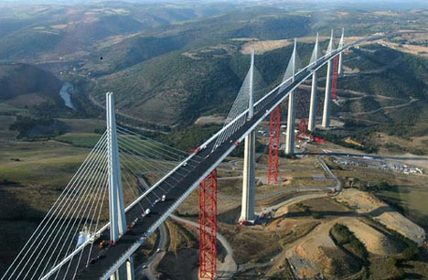
Model is an intentionally distorted system description that emphasizes desirable features
Everything should be made as simple as possible, but not simpler. A. Einstein
Model is not unique
Bridge: for traffic model – a piece of road
For flight navigation model – an obstacle
For vibration model – an unbreakable elastic structure
For strength model – an elastic-plastic structure
For bungle jumping -- a base.
For an artist – a shape.
The Millau Viaduct

Slide 8
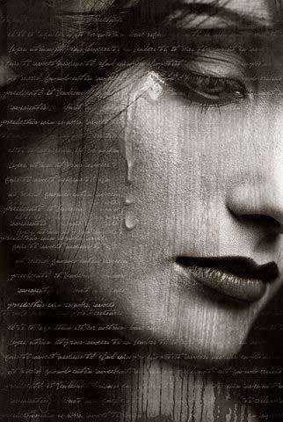
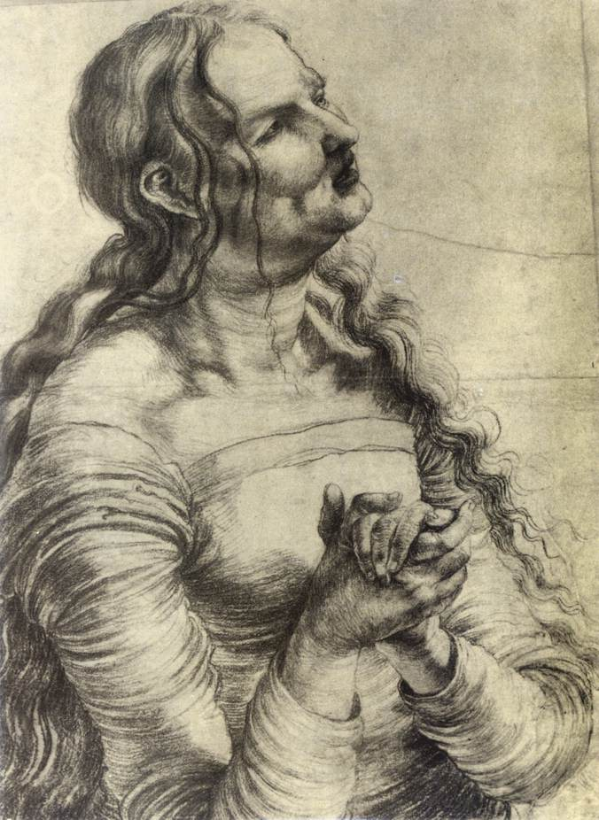
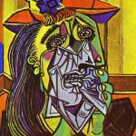
Three visual models of the same emotion

Slide 9
Types of math models
Goals: descriptive or design/optimization (natural or engineering model).
Range of applicability (Ideal gas, Black matter, optimization)
Validation: Mental experiment vs. real experiment. Galileo.
Results: Numerical or analytic. Simulation models.
Predictability: Curve fitting vs. equation solving.
(based on a priori principles or empirical). The “good” model should to a degree predict system behavior in a new environment.
Mathematical tools
Geometry, Equation solving, ODE, PDE, numerics, game theory, probability, statistics, optimization and control theory,
Creativity
Mathematics is made of 50% formulas, 50% proofs, and 50% imagination.

Slide 10
Modeling of the Universe (Problem 1)
Write a short essay (< 2 pages) about models of Universe:
Turtles all the way down
Ptolemy (Klaúdios Ptolemaîos),
Nicolaus Copernicus
Tycho Brahe and Johannes Kepler,
Isaac Newton (gravity law)
Albert Einstein.(general relativity)
Characterize the models as empirical, or data fitting, or equation solving, or a general-principle-based, and comment on complexity of the models and motivation for the improvement/development. thought and physical experiments.
Use Internet, Wiki, or any other available sources
http://astro.unl.edu/naap/ssm/animations/ptolemaic.swf

Slide 11
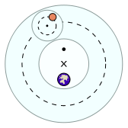
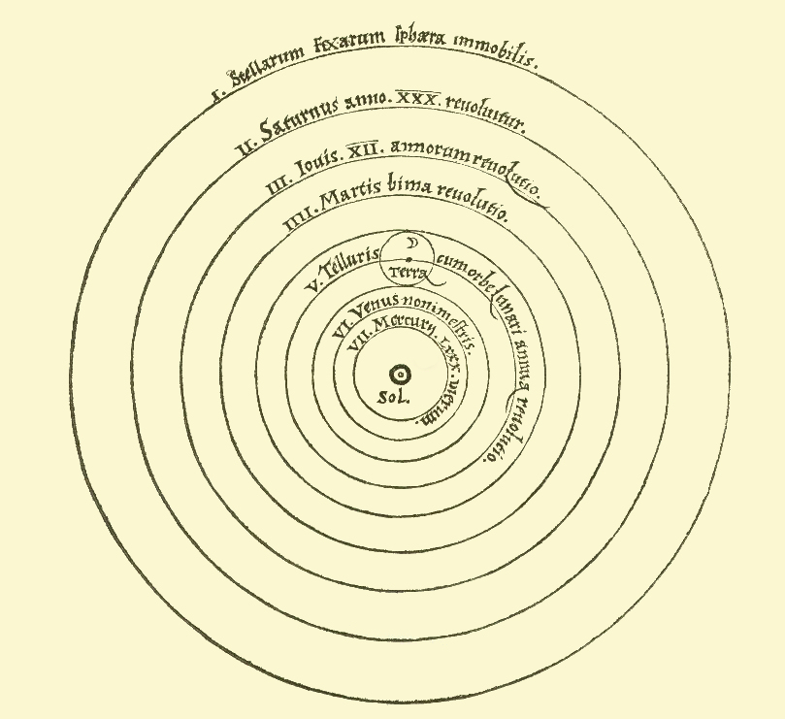
Early models
Ptolemy:
Earth in the center, planets move with constant speed, circular orbits, and epicycles
Copernicus
Sun in the center, planets move with constant speed, circular orbits, and epicycles
http://en.wikipedia.org/wiki/Geocentric_model
http://en.wikipedia.org/wiki/Copernican_heliocentrism

Slide 12
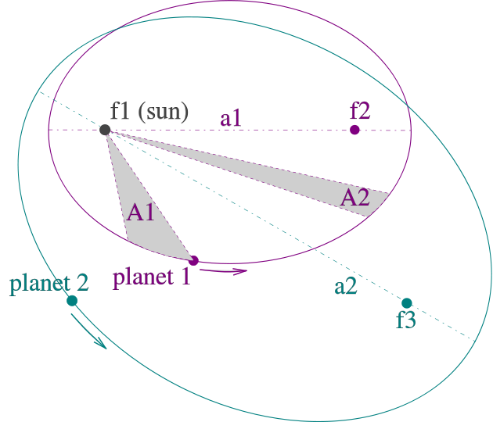
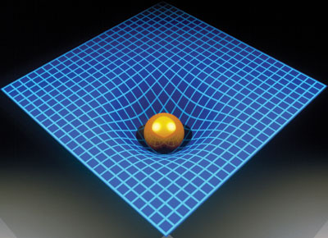
Kepler’s model, Newton’ law
Johannes Kepler published his
first two laws in 1609, the third –in 1619
The orbits are ellipses, with focal points ƒ1 and ƒ2 for the first planet and ƒ1 and ƒ3 for the second planet. The Sun is placed in focal point ƒ1.
(2) The two shaded sectors A1 and A2 have the same surface area and the time for planet 1 to cover segment A1 is equal to the time to cover segment A2.
(3) The total orbit times for planet 1 and planet 2 have a ratio a13/2 : a23/2.
Newton gravity law explains all three Kepler’s laws
Einstein’s general relativity expains the nature of the gravity force

