Slide 1
Topics in History of Mathematics Fall 2023 3. Mathematics today. Challenges
Andrej Cherkaev
Professor
Department of mathematics
University of Utah

Slide 2
Math and society
Complexity of Mathematics reflects our ability to handle logic, quantities, shapes, processes, arrangements, etc.
Mathematics studies:
Space, Change, Structure,
Numbers, Modeling,
Simulation, Optimization,
Logic, Structures,
Probability, Statistics,
Computing
Today, mathematics is all around us in computing, engineering, architecture, medicine, transportation, art, money, elections, and even sports.
There is no clear boundary between math and various applications.

Slide 3
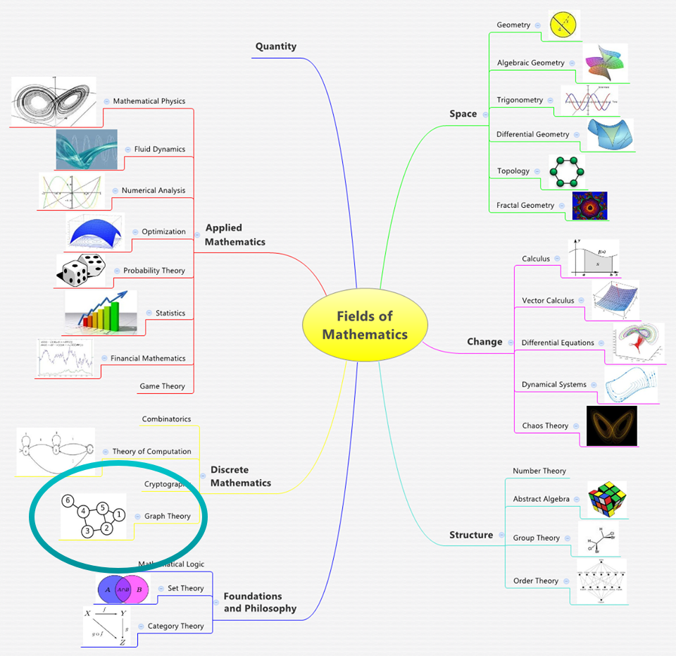
Mathematics today
The diversity of areas of contemporary mathematics is shown in the glossary
https://en.wikipedia.org/wiki/Glossary_of_areas_of_mathematics
Take a look.
Branches:
Chaos and homogenization.
Morphing and dynamics.
Numerical analysis.
Modeling of Natural phenomena,
Optimization, Game theory.
Probability & Statistics.
Financial Math,
Combinatorics,
Groups, Graphs
Geometry and topology,
Set theory, Category Theory etc.
See the enlarged graph on the next slide

Slide 5
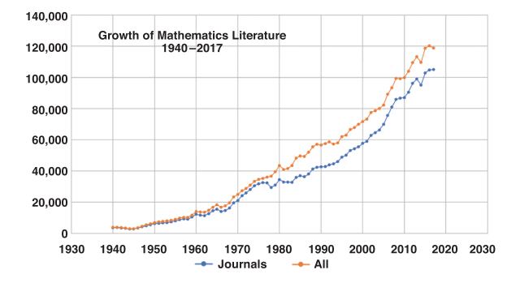
Size of math research
More than 120 000 research papers are published annually. This number grows 5—10% a year
The number of annual publications:
From “Looking
at the Mathematics Literature”
By Edward Dunne

Slide 6
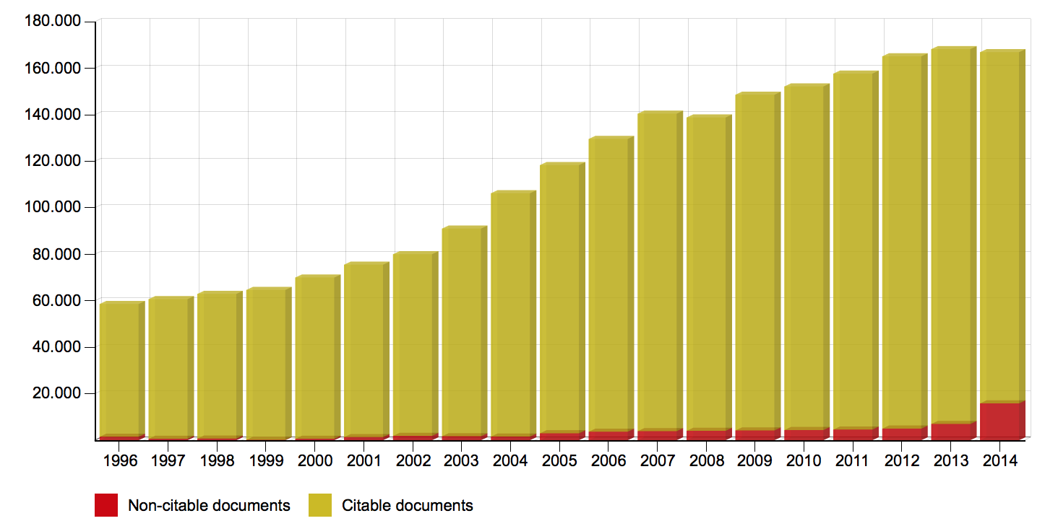
According to SCImago:
The graph gives the total number of math papers per year, according to SCImago:
The mismatch reflects uncertainty in definition of what is a “math paper”.

Slide 7
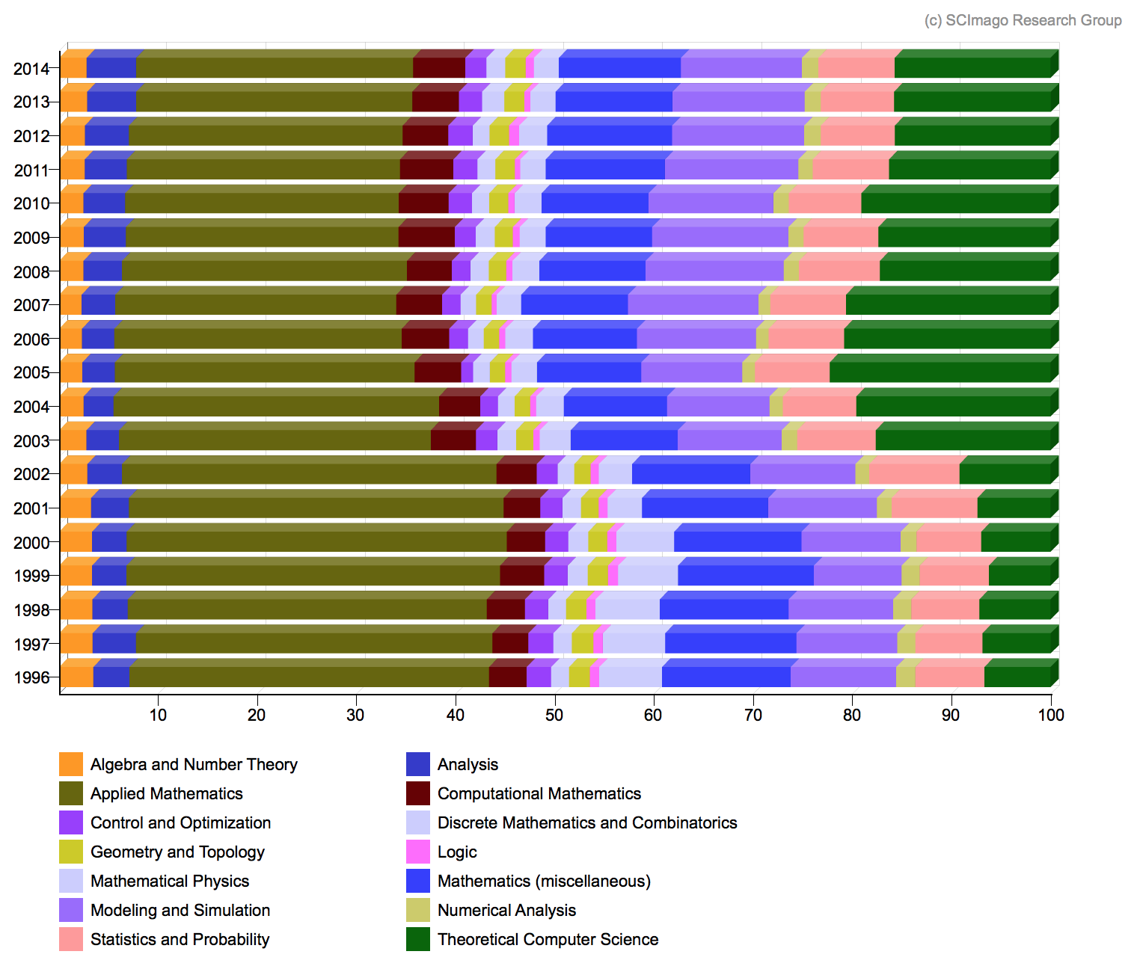
According to SCImago:
The graph breaks the papers down per subject area.
Note: “Applied math” is too general classification subject. It could be divided into dozen subjects.
The reference: https://mathoverflow.net/questions/233984/how-many-papers-are-posted-a-year

Slide 8
New direction: Theoretical computer science (TCS)
Wikipedia:
TCS covers a wide variety of topics including algorithms, data structures, computational complexity, parallel and distributed computation, probabilistic computation, quantum computation, automata theory, information theory, cryptography, program semantics and verification, algorithmic game theory, machine learning, computational biology, computational economics, computational geometry, and computational number theory and algebra. Work in this field is often distinguished by its emphasis on mathematical technique and rigor.

Slide 9
Topics for discussion

Slide 10
New challenges: computers and AI
Computers and AI bring novel challenges that change the very definition of mathematics.
•Computers help prove theorems that remain unsolved for centuries despite efforts of the best minds, e.g., Kepler's problem of dense packing of spheres. But these proofs can be verified only by other computers.
•Some models (like weather prediction or climate change) are so large that no single person knows all their details. Machine Learning uses nonconventional logical tools.
•Big Data problems, e.g., DNA sequence description, require new math tools/structures to deal with.

Slide 11
Challenges in Math Education
The K-12 curriculum teaches geometry ( 2nd century BC), algebra (16th – 17th centuries), functions, and the basics of calculus (17th – 18th centuries).
The undergraduate engineering math teaches calculus, ODE, PDE, Fourier series (18th – 19th century), linear algebra, and statistics (19th – the first half of the 20th century).
How can math educators inform the public about discoveries in modern math fields?

Slide 12
Foundations
Was math discovered or invented?
Foundation of math is intrinsically incomplete. What is a perfect proof?

Slide 13
Approaching Singularity Point
More than 150 000 research papers in math are published annually.
How can mathematicians communicate their funding?
Is it technically possible and worthwhile to preserve the results?
What research should be saved for the future? How can this be done?
In your opinion, what branches of mathematics will be trendy in 20 years?

