Slide 1
Variational principles and Optimality in nature
Andrej Cherkaev
Department of Mathematics University of Utah
cherk@math.utah.edu
USAG November 2013.

Slide 2
Components of applied math
Differential equations
Math Modeling
Numerical Methods
Applied math
Statistics
approx
Optimization
Physics, or biologogy, or chemisty, or ..

Slide 3
Why study applied math?
Applied Math is one of the most prestigious and favored profession. Everyone needs us.
The applied math problems are inspired by a nature phenomenon or a social need. The phenomena is modeled and rigorously investigated. This work combines social value, elegance and beauty.
Study of applied problems lead to development of calculus, linear algebra, geometry, probability, etc.
And, yes, we can also teach. In academia, we work on our own problems and collaborate with our colleagues in departments of science, engineering, mining, finances, and medicine.

Slide 4
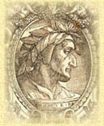
Optimality
The desire for optimality (perfection) is inherent for human race. The search for extremes inspires mountaineers, scientists, mathematicians, and the rest of the human race.
Dante All that is superfluous displeases God and Nature All that displeases God and Nature is evil.
In engineering, optimal projects are considered beautiful and rational, and the far-from-optimal ones are called ugly and meaningless. Obviously, every engineer tries to create the best project and he/she relies on optimization methods to achieve the goal.
Two types of optimization problems:
1. Find an optimal solution (engineering)
2. Understand optimality of a natural phenomenon (science)

Slide 5
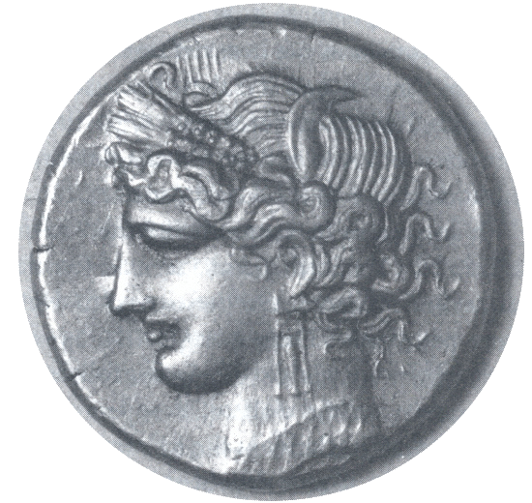
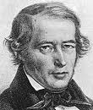
Beginning: Geometry Isoperimetric Problem (Dido Problem)
Probably the first variational problem (isoperimetric problem) has been solved by wise Dido, founder and queen of Carthage the mighty rival of Rome:
What is the area of land of maximum area that can be encircled by a rope of given length?
Four hinges proof by Jacob Steiner
1. The domain is convex
2. In the perimeter is cut in half, the area is cut too.
3. The hinge argument

Slide 6
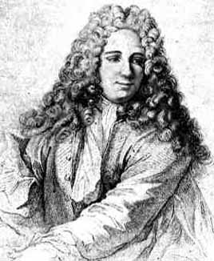
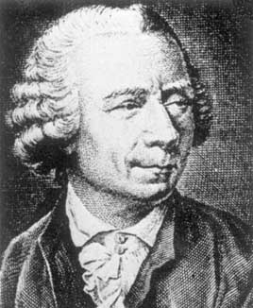
Search for optimality in Nature
The general principle by Pierre Louis Maupertuis (1698-1759) proclaims: If there occur some changes in nature, the amount of action necessary for this change must be as small as possible. This principle proclaims that the nature always finds the "best" way to reach a goal.”
Leonhard Euler: "Since the fabric of the Universe is most perfect and is the work of a most wise Creator, nothing whatsoever takes place in the Universe in which some relation of maximum and minimum does not appear."

Slide 7
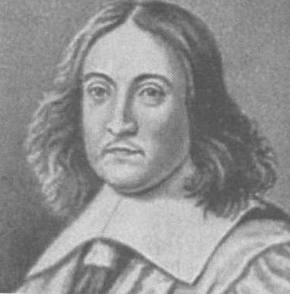
Ferma’s principle
(0,1)
Fermat’s principle of least time
(which he used to derive Snell's law in 1657)
was the first variational principle in physics
(x,0)
(a, -1)

Slide 8
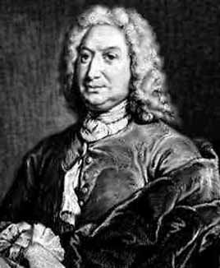
Brachistochrone
Johann Bernulli challenge: (June 1696): Find the shape of the curve down which a bead sliding from rest and accelerated by gravity will slip (without friction) from one point to another in the least time.
… it is known with certainty that there is scarcely anything which more greatly excites noble and ingenious spirits to labors which lead to the increase of knowledge than to propose difficult and at the same time useful problems through the solution of which, as by no other means, they may attain to fame and build for themselves eternal monuments among posterity.
Five solutions were obtained by: Johann Bernulli himself, Leibniz, L'Hospital, Newton, and Jacob Bernoulli.

Slide 9
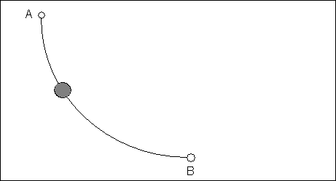
Brachistochrone
Brachistochrone is the same Fermat problem, but the speed is defined from the conservation of energy law:
Solution: an inverted cycloid

Slide 10
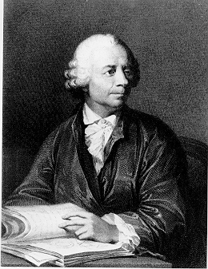
Euler equation (functional derivative)
S(u,u’,u’’) is the functional derivative, an analog of gradient for
the functional argument.
Using this equation, one can derive solution to Brachistochrone problem,
find minimal surface of revolution, solve Dido problem. etc.

Slide 11
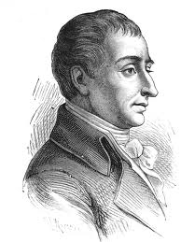
Lagrangian
Lagrange applied Euler equation to reformulate Newton law of motion:
Lagrange, Mécanique analytique
"The admirers of the Analysis will be pleased to learn that Mechanics became one of its new branches”
The reader will find no figures in this work. The methods which I set forth do not require either constructions or geometrical or mechanical reasoning: but only algebraic operations, subject to a regular and uniform rule of procedure.
Why minus?

Slide 12
Lagrangian
Examples:
Oscillator Celestial mechanics
Is Newton law of motion equivalent to minimization of action K-V ?
If so, then our world is indeed "the best of all possible worlds" according to Gottfried Leibniz (1710)

Slide 13
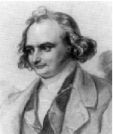
Oops! Jacobi variation.
The Euler equation is the stationarity condition. Does it correspond to a local minimum?
Look at second variation. Assume that S(u)=0, then
Example
For long trajectories, the second
variation changes its sign!
(Newton law is an instant relation_.

Slide 14
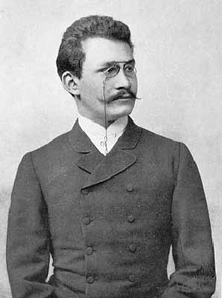
Saving the natural minimal principle through unnatural geometry
In Minkowski geometry, the time axis is imaginary, the distance is computed as
If we replace t = i τ, kinetic energy changes its sign, T-> -T and action becomes the negative of sum of kinetic and potential energies.
L is still real because the of double differentiation.
The stationary equations are the same, but the energy in Minkovsky geometry reaches maximum.

Slide 15
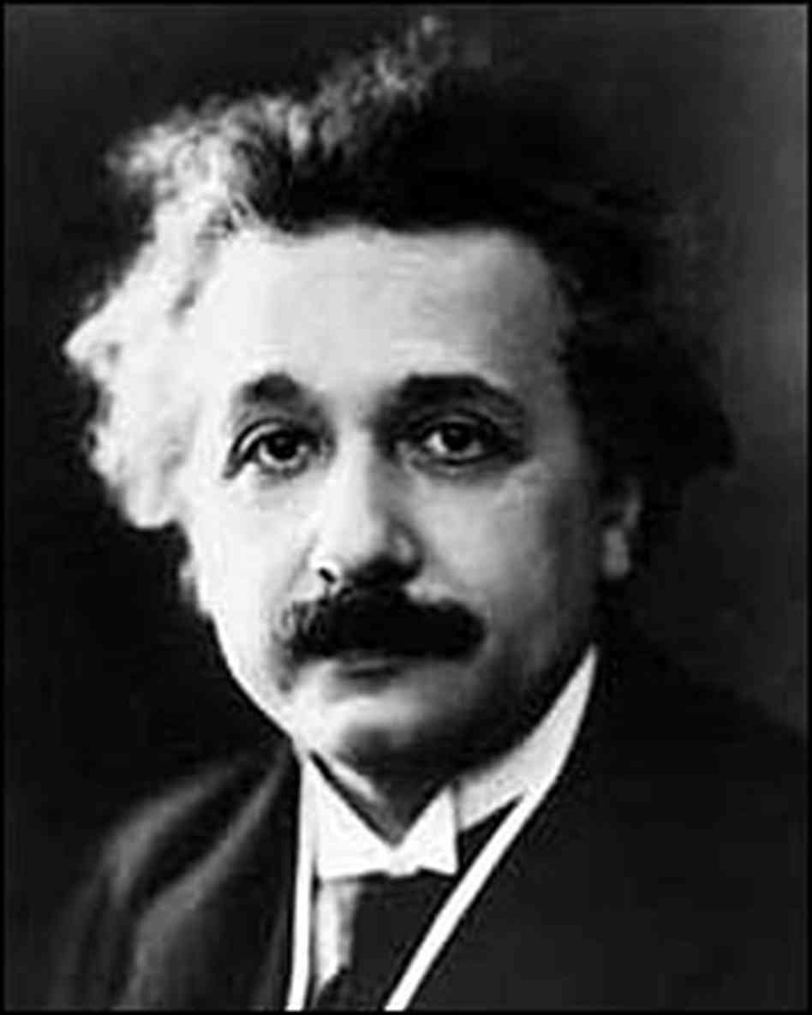
STR solves the mystery
In Special Relativity (1905), a particle moves so that its integral of its whole energy is maximized
In the coordinate system of an observer, the time is different, than the time of a moving particle
Now, substitute this into (*) and find:
So, the term -K (including the minus sign!) appears because of the difference in time of a particle and of an observer!
Albert Einstein

Slide 16
Other (contemporary) variational principles in continua
A stable equilibrium is always a local minimum of the energy
Systems with many equilibria lead to a chaotic motion or jerky transitions between them (proteins, crash of a construction).
The principle of maximal energy release rate in cracking
The principle of maximal energy dissipation
Minimum entropy principle in chemical reactions
Biological principles:
The mathematical method: evolutionary games that model animal or human behavior models, establishing their evolutionary usefulness

Slide 17
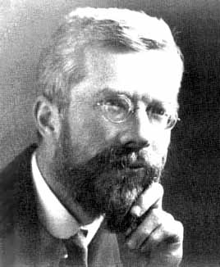
Optimality of evolution
R. A. Fisher's Fundamental theorem of natural selection,
in Genetical theory of natural selection (1930)
The rate of increase in fitness of any organism at any time is equal to its genetic variance in fitness at that time. A living being maximizes Inclusive fitness – the probability to send its genes to the next generation
Fisher’s example:
Between two groups (male and female) of different sizes s1 and s2, s1 < s2, the probabilities p1 and p2 to find a mate from the opposite group are, respectively:
The smaller group s1 is in a better position, therefore, its size increases, and is grows faster. The equilibrium is reached when s1=s2.
Why the election results are always close?

Slide 18
Doves and hawks ”The logic of animal conflict” by Maynard, Smith and Price 1973
Suppose there are C per cent of doves and (100-c) per cent of hawks
When a dove meets a dove, they split bounty V equally, each gets V/2
When a dove meets a hawk, the hawk takes all: a dove gets 0, a hawk gets V.
When a hawk meets a hawk, they fight and each hawk looses P.
The average gain of a dove is VC/2.
The average gain of a hawk is VC -P(1- C).
Equilibrium

Slide 19
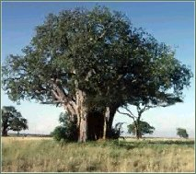
All things are crated optimal The question is: in what sense?
The symmetry of trees correspond to the equally high strength against the “worst direction” of the wind.
The symmetry solves the problem: maximize the strength in the weakest direction.

Slide 20
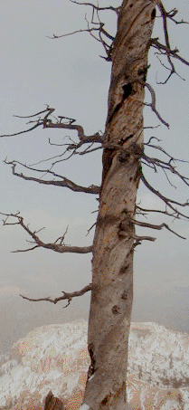
Mistery of spriral trees math.utah.edu/~cherk/spiral-trees/story.html
Why do they spiral?
Postulate: If a natural design becomes more complex, there is a reason behind.
Problem: find the goal functional that reaches its minimum at realistic angles (about 45º of spiraling).
The answer is not unique. Spiraling allow to keep the symmetry when roots at one side die. It is a compromise between the length of the path along the thread from a root to a brunch, and flexibility due to spiraling.
S. Leelavanishkul and A. Ch. 2004, 2009

Slide 21
Novel branches of variational calculus Problems without solutions
infinitely oscillating minimizing sequence (Laurence Young, 1905-2000)
u(x)
u’(x)

Slide 22
Multidimensional problem: Optimal composite
Problem: Find materials’ layout that minimizes the energy of the system (the work of applied forces) plus the total cost of materials.
Feature: Infinite fast alternations, the faster the better. This time, the solution also depends on geometrical shape of mixing the subdomains of pure materials, because of boundary conditions: normal stress and tangent deformation stay continuous at the boundary between several materials:
Maximal stiffness
Minimal stiffness

Slide 23
Two-material optimal structures adapt to an anisotropy of a loading
Unidirectional
stress
Hydrostatic
stresss
Pure shear
Color code:
orange – strong material
blue -- weak material,
white -- void.

Slide 24
Three-material optimal structures are adapted to an anisotropy and volume fraction m1
Unidirectional
stress
Hydrostatic
stresss
Pure shear
Ch & Zhang, 2011, Ch & Dzierżanowski, 2013

Slide 25
Optimal geometries are not unique. Isotropic wheel assemblages
Hashin-Shtrikman type
assembly
Elements, in dependence on volume fraction of the best (white field) material.
strong – white, intermediate – gray, void – black.
A.Cherkaev, 2011

Slide 26
Lower cost g2: structures
Notice that the optimal structures
for more intensive fields correspond
to P1-P2 composites.
After the first transition, P1 always enters the 1-2-3 structures (gray areas) via 1-3 laminate.

Slide 27
Special case of the materials’ cost
The graph shows the optimal structures in dependence of eigenvalues of the external stress field.
Large stresses correspond to the optimality of pure stiff material. Gray fields show three–material structures.

Slide 28
Example of three-material design (Computations by Nathan Briggs) Bridge #1
Black-and white design
volume fraction
Volume fraction of P2
Volume fraction of P1
Distribution of composites

Slide 29
Bridge #2, smaller total weight

Slide 30
Cantilever, loaded at the middle

Slide 31
Cantilever, loaded at the the edge

Slide 32
Thank you!

Slide 33
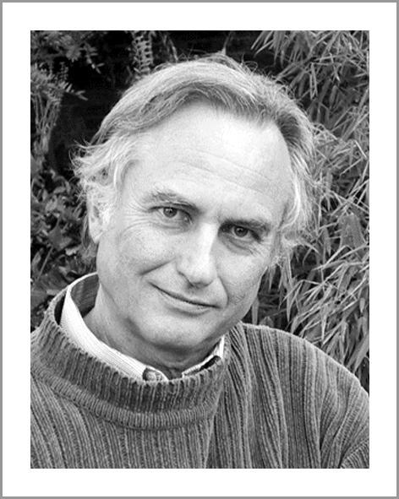
After physics, optimality of evolution
Instead of action, a living being maximizes Inclusive fitness – the probability to send its genes to the next generation.
Selfish Gene by Richard Dawkins 1976.
The mathematical method: evolutionary games.
Example:
Between two groups (male and female) of different sizes s1 and s2, s1 < s2, the probabilities p1 and p2 to find a mate from the opposite group are:
The smaller group is in a better position and its size increases, so is grows faster. The equilibrium is reached when s1=s2.
Why the election results are always close?

Slide 34
Plan
Introduction: Extremal principles: Description through minimization. Dido problem.
History
Fermat principle.
Calculus of variations. Euler equation, Brachistochrone
Lagrange approch
Jacobi Columbus principle.
Special relativity. Minkowski geometry.
Today:
Rationality of the evolution.
Male and Female newborns. Evolutionary games
Optimality of the spiral tree
Problems without solution.
Minimal surface
much ado about nothing.

