Slide 1
Topics in History of Mathematics Fall 2023 1-2.
The course. Contents
Andrej Cherkaev
Professor
Department of mathematics
University of Utah

Slide 2
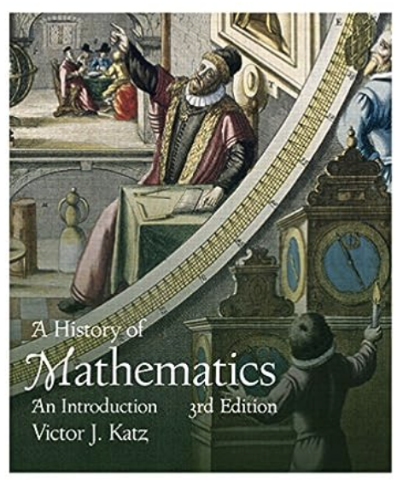
Introduction
Text book.

Slide 3
Mathematics and society
Mathematics has been a hallmark of every society since the beginning of recorded history. Its complexity reflects a civilization's ability to handle logic, quantities, shapes, processes, arrangements, etc.
Mathematics (arithmetic and geometry) first appears in the neolithic society in the first cities-states. It was necessary for
Organization of society and planning for collective work, army supply, salaries, taxes, etc.
Trade within the states and between them.
Megalithic constructions of temples, pyramids, ziggurats, palaces defending walls, irrigation channels, etc.
Astronomy and astrology

Slide 4
History of math vs. history of natural sciences
The history of mathematics is different from the history of other natural sciences. Natural sciences develop within paradigms that alternate with time. For example,
•DNA discovery (James Watson and Francis Crick, 1953) rebuilt the foundation of biology and medicine.
•The discovery of atomic structure (Niels Bohr, 1905) resulted in a rethinking of chemistry basics.
•The discovery of plate tectonics (the 1950s) changed the foundation of geophysics.
•Today's picture of the Universe is much different from what we imagined 50 years ago, and so on.
Studying earlier stages of natural sciences development is mainly a history subject. Al-chemistry and astrology are curious, but their theories have little to do with modern chemistry and astronomy.

Slide 5
History of math vs. history of natural sciences
In contrast, mathematics only adds to its treasure of knowledge; it develops and generalizes the previous findings accepting them. In that sense, math discoveries are timeless. Math is similar to art and technology. We admire ancient Greek sculptures as we admire Greek geometry. Moreover, we teach this geometry in middle school. Likewise, we use the antique wheel and level today and will do so in the future.

Slide 6
What can we learn about math history in one semester?
Mathematics collected an enormous body of concepts and theories in the four millennia of development. The challenge of this course is to overlook their origins.
It is impossible to discuss thousands of beautiful and important discoveries. We need to prioritize topics
The criterion I choose is the direct impact of historical math development on contemporary math concepts.
Please look at the timetable of math history: https://mathigon.org/timeline/

Slide 7
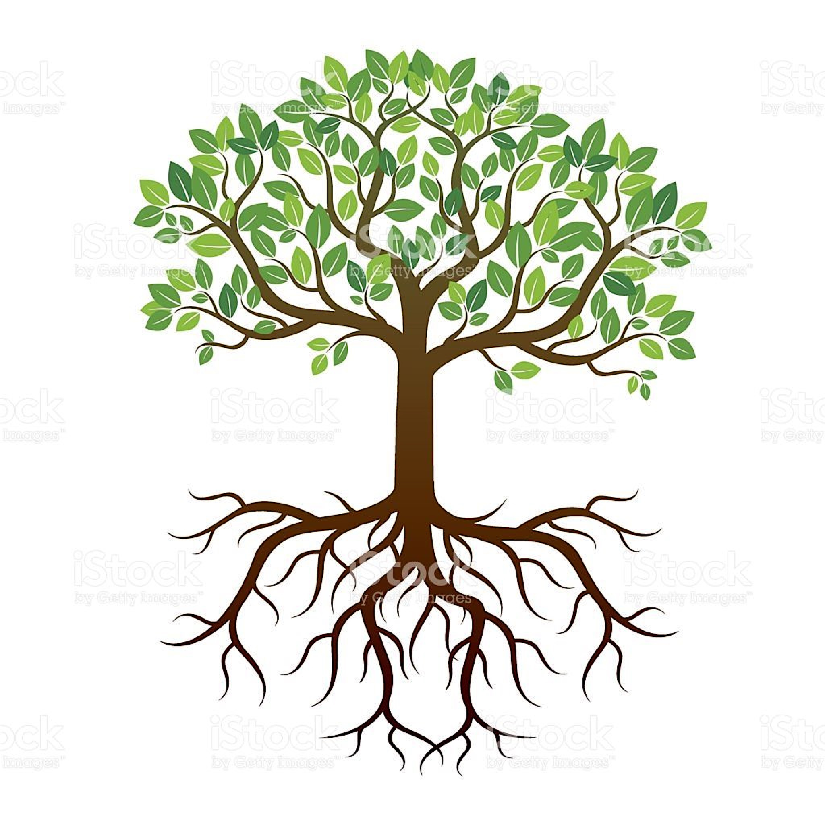
Scheme of the course
Part 4- Leaves .
Glance into contemporary mathematics
Part 3- Branches .
Mathematics of 19th century
Part 2 – Trunk.
Foundations of modern math (17th-18th centuries)
Part 1 – Roots.
Ancient and Medieval Math (before 17th century)

Slide 8
What will be achieved?
Understanding of the logic and motivation of mathematicians of the past.
Observing the tendencies of math development.
Learning about benchmark problems. Exercise.
Learning about prominent mathematicians.
Glance into modern math challenges.
Each student will
  do the homework,
  discuss the topics in the class.
  write three essays
  review essays of the classmates.

Slide 9
Overview of the syllabus

Slide 10
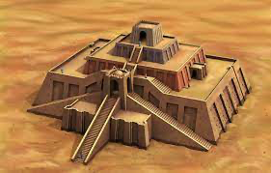
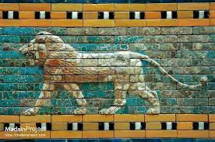
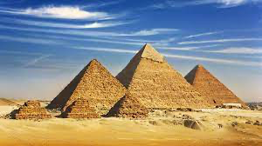
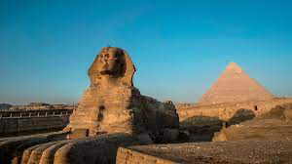
Bronze Age
Number systems in Babylon and Egypt. Latin and Indo-Arabic numbers.
Babylonian algebra: Multiplication-division. Square roots (iterations), Quadratic equations and Pythagoras triples. Astronomy and calendar.
Egypt: Multiplication-division. Egyptian fractions, approximation of Pi, volumes of pyramids and other bodies, trigonometry.

Slide 11
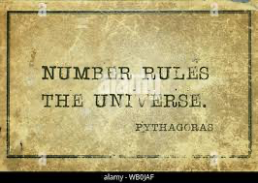
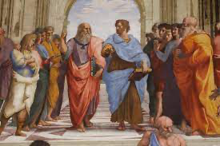
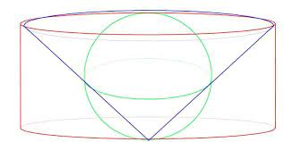
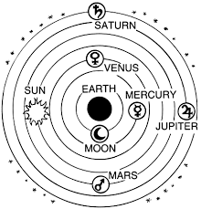
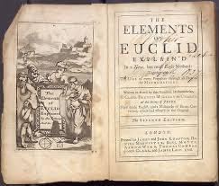
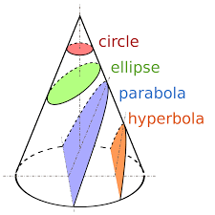
Greece and Hellenism
Pythagoras and number theory. Cosmos and magic numbers,
irrational numbers.
Aristotle – logic.
Archimedes: Beginning of calculus.
Volumes of cones and spheres. Calculation of Pi.
Euclid - axioms, theorems, proofs. Geometry and number theory.
Ptolemy. The model of the solar system.
Conic sections.

Slide 12
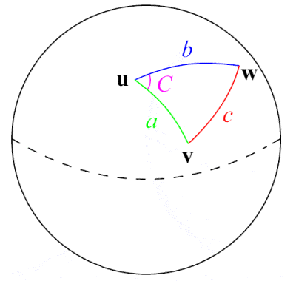
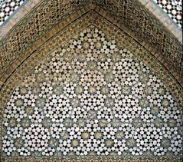
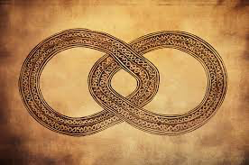
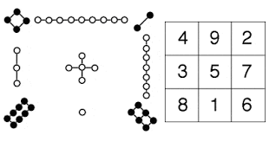
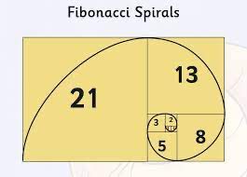
Medieval Math (before 16th century)
  Muslim world (Persian and Arabs)
    Preservation and expansion of the geometry; al-gebra, plane and spherical trigonometry, cubic equations; symmetries (mosaics).
  India
    Decimal system, infinity and zero, series.
  China
    Symmetries, equation solving, negative numbers, linear algebra.
  Europe:
    Fibonacci, Indo-Arabic numerals, infinity, printing press.

Slide 13
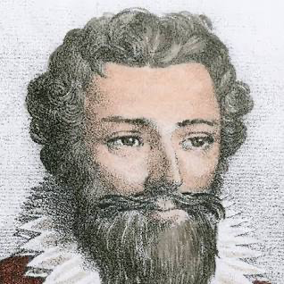
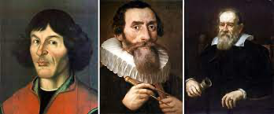
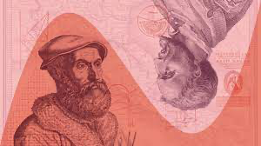
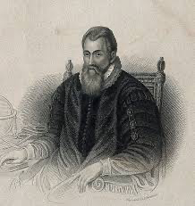
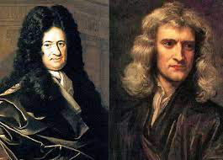
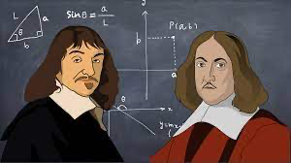
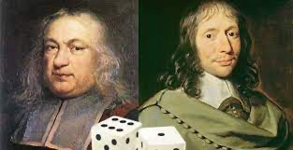
Part 2 – Foundations of modern math. Scientific revolution (16th-17th centuries)
Late 16th century: Copernicus, Kepler, Galileo – models of the solar system; Tartaglia, Cardano – cubics and imaginary numbers.
The 17th century: Napier –logarithms; Fermat, Pascal – probability; Descartes, Fermat – coordinates graphs of functions; Newton, Leibnitz - Calculus, differential equations.

Slide 14
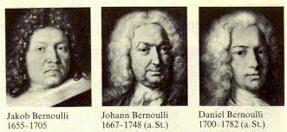
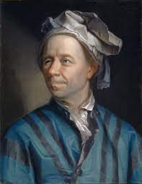
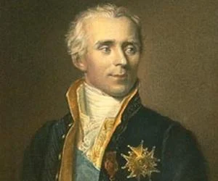
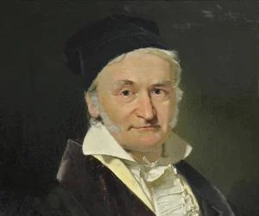
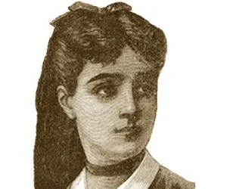

Part 2 – Foundations of modern math. Scientific revolution (18th centuries)
The 18th century Bernoulli family – Calc. of variations, hydrodynamics, etc. Euler –series, topology, modern notations, etc, Lagrange– mechanics, Gauss- algebra, Laplace – gravity, First ODEs and PDEs, Germain – math modeling.
The central part of the contemporary
undergraduate curriculum is based on 18th-century discoveries.

Slide 15
Part 3 - 19th century: Industrial revolution
  Mathematics became a profession. Math became a part of engineering education.
  Geometry: Curved spaces, non-Euclidean geometry - Lobachevsky, Bolyai, Gauss, Riemann.
  Analysis: Rigorous proofs - Cauchy, Gauss, Weierstrass, Complex analysis - Riemann, Fourier - series
  Algebra: Fundamental Theorem of Algebra – Gauss. Solvability of polynomial equations Galois, Abel–Ruffini. Vectors and matrices - Cayley et al. Abstract Algebra – Lee.
  Math logic – Boole, Heaviside.
  Math modeling and Differential equations: description of nature and engineering - Cauchy, Maxwell. Laplace – gravitational field.
  Set theory and challenge to foundations – Cantor.
  Next century vision - Hilbert

Slide 16
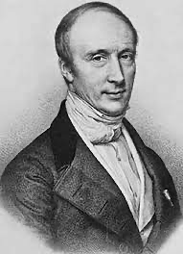
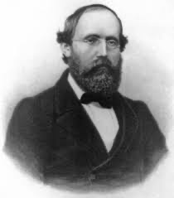
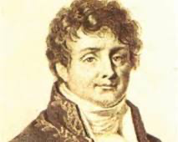
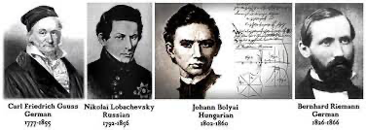
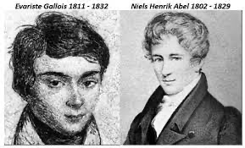
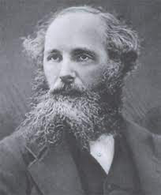
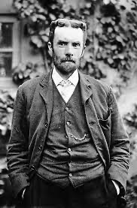
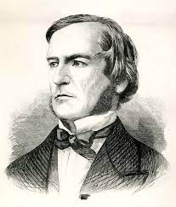

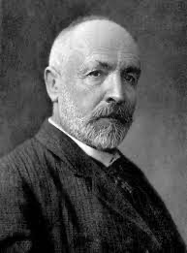
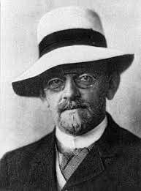
Who are they?

Slide 17
Part 4 - Glance into contemporary mathematics.
  Foundations: Set theory. Continuum hypothesis, Gödel theorem.
  Analysis: Generalized functions, distributions.
  Geometry: fractals, aperiodic tiling, graphs.
  Abstract algebra.
  Chaos, Aggregation, and homogenization.
  Statistics and probability theory.
  Math modeling: description of natural, social, and engineering phenomena.
  Math of conflict: game theory. Math biology.
  Numeric.
  Big Data, Machine Learning, etc.

Slide 18
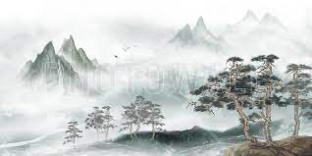
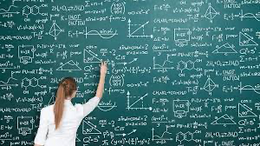
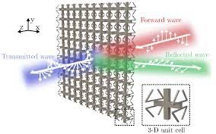

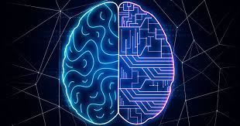
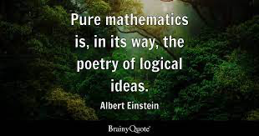
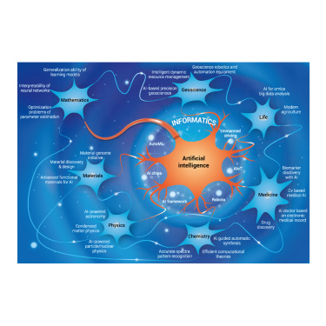
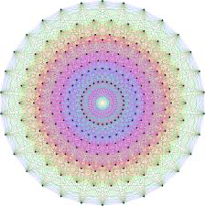
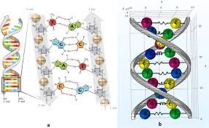
What lies ahead?

